Slide 1
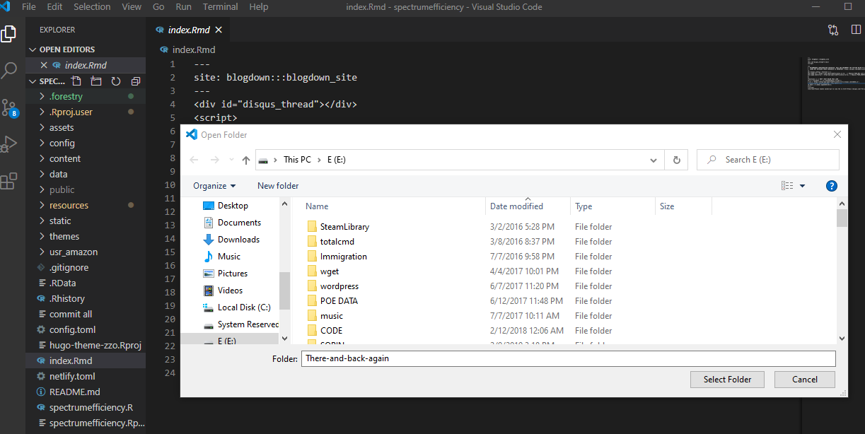
New folder

Slide 2
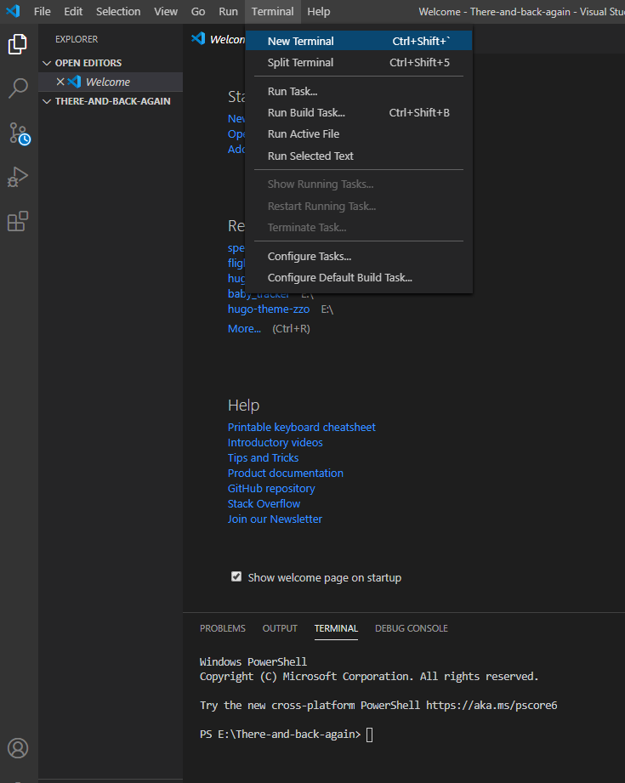
We go to the terminal in Vcode so we have a great user experience with github

Slide 3
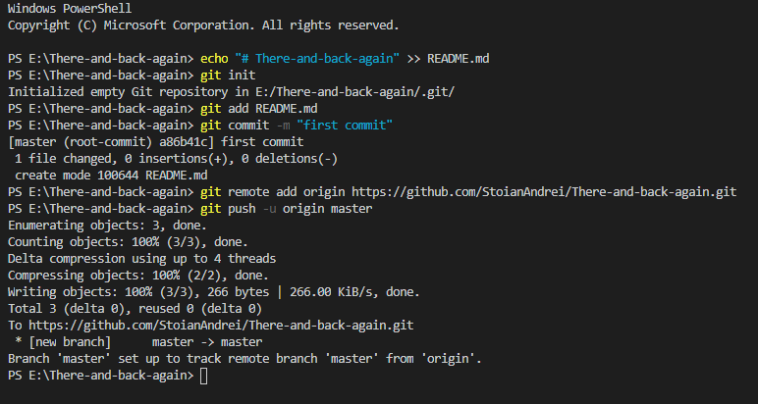
…or create a new repository on the command line
echo "# There-and-back-again" >> README.md
git init git add README.md
git commit -m "first commit"
git remote add origin https://github.com/StoianAndrei/There-and-back-again.git
git push -u origin master
Copy paste and see results

Slide 4
…or push an existing repository from the command line
git remote add origin https://github.com/StoianAndrei/There-and-back-again.git
git push -u origin master

Slide 5
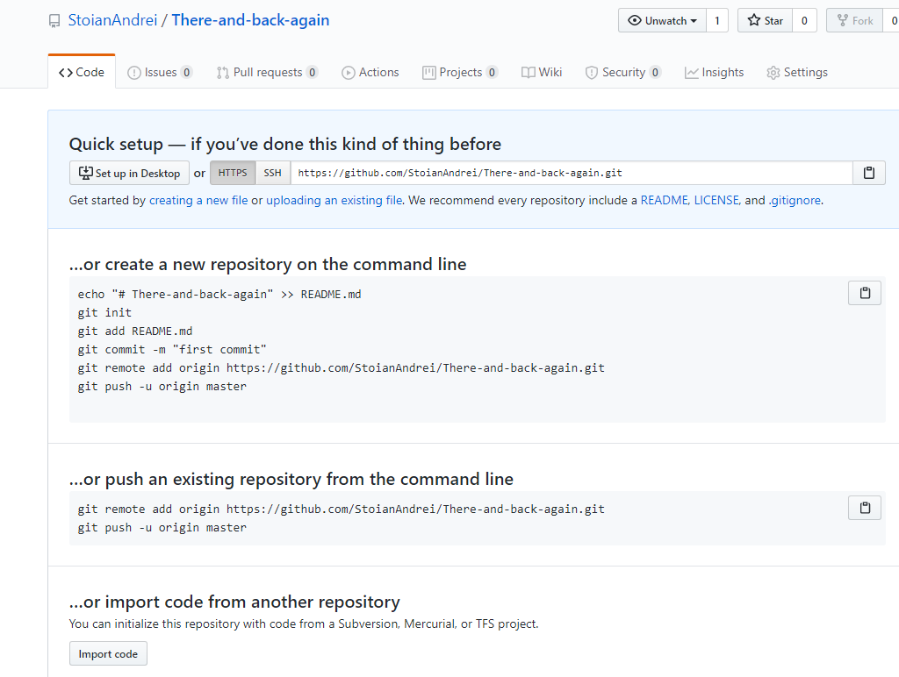
From this when I press now refresh

Slide 6
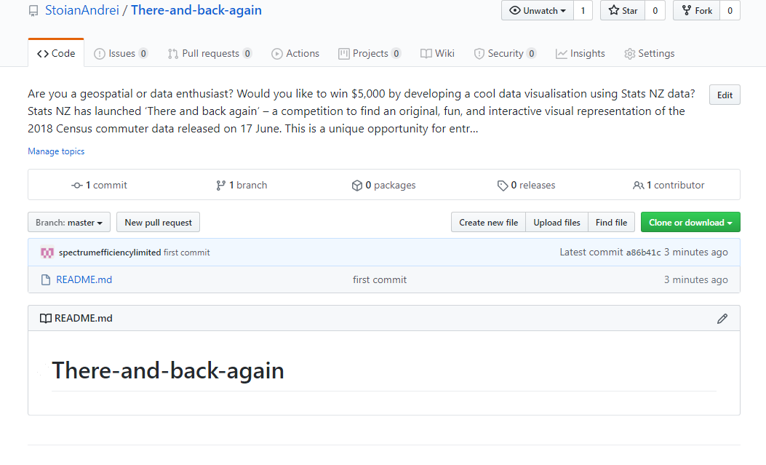
To this all of that with one command

Slide 7
Now in my folder is linked to the repo
https://github.com/StoianAndrei/There-and-back-again.git
So now I create a file: index.md
I hit git status to see what is changed

Slide 8
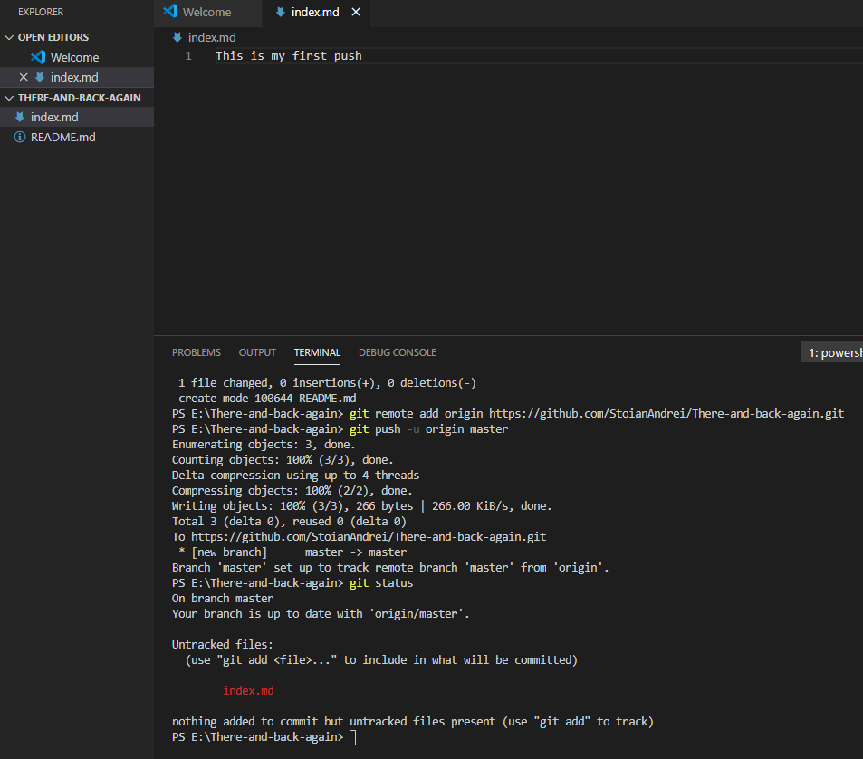
We see that there is this new index.md
Untracked files:
(use "git add <file>..." to include in what will be committed)
Hits what we do next we add all.
git add –all
Then we comit all
git commit –all –m “new post”
And then we push to origin
git push –u origin master

Slide 9
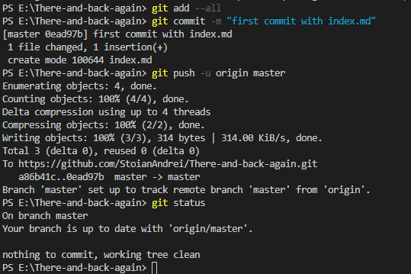
And now we are up to date

Slide 10
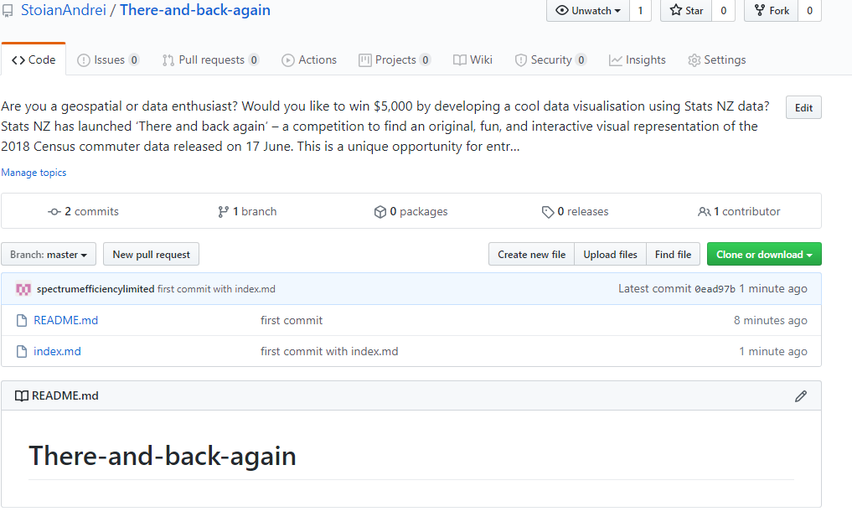
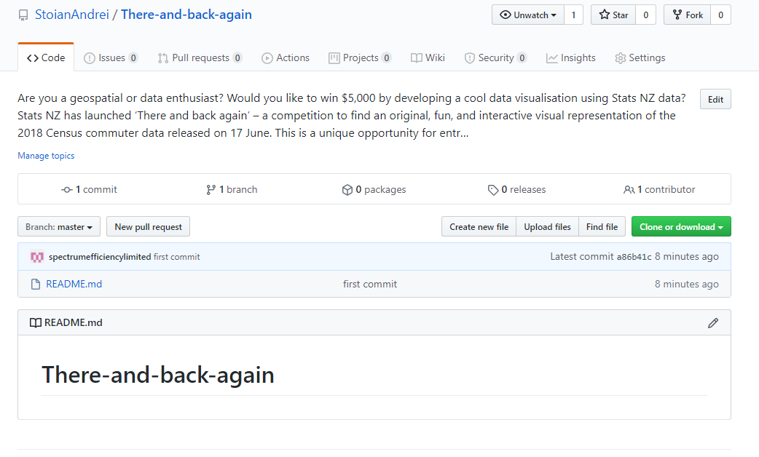
Before and after.

Slide 11
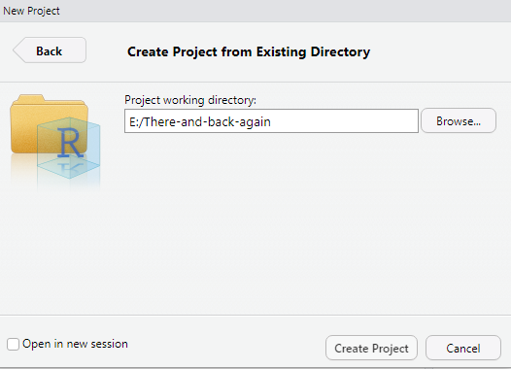
New Project in R

Slide 12
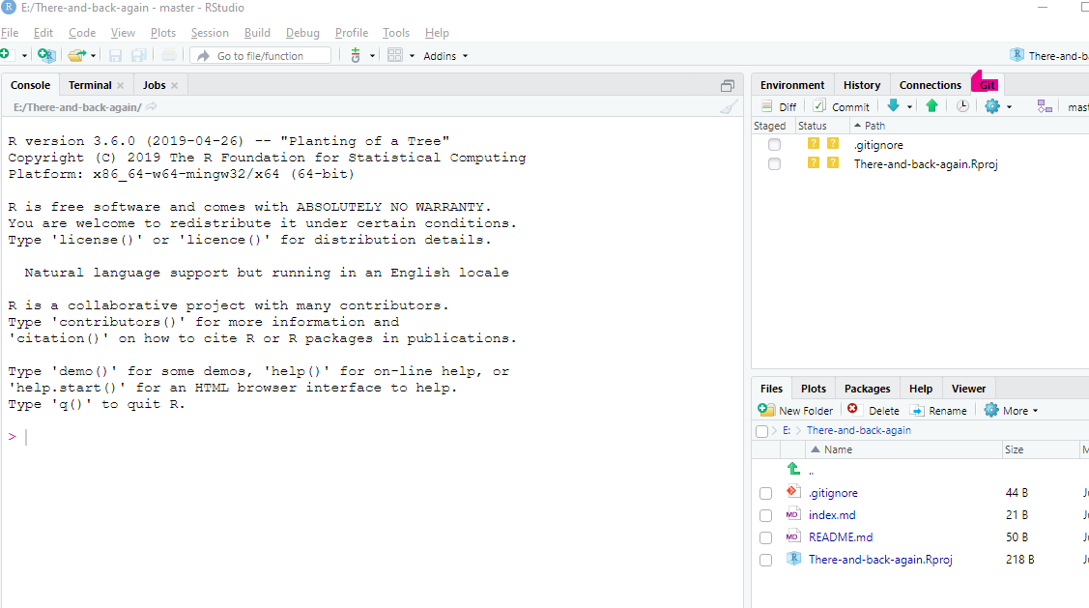
Immediately we see that we have a connection to github

Slide 13
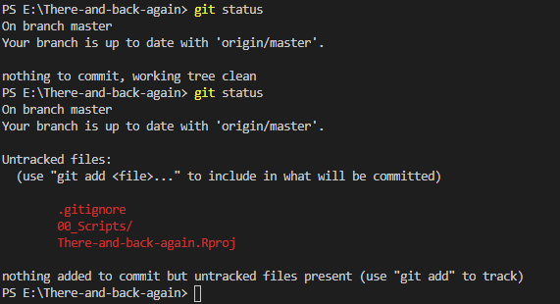
So when you import it will already have a structure from Matt

Slide 14
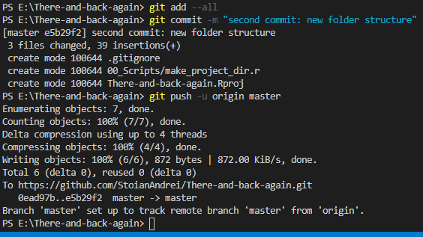
Status / add / commit / Push data

Slide 15
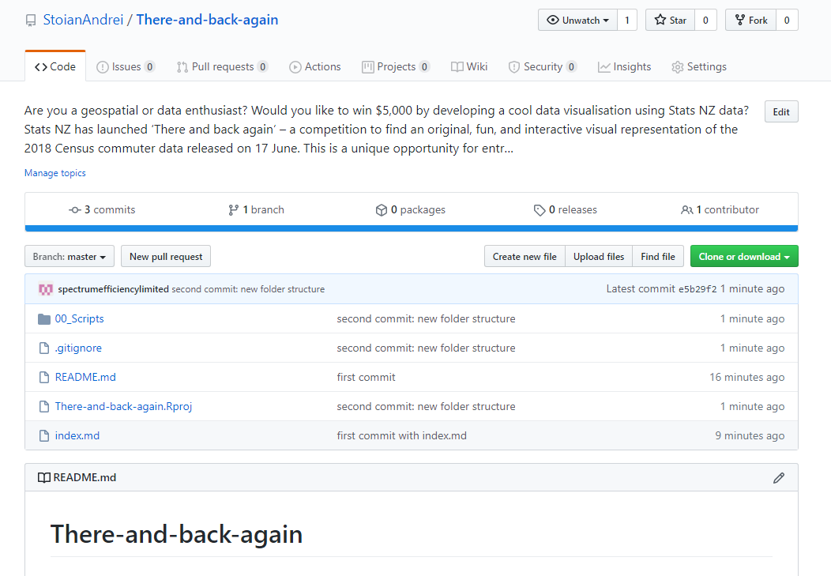
Have a look at how it looks. Where are my other folders?
The were git ignored
No file in them

