Slide 1

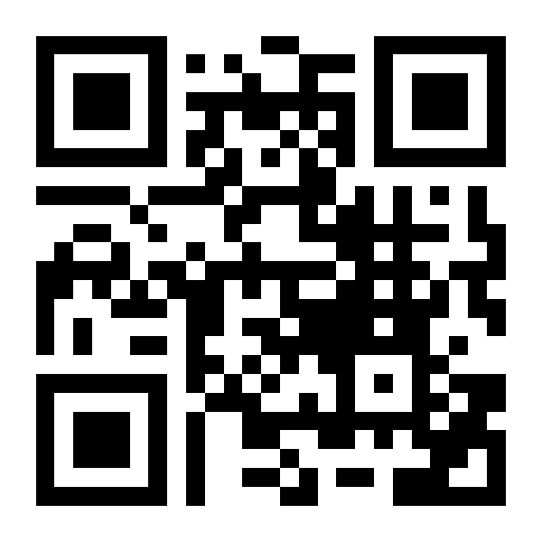

Vegas Stoics
A local community for Stoic practice
Practice Stoicism.
Meet people.
Join the conversation.
All are welcome.
Explore Stoic ideas for everyday life through
friendly discussion and shared practice.
New to Stoicism? You’re welcome here.
4th Sunday of every month
9:00–10:30 AM (90 minutes)
The Quad behind Urth Caffé
6820 Helen Toland St Suite 110
Las Vegas, NV 89113
vegas-stoics.com
Meeting details and more about our group
member of The Stoic Fellowship community of stoas.
Notes:
EDITING THIS TEMPLATE
A4 portrait, 210 × 297 mm. Print this slide only at 100% / actual size.
In Google Drive, upload the PPTX and open with Google Slides. Save as Google Slides, then make a copy before editing.
1. Replace the logo image, keeping its proportions. A wide logo can use the same upper-right area. Delete the logo if your group has none.
2. Edit the group name and short description. For long names use two lines or reduce the font size.
3. Change the schedule, time, venue and address.
4. Edit the website text AND replace the QR image with a code for your own URL. The QR does not update automatically.
5. Keep or edit the invitation, welcome and discussion copy.
6. Optional: change the blue main accents and orange rules. Keep the Fellowship footer magenta or edit it independently with text/fill color controls. Arial and Georgia are common Google Slides-compatible fonts.
OPTIONAL HERO PHOTO
The default uses an editable blue invitation field. For an optional photo, replace that field with a wide image while retaining the invitation text. Use a dark, uncluttered image so white text remains readable. Keep the photograph as a separate replaceable image.
The original logo is a supplied PNG, preserved as a separate replaceable picture. Its internal artwork is not editable. All text and rules are native objects.
FELLOWSHIP VARIANT: The Fellowship logo is a separate replaceable PNG. The membership phrase is editable text. Remove both when adapting for a group that does not use this affiliation. Fellowship logo supplied by the organizer: logo-2 - inverted logo.png.
Example details supplied by organizer. Website and QR destination: https://www.vegas-stoics.com/. Logo: uploaded Vegas Stoics - small.png.
Before sharing, check the imported layout and scan the QR. To distribute, share your Google Slides copy as view-only and ask organizers to make a copy.

