Slide 1
Finding Structure in Gradable Adjectives through Computer and Human Judgment
Kevin Leung, with Dan Lassiter from the CoCo Lab

Slide 2
What are gradable adjectives?
Gradable adjectives are adjectives that accept degree modifiers
“The Klingons are very close!”
?? “He’s very dead, Jim!”
Kennedy and McNally (2005) theorize that the gradable adjectives can be grouped depending on its scale structure
For example, proportional modifiers work with closed scales
“The warp engines are half engaged.”
?? “Spock thought the math problem was half interesting.”
Or slightly, which only relates to minimum values
“The Enterprise was slightly damaged by the torpedo.”
?? “The alien world was slightly safe.”

Slide 3
How do we evaluate this theory?
Our goal is to evaluate the Kennedy & McNally theory
3 data sources
plausibility from theory
human judgments about naturalness
computer judgments from vector-space models
Find correlations between datasets
Explore where the theory succeeds and where it needs to be extended and improved

Slide 4
How did we gather theory predictions?
Label 49 adjectives and 14 modifiers that Kennedy & McNally make claims about
Label pairings according to this chart
 | intensifier (very) | min (slightly) | max (completely) | proportional (half)
open (big) | yes | no | no | no
closed above (straight) | sort of | no | yes | no
closed below (dangerous) | sort of | yes | no | no
closed both (necessary) | sort of | sort of | yes | yes

Slide 5
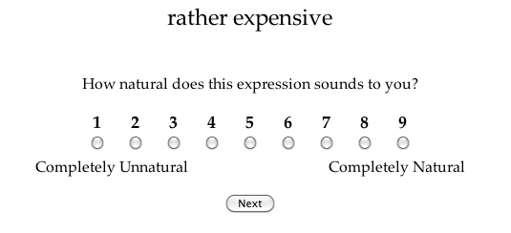
How did we gather human judgments?
mturk study with all 698 pairs, ~300 subjects
Each turker sees 98 pairs
In total, ~40 ratings per pair

Slide 6
How did we gather computer judgments?
Dependency parse of NYT Gigaword
Count all instances of adverbial modification
Assemble counts into a word x word matrix
Apply various weighting schemes
 | absolutely | completely | extremely | half | much
able | 8 | 6 | 11 | 0 | 113
accurate | 42 | 117 | 86 | 5 | 104
asleep | 0 | 2 | 0 | 49 | 1
awake | 0 | 5 | 0 | 3 | 11
bent | 3 | 2 | 0 | 0 | 25

Slide 7
What do the results look like?*
Best correlation with humans: PMI
*from pilot data with a similar, but slightly different stimuli and experimental setup

Slide 8
What do the results look like?*
PMI agrees with theory: 52%
Humans agree with theory: 65%
Probability matching agrees with theory: 65%
Agreement:
“half simple”
“perfectly natural”
Disagreement:
“positively popular”
“slightly bad”
*from pilot data with a similar, but slightly different stimuli and experimental setup

Slide 9
What do the results look like?
adjs. w/ a minimum

Slide 10
What’s left to do?
Fully process experimental data
Find sets of good and bad matches
possibly cluster over word vectors
Think through the other factors that might account for differences

