Slide 1
IDENTIFYING STRUCTURE IN GRADABLE ADJECTIVES THROUGH CORPUS ANALYSIS
Kevin Leung, with Dan Lassiter

Slide 2
The Problem – What are the types of gradable adjectives?
Gradable adjectives are adjectives that accept degree modifiers
“The Klingons are very close!”
?? “He’s very dead, Jim!”
Kennedy and McNally (2005) theorize that the gradable adjectives can be grouped depending on its scale structure
For example, proportional modifiers work with closed scales
“The warp engines are half engaged.”
?? “Spock thought the math problem was half interesting.”
Or slightly, which only relates to minimum values
“The Enterprise was slightly damaged by the torpedo.”
?? “The alien world was slightly safe.”

Slide 3
The Approach – Corpus Analysis
Find all instances of degree modification and see whether some adjectives tend to be modified by the same adverbs
Compared bigram and dependency counts from Gigaword
.984 similarity between the 2 datasets, with roughly 90% consistency in both directions
Some differences
“Next to a state-of-the-art special edition laserdisc, these early CD-ROM ‘interactive companions,’ with their grainy, jerky video clips in 3-in boxes, are still primitive, technically and aesthetically.” (Dependency only)
“This scene plays out millions of times every day as children of all ages act exactly like children and fail to appear where expected.” (Bigram only)
Just use Web 1T for massive, massive counts

Slide 4
Metrics and Clustering
What do you do with a giant co-occurrence matrix?
Metrics
Observed Over Expected Counts (OOE) – how weird is the data?
Pointwise Mutual Information (PMI) – sparsity begone!
Thresholded (TH) – grammatical is grammatical is grammatical
Raw counts (RAW) – keeping it simple
Clustering (now enhanced with PCA!)
K-means
Hierarchical Clustering
Mixture of Gaussians
Coclustering (no PCA required!)

Slide 5
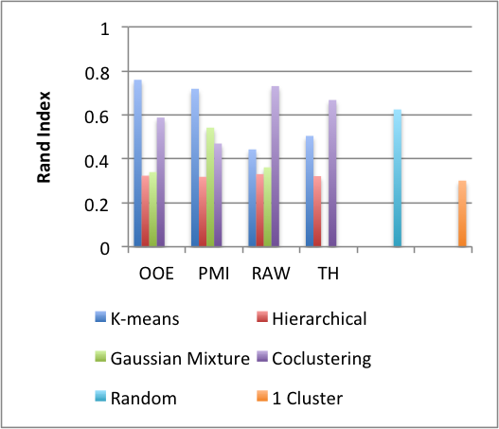
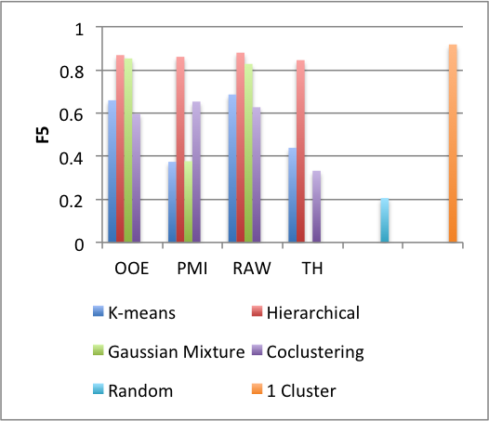
Results
…it’s not so clean
by hand, though, it did find the gradable/non-gradable split
Notes:
Note Random and 1 Cluster Performance
K-means OOE and Coclustering RAW both worked

Slide 6
Error Analysis of Interest
Found classes of semantic relatedness
economic, military, physical, and political
Clustered certain and possible, which might be confidence
“It’s completely certain that the Red Shirt will be eaten by the alien.”
“It’s completely possible that the Red Shirt will be eaten by the alien.”
Web 1T is a little weird, sometimes
fucking young is very common
feel free to speculate why that might be the case with internet data

Slide 7
Future Work
Use word sense disambiguation to narrow down to degree modification
Marking the data for more properties to account for in clustering
Stop breaking the corn cluster and finish parses before running out of memory

