Slide 1
Lecture 7
Logical Operators in R
Missing Data
Recoding Missing Data
Count of Missing Data

Slide 2
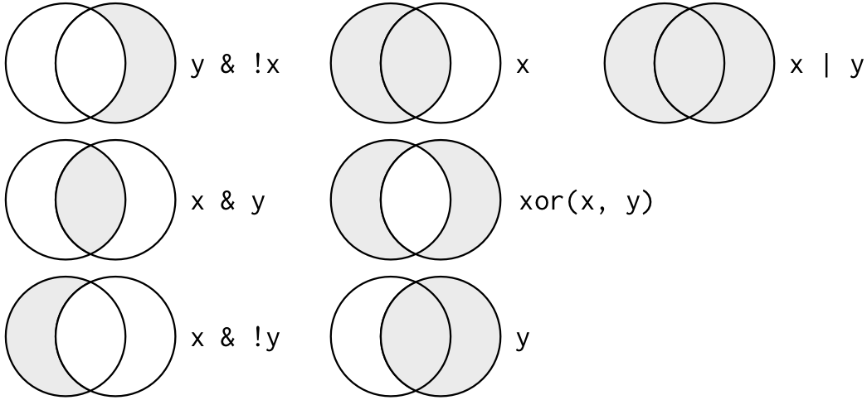
Set Operations

Slide 3
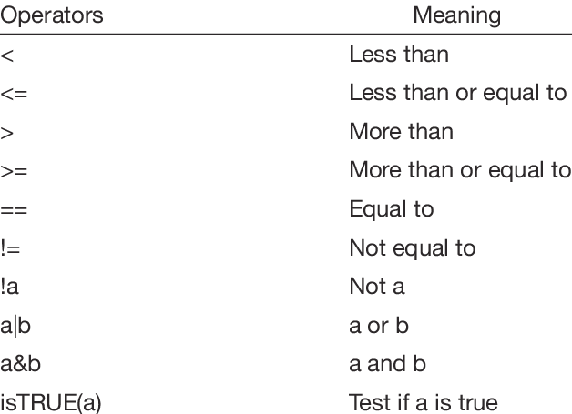
Logical Operators in R
%in% in the set

Slide 4
Examples
## Finds all flights that departed in November or December:
filter(flights, month == 11 | month == 12)
nov_dec <- filter(flights, month %in% c(11, 12))
## Find flights that weren’t delayed (on arrival or departure) by more than two hours:
filter(flights, !(arr_delay > 120 | dep_delay > 120))
filter(flights, arr_delay <= 120, dep_delay <= 120)

Slide 5
Missing Data
Missing values represented by NA (not available)
Impossible values (e.g., divide by zero) represented by NaN (not a number)
Testing for missing values: is.na()
- returns a logical vector with TRUE in the element locations that contain missing values represented by NA. is.na() will work on vectors, lists, matrices, and data frames.
> # vector with missing data
> x <- c(1:4, NA, 6:7, NA)
> x
[1] 1 2 3 4 NA 6 7 NA
>
> is.na(x)
[1] FALSE FALSE FALSE FALSE TRUE FALSE FALSE TRUE
>
> which(is.na(x)) ##identify locations in the vector with NAs
[1] 5 8

Slide 6
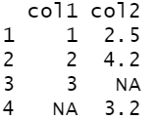

Recoding Missing Values
Missing values can be recoded by
Recoding specific indicators that represent missing values.
># vector with missing data
>x <- c(1:4, NA, 6:7, NA)
>x[is.na(x)] <- mean(x, na.rm = TRUE)
#na.rm is a logical parameter evaluating to TRUE or FALSE indicating whether NA values should be stripped before the computation proceeds.
>x
[1] 1.000000 2.000000 3.000000 4.000000 3.833333 6.000000 7.000000 3.833333
>round(x, 2)
[1] 1.00 2.00 3.00 4.00 3.83 6.00 7.00 3.83
Omitting all rows containing missing values.
> df<- data.frame(col1 = c(1:3, NA), col2 = c(2.5, 4.2, NA, 3.2))
> df
> na.omit(df)

Slide 7
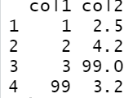
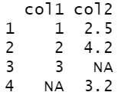
Recoding Missing Values
Missing values can be recoded by
Using normal sub-setting and assignment operations.
# data frame that codes missing values as 99
>df <- data.frame(col1 = c(1:3, 99), col2 = c(2.5, 4.2, 99, 3.2))
>df
> # change 99s to NAs
>df[df == 99] <- NA
>df

Slide 8
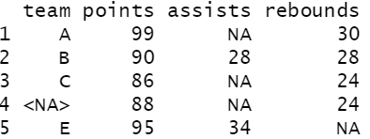
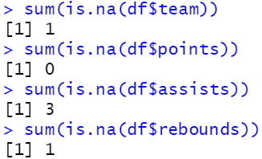

Count of Missing Data
Missing values represented by NA (not available)
#create data frame
df <- data.frame(team=c('A', 'B', 'C', NA, 'E'),
points=c(99, 90, 86, 88, 95),
assists=c(NA, 28, NA, NA, 34),
rebounds=c(30, 28, 24, 24, NA))
df
Location of missing values
> which(is.na(df$assists))
[1] 1 3 4
Count number of missing values in a column
>sum(is.na(df$column_name))
Total number of missing values in entire data
>sum(is.na(df))

