Slide 1
AI Assignment 3: Game Playing
Team Members: CS22B043 , CS22B050
The evaluation function is a numerical estimator that measures how favorable a given board state is, helping the AI decide on the best move. Instead of manually crafting heuristics, this project uses the Stockfish chess engine for advanced evaluation.
– Stockfish to analyze a board state with a time constraint
– Returns a numerical score that represents the advantage from White's perspective.Handles forced mates by assigning high positive/negative scores.
– Both Minimax and Alpha-Beta Pruning rely on this evaluation function at leaf nodes.These scores are propagated back up the game tree to determine optimal moves
Environment:
Evaluation Function Used:
This project is built around a chess-playing environment using the python-chess library, which simulates a virtual chessboard and manages legal move generation, board states, and game outcomes. It integrates with the powerful Stockfish engine to evaluate positions and guide decision-making for AI algorithms like Minimax and Alpha-Beta pruning.

Slide 2
Search Mechanism
Minimax with K-Ply
Alpha-Beta with K-Ply
Minimax
Alpha-Beta Pruning
Entire Game Tree is built first. Same basic idea as Minimax, but adds α (max bound) and β (min bound). Prunes branches that won't influence the final decision. Significantly reduces computation time.Gives the same result as Minimax but faster.
A limited version of Minimax. Only searches the tree up to k levels deep (e.g., 2-ply or 3-ply). Ideal when full-depth is too expensive. Evaluation function is applied at k-th level leaf nodes.Faster than Minimax, but less accurate.
Entire Game Tree is built first before applying the Minimax Algorithm.
Explores entire game tree up to a large depth .
Alternates between Max (AI) and Min (Opponent) nodes. No pruning — evaluates every leaf node.Computationally very expensive.
Best used when depth is manageable or full search is needed.
Combines depth-limited search (like K-ply Minimax) with pruning optimization. Prunes irrelevant branches within k levels. Fastest among all, especially at larger branching factors. Retains good decision quality while saving time.

Slide 3
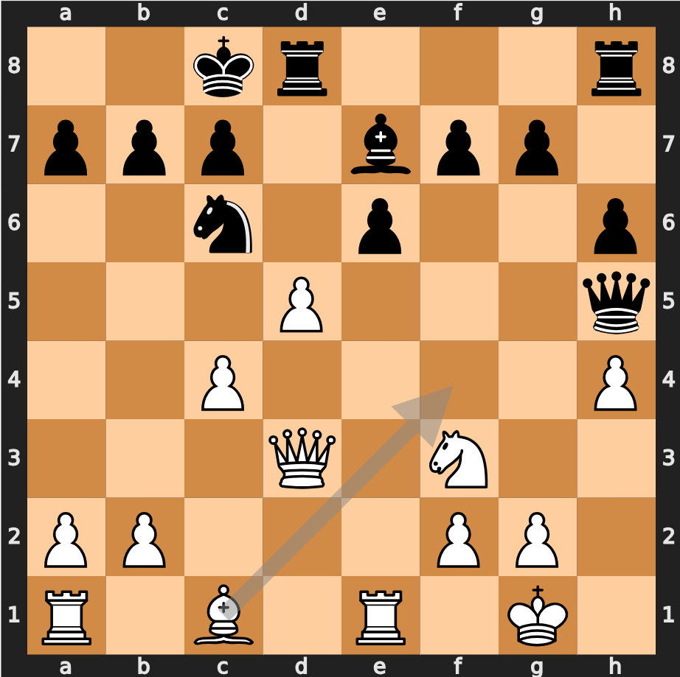
All four algorithms use Stockfish to evaluate leaf nodes or board states.
Stockfish returns a consistent numerical score for each board configuration, making the "best move" selection uniform.
Minimax and Alpha-Beta are deterministic: given the same tree structure and evaluation, they will always pick the same move.
The only difference is how efficiently the tree is explored — not the result itself.
Board Configuration- C1F4 Best Move

Slide 4
Performance Evaluation
Algorithm | Time | Tree Depth Explored | Number of Evaluations
Minimax | 199.17 s (Time taken to build the tree = 199.10 s) | Full until evaluation limit (Tree is built before the algorithm is applied) | Many
Alpha - Beta Pruning | 199.14 s (Time taken to build the tree = 199.10 s) | Till pruning threshold -Tree is built before the algorithm is applied | Fewer due to pruning
Minimax with k-ply | 9.86 s (Tree is build on Fly, hence cannot be separated ) | Fixed K-ply (2) | Limited by depth
Alpha - Beta Pruning with k-ply | 0.88 s (Tree is build on Fly, hence cannot be separated ) | Fixed K-ply (2) with pruning | Least

Slide 5

Game Simulation

Slide 6
Observations
In vanilla version of Algorithms, tree construction is the over 99% of the time. Hence, their K-ply variants are a good call for practical applications. All four algorithms — Minimax, Alpha-Beta Pruning, and their K-ply variants — consistently selected c1f4 as the best move.This suggests that the decision quality remains consistent, regardless of the method or depth used.It confirms the reliability of the evaluation function (Stockfish) in identifying optimal moves. Minimax without pruning took the longest time due to full-depth search and no optimization. Alpha-Beta Pruning (Full) gave the same move and similar quality but was much faster due to pruning. K-ply Algorithms were significantly faster
Alpha-Beta (K-ply) had the fastest runtime: 0.88s — ideal for real-time applications.
Minimax (K-ply) reduced time to ~10s.
Evaluation scores dropped in K-ply versions — expected, as deeper context is lost.
Alpha-Beta Pruning is superior in efficiency, especially with depth limitation.

