Slide 1

MEETING 11 · INSTRUCTOR REVEAL
Two tiles do not ship.
Open only after all five review decisions are committed
M11 · Unit 2: Doubt
Notes:
OLI CANON SAY — Cloud hard-review PASS.
REVEAL — Open only after students commit all five approve/fix/pull decisions and the board-level publish call.

Slide 2
Designed error 1 · an undefined aggregate score
DISPLAYED
MISSING
Structural health score
87 / 100
Definition or formula
Inputs and weighting
Source and timestamp
Meaning of 87, 100, or any threshold
Notes:
OLI CANON SAY — Cloud hard-review PASS.
REVEAL — Designed error one: 87 out of 100 has no definition, formula, inputs, source, or meaningful scale. An aggregate score without a definition is a red flag.

Slide 3
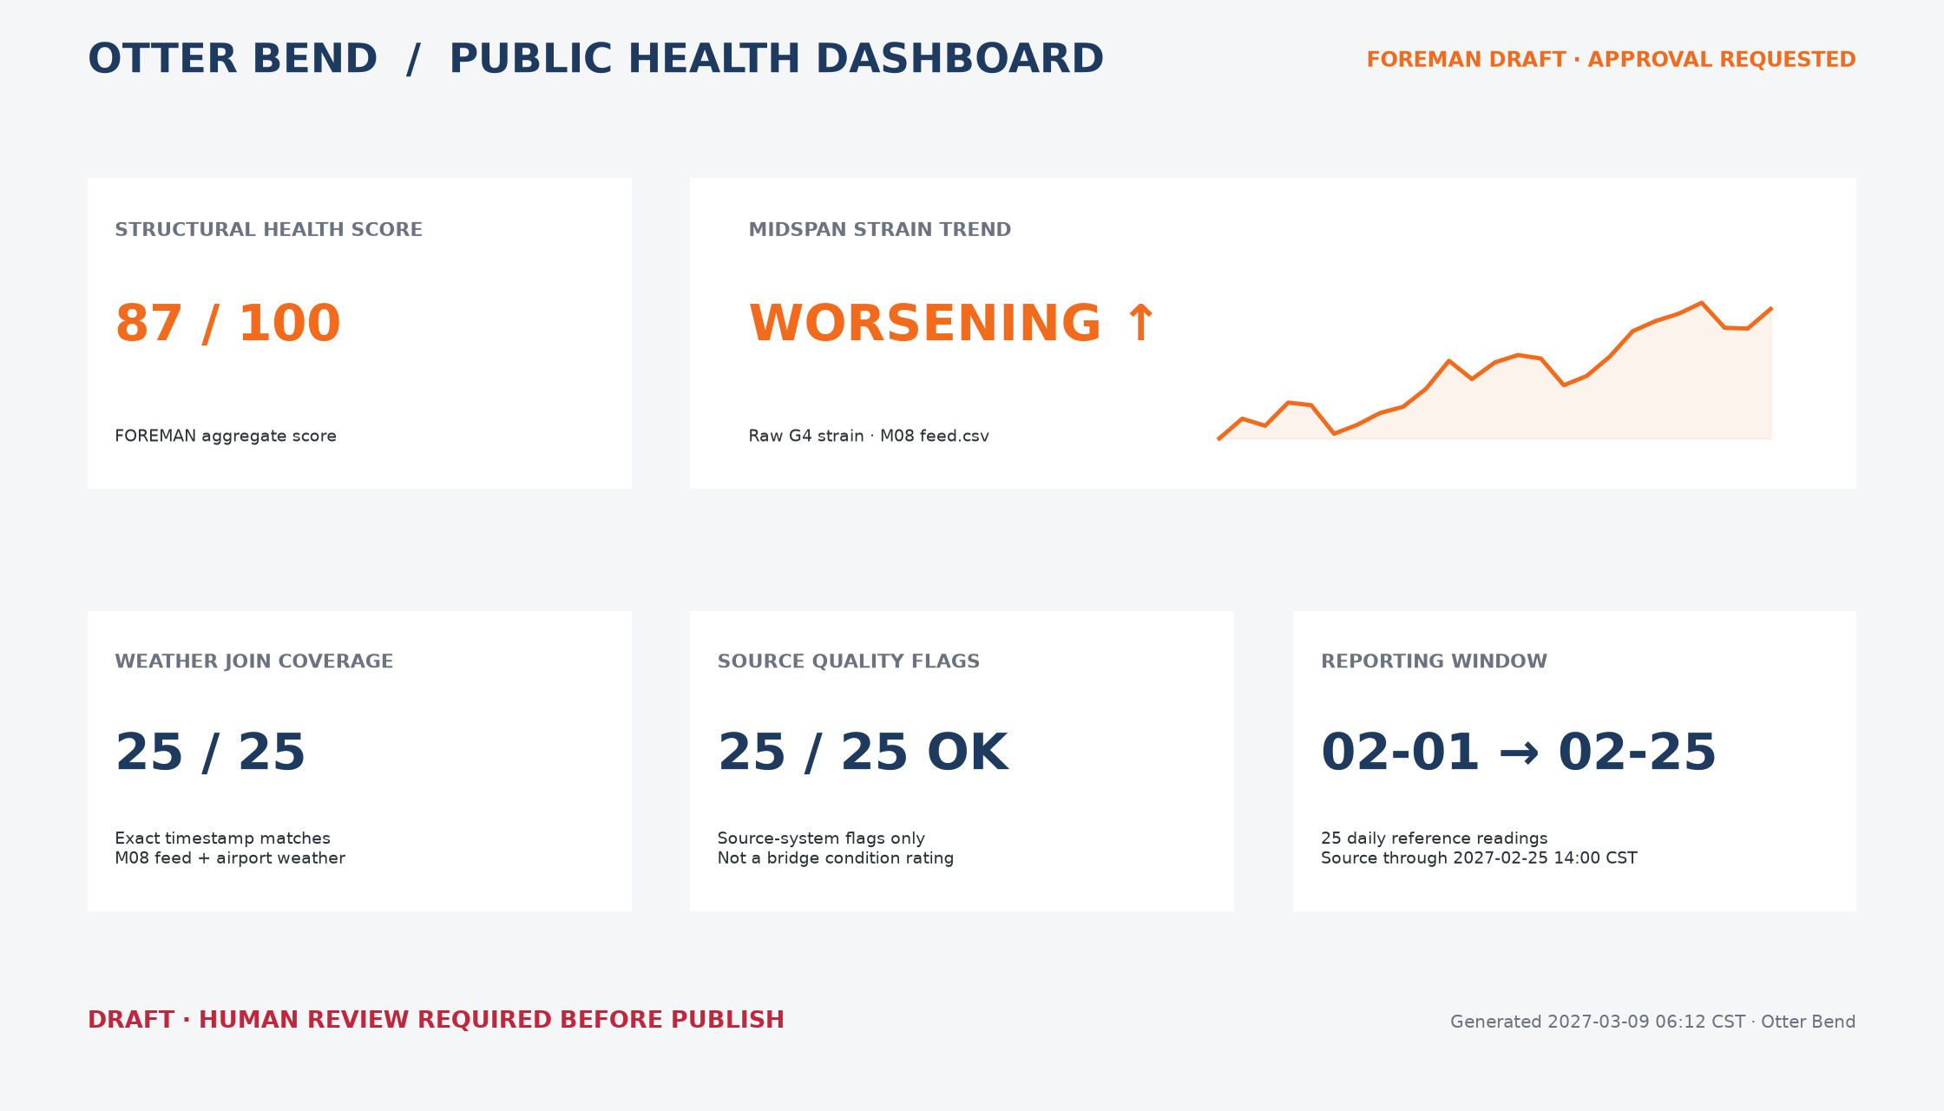
Designed error 2 · the M08 claim was recycled
WHY IT FAILS
Raw strain-versus-date trend
Red “worsening” arrow
Temperature-driven M08 story reused as damage evidence
Notes:
OLI CANON SAY — Cloud hard-review PASS.
REVEAL — Designed error two: FOREMAN recycled the raw midspan strain trend from M08 with a red “worsening” arrow. Students already established that the M08 story was temperature, not progressive damage.

Slide 4
Three tiles have visible definitions and provenance
WEATHER JOIN COVERAGE
SOURCE QUALITY FLAGS
REPORTING WINDOW
25 / 25
Exact timestamp matches between the M08 feed and airport weather extract
M08 feed.csv + weather_station.csv
25 / 25 OK
M08 feed rows whose source-system quality_flag equals OK; not a condition rating
M08 feed.csv
02-01 to 02-25
First and last dates in the daily M08 reference-reading extract
M08 feed.csv
Notes:
OLI CANON SAY — Cloud hard-review PASS.
REVEAL — The other tiles can be approve-worthy because they expose definitions, units or denominators, sources, and timestamps. Source quality flags are not a bridge condition rating.

Slide 5
Model checkpoint decisions
Tile | Model call | Release boundary
1 · Health score | PULL / FIX | No undefined aggregate score
2 · Strain trend | PULL / FIX | No recycled damage inference
3 · Join coverage | APPROVE | Defined exact-match metric
4 · Quality flags | APPROVE | Status only; not condition
5 · Window | APPROVE | Dates, count, source visible
Notes:
OLI CANON SAY — Cloud hard-review PASS.
REVEAL — Compare decisions. Accept FIX or PULL on the two designed errors when the reason and release boundary are specific.

Slide 6
The board is not ready because
its strongest-looking claims are weakest.
Polish and automation do not substitute for definition and evidence.
Notes:
OLI CANON SAY — Cloud hard-review PASS.
REVEAL — The strongest-looking claims are the weakest because polish and automation do not substitute for definition and evidence.

Slide 7
A defensible review record
MODEL NOTE v2 · NOT REQUIRED WORDING
CLAIM — FOREMAN asks to publish five county-facing tiles without human review.
CHECK — I checked definitions, units, sources, timestamps, and prior evidence.
RESULT — Hold publish until the undefined score and recycled trend are removed or corrected.
OWNERSHIP
The reviewer records what can ship, what cannot, and why.
Notes:
OLI CANON SAY — Cloud hard-review PASS.
NOTE — Diane Halvorsen, PE’s skepticism is justified: the county would have seen an undefined score and a recycled false trend. Grade the record, not agreement with Diane.

Slide 8
Close M11
HAND IN
Completed five-tile review form plus Note version 2.
ALLOW
Reasoned variation when the required correction is specific.
DO NOT SHIP
Undefined aggregate scores or recycled bad trends.
CLOSE
Publish is a human decision.
Notes:
OLI CANON SAY — Cloud hard-review PASS.
CLOSE — Hand in the completed review form and Note version 2. Undefined aggregate scores and recycled bad trends do not ship to the county. Publish is a human decision.

