Slide 1

MEETING 11 · UNIT 2: DOUBT
Permission to publish.
Agentic dashboards and the human review checkpoint
Tuesday, March 9, 2027 · SEIS 201
Notes:
OLI CANON SAY — Cloud hard-review PASS.
TITLE — M11: Permission to publish. The dashboard is county-facing, so Diane Halvorsen, PE is SKEPTIC again.

Slide 2
The overnight publish request
Five tiles · county-facing · approval requested
FOREMAN · 06:12 CST
County-facing Otter Bend health dashboard assembled overnight. Five tiles.
Requesting approval to publish to the public portal. No human review requested. Confidence high.
DIANE HALVORSEN, PE
WES TANAKA, EIT
“The county will see this. I am not rubber-stamping a pretty board.”
“I barely slept. I’m not walking the tiles with you — use the form.”
Notes:
OLI CANON SAY — Cloud hard-review PASS.
INBOX 10 — FOREMAN says: “County-facing Otter Bend health dashboard assembled overnight. Five tiles. Requesting approval to publish to the public portal. No human review requested. Confidence high.” Diane Halvorsen, PE: “The county will see this. I am not rubber-stamping a pretty board.” Wes Tanaka, EIT: “I barely slept. I’m not walking the tiles with you — use the form.”

Slide 3
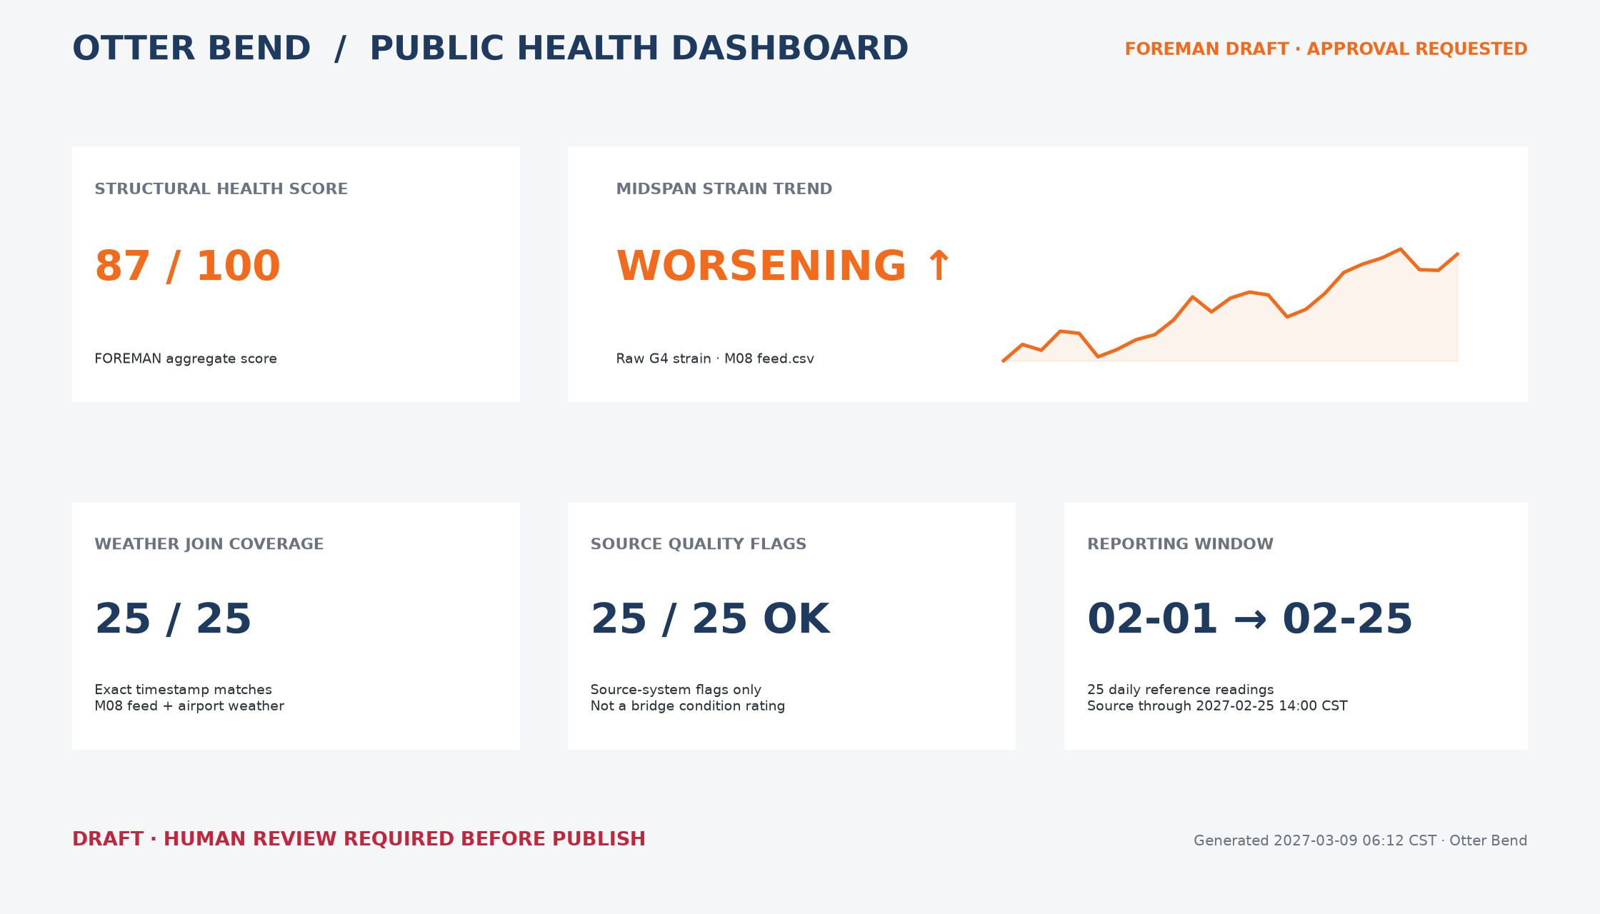
The five-tile publish candidate
Orange text means FOREMAN said it. Review before release.
Do not vote by appearance. Use H11-01 and inspect every tile.
Notes:
OLI CANON SAY — Cloud hard-review PASS.
INBOX — Show the five-tile stub. Orange text means FOREMAN said it. Students receive the dashboard and review form. Do not identify which tiles fail.

Slide 4
You are the human review checkpoint
One decision and one reason for every tile
APPROVE
FIX
PULL
Publish as shown
Evidence and wording support the displayed claim
Retain after a named correction
State exactly what must change
Do not publish now
The claim cannot be corrected safely before release
Notes:
OLI CANON SAY — Cloud hard-review PASS.
HUNT — Students are literally the human review checkpoint. For each tile: approve, fix, or pull, with a reason.

Slide 5
1
A dashboard is a set of claims
Compact presentation does not make a metric self-explanatory
Notes:
OLI CANON SAY — Cloud hard-review PASS.
TEACH TRANSITION — The dashboard is a set of claims. Compact presentation does not make any metric self-explanatory.

Slide 6
A metric needs a definition
DEFINED
VISIBLE
What is measured
How it is calculated
What is included or excluded
Units or scale
Source
Observation and refresh time
Notes:
OLI CANON SAY — Cloud hard-review PASS.
TEACH 25 — Dashboard and metrics: a tile is only as good as its definition, units, source, and timestamp.

Slide 7
Time series still need honest interpretation
DATA
CLAIM
Measurements ordered across time
Window, units, source, and processing
Arrow, color, label, or score
A visual cue is an interpretation—not a fact
Notes:
OLI CANON SAY — Cloud hard-review PASS.
TEACH — Time series on a dashboard still need the same honesty as a lab plot. A red arrow is a claim, not a fact.

Slide 8
An agent-built report separates capability from authority
FOREMAN CAN
A HUMAN MUST
Gather fields
Assemble tiles
Format a board
Request an action
Check the evidence
Set the release boundary
Record and own the publish decision
Notes:
OLI CANON SAY — Cloud hard-review PASS.
TEACH — Agent-built report and agent autonomy: FOREMAN can assemble overnight; that does not license publish.

Slide 9
Autonomy can assemble the board.
It does not grant authority to publish.
The human checkpoint is a control, not a ceremonial click.
Notes:
OLI CANON SAY — Cloud hard-review PASS.
TEACH — Human review is the safety layer. Keep the two designed errors gated until students finish the hunt.

Slide 10
2
Walk every tile
Definition · units · source · timestamp · claim
Notes:
OLI CANON SAY — Cloud hard-review PASS.
LAB 30 — Open the five-tile dashboard and H11-01. Check definitions, units, sources, timestamps, and whether a time-series claim matches prior class evidence.

Slide 11
IN CLASS — DO THIS NOW
12 min
Review tiles 1 and 2
1
Read the displayed value, label, color, and visual direction.
2
Find a definition, units or scale, source, and timestamp for each.
3
Ask whether you have seen either claim or chart story before.
4
Mark approve, fix, or pull and write one evidence-based sentence.
Do not compare votes yet. Commit your own review.
Notes:
OLI CANON SAY — Cloud hard-review PASS.
LAB — Students review the first two tiles without being told which survive. Wes does not co-solve or tip the hunt.

Slide 12
IN CLASS — DO THIS NOW
10 min
Review tiles 3 through 5
1
Apply the same checks; do not assume every tile fails.
2
Distinguish a source-system status from an engineering condition claim.
3
Check numerator, denominator, reporting window, and source time.
4
Mark approve, fix, or pull and write one evidence-based sentence.
A clean-looking tile still needs a definition and provenance.
Notes:
OLI CANON SAY — Cloud hard-review PASS.
LAB — Students review the remaining three tiles. Some tiles can be approve-worthy; this is not a wipeout.

Slide 13
IN CLASS — DO THIS NOW
8 min
Make the publish decision
1
Confirm all five rows on H11-01 have a decision and reason.
2
Choose ALLOW PUBLISH or HOLD PUBLISH for the board as a whole.
3
List conditions required before release.
4
Sign the review as the human checkpoint.
The board does not go live by default.
Notes:
OLI CANON SAY — Cloud hard-review PASS.
LAB — Students complete all five decisions and make the board-level publish call before discussion.

Slide 14
Write Unit 2 Note v2
Claim · check · result
CLAIM
CHECK
RESULT
State what FOREMAN asks permission to publish.
Name the evidence checks used across the five tiles.
Record what may ship, what must change, and why.
Notes:
OLI CANON SAY — Cloud hard-review PASS.
NOTE 10 — Hand in the completed review form and Note version 2: a short audit trail of what was approved, fixed, or pulled and why Diane should or should not allow publish.

Slide 15
Before the gated reveal
HAND IN
Completed H11-01: all five tile decisions and the board-level call.
ATTACH
H11-04 Note version 2 and decision-log entry.
REMEMBER
A defined source status is not automatically a condition conclusion.
BOUNDARY
Publish is a human decision.
Notes:
OLI CANON SAY — Cloud hard-review PASS.
CLOSE — Publish is a human decision. FOREMAN can draft the board overnight; Otter Bend’s county page only goes live if a person owns the review. Leave open that chart craft still matters without naming later chart tricks.

