Slide 1

MEETING 01 · UNIT 1: HIRED
Your first day at
ACMEJOB.Ai
What is AI, and what is the difference between a rule and a learned pattern
Tuesday, February 2, 2027 · SEIS 201

Slide 2
You were hired this morning
ACMEJOB.Ai — a 60-year-old Minnesota civil and mechanical firm that added two letters to its name two years ago
DIANE HALVORSEN, PE
WES TANAKA, EIT
FOREMAN v4.2
Principal engineer, 27 years.
Knows every inspector and contractor in the county.
Does not trust FOREMAN.
Asks one question, every time.
Second year out of school.
Split across three projects.
Genuinely trying.
His handoffs arrive late and incomplete.
The firm's AI platform.
Fast, fluent, confident.
Reads more than any of you can.
Wrong about one time in five, at full confidence.
The colour code holds all semester: orange is the machine, blue is a person. When you cannot remember who said something, look at the colour.

Slide 3
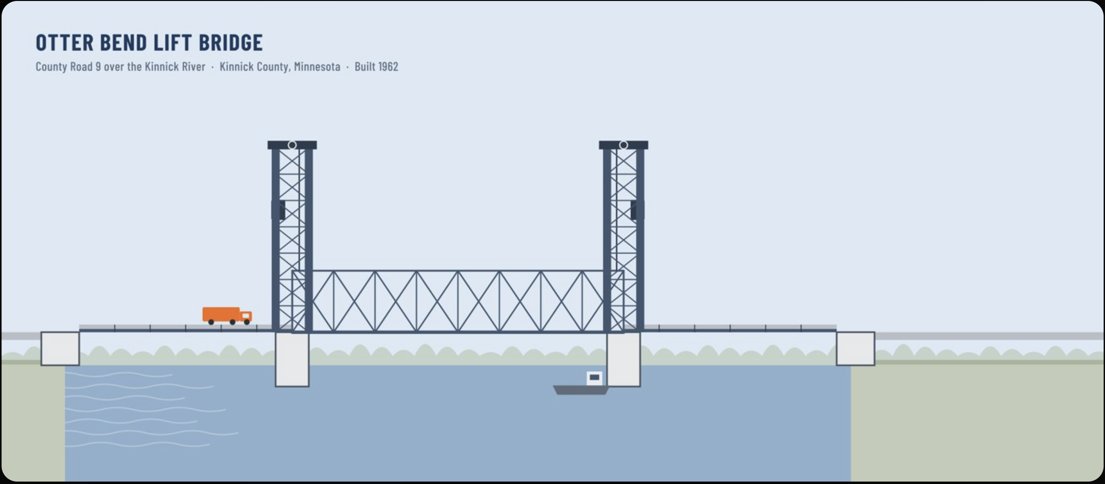
Here’s the job
Otter Bend Lift Bridge · County Road 9 over the Kinnick River
Kinnick County wants an answer by May: rehabilitate, or replace?

Slide 4
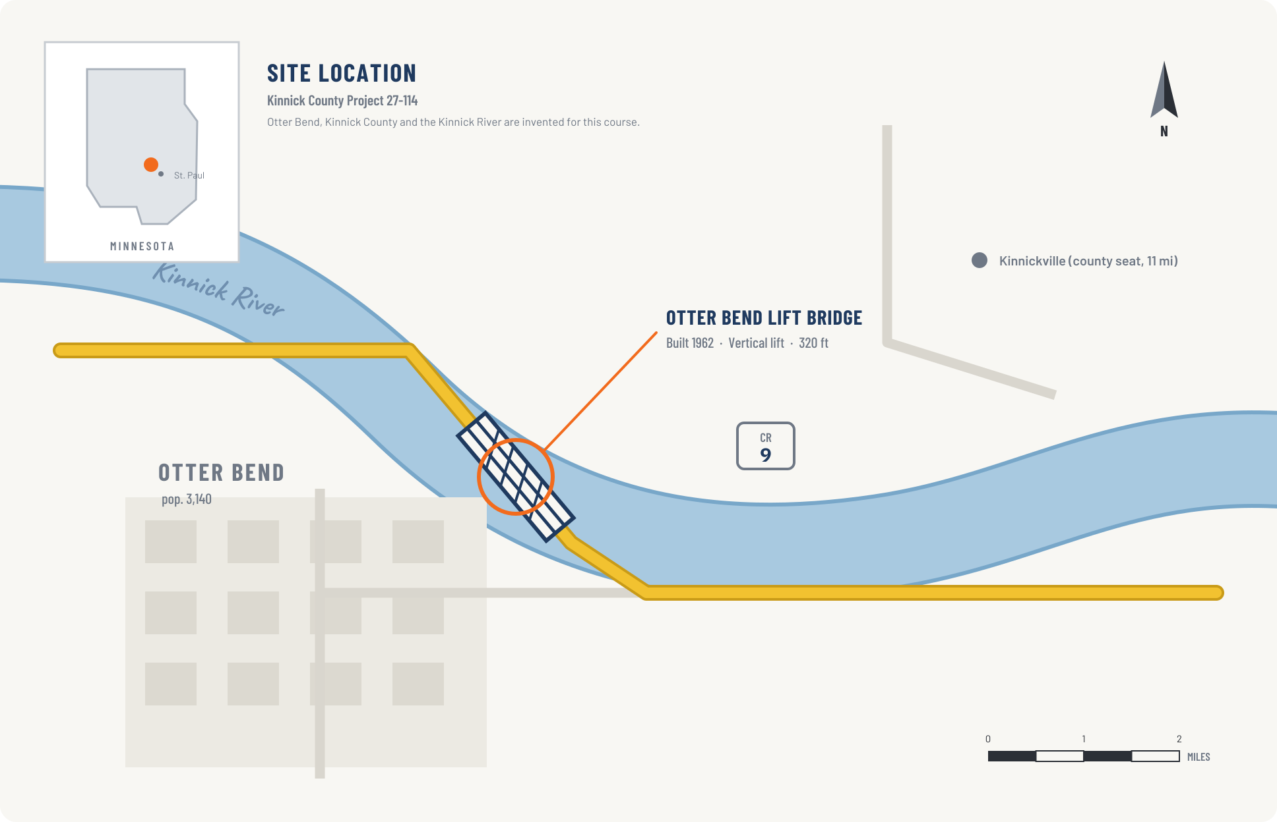
Place matters
Otter Bend, Kinnick County · County Road 9
Every lab, dataset and exam this semester comes back to this one fictional site.

Slide 5
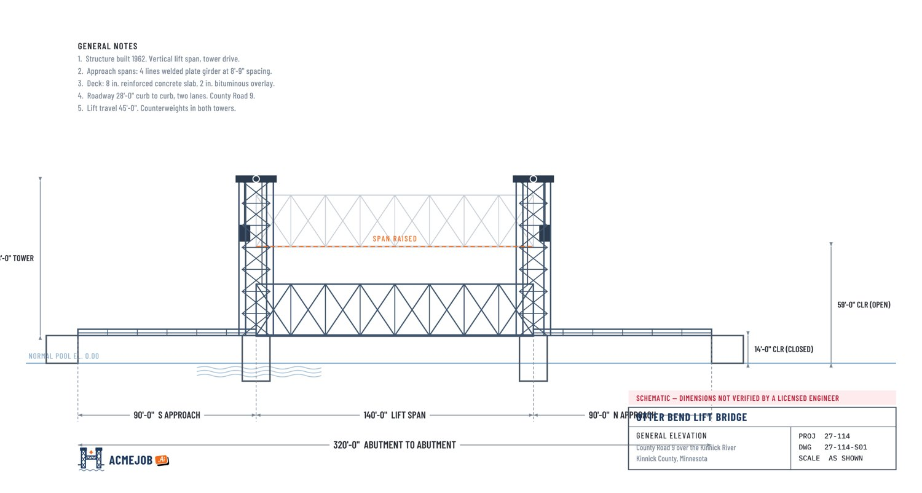
Read the bridge before the notes
320′ total · 140′ lift span · two 90′ approach spans
For now, orient yourself to the lift span and approaches; you do not need every drawing callout.

Slide 6
Two things happened before
nine o'clock this morning.
And they do not agree with each other.

Slide 7
Exhibit A — FOREMAN's demo, 07:41
FOREMAN v4.2 — DECK CONDITION ASSESSMENT
“Deck is in fair to good condition overall. Mean panel rating 6.8. No panel rated below 6. No immediate action required. Model confidence is high across all panels (mean 92.0%).”
Six panels rated from photographs. Elapsed time: 1.9 seconds.
It read six photographs and produced six numbers, faster than you can open the file. Ask yourself now, before we go further: what would it take to check this?

Slide 8
Exhibit B — Diane's orientation memo, 08:30
DIANE HALVORSEN, PE
“Every number you hand me comes with one sentence: how do you know that is right?”
She is not asking you to prove the number from first principles. She is asking you to know which check you did — so that when the county asks her, the answer is not “the computer said so.”
TODAY'S ARGUMENT, IN ONE LINE
FOREMAN produced an answer nobody can check. Diane's method produces an answer anybody can check. Both are legitimate engineering. Knowing which one you are holding is the job.

Slide 9
1
Rules
Steps somebody wrote down, that anybody can repeat

Slide 10
A rule: the load rating check
Diane's standard sheet LR-1. This is arithmetic — you do not need to have taken structures.
RF = ( C − D ) ÷ ( L × IM )
C girder moment capacity — what the steel can carry
D dead load moment — the weight of the structure itself
L live load moment — the rating truck, an HS-20 at 36 tons
IM impact factor — allowance for a moving load bouncing. 1.33.
Above RF = 1.00 the girder carries the truck. Below it, you post or restrict the bridge.

Slide 11
Worked: Girder G-3, south approach
Follow it with a pencil. Every line is checkable by somebody who was not in the room.
Step | Substitution | Result
1. Capacity minus dead load | 3,920 − 1,455 | 2,465 kip-ft
2. Live load with impact | 1,080 × 1.33 | 1,436.4 kip-ft
3. Rating factor | 2,465 ÷ 1,436.4 | 1.716
4. Rating in tons | 1.716 × 36 | 61.8 tons
That is the entire point of a rule. Nobody has to trust Diane. They can redo it.

Slide 12
IN CLASS — DO THIS NOW
10 min
Work the rating factor for Girder G-4
1
G-4 sits under the wheel line. Its bottom flange has 60 years of section loss, so its capacity is lower: C = 3,850 kip-ft. D and L are unchanged.
2
Work the four steps on handout H1-02. Show every substitution.
3
Is your RF above or below 1.00? Say what that means for a 36-ton truck.
4
Write one sentence: how do you know your answer is right?
If you finish early: what happens to the rating if the section loss is worse than assumed and C drops to 3,500?

Slide 13
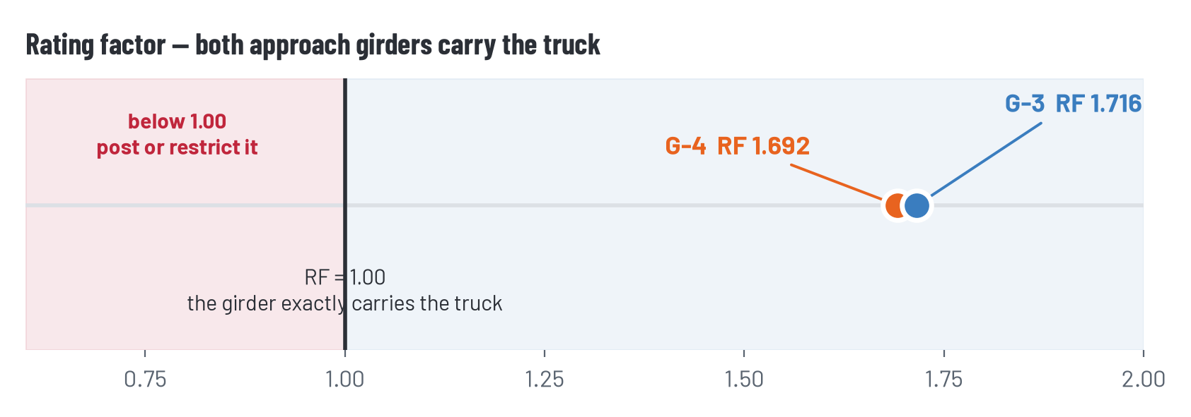
The answer
RF = 1.692, which is a rating of 60.9 tons
G-4 carries the rating truck, with less margin than G-3. Both girders pass. Nothing here required judgement — and that is exactly what makes it a rule.

Slide 14
2
Learned patterns
Nobody wrote the steps down. A machine was shown examples until it picked up the pattern.

Slide 15
How FOREMAN rated the deck
There is no formula in here anywhere
Training 41,800 photographs of bridge decks, each labelled by an inspector
Learning the model adjusts itself until its ratings match the labels
Use show it a new photograph, it returns the rating that best matches the pattern it picked up
Confidence the model's own estimate of how well it did, produced by the model itself
WHY THIS IS NOT A BAD THING
Nobody can write the rule for what spalling looks like in a photograph. If you want that job done at all, it has to be learned. The question is never whether to use it — it is what you would accept as evidence that it worked.

Slide 16
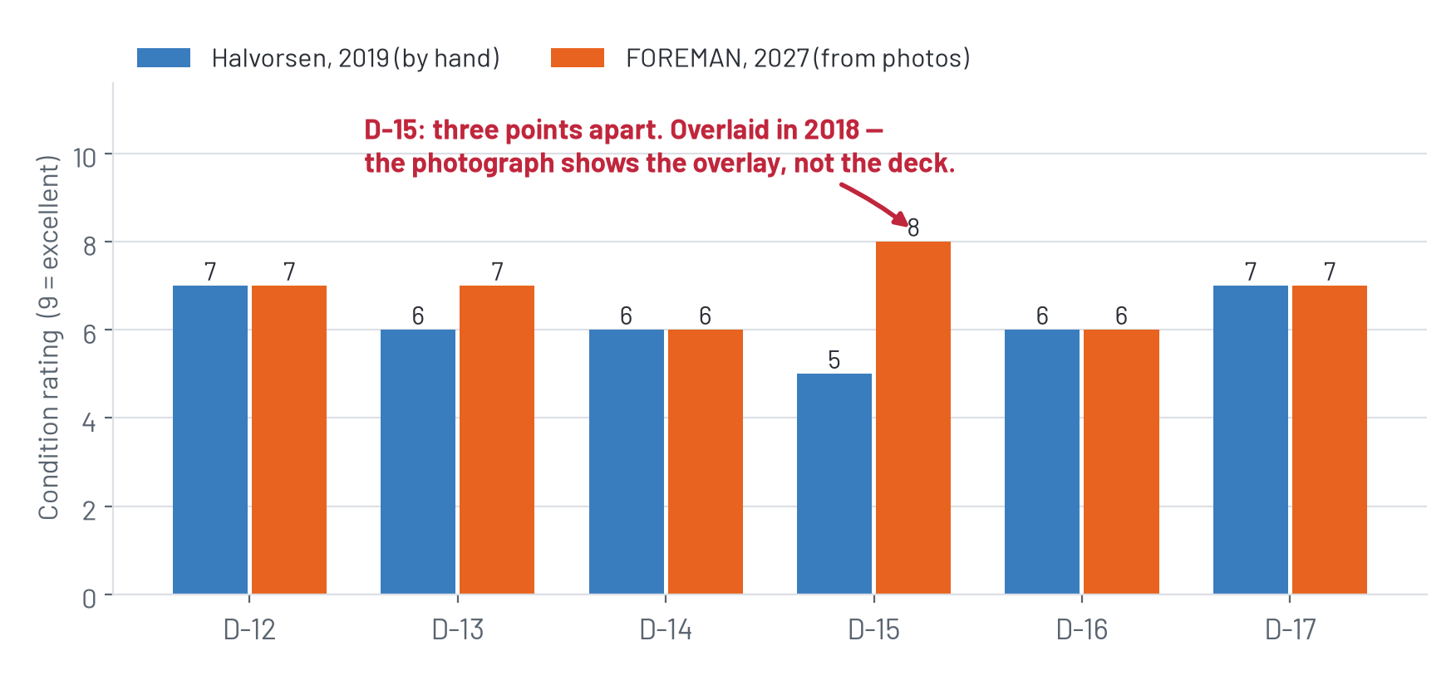
Same six panels. Two sources.
FOREMAN's 2027 photo ratings against Diane's 2019 field ratings
Five panels agree within a point. One is three points apart.

Slide 17
Which panel was FOREMAN
most confident about?

Slide 18
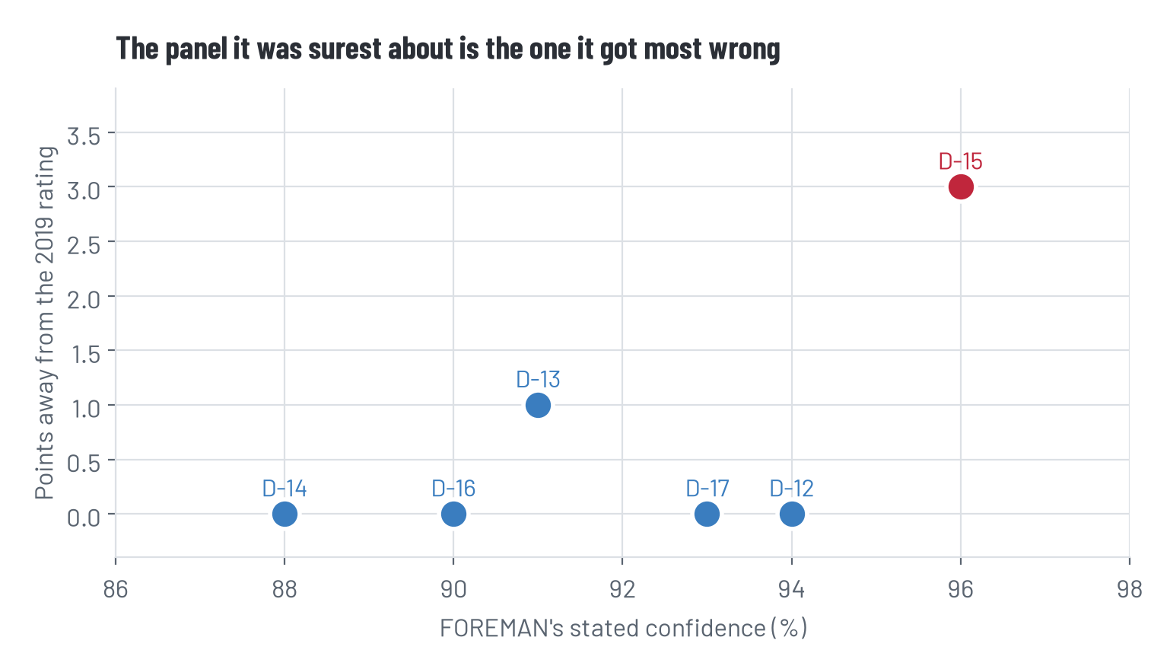
D-15. At 96 percent.
The panel was overlaid with new surfacing in 2018. The photograph shows a smooth, clean overlay — so the model was surer, not less sure. Confidence went up precisely because the evidence got worse.

Slide 19
Nobody here is wrong
This is the distinction the whole semester rests on
WHAT FOREMAN DID
WHAT DIANE HAD
Answered the question it was asked: what condition does this surface appear to be in?
Its answer was reasonable for that question.
It had no way to know the surface was not the deck.
She could tap the deck with a hammer and listen.
She remembered the 2018 overlay because she was there.
None of that is in a photograph, and no amount of training data puts it there.
The failure was in the question, not the algorithm. Remember that when somebody tells you a better model would have caught it.

Slide 20
Rules and learned patterns, side by side
 | A rule | A learned pattern
Built from | Steps somebody wrote down | Examples somebody labelled
Shows its work | Every line | No line
You check it by | Redoing the steps | Testing it on cases it never saw
Fails by | Being wrong the same way every time | Being wrong on things unlike its training
Tells you it failed | It does not, but you can see where | It does not, and it sounds the same either way
Most real work is a mix. The skill is knowing which part you are holding at any moment.

Slide 21
IN CLASS — DO THIS NOW
12 min
Task sort — rule, learned, or both?
1
Handout H1-05 lists nine things this firm does on the Otter Bend job.
2
For each: how would you build it — a rule, a learned pattern, or either?
3
Then the harder column: what single piece of evidence would convince you it works?
4
Two of the nine are genuinely arguable. Be ready to say which two.
Work in pairs. Disagreement is the point — if your pair agrees on all nine, you are not arguing hard enough about number 9.

Slide 22
Where that lands
# | Task | Answer
1 | Rating factor for a girder | Rule
2 | Find spalling in 400 photographs | Learned
3 | Counterweight balance check | Rule
4 | Draft the county cover letter | Learned
5 | Flag any strain reading above 250 µε | Rule
6 | Predict which panels need repair in 5 years | Learned
7 | Convert 42 ft 7 in to metres | Rule
8 | Fatigue crack or shrinkage crack? | Both — argue it
9 | Look up an interval in the county spec | Both — argue it

Slide 23
Number 9 is a rule —
if you open the document.
Next Tuesday we find out what happens when you ask a language model instead. Do not look it up before then.

Slide 24
The note
One sentence. It is due before you leave.
I believe [the number or claim] is right because I checked it against [the thing you checked it against].
STRONG
NOT YET
“I believe the rating factor of 1.69 is right because I worked the arithmetic twice and the second pass matched.”
Names the claim. Names a check somebody else could repeat.
“I believe the deck is in fair condition because FOREMAN rated it 6.8 with 92% confidence.”
Confidence is not a check. Nothing was compared to anything.

Slide 25
Mask off — two minutes
The part where I stop being the firm and go back to being your instructor
Diane is a character. She is not the grader and her reaction is never your grade. Some weeks she will be in a hurry and wave through work that deserved better.
The rubric is the grade. It scores the claim you named and the check you did — never whether the number turned out right.
You are allowed to disagree with her. Doing it with evidence is the assignment.

Slide 26
Before Thursday
Read
The orientation memo and the deck panel history, if you have not already
Thursday
Bring a ruler or calipers if you own them. We measure something physical before anyone touches sensor data
Coming
HW1 is handed out Thursday. It is about eight strain gauges and whether you believe them

