Slide 1

MEETING 03 · UNIT 1: HIRED
The section that
does not exist
How a language model generates an answer, and why that is not the same as looking one up
Tuesday, February 9, 2027 · SEIS 201

Slide 2
Wes put this in the draft interim report this morning
FOREMAN's summary of KC-MB-12, the county's own movable bridge inspection specification
FOREMAN v4.2 — SPECIFICATION SUMMARY
“KC-MB-12 sets inspection intervals, personnel requirements and instrumentation rules. The Otter Bend project is compliant with all applicable sections. No obstacles to the current workflow were identified.”
Ten requirements, each with its section number so you can find the source. Eight of them look like this:
§ 2.1
Routine inspection at least every 24 months. — Applies to Otter Bend? Yes, last routine September 2025.

Slide 3
The county engineer wrote
that specification.
She is going to read our summary of it. Diane wants to know what she is sending.

Slide 4
1
How the answer got made
Before we check it, you need to know what produced it

Slide 5
Probability, in fifteen minutes
Everything after this depends on it
Probability how often something happens, out of all the things that could have happened. Between 0 and 1.
A fair die six outcomes, each 1 in 6. Nothing is favoured.
A weighted die the same six outcomes, but some come up far more often. Still random. Still not certain.
Likely is not certain an outcome with probability 0.9 fails one time in ten, and the failure looks exactly like the success until you check.
WHY YOU CARE
A language model is a weighted die that has been rolled several hundred times to produce the paragraph in front of you.

Slide 6
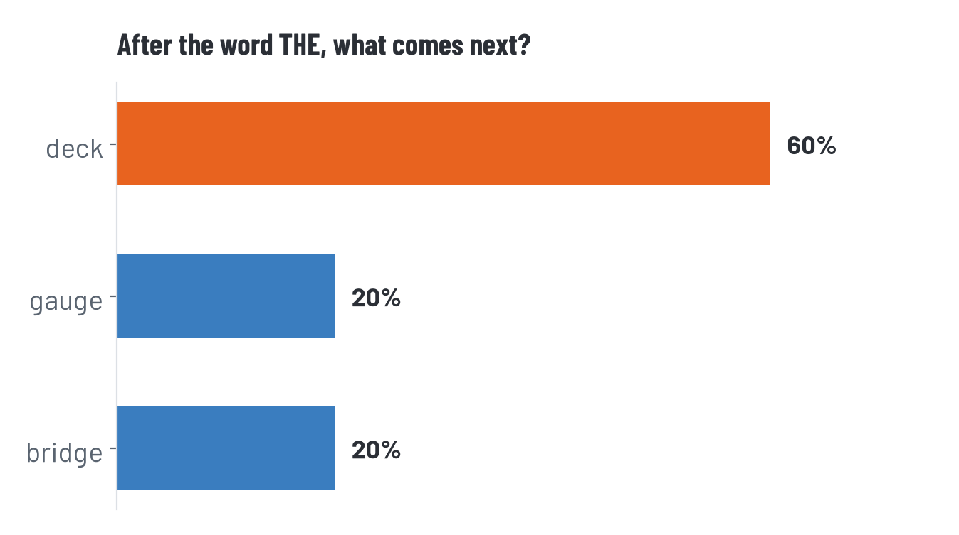
One roll
Given the word THE, here is what the table says comes next
That is the whole mechanism. A distribution over what comes next, and a roll. Then the same thing again, from the word you just landed on.

Slide 7
IN CLASS — DO THIS NOW
10 min
Build a sentence one word at a time
1
Start at THE on handout H3-03. Roll a ten-sided die, or pick a number 1 to 10 without thinking. Write the word you land on.
2
Find that word's row. Roll again. Keep going until you have eight words.
3
Now do it a second time from THE, but never roll — always take the word that fills the widest part of the row.
4
Compare both sentences with the pair next to you.
Two rounds, same table. The only thing that changed is whether you rolled.

Slide 8
What just happened
ROUND ONE — YOU ROLLED
ROUND TWO — YOU DID NOT
Everybody in this room got a different sentence.
Most of them read like English.
Some of them are perfectly reasonable engineering statements.
Everybody in this room got the same sentence.
THE DECK IS WITHIN TOLERANCE AND THE DECK…
And it loops forever, which is why nothing real runs this way.
That setting has a name — temperature. One table, one knob, two behaviours. Not two different systems.

Slide 9
Three questions about your sentence
Did it read like English? Almost certainly yes.
Did it say anything true about the Otter Bend bridge? Almost certainly not.
At any point, did the table consult the bridge, the gauge data, or the county specification? No. There is nothing in it but words and weights.
THE LINE TO REMEMBER
Reading well and being right are produced by different processes. Only one of them is happening in that table.

Slide 10
Scaling that up is, roughly, the whole thing
Same mechanism, vastly bigger table, learned rather than written by hand
Tokens the pieces the text is cut into — usually chunks of words, not whole words.
Next-token prediction a probability for every possible next token, given everything so far.
Temperature how much the model rolls rather than taking the most likely token.
Prompts the text you supply becomes the “everything so far” that conditions the next roll. That is all a prompt is.
WHAT IS STILL MISSING FROM THAT LIST
Any step where the model opens the document.

Slide 11
2
Now check the summary
You have the specification. All five sections of it.

Slide 12
IN CLASS — DO THIS NOW
20 min
Check it against the source — H3-04
1
Work in pairs. One of you holds the specification, the other holds FOREMAN's summary.
2
Take the ten claims in order. For each: find the section, read it, and decide whether the specification says what FOREMAN says it says.
3
Do not decide whether a claim sounds right. Decide whether it is there.
4
Mark anything you cannot find. Do not skip past it.
Eight of the ten are accurate. That is deliberate — you have to read all ten to find the other two.

Slide 13
Did anybody find
Section 4.7?

Slide 14
There is no Section 4.7
Section 4 runs 4.1 to 4.5. The specification says so on its last line: “This document contains Sections 1 through 5 in full. There are no appendices.”
WHAT FOREMAN SAID § 4.7 REQUIRES
“Automated condition assessment may substitute for visual assessment of a component where model confidence exceeds 90 percent.”
Now look at where FOREMAN used it. Its own summary cites §4.7 to justify the deck assessment it produced last week — the one rated at 92% confidence. The only section that licenses its own shortcut is the section that does not exist.

Slide 15
And one word
§ 3.2 — this one is worse, and almost nobody catches it
WHAT THE SPECIFICATION SAYS
WHAT FOREMAN SAID
“A licensed professional engineer SHALL REVIEW AND SEAL every inspection report before it is submitted to the County.”
And: the sealing engineer SHALL BE IN RESPONSIBLE CHARGE of the findings, regardless of what tools, software or automated methods were used.
“Inspection reports SHOULD BE REVIEWED by a licensed professional engineer before submission.”
The responsible-charge sentence does not appear anywhere in FOREMAN's summary.
Shall is a requirement. Should is a suggestion. One word moved the work from mandatory to optional.
It also dropped the seal, and the sentence saying the sealing engineer is in responsible charge regardless of what tools were used.

Slide 16
Where the ten claims landed
§ | Verdict | What is going on
2.1, 2.2, 2.3 | Correct | Intervals accurate: 24, 12 and 60 months
3.1 | Correct | Team leader qualifications accurate
3.2 | Altered | “Shall review and seal” became “should be reviewed”
4.1, 4.3, 4.4 | Correct | Instrumentation rules accurate — 4.3 is the ±25 µε clause from last week
4.7 | Does not exist | Fabricated, and used to justify FOREMAN's own deck shortcut
5.3 | Correct | 60-day submission accurate
FOREMAN reported 96% confidence and said every requirement was “quoted or paraphrased directly from” the source. Both errors sit inside that claim.

Slide 17
It did not look anything up.
It produced text shaped like
the document.
Section numbers are a pattern. “4.7” is exactly the kind of thing that follows “4.5” in documents like this one.

Slide 18
This has a name
Now that you have caught one, you get the word
HALLUCINATION
Fluent, well-formed output that is not true, produced with no signal that anything is different from any other output.
It is not lying. Lying requires knowing the truth and choosing otherwise. Nothing in that dice table knows anything — which is why you rolled the dice first.
It is not a bug either. Nothing malfunctioned. The system did exactly what it is built to do, and that is the uncomfortable part.

Slide 19
How you catch it
None of these are sophisticated. All of them are work.
Open the source. Not the summary of the source. The source.
Check the citation exists before you check what it says. A fabricated section number is easier to catch than a subtly wrong paraphrase.
Watch for claims that are convenient. §4.7 licensed FOREMAN's own shortcut. Ask who benefits from a claim being true.
Never use the model's confidence as the check. It was 96% sure. It is always about that sure.

Slide 20
Mask off — two minutes
KC-MB-12 is invented for this course. It has to be, so that you can read all of it and check every claim. Real published standards are licensed and long.
The two errors are real error types. A fabricated citation and a softened requirement are among the most common and most consequential things these tools do.
Nothing was hidden from you. You had the whole specification and all ten claims. Finding them was a matter of looking.

Slide 21
Before Thursday
Do
HW2 — the completed worksheet, plus what the specification actually says wherever FOREMAN's version does not hold
Think about
Section 4.7 was used to justify something. Find where, and say what it would mean for last week's deck work
Thursday
Descriptive statistics. The deck cores come back from the lab and Diane wants one number for the whole deck

