Slide 1

MEETING 12 · INSTRUCTOR REVEAL
Pretty does not mean honest.
Open only after students commit dispositions and redraws
M12 · Unit 2: Doubt
Notes:
CLOUD-PASS CANON SAY · revised M12.
REVEAL — SAY: “Name the designed errors only now. Tile A uses a truncated y-axis that makes ordinary variation look like failure.”

Slide 2
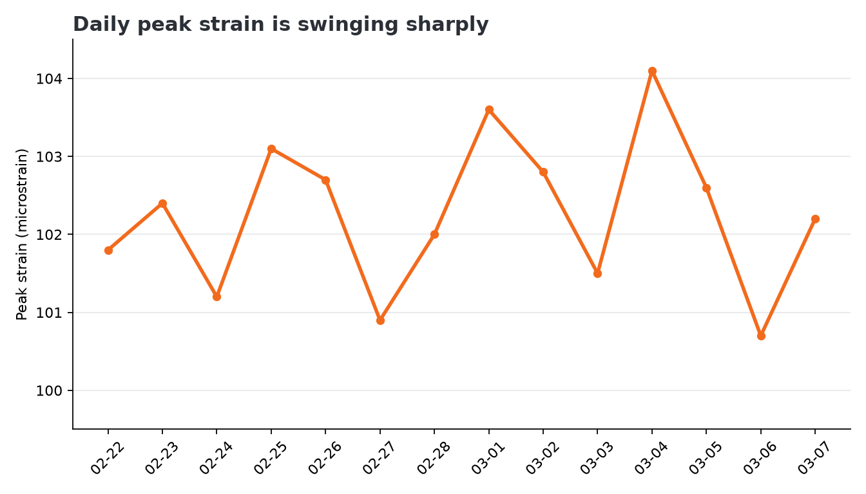
Tile A · truncated y-axis
WHY IT FAILS
99.5–104.5 µε scale
Ordinary movement fills the frame
Failure-sounding title outruns the data
Notes:
CLOUD-PASS CANON SAY · revised M12.
REVEAL — SAY: “The repair restores magnitude context and removes the diagnostic title. A narrower scale could be used only with an explicit reason and honest context.”

Slide 3
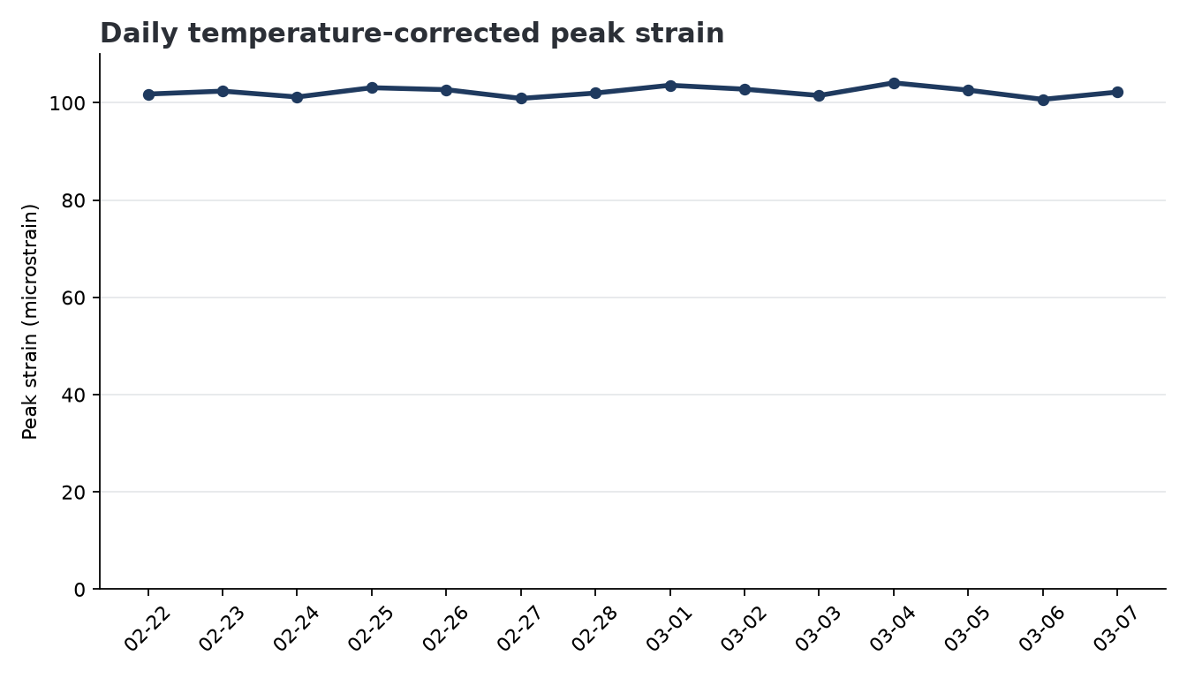
Repair A · restore magnitude context
Notes:
CLOUD-PASS CANON SAY · revised M12.
REVEAL — SAY: “Tile B uses a pie for hourly traffic. A pie destroys the time order the reader needs.”

Slide 4
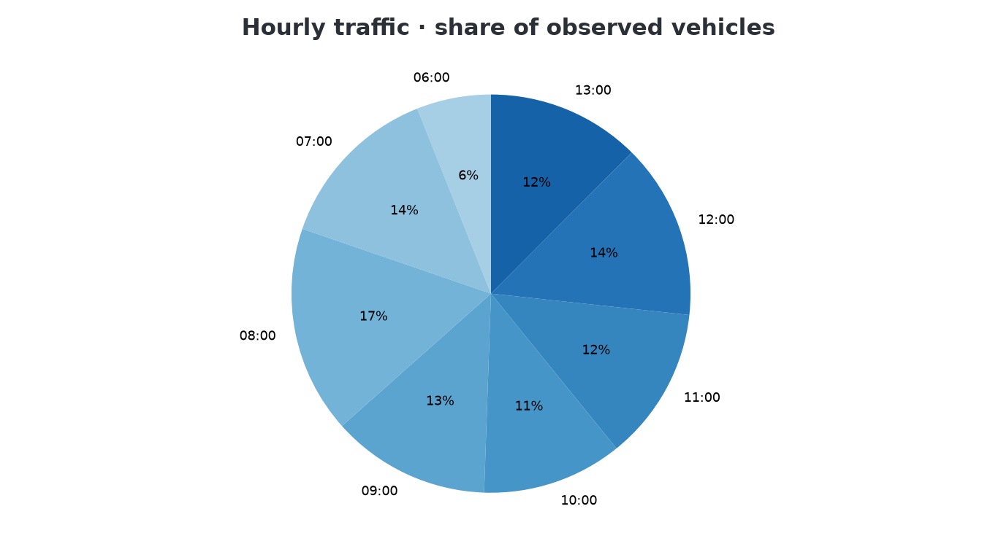
Tile B · wrong chart type for ordered time
WHY IT FAILS
Pie treats hours as unordered shares
Sequence is hard to compare
Question is hourly pattern, not composition
Notes:
CLOUD-PASS CANON SAY · revised M12.
REVEAL — SAY: “The repair uses ordered bars. A line would also preserve the hourly sequence.”

Slide 5
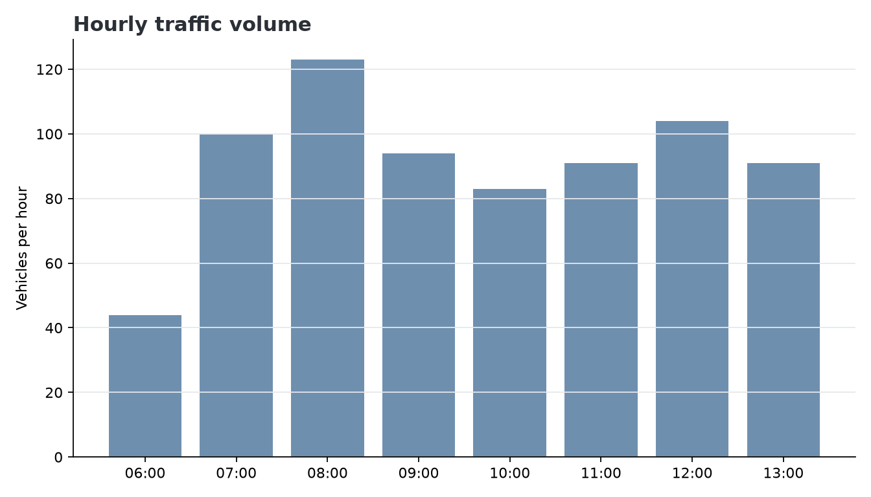
Repair B · put hour back on the x-axis
Notes:
CLOUD-PASS CANON SAY · revised M12.
REVEAL — SAY: “Tile C is the cleaner chart. Its bars answer a category-comparison question from a common zero baseline. The hunt was never supposed to be a wipeout.”

Slide 6
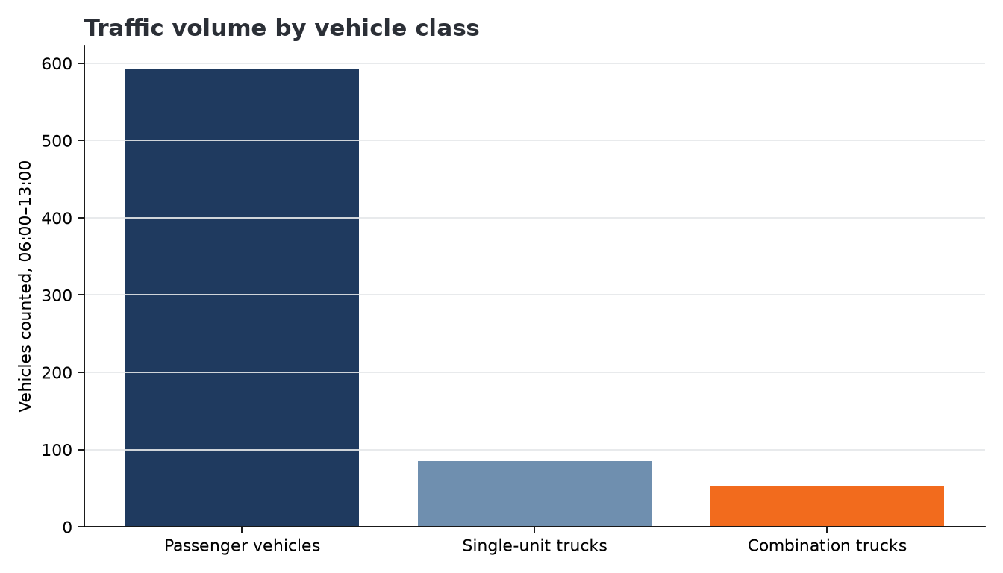
Tile C · approve
WHY IT WORKS
Bars match category comparison
Common zero baseline
Counts and observation window are labeled
Notes:
CLOUD-PASS CANON SAY · revised M12.
REVEAL — SAY: “FOREMAN did not invent numbers. The misleading story came from chart type, scale, and title. Critiquing that finished output is the engineering skill.”

Slide 7
The chart can lie while every number is true.
Human review tests the question, encoding, scale, and claim—not only arithmetic.
Notes:
CLOUD-PASS CANON SAY · revised M12.
CLOSE — SAY: “If an Otter Bend chart would scare the county about ordinary variation—or use a chart type that cannot show the question—it does not ship. Diane Halvorsen, PE owns what the county sees.”

Slide 8
Close M12
HW6
Two corrected charts, clearly labeled, with Note v2.
PRIMER
Async code reading due before M15.
WES
Delivered the pack; did not co-solve.
SPOILER GUARD
No M13 or Exam 1 scenario details.
Notes:
CLOUD-PASS CANON SAY · revised M12.
CLOSE — SAY: “Collect HW6, assign the code-reading primer due before M15, and preserve the spoiler guard: no M13 details and no Exam 1 scenario details.”

