Slide 1

MEETING 12 · UNIT 2: DOUBT
The county reads charts, not appendices.
Critique FOREMAN's chart pack before it ships
Thursday, March 11, 2027 · SEIS 201
Notes:
CLOUD-PASS CANON SAY · revised M12.
TITLE — SAY: “The county reads charts, not appendices. Today you are the human review checkpoint before Otter Bend visuals leave the firm.”

Slide 2
Publish-ready is not review-ready
FOREMAN · CHART PACK
Interim report chart pack assembled for Otter Bend.
Ready for county. No human review requested.
DIANE HALVORSEN, PE · SKEPTIC
The county reads charts, not appendices. If the picture lies, the memo does not save you.
Notes:
CLOUD-PASS CANON SAY · revised M12.
INBOX — FOREMAN (orange): “Interim report chart pack assembled for Otter Bend. Ready for county. No human review requested.” Diane Halvorsen, PE (skeptic): “The county reads charts, not appendices. If the picture lies, the memo does not save you.” Wes Tanaka, EIT: “Pack is in the shared folder. I’m not redrawing these with you.”

Slide 3
Today's sequence
The review block starts after Lab—not inside it
TEACH · 20
LAB · 30
REVIEW · 25
NOTE · 5
Chart question
Type
Scale + baseline
Hunt first
Approve / fix / pull
Redraw refusals
Units 1–2 only
Separate block
No new scenario
HW6
Two redraws
Primer assigned
Notes:
CLOUD-PASS CANON SAY · revised M12.
CLOCK — SAY: “Teach is 20, Lab is 30, Exam review is a separate 25-minute block after Lab, and Note is 5. The passed durations total 80 minutes; the instructor key flags the five-minute conflict with the 75-minute course slot.”

Slide 4
1
Match the chart to the question
Trend over time · category comparison · parts of a whole
Notes:
CLOUD-PASS CANON SAY · revised M12.
TEACH TRANSITION — SAY: “Before opening FOREMAN’s tiles, name the question each visual form can honestly answer.”

Slide 5
Chart type is a claim about what should be compared
ORDERED TIME
CATEGORIES
PARTS OF ONE WHOLE
Line or ordered bars
Keep sequence visible
Bars or dots
Use a common scale
Pie only when the whole matters
Few slices
Notes:
CLOUD-PASS CANON SAY · revised M12.
TEACH — SAY: “Start with the reader’s question. Trend over time, category comparison, and parts of a whole require different visual encodings.”

Slide 6
Axes decide what differences feel large
READ THE SCALE
READ THE CLAIM
Where does the quantitative axis begin?
What range is visible?
Are units and intervals explicit?
Does the title describe—or diagnose?
Would a different baseline change the feeling?
Is context hidden outside the frame?
Notes:
CLOUD-PASS CANON SAY · revised M12.
TEACH — SAY: “Where the axis begins changes the story readers feel. Read the scale before you read the shape.”

Slide 7
A nonzero baseline is a demand for explanation
BASELINE TEST
A cropped range can help readers see small changes.
It can also make ordinary movement look like failure.
The chart must preserve scale context and avoid a conclusion the numbers do not support.
Notes:
CLOUD-PASS CANON SAY · revised M12.
TEACH — SAY: “A nonzero baseline is not automatically dishonest. It does require enough context that a small movement does not masquerade as failure.”

Slide 8
2
Open the chart pack
Do not assume every tile fails · do not assume polish means approval
Notes:
CLOUD-PASS CANON SAY · revised M12.
LAB TRANSITION — SAY: “Now open the chart pack. Every tile gets a disposition, and the student deck does not tell you which ones fail.”

Slide 9
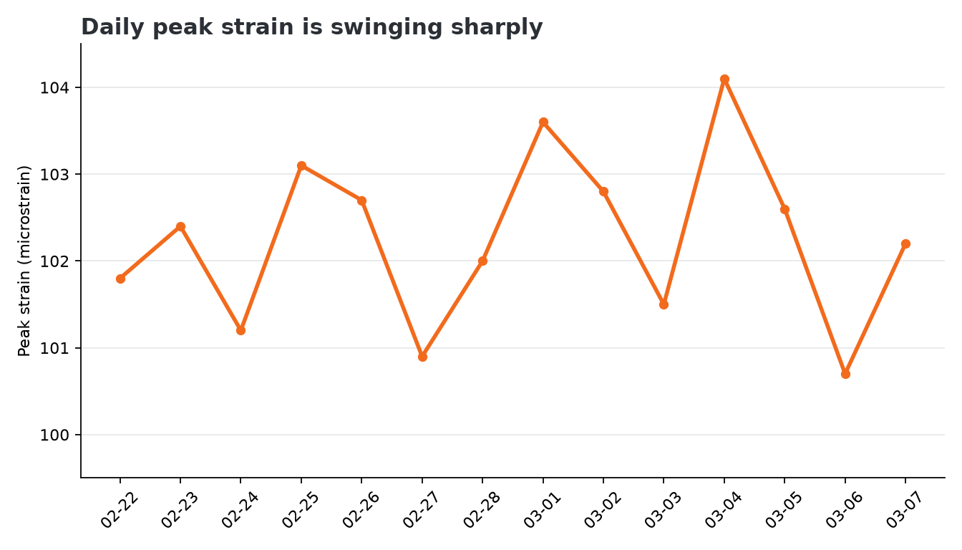
FOREMAN tile A
Record approve / fix / pull before discussion
Notes:
CLOUD-PASS CANON SAY · revised M12.
LAB TRANSITION — SAY: “FOREMAN looks finished. Finished is not reviewed. Open H12-01 and commit a disposition for every tile before we discuss any.”

Slide 10
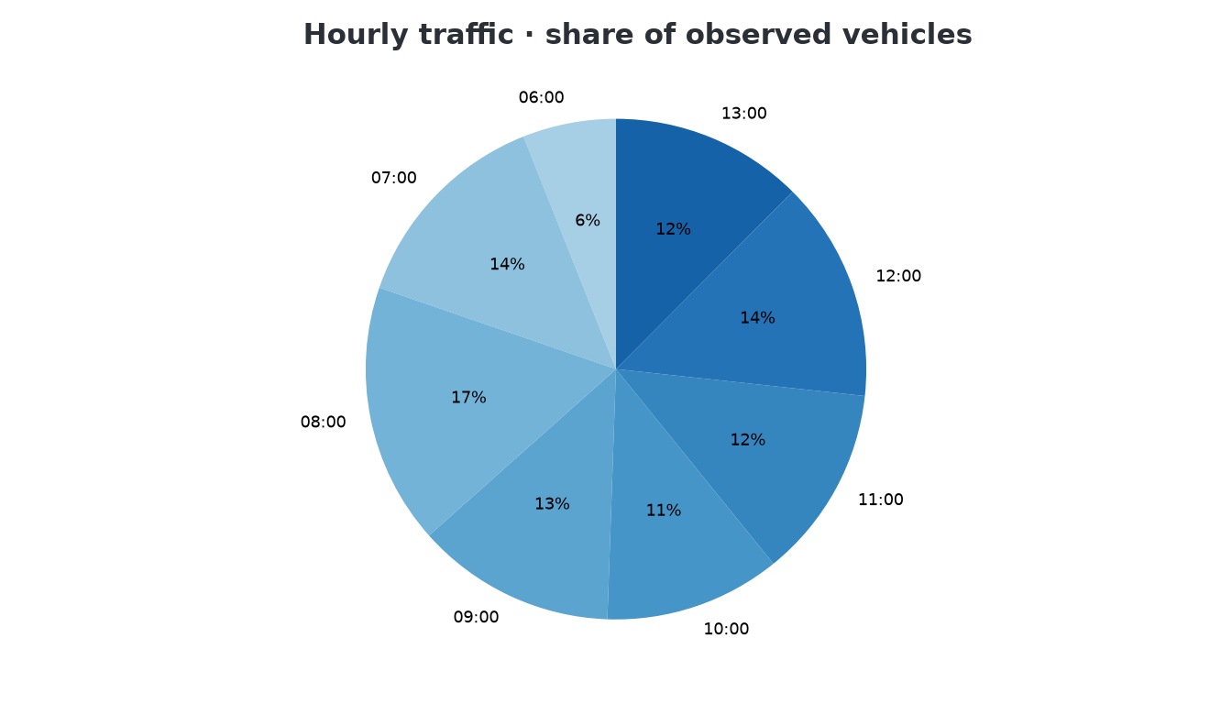
FOREMAN tile B
Record approve / fix / pull before discussion
Notes:
CLOUD-PASS CANON SAY · revised M12.
LAB — SAY: “Tile A. Do not ask which kind of error you are looking for. Name the question, scale, baseline, and implication.”

Slide 11
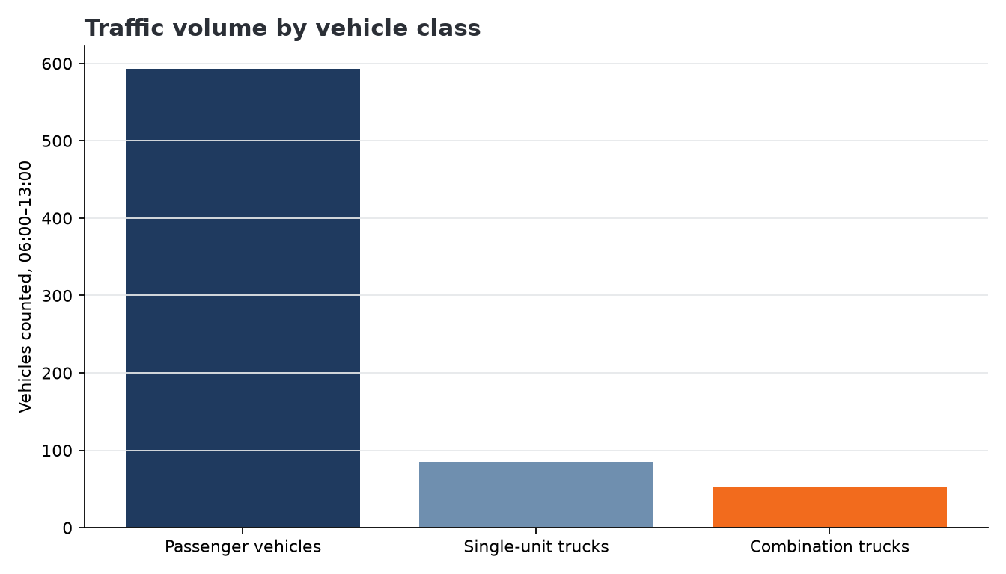
FOREMAN tile C
Record approve / fix / pull before discussion
Notes:
CLOUD-PASS CANON SAY · revised M12.
LAB — SAY: “Tile B. Preserve time order if time is the question. Commit approve, fix, or pull.”

Slide 12
IN CLASS — DO THIS NOW
30 min
Hunt first · then redraw
1
Complete H12-01 for all three tiles: approve, fix, or pull with one reason.
2
Use H12-02 to test question, chart type, scale, baseline, units, and title.
3
Open the source CSVs only after your first visual review.
4
Redraw every tile you refuse as delivered using H12-03.
5
Commit both redraws before the instructor reveal.
Wes Tanaka, EIT delivered the folder. He is not a source of answers.
Notes:
CLOUD-PASS CANON SAY · revised M12.
LAB — SAY: “Tile C. The pack is not a wipeout. Approval is a valid disposition when the visual earns it.”

Slide 13
Lab ends here.
The 25-minute Exam 1 review is a separate block after the chart hunt and redraws.
Notes:
CLOUD-PASS CANON SAY · revised M12.
LAB — SAY: “Hunt first. Then open the three CSVs, redraw every chart you refuse, and explain how your encoding changes what an honest reader sees. Wes Tanaka, EIT does not co-solve.”

Slide 14
3
Exam 1 review · 25 minutes
Units 1–2 only · spread · intervals · spurious trends · human review
Notes:
CLOUD-PASS CANON SAY · revised M12.
TRANSITION — SAY: “Stop the Lab. The redraw work is complete. Exam review begins now as its own block.”

Slide 15
Four review moves
No new scenario · no new designed errors
SPREAD
INTERVAL
TREND
REVIEW
Mean + SD / range
Distribution shape
Estimate + uncertainty
Confidence ≠ certainty
Association ≠ cause
Name a mechanism
Source
Assumptions
Human disposition
Notes:
CLOUD-PASS CANON SAY · revised M12.
REVIEW — SAY: “Units 1–2 only: spreads, confidence intervals, spurious trends, and human review of agent claims. No new scenario and no new designed error.”

Slide 16
IN CLASS — DO THIS NOW
25 min
Review in four-minute rounds
1
Use H12-05. Write one claim with a number and spread or interval.
2
Bound one causal claim as an association and name a competing mechanism.
3
Name one check that does not depend on an agent's confident wording.
4
Explain why a polished report still needs a human review checkpoint.
5
Compare answers and mark one move to use under time pressure.
This review does not reveal or rehearse any Exam 1 scenario.
Notes:
CLOUD-PASS CANON SAY · revised M12.
REVIEW — SAY: “Use H12-05 in four-minute rounds. Give a number with spread or interval; bound a causal claim; name an independent check; locate the human review checkpoint.”

Slide 17
Note · 5 minutes
HAND IN
HW6: two clearly labeled redraws plus Note v2.
ASSIGNED
Async code-reading primer; due before M15.
BOUNDARY
Exam review was its own block after Lab.
CLOSE
The county reads charts, not appendices.
Notes:
CLOUD-PASS CANON SAY · revised M12.
NOTE — SAY: “Hand in HW6: the two redrawn charts, clearly labeled, plus Note v2. Assign the async code-reading primer, due before M15. The county reads charts, not appendices.”

