Slide 1
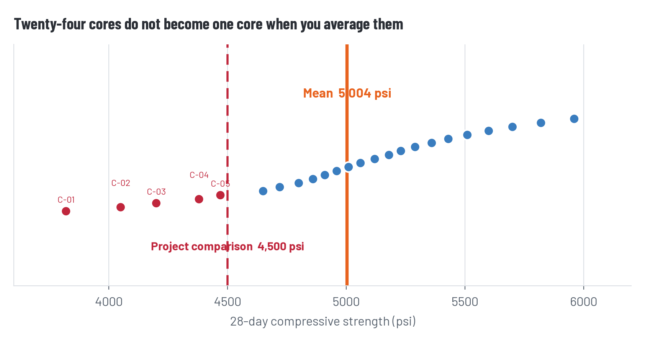
Put every core back on the page
The orange line is the mean. Every dot is still an observation.
The mean sits above the project comparison while individual results extend well below it. Center and spread are answering different questions.
Notes:
Open only after pairs report their values. Ask students to narrate the plot before you narrate it.

Slide 2
One file, several honest summaries
Statistic | Result | Job
n | 24 | How much data
Mean | 5,003.75 psi | Center
Sample variance | 307,659.24 psi² | Squared spread
Sample SD | 554.67 psi | Spread in original units
Sample CV | 11.09% | Spread relative to center
Range | 3,820–5,960 psi | Extremes
Below 4,500 | 5 of 24 | Low tail
Notes:
Reconcile spreadsheet outputs. STDEV.S and VAR.S are the expected formulas because these cores sample a larger deck.

Slide 3
The mean did not move. The story did.
MEAN-ONLY SENTENCE
SPREAD-AWARE SENTENCE
“The 24 cores average 5,004 psi, above the 4,500 psi project comparison.”
“The mean is 5,004 psi, but sample SD is 555 psi (CV 11.1%) and 5 of 24 results are below 4,500 psi.”
Both sentences are numerically correct. Only one tells the reader where the risk in the summary lives.
Notes:
Read both sentences aloud. Ask what disappeared in the mean-only version and what decision might change when it returns.

Slide 4
Uncertainty from spread
The file does not support a single-value picture of the tested concrete
Spread is not a mistake to clean away. It is observed variation in the sampled material and testing process.
Standard deviation quantifies it. CV makes its size comparable to the mean.
The low tail remains real after averaging. A center summarizes observations; it does not replace them.
This is descriptive uncertainty. Inference about the whole deck requires attention to how and where the sample was taken.
DO NOT OVERCLAIM
A core below 4,500 psi is not, by itself, a complete code finding. A mean above 4,500 psi is not, by itself, an adequacy determination.
Notes:
Frame spread as a finding, not a defect in the dataset. Hold the engineering boundary: descriptive statistics are not a code determination.

Slide 5
Twenty-four cores are not the deck
Read the columns FOREMAN did not summarize
WHAT THE FILE SAYS
Every row lists drill_zone = shoulder. Access was easy there. No core in this file came from a traffic lane, joint, tower interface, or underside.
Population every location or volume of deck concrete about which the claim is intended.
Sample the 24 tested cores.
Scope the results describe these sampled shoulder locations. They do not establish the condition of every deck region.
More rows do not repair a sampling frame that never reaches the places you care about.
Notes:
Reveal drill_zone = shoulder. Ask which deck regions remain unobserved and why 24 convenient cores are still a sample.

Slide 6
A three-sentence answer Diane can use
MODEL — REVEAL AFTER STUDENTS WRITE
1. The 24 tested cores average 5,004 psi.
2. Their sample SD is 555 psi (CV 11.1%), and 5 of 24 results fall below the 4,500 psi project comparison, so the mean alone hides consequential spread.
3. Because every core was drilled from an accessible shoulder location, these results describe the sampled locations but do not establish the condition of the entire deck.
Short does not have to mean false. It has to mean disciplined.
Notes:
Show the model only after students write. Accept equivalent language that gives center, spread/count, and scope without overclaiming.

Slide 7
Mask off — two minutes
Diane is wrong to demand only one number. The mean cannot carry the spread, the low tail, and the sampling scope.
Diane is right to demand a short answer. Clients need a usable statement, not a pasted spreadsheet.
FOREMAN's arithmetic is correct. The designed error is turning one correct statistic into an unsupported adequacy conclusion.
Diane is not the grader. The check and the record are graded, not whether she likes the brief.
Notes:
Mask off the role tension: Diane's brevity request is operationally reasonable, while one-number certainty is not.

Slide 8
Before Tuesday
Hand in
H4-04: three sentences plus the one-sentence verification note
Log
What you checked, what you accepted, and how many of the six hours you spent
Tuesday
FOREMAN runs against the live sensor stream overnight — and acts on one reading
Notes:
Collect H4-04 and decision-log entries. Preview M05 without revealing its designed error.

