Slide 1

MEETING 09 · INSTRUCTOR REVEAL
The decimals came from formatting.
Open only after students commit the precision and sampling audits
M09 · Unit 2: Doubt
Notes:
OLI CANON SAY — revised M09 Cloud re-check PASS.
REVEAL — Open only after students commit the precision audit, sampling-frame audit, and Note version 2.

Slide 2
The arithmetic is reproducible
CALCULATION
DISPLAY
Mean tested life: 44,872,500 cycles
Accumulated estimate: 3,000,184 cycles
Difference: 41,872,316 cycles
41,872,316 cycles
Eight significant figures imply single-cycle resolution the evidence does not have.
Notes:
OLI CANON SAY — revised M09 Cloud re-check PASS.
REVEAL — Confirm that FOREMAN’s arithmetic produces 41,872,316 cycles. Its designed error is eight significant figures with no range when the fatigue scatter supports only two or three.

Slide 3
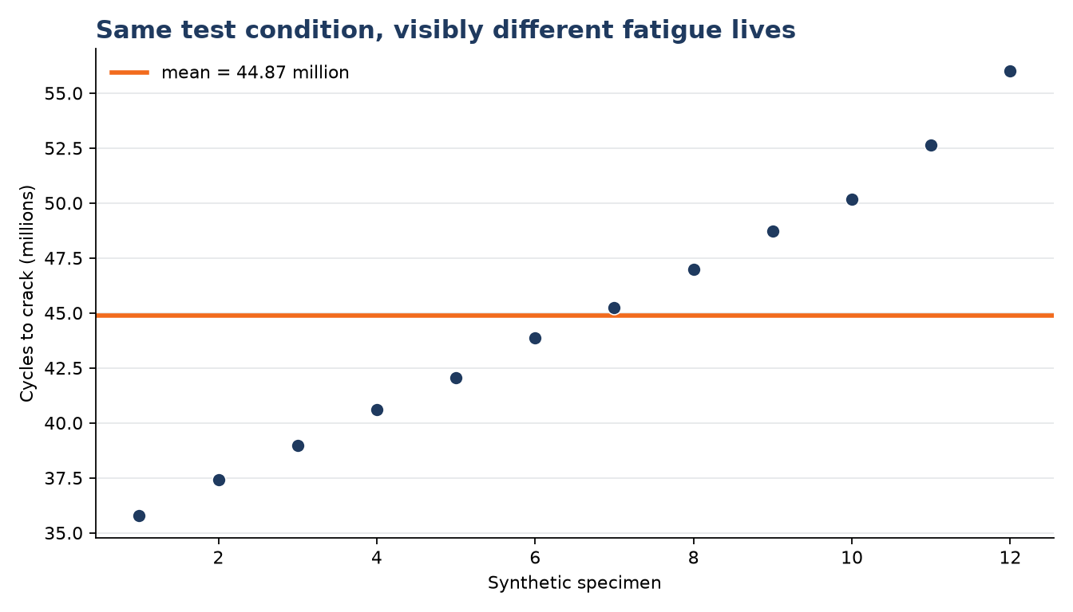
The tests do not support single-cycle resolution
EVIDENCE SCALE
n = 12
SD ≈ 6.3 million cycles
Range: 35.78–56.00 million
Recorded to 10,000 cycles
Notes:
OLI CANON SAY — revised M09 Cloud re-check PASS.
REVEAL — Show the small fatigue-test dataset and visible scatter. Keep the descriptive minimum and maximum separate from methods not yet taught.

Slide 4
A supported report is rounded—and bounded
MODEL RESPONSE · NOT REQUIRED WORDING
About 42 million cycles is the screening point estimate.
The tests show substantial scatter, and the estimate does not quantify component transfer, service loading, environment, or inspection uncertainty.
NOT A FORMAL INTERVAL
M09 describes visible spread and reporting scale; the observed test span is descriptive only.
Notes:
OLI CANON SAY — revised M09 Cloud re-check PASS.
REVEAL — A defensible response may keep a rounded planning estimate, but it must state the scatter, transfer limits, and need for qualified review.

Slide 5
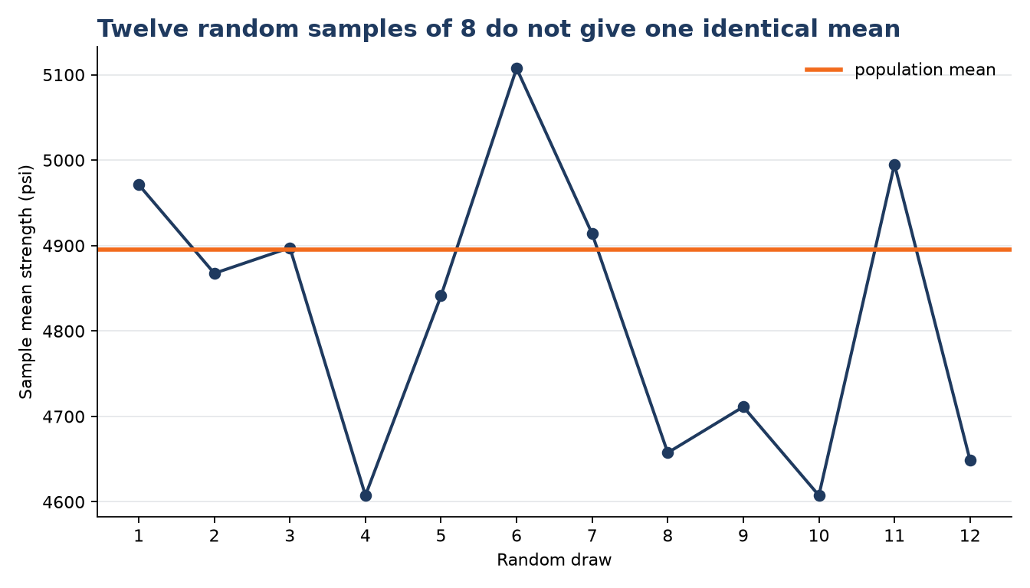
Random samples produce different means
TWELVE n = 8 DRAWS
Smallest mean: 4,607.5 psi
Largest mean: 5,107.5 psi
One fixed population
Different chance-selected units
Notes:
OLI CANON SAY — revised M09 Cloud re-check PASS.
REVEAL — Compare the class sample means. One fixed 200-value instructional population produced different n = 8 means: sampling variability.

Slide 6
The real cores were not random from the whole deck
WHAT WAS OBSERVED
CLAIM BOUNDARY
24 tested cores
West and east sides
Accessible shoulder locations only
No lane or center cores
Selection followed access
Whole-deck representation is not established
Notes:
OLI CANON SAY — revised M09 Cloud re-check PASS.
REVEAL — Every real Otter Bend core was drilled from the shoulder for easy access. That is a convenience frame and does not establish whole-deck representation. The 200-value demonstrator is not bridge truth.

Slide 7
Randomness is a property of selection.
Precision is a property of evidence.
Neither can be added after the data are collected.
Notes:
OLI CANON SAY — revised M09 Cloud re-check PASS.
REVEAL — Randomness belongs to selection; precision belongs to evidence. Neither can be added after collection.

Slide 8
Use a bounded Note v2
CLAIM · CHECK · RESULT
CLAIM — FOREMAN reports 41,872,316 cycles remaining with high confidence.
CHECK — The 12 tests were recorded to 10,000 cycles and have an SD near 6.3 million cycles; transfer assumptions are unquantified.
RESULT — Report about 42 million cycles only as a screening point estimate, state the limitations, and obtain qualified review.
Notes:
OLI CANON SAY — revised M09 Cloud re-check PASS.
NOTE — Compare claim/check/result records. The hand-in is Note version 2 only; do not require a later method.

Slide 9
Close M09
NOTE v2
Claim, check, result—rounding and limitations belong in the record.
SAMPLE
Keep the simulated demonstrator separate from actual Otter Bend evidence.
HOURS
Record what was checked and what remains unverified.
SCOPE
Close without teaching M10's interval or significance methods early.
Notes:
OLI CANON SAY — revised M09 Cloud re-check PASS.
CLOSE — Diane remains in BELIEVER mode and still wants one number. Hook only the plain question of whether the deck got worse; do not preview or name a later statistical method.

