Slide 1

MEETING 02 · UNIT 1: HIRED
Measure one thing,
five times
Why measurement is uncertain, and what averaging can and cannot fix
Thursday, February 4, 2027 · SEIS 201

Slide 2
FOREMAN cleared the gauge array at 06:02 this morning
FOREMAN v4.2 — BASELINE ACCEPTANCE CHECK
“PASS. Array baseline offset 23.062500 µε against a specification limit of ±25 µε. The array is within tolerance and cleared for service. Confidence 97%.”
Northline invoices us the moment we accept the array, and the February load response study runs off these eight gauges. Diane will not accept it until somebody has looked.
THE QUESTION ON THE TABLE
Do we accept the array?

Slide 3
We are not going to open
that file for forty minutes.
You cannot judge somebody else's measurements until you have watched your own disagree with each other.

Slide 4
1
What a measurement is
Nobody measures anything once

Slide 5
Measure the same thing five times and you get five answers
This is not carelessness. It is what measurement is.
The reading one number off the instrument. On its own it tells you almost nothing.
The spread how far apart your repeated readings are. This is the honest width of what you know.
The resolution the smallest division the instrument can actually show. You cannot know anything finer than this, no matter how many readings you take.
The true value what you are trying to find. You never see it. You only ever see readings.
WRITE THIS DOWN
A measurement is a range, not a number. Reporting it as a single number is a decision you made, and you should be able to say what you threw away.

Slide 6
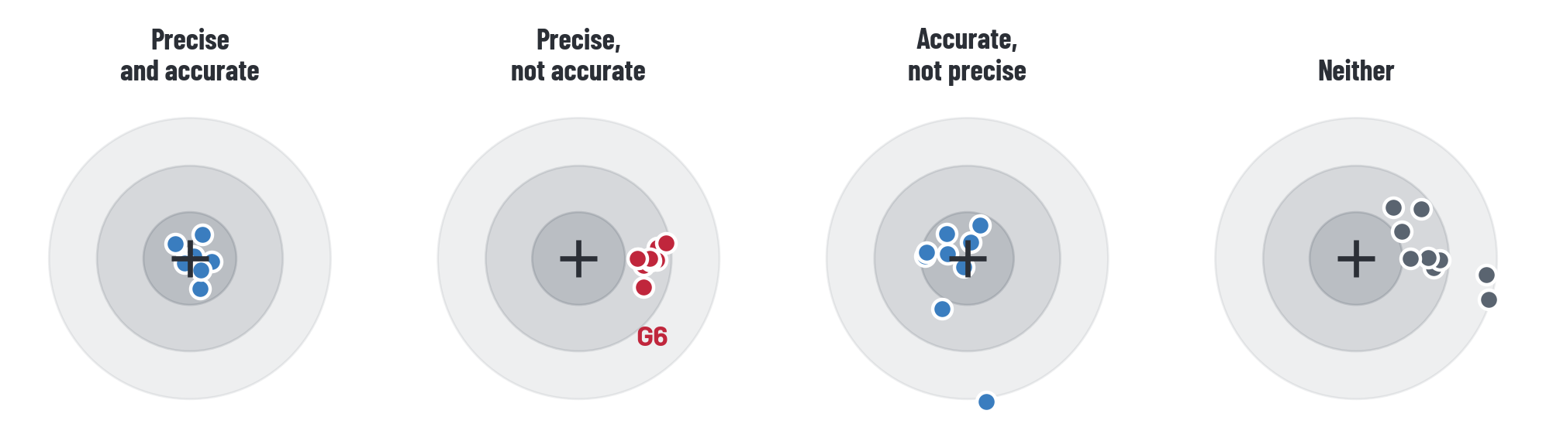
Two ways to be wrong
The crosshair is the true value. Each dot is one reading.
Precise means your readings agree with each other. Accurate means they agree with the truth. They are independent, and only one of them is visible from inside your own data.

Slide 7
This is the distinction that matters today
RANDOM ERROR
SYSTEMATIC ERROR
Pushes you up as often as down.
Shows up as scatter in your own readings.
More readings shrink it.
Averaging works.
Pushes the same way every time.
Invisible inside your own readings — they agree beautifully.
More readings do nothing.
Averaging hides it.
Hold on to that last line. In forty minutes it is going to cost somebody an invoice.

Slide 8
IN CLASS — DO THIS NOW
25 min
The measurement lab — handout H2-01
1
Part A. Measure the pin five times. Put the instrument down between readings. Record every value, including the one you think is wrong.
2
Part B. Swap pins with the pair next to you and measure theirs. Compare their mean with yours, and compare that gap with your own spread.
3
Part C. Turn your diameter into a cross-sectional area, and carry the uncertainty with it.
No calipers on your table? A ruler works, and works better for Part A. No instrument at all? Use pin_measurements_backup.csv — 24 readings, two people.

Slide 9
Part C — uncertainty does not stay where you left it
A = π d² / 4
Because the diameter is squared, a 1% error in d becomes a 2% error in A. Nobody cares about the diameter. They care about the area of steel, because that is what carries the load — and that is the number your uncertainty has to survive into.
WITH THE BACKUP DATA
Mean diameter 38.110 mm, spread 0.0257 mm — about 0.067% of d. Area comes out 1141 mm², ± 0.135% — twice the percentage you started with.

Slide 10
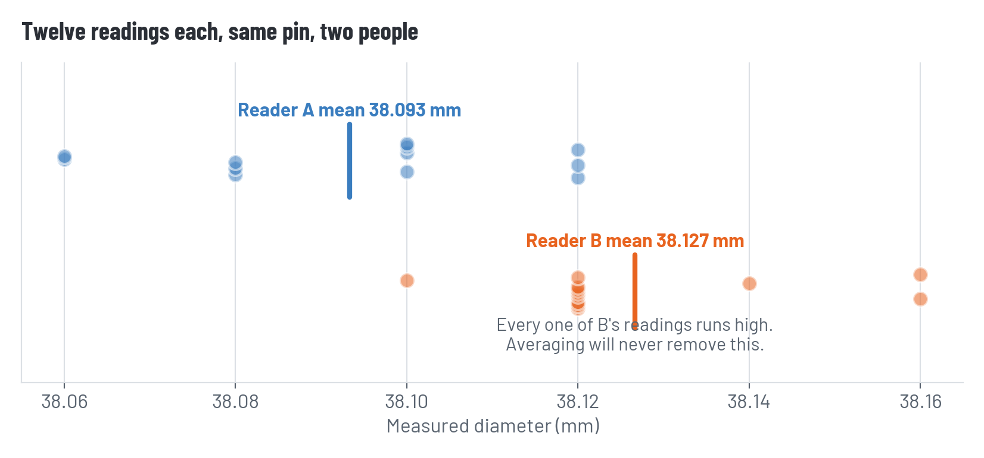
What the backup data shows
Two people, the same pin, twelve readings each
Reader B is about 33 micrometres high on every single reading. Their own twelve readings agree with each other beautifully. Nothing inside B's data can reveal this — it only shows up when you compare with A.

Slide 11
Now open the gauge file.
gauges_install.csv — eight gauges, twelve readings each, taken on install day with the roadway closed.

Slide 12
2
Eight gauges
FOREMAN read all 96 numbers in 0.4 seconds. We are going to read them one gauge at a time.

Slide 13
One gauge at a time
Specification KC-MB-12 §4.3: each gauge shall read within ±25 µε of zero under no load
Gauge | Mean (µε) | Spread | Within ±25 µε?
G1 | 0.08 | 5 | yes
G2 | -0.50 | 8 | yes
G3 | -0.75 | 8 | yes
G4 | -1.08 | 7 | yes
G5 | -0.25 | 7 | yes
G6 | 187.50 | 8 | NO
G7 | -0.08 | 12 | yes
G8 | -0.42 | 10 | yes

Slide 14
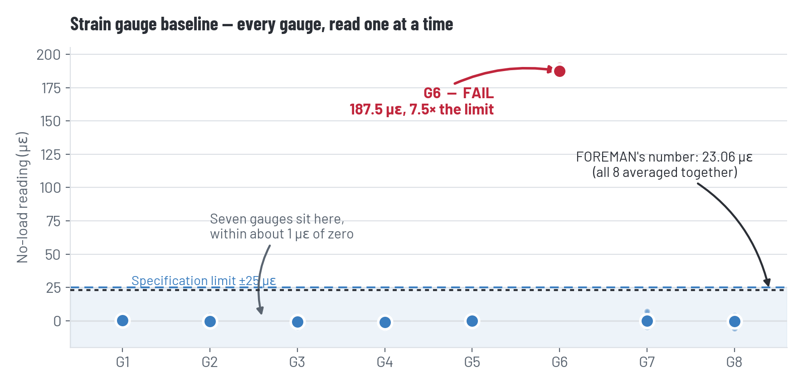
G6
Seven gauges sit within about one microstrain of zero. G6 reads 187.5 — seven times the limit. Its own twelve readings are as tight as everybody else's, so nothing inside G6 looks wrong.

Slide 15
So how did it pass?
FOREMAN's arithmetic is correct. Every digit of it.
G6 187.50 + the other seven (−3.00) = 184.50 µε
184.50 ÷ 8 gauges = 23.06 µε
23.06 < 25 PASS
Averaging eight gauges divided one gauge's error by eight, and slid a failure of 162 µε under a limit it fails outright. The error is not in how FOREMAN computed. It is in what it chose to compute.
AND THE SECOND ONE
It reported 23.062500 µε — six decimal places, from an instrument whose installation record says it resolves 1 µε.

Slide 16
Somebody already knew
Page 2 of the installation record, in the margin, in pen
“Northline guy was in a hurry. I watched him re-glue G6 and didn't see him re-zero it. Said it was fine.”
— W. Tanaka, EIT
One hour spent reading the installation record would have handed you the answer.
Two hours spent recomputing the eight means would have found it the hard way, and taught you more.
Zero hours carries G6 into the February study, into HW3, and into April.

Slide 17
This one comes back.
In April a four-step workflow produces a number nobody can explain, and one of its inputs came from a February file with your name on it. Nobody will tell you which.

Slide 18
HW1, and your ten hours
Handout H2-04. Due Tuesday, one page.
What you could do | Hours | What it buys
Recompute all eight gauge means yourself | 2 | You know the numbers are real
Spot-check one gauge | 1 | Your method works — not that the rest is right
Read the installation record and field notes | 1 | Context FOREMAN did not have
Call Northline about the install | 1 | An answer next meeting, not today
Re-derive FOREMAN's array figure | 2 | You learn what it actually did
Accept FOREMAN's result as delivered | 0 | Four hours saved, a number you cannot defend
You have ten. You cannot do all of it — that is the assignment. Write down what you chose not to check, on the decision log. You will want it in May.

Slide 19
Mask off — two minutes
Hours are never points. Running out of them costs you nothing. Spending them on the wrong thing costs you nothing.
There was no trick. The data was in the file, the warning was in the margin, and the arithmetic was correct. Nothing was hidden from you.
Nobody is expected to catch everything. You are expected to know what you did not check, and to say so.

Slide 20
Before Tuesday
Do
HW1, one page, due Tuesday. Start your decision log — week 1 line
Keep
The decision log lives in your folder all semester. Two minutes a week
Tuesday
FOREMAN summarizes the county specification, and we find out what happens when a language model looks something up

