Slide 1

MEETING 08 · INSTRUCTOR REVEAL
Date was carrying temperature.
Open only after students commit the regression hunt
M08 · Unit 2: Doubt
Notes:
OLI STORY/SAY STATUS: PENDING CLOUD PASS — DO NOT TREAT THIS HOOK AS CANON SAY.
PASTE APPROVED SAY HERE, preserving the instructional action below.
REVEAL TITLE HOOK — Open only after students commit H8-02 and Note v2.

Slide 2
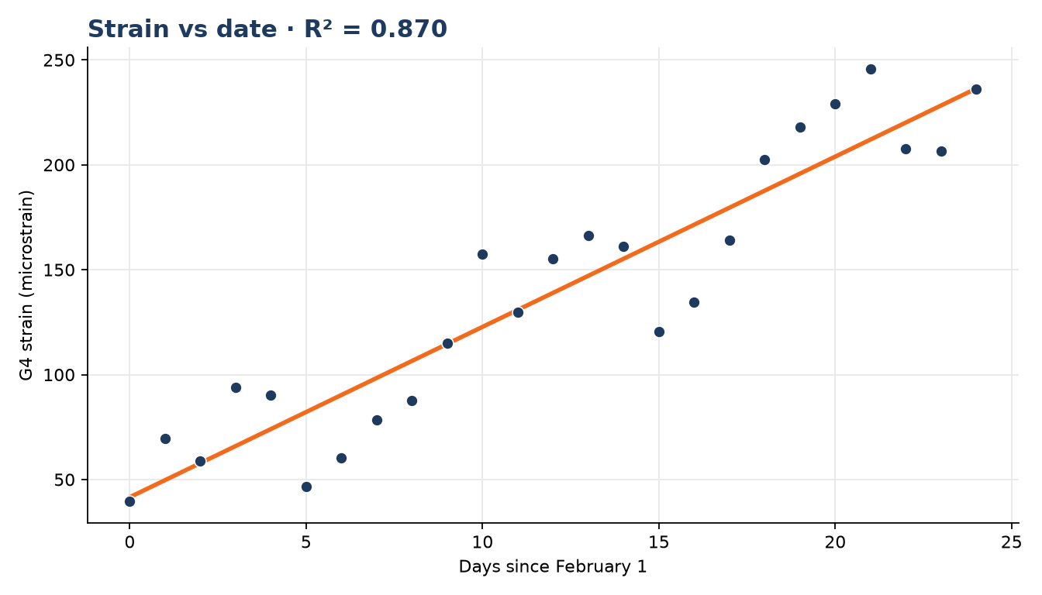
FOREMAN reproduced the date fit—and overclaimed it
DATE MODEL
Slope: 8.12 µε/day
R²: 0.870
Strong association
Cause unresolved
Notes:
OLI STORY/SAY STATUS: PENDING CLOUD PASS — DO NOT TREAT THIS HOOK AS CANON SAY.
PASTE APPROVED SAY HERE, preserving the instructional action below.
REVEAL HOOK — Confirm the date-model values. Separate reproducible calculation from unsupported causal interpretation.

Slide 3
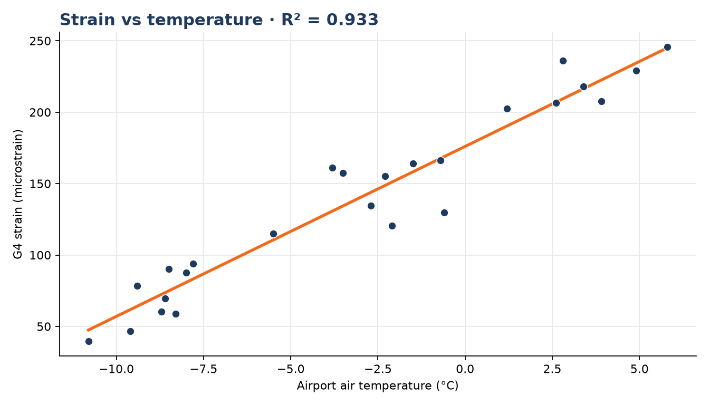
Temperature explains the observed pattern
TEMPERATURE MODEL
Slope: 11.90 µε/°C
R²: 0.933
Physical mechanism: thermal expansion
Notes:
OLI STORY/SAY STATUS: PENDING CLOUD PASS — DO NOT TREAT THIS HOOK AS CANON SAY.
PASTE APPROVED SAY HERE, preserving the instructional action below.
REVEAL HOOK — Confirm the temperature-model values and elicit the physical mechanism.

Slide 4
The confound is a causal structure
DATE
AIR TEMPERATURE
MEASURED STRAIN
Tracks seasonal progress
→
Warms over the observed window
→
Changes with thermal expansion and restraint
Notes:
OLI STORY/SAY STATUS: PENDING CLOUD PASS — DO NOT TREAT THIS HOOK AS CANON SAY.
PASTE APPROVED SAY HERE, preserving the instructional action below.
REVEAL HOOK — Walk date → temperature → measured strain. Clarify that date is a proxy in this observed window.

Slide 5
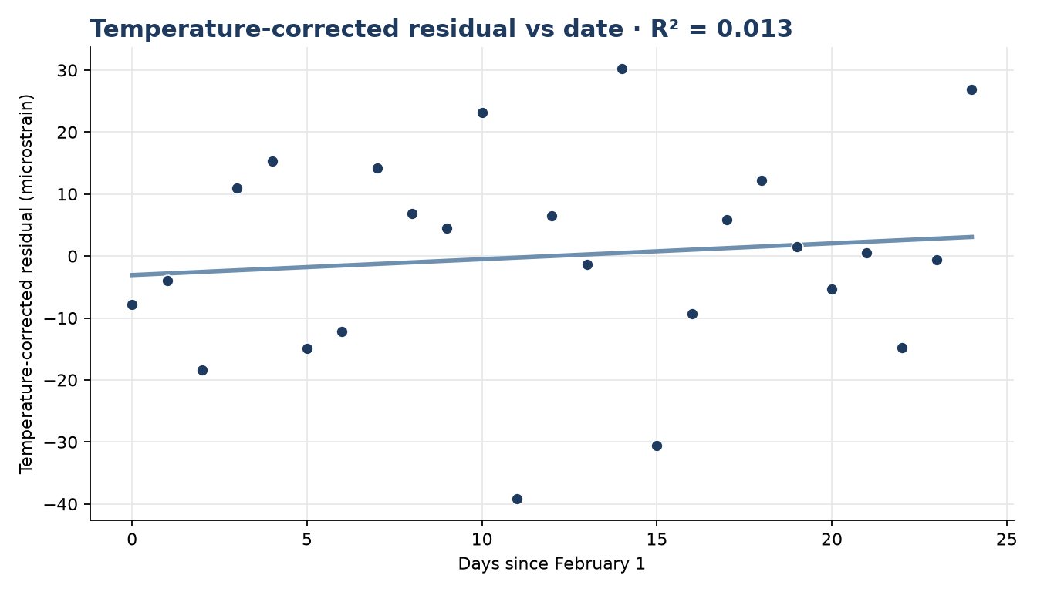
After correction, the date trend disappears
RESIDUAL MODEL
Slope: 0.26 µε/day
R²: 0.013
No meaningful date trend in this extract
Notes:
OLI STORY/SAY STATUS: PENDING CLOUD PASS — DO NOT TREAT THIS HOOK AS CANON SAY.
PASTE APPROVED SAY HERE, preserving the instructional action below.
REVEAL HOOK — Show residual model. Use 'no meaningful trend in this extract,' not 'proof of no damage.'

Slide 6
The date trend is real.
The damage inference is not supported.
Temperature correction changes the engineering claim.
Notes:
OLI STORY/SAY STATUS: PENDING CLOUD PASS — DO NOT TREAT THIS HOOK AS CANON SAY.
PASTE APPROVED SAY HERE, preserving the instructional action below.
REVEAL HOOK — State the designed error: FOREMAN treated fit as proof of deterioration.

Slide 7
Use a bounded correction
MODEL RESPONSE · NOT REQUIRED WORDING
The uncorrected G4 strain increases with date, but date tracks warming in this observation window.
After modeling the temperature-linked response, the residual does not show a meaningful date trend; this evidence does not support progressive deterioration.
DO NOT CLAIM
Temperature correction proves the bridge has no damage.
Notes:
OLI STORY/SAY STATUS: PENDING CLOUD PASS — DO NOT TREAT THIS HOOK AS CANON SAY.
PASTE APPROVED SAY HERE, preserving the instructional action below.
MODEL RESPONSE HOOK — Compare student boundaries; accept equivalent evidence-based wording.

Slide 8
Close M08
HW4
Complete the temperature correction and submit the corrected trend.
NOTE v2
Claim, check, result—the mechanism belongs in the record.
HOURS
Record what you checked and what remains unverified.
SCOPE
No later bearing-wear or Exam details enter M08.
Notes:
OLI STORY/SAY STATUS: PENDING CLOUD PASS — DO NOT TREAT THIS HOOK AS CANON SAY.
PASTE APPROVED SAY HERE, preserving the instructional action below.
CLOSE HOOK — Assign HW4 and collect Note v2. Approved Oli story close may be pasted here later.

