Slide 1

MEETING 10 · INSTRUCTOR REVEAL
Probably a small real change.
Open only after students commit the paired interval
M10 · Unit 2: Doubt
Notes:
OLI SAY PLACEHOLDER — CLOUD PASS PENDING.
Beat: reveal title
Do not improvise or treat this scaffold as approved canon. Replace only from the Cloud-PASS M10 SAY file on follow-up.

Slide 2
The coupon interval establishes the method
SIX COUPONS · 95% CONFIDENCE
Mean = 49.50 ksi
SE = 0.50 ksi · t* = 2.571
95% CI = [48.22, 50.78] ksi
Notes:
OLI SAY PLACEHOLDER — CLOUD PASS PENDING.
Beat: coupon result
Do not improvise or treat this scaffold as approved canon. Replace only from the Cloud-PASS M10 SAY file on follow-up.

Slide 3
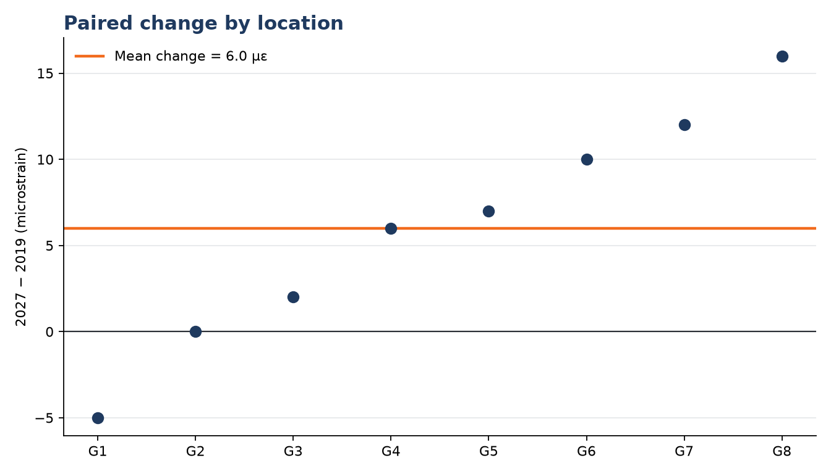
Same-location changes reveal a small positive mean
PAIRED ESTIMATE
n = 8 locations
Mean = 6.00 µε
SD = 6.82 µε
SE = 2.41 µε
Notes:
OLI SAY PLACEHOLDER — CLOUD PASS PENDING.
Beat: paired estimate
Do not improvise or treat this scaffold as approved canon. Replace only from the Cloud-PASS M10 SAY file on follow-up.

Slide 4
At 95%, zero sits just outside the interval
95% INTERVAL
SUPPORTED
t* = 2.365
[0.29, 11.71] µε
Zero excluded—barely
Evidence of a positive mean change
Magnitude remains small and uncertain
Not a complete damage diagnosis
Notes:
OLI SAY PLACEHOLDER — CLOUD PASS PENDING.
Beat: 95% interval
Do not improvise or treat this scaffold as approved canon. Replace only from the Cloud-PASS M10 SAY file on follow-up.

Slide 5
At 99%, the wider interval includes zero
99% INTERVAL
WHY
t* = 3.499
[-2.44, 14.44] µε
Zero remains plausible
Same estimate and data
Higher confidence demand
Wider uncertainty band
Notes:
OLI SAY PLACEHOLDER — CLOUD PASS PENDING.
Beat: 99% interval
Do not improvise or treat this scaffold as approved canon. Replace only from the Cloud-PASS M10 SAY file on follow-up.

Slide 6
The signal survives a 95% interval.
The certainty does not survive 99%.
Probably a small real change is stronger than either “noise” or “confirmed.”
Notes:
OLI SAY PLACEHOLDER — CLOUD PASS PENDING.
Beat: confidence-level synthesis
Do not improvise or treat this scaffold as approved canon. Replace only from the Cloud-PASS M10 SAY file on follow-up.

Slide 7
FOREMAN turned significance into certainty
VALID
INVALID LEAP
The paired estimate is +6.0 µε
The 95% interval excludes zero
Matched controls reduce some process noise
p = 0.04 means 96% probability
Significant means confirmed
Positive strain change proves deck deterioration
Notes:
OLI SAY PLACEHOLDER — CLOUD PASS PENDING.
Beat: FOREMAN designed error
Do not improvise or treat this scaffold as approved canon. Replace only from the Cloud-PASS M10 SAY file on follow-up.

Slide 8
A bounded answer keeps the uncertainty visible
MODEL RESPONSE · NOT REQUIRED WORDING
The eight matched locations show a mean increase of 6.0 microstrain.
The 95% interval is [0.29, 11.71] microstrain; the 99% interval is [-2.44, 14.44]. This is probably a small real change, not confirmed deterioration.
Notes:
OLI SAY PLACEHOLDER — CLOUD PASS PENDING.
Beat: bounded response
Do not improvise or treat this scaffold as approved canon. Replace only from the Cloud-PASS M10 SAY file on follow-up.

Slide 9
Close M10
HW5
Audit duplicate timestamps before calculating the peak-strain interval.
NOTE v2
Include the estimate and interval in claim/check/result.
DIANE
Her demand for yes/no is schedule pressure—not the grading key.
SPOILER GUARD
Keep all Exam 1 scenario details out of this meeting.
Notes:
OLI SAY PLACEHOLDER — CLOUD PASS PENDING.
Beat: HW5 and close
Do not improvise or treat this scaffold as approved canon. Replace only from the Cloud-PASS M10 SAY file on follow-up.

