Slide 1
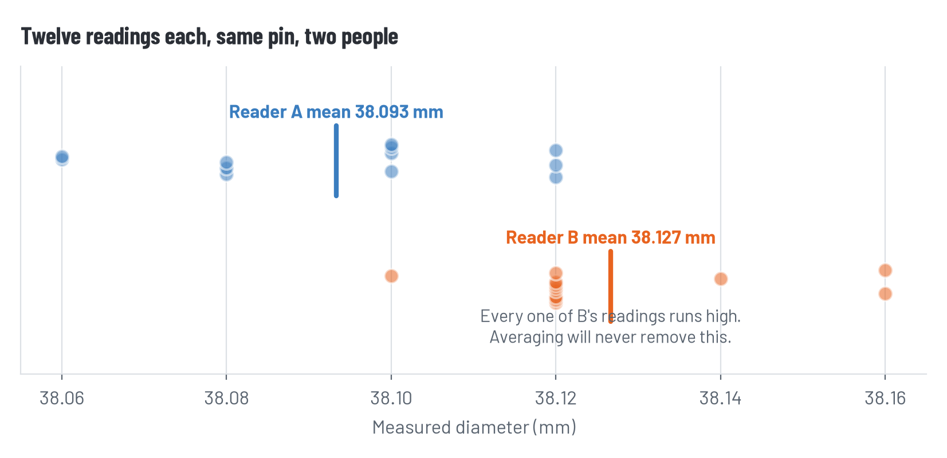
What the backup data shows
Two people, the same pin, twelve readings each
Reader B is about 33 micrometres high on every single reading. Their own twelve readings agree with each other beautifully. Nothing inside B's data can reveal this — it only shows up when you compare with A.

Slide 2
One gauge at a time
Specification KC-MB-12 §4.3: each gauge shall read within ±25 µε of zero under no load
Gauge | Mean (µε) | Spread | Within ±25 µε?
G1 | 0.08 | 5 | yes
G2 | -0.50 | 8 | yes
G3 | -0.75 | 8 | yes
G4 | -1.08 | 7 | yes
G5 | -0.25 | 7 | yes
G6 | 187.50 | 8 | NO
G7 | -0.08 | 12 | yes
G8 | -0.42 | 10 | yes

Slide 3
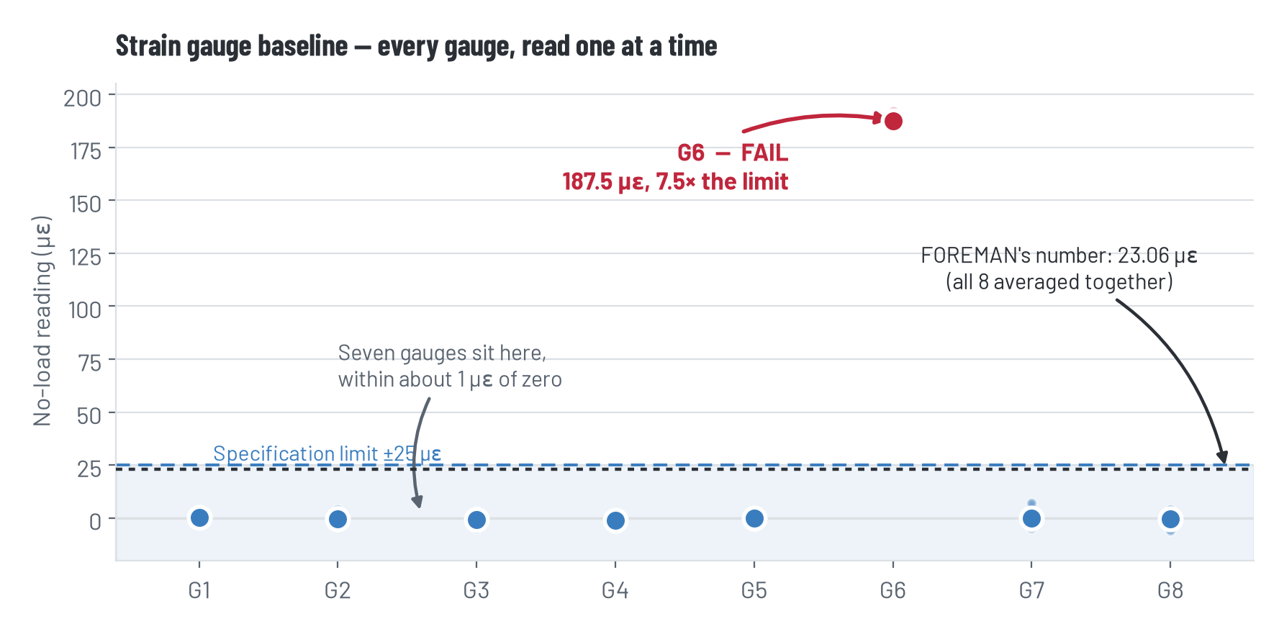
G6
Seven gauges sit within about one microstrain of zero. G6 reads 187.5 — seven times the limit. Its own twelve readings are as tight as everybody else's, so nothing inside G6 looks wrong.

Slide 4
So how did it pass?
FOREMAN's arithmetic is correct. Every digit of it.
G6 187.50 + the other seven (−3.00) = 184.50 µε
184.50 ÷ 8 gauges = 23.06 µε
23.06 < 25 PASS
Averaging eight gauges divided one gauge's error by eight, and slid a failure of 162 µε under a limit it fails outright. The error is not in how FOREMAN computed. It is in what it chose to compute.
AND THE SECOND ONE
It reported 23.062500 µε — six decimal places, from an instrument whose installation record says it resolves 1 µε.

Slide 5
Somebody already knew
Page 2 of the installation record, in the margin, in pen
“Northline guy was in a hurry. I watched him re-glue G6 and didn't see him re-zero it. Said it was fine.”
— W. Tanaka, EIT
One hour spent reading the installation record would have handed you the answer.
Two hours spent recomputing the eight means would have found it the hard way, and taught you more.
Zero hours carries G6 into the February study, into HW3, and into April.

Slide 6
This one comes back.
In April a four-step workflow produces a number nobody can explain, and one of its inputs came from a February file with your name on it. Nobody will tell you which.

Slide 7
HW1, and your ten hours
Handout H2-04. Due Tuesday, one page.
What you could do | Hours | What it buys
Recompute all eight gauge means yourself | 2 | You know the numbers are real
Spot-check one gauge | 1 | Your method works — not that the rest is right
Read the installation record and field notes | 1 | Context FOREMAN did not have
Call Northline about the install | 1 | An answer next meeting, not today
Re-derive FOREMAN's array figure | 2 | You learn what it actually did
Accept FOREMAN's result as delivered | 0 | Four hours saved, a number you cannot defend
You have ten. You cannot do all of it — that is the assignment. Write down what you chose not to check, on the decision log. You will want it in May.

Slide 8
Mask off — two minutes
Hours are never points. Running out of them costs you nothing. Spending them on the wrong thing costs you nothing.
There was no trick. The data was in the file, the warning was in the margin, and the arithmetic was correct. Nothing was hidden from you.
Nobody is expected to catch everything. You are expected to know what you did not check, and to say so.

Slide 9
Before Tuesday
Do
HW1, one page, due Tuesday. Start your decision log — week 1 line
Keep
The decision log lives in your folder all semester. Two minutes a week
Tuesday
FOREMAN summarizes the county specification, and we find out what happens when a language model looks something up

