Slide 1

System Overview
Digital Multi-Effects Unit for Guitar, Harmonica, Bass
Intended Use: Simple Amp-Simulator for Live Use
Fully Open-Source (Hardware and Software)
48 kHz Sampling Rate, 16bit sample depth
Ulta-Low latency: 0.6ms roundtrip
3 Live Adjustable Parameters
Mono HiZ-Input
Mono Line Out

Slide 2

Basic Effect blocks
Delay, max Time 1.36s
Modulated Delay for Flanger, Chorus, Vibrato
Algorithmic Reverb
Waveshaper for Distortion / Amp Simulation
64 Tap Impulse Response Filter, used for Cab Simulation
First Order IIR Filter, for EQ/Preamp modeling
Second Order IIR Filter, for EQ / Cab Simulation
Bitcrusher
Gain Stage
Dynamic Compressor

Slide 3
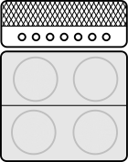


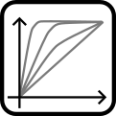

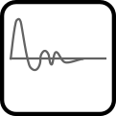
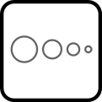
Example FX Program
«Cut»
«Gain»
«Delay Intensity»
Amp Model
High Gain
1st order Highpass
Wave
shaper
Wave
shaper
2nd order Lowpass
FIR Filter
Delay
Amplifier
Cabinet
Fx
Loop

Slide 4
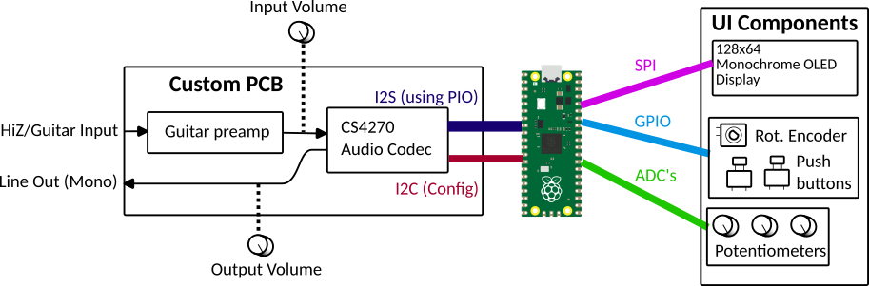
System Schematic

Slide 5

Cores
Leverages the dual-core Capabilities of the RP2040
* Core 0: Main Audio Processing (IRQ), Hardware
UI Element Handling (IRQ)
* Core 1: Display Updates, UI Processing, FIR
Calculation

Slide 6
Interrupts
Audio Buffers (via DMA)
Rotary Encoder Increment
Buttons
FIR Calculation
ADC Readouts

Slide 7
Software
Bare-Metal approach (except CMSIS register definitions, float math routines)
Written in C & Assembly (Startup Codes, specific Hardware functions)
Makefile compileable under Linux and the ARM gcc toolchain
Addon-Tools:
  Python Scripts for Filter design and Cab Modeling
  Tool for processing wave-files through the fx programs, allows development of fx programs without the actual hardware

