Slide 1

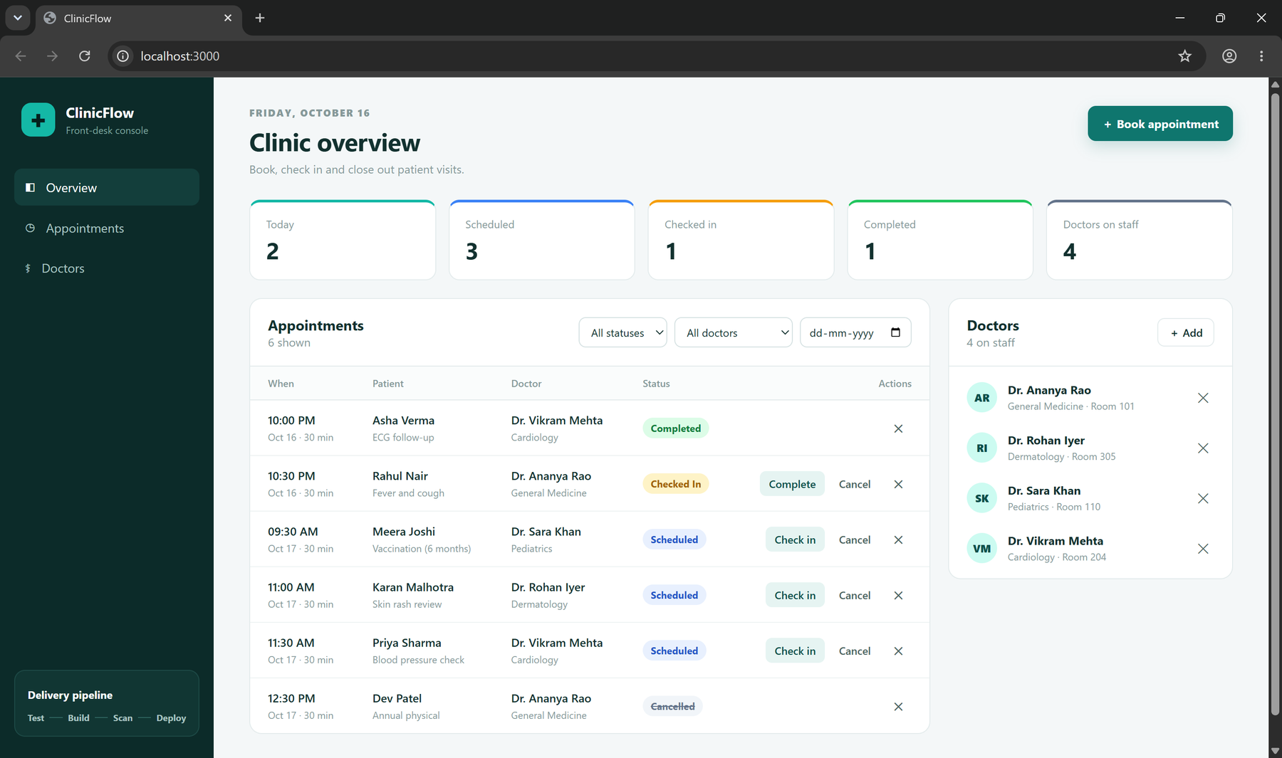
ClinicFlow
Clinic appointment booking, shipped from a laptop to a monitored Kubernetes cluster
Tushar Srivastava
Session 21 · DevOps Final Capstone Project
github.com/Stonetenth2005/Devops-Capstone
Notes:
Introduce ClinicFlow: a front-desk console for a small clinic. The app is the vehicle; the real goal is a full delivery path: tests, containers, CI/CD with a security gate, Terraform on AWS, Helm on Kubernetes, and Prometheus/Grafana monitoring.

Slide 2



What ClinicFlow does
Book appointments
A doctor can never be double-booked: overlaps return HTTP 409
Run the visit workflow
Check patients in on arrival, mark visits complete, or cancel
Manage the doctor roster
Add or remove doctors with specialty and room
Status workflow (other moves → 409)
SCHEDULED
CHECKED_IN
COMPLETED
CANCELLED (from Scheduled or Checked in)
Front-desk dashboard: React UI backed by FastAPI and PostgreSQL
Notes:
Three jobs for the receptionist. The interesting rule is the booking constraint: the backend rejects overlapping, non-cancelled appointments for the same doctor with 409 Conflict. Back-to-back slots are fine and a cancelled slot can be re-booked.

Slide 3








One push, end to end
git push
GitHub Actions
Trivy gate
GHCR
Helm upgrade
to main
ruff · pytest · build · validate
fail on fixable HIGH / CRITICAL
images tagged with commit SHA
rolling update, --wait
Terraform → AWS
Kubernetes (namespace clinicflow)
Observe
VPC 10.30.0.0/16, 2 public + 2 private subnets, NAT
EKS with managed node group (2× t3.medium)
EBS CSI driver for Postgres volumes
Ingress / → frontend, /api → backend
Frontend React + Nginx × 2
Backend FastAPI × 2–6 (HPA)
Postgres StatefulSet + gp3 PVC
Backend /metrics
ServiceMonitor → Prometheus
Grafana “ClinicFlow API” dashboard, 8 panels
Notes:
Walk left to right: a push to main runs lint and tests, builds both images, scans them with Trivy, pushes SHA-tagged images to GHCR and runs helm upgrade. Terraform provisions the VPC and EKS underneath; Prometheus scrapes the backend and Grafana visualises it.

Slide 4




Ten modules, one repository
10 pts
10 pts
5 pts
10 pts
15 pts
M1
M2
M3
M4
M5
Application
FastAPI + React + Postgres
Testing
19 pytest cases, ruff
Git & GitHub
28 meaningful commits
Docker
Multi-stage, non-root
CI/CD
Actions → GHCR, SHA tags
5 pts
15 pts
15 pts
10 pts
5 pts
M6
M7
M8
M9
M10
DevSecOps
Trivy HIGH/CRITICAL gate
Terraform
VPC + EKS, 61 resources
Kubernetes + Helm
Chart, Ingress, HPA
Observability
Prometheus + Grafana
Presentation
README + demo video
Notes:
Every rubric module maps to a folder in the repo, and each has screenshot evidence in /screenshots. The rest of the deck goes through them in order: Build (M1–M3), Ship (M4–M6), Run (M7–M9), then the live demo.

Slide 5

Build
M1 Application · M2 Testing · M3 Git and GitHub

Slide 6
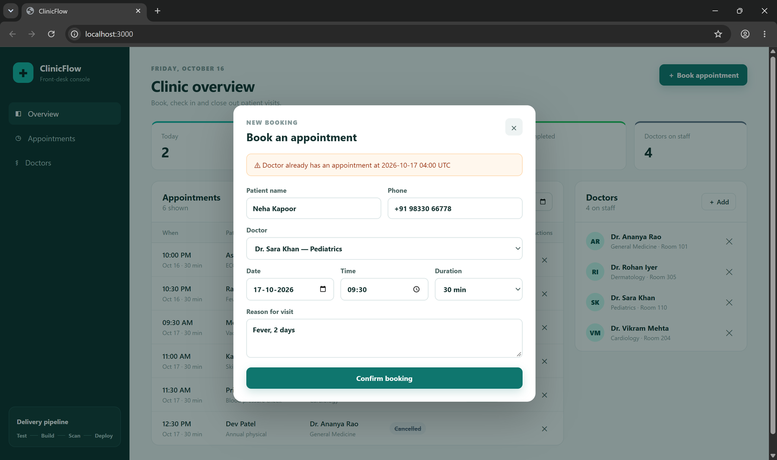

A real API with real rules
M1 App · 10 pts
Method | Path | Purpose
GET | /health · /ready | Liveness · DB readiness
GET / POST | /api/doctors | List · add doctor
DELETE | /api/doctors/{id} | Remove doctor
GET / POST | /api/appointments | Filter · book
PUT / DELETE | /api/appointments/{id} | Reschedule, status · delete
GET | /api/appointments/stats | Dashboard counters
PostgreSQL 16 + Alembic
Migration 0001 creates doctors and appointments; 0002 seeds the roster. An advisory lock lets several replicas start safely.
Booking an overlapping slot is rejected with 409 Conflict
Swagger UI at /docs documents every endpoint
Notes:
Nine REST endpoints under /api cover GET, POST, PUT and DELETE, plus /health, /ready and /metrics. Schema is owned by Alembic, never created by the app. Show the 409 when the same doctor is double-booked.

Slide 7
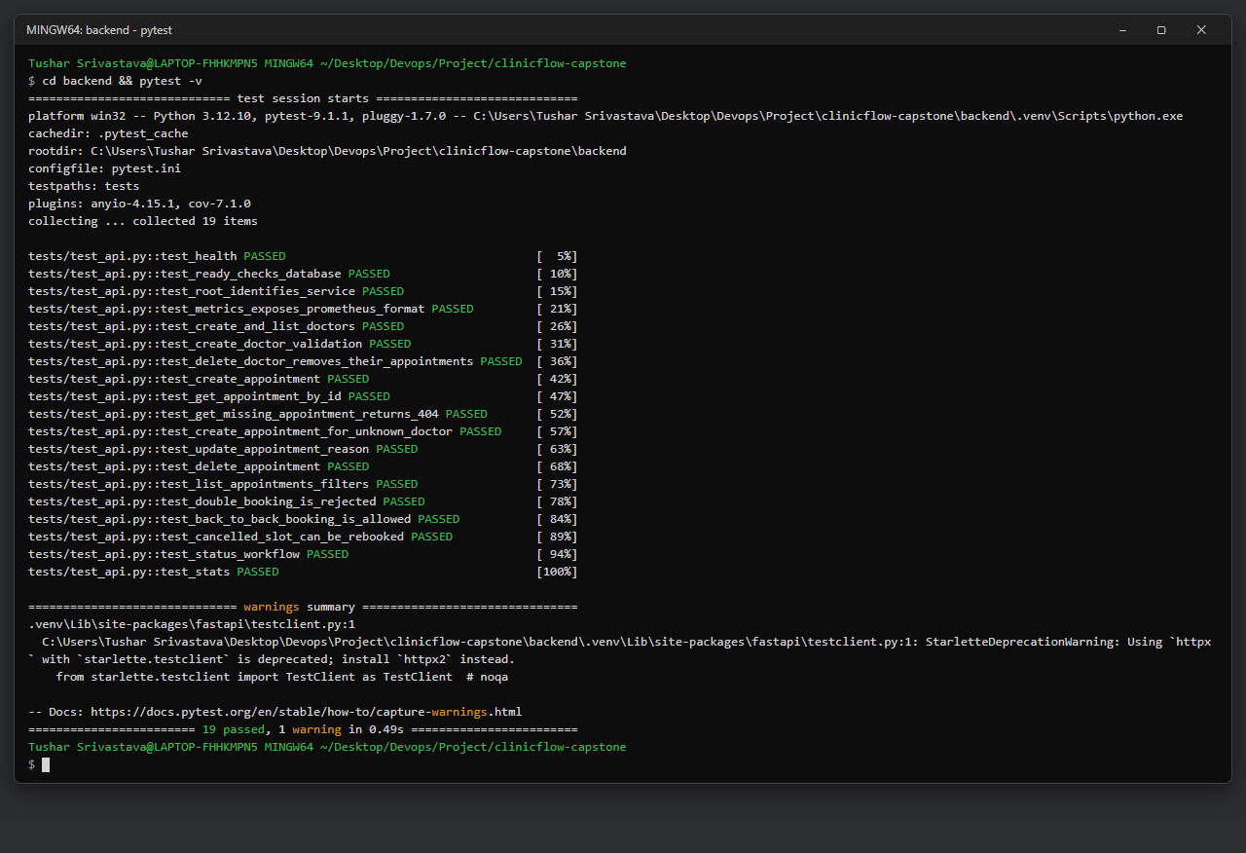
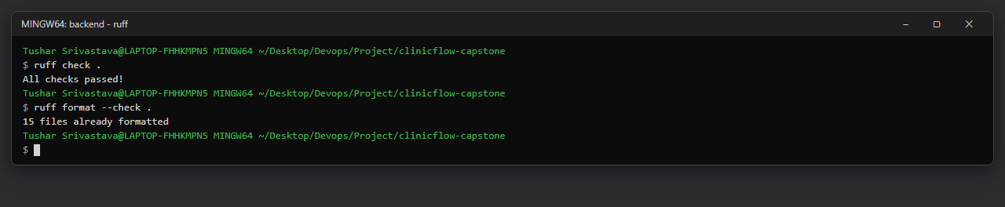
Tests run before anything ships
M2 Testing · 10 pts
19
0
pytest cases, all passing
tests that touch PostgreSQL
conftest.py gives every test a fresh in-memory SQLite database via FastAPI dependency overrides
Covers health, readiness, metrics, doctor CRUD, appointment CRUD and filters, double-booking, status workflow, stats
ruff lint + format check gates the same CI job
Notes:
pytest -v shows 19 passed. The isolation matters: the pipeline never needs a database server and tests can never damage real data.

Slide 8
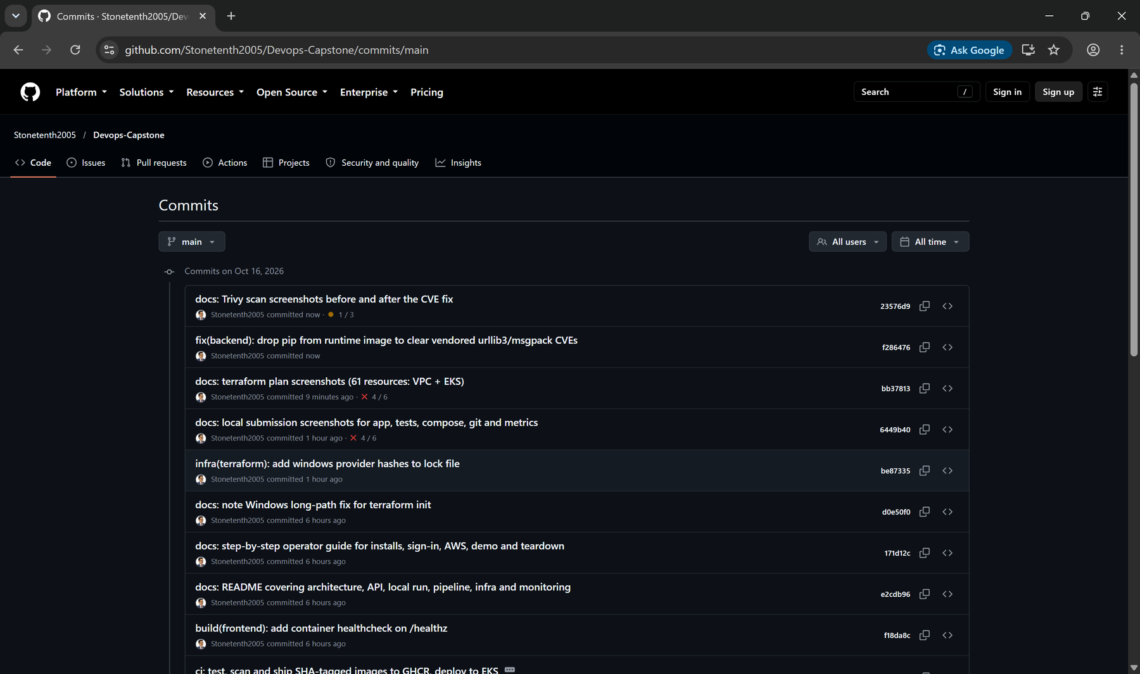
History that tells the story
M3 Git · 5 pts
28
0
commits on main
secrets in history
Conventional prefixes: feat, fix, test, build, ci, infra, deploy, ops, docs
Messages say why: “fix(db): serialise Alembic runs with a Postgres advisory lock”
.gitignore covers .env, __pycache__, node_modules, .venv, *.tfvars, Terraform state, kubeconfigs
Public repo: github.com/Stonetenth2005/Devops-Capstone
Notes:
Each commit is one logical change, so the log reads like a build diary: app, tests, migrations, Docker, Helm, CI, docs, then the security fixes.

Slide 9

Ship
M4 Docker · M5 CI/CD · M6 DevSecOps

Slide 10
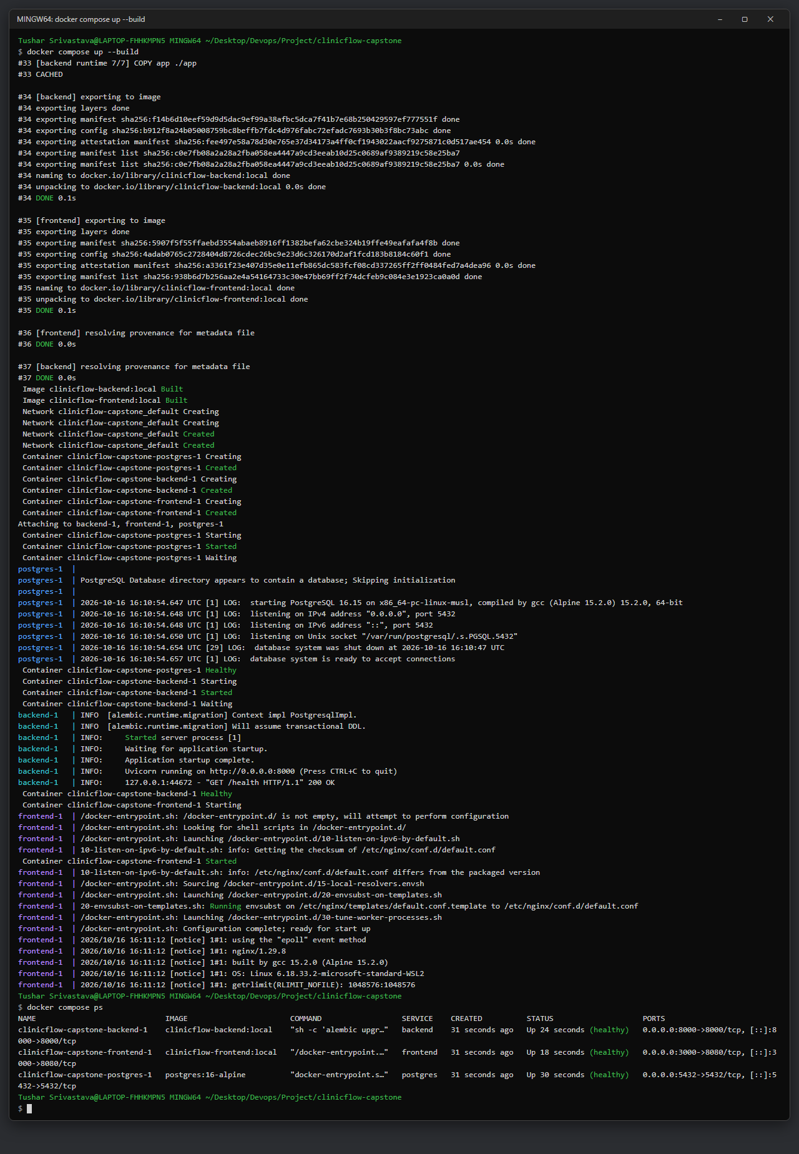


Small, non-root images
M4 Docker · 10 pts
Backend
uid 10001 · appuser
Build python:3.12-slim creates a venv
Runtime slim image with only venv + code; alembic upgrade, then Uvicorn
Frontend
uid 101 · nginx
Build node:22-alpine runs npm ci && npm run build
Runtime nginx-unprivileged serves dist/ on :8080, proxies /api
docker compose up --build
postgres, backend and frontend start with healthchecks; UI on localhost:3000
All three services up from one command
Notes:
Both Dockerfiles are multi-stage so build tools never reach the runtime image, and both run as non-root. Compose waits on Postgres health before starting the backend.

Slide 11
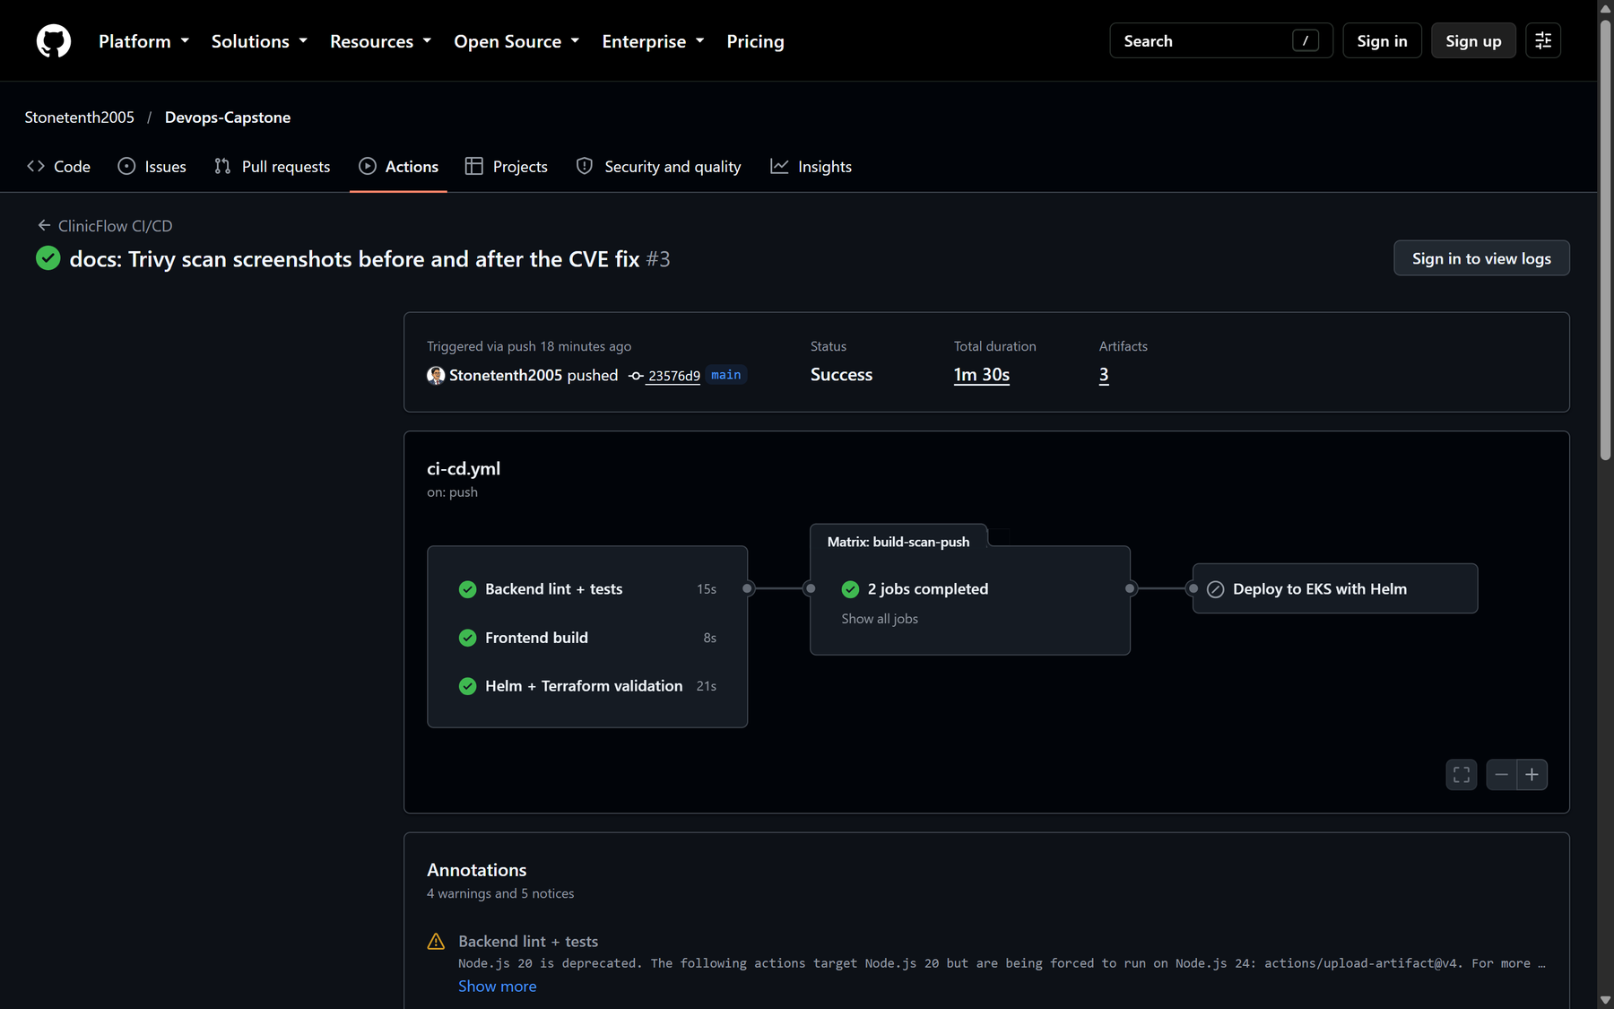
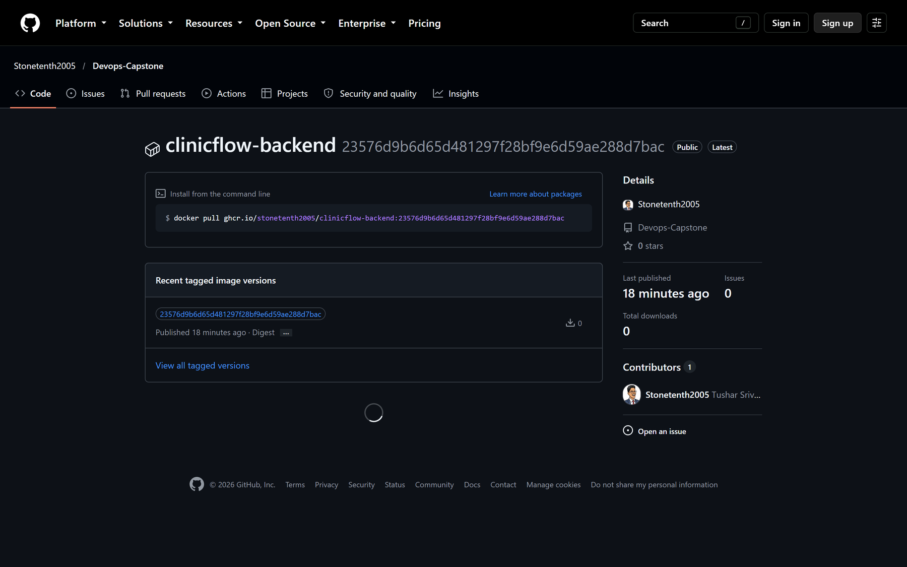
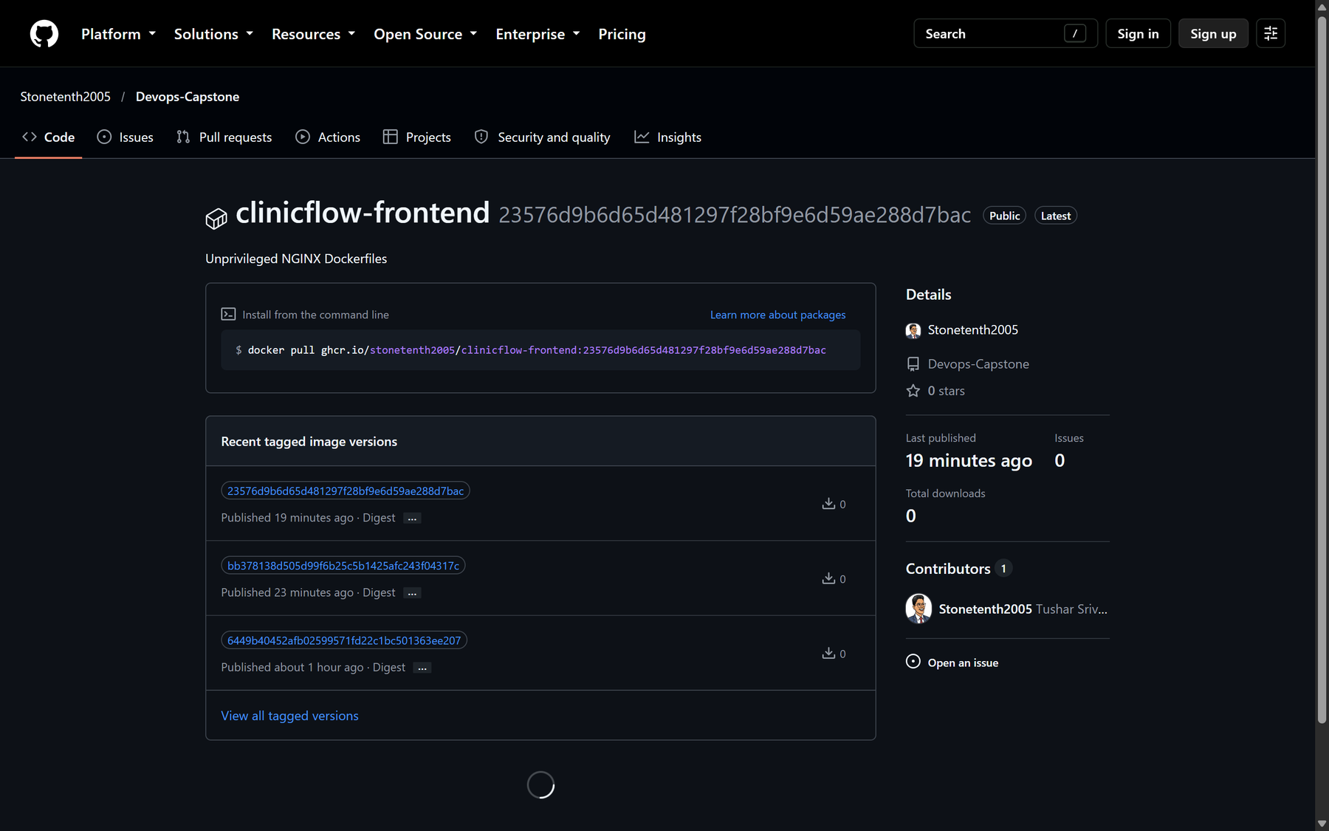

Every push to main, automated
M5 CI/CD · 15 pts
1
backend-test
ruff + pytest; any failure stops the run
2
frontend-build
npm ci && npm run build
3
iac-validate
helm lint/template, terraform fmt + validate
4
build-scan-push
matrix: backend, frontend → Trivy → GHCR
5
deploy
aws eks update-kubeconfig, helm upgrade --wait
Tag = Git commit SHA, never latest: every pod traces back to one commit
Notes:
Tests come first so a broken build never produces an image. Pull requests build and scan but never push. The deploy job targets EKS and is switched on by the DEPLOY_ENABLED repo variable, so the cluster only costs money while it is needed.

Slide 12
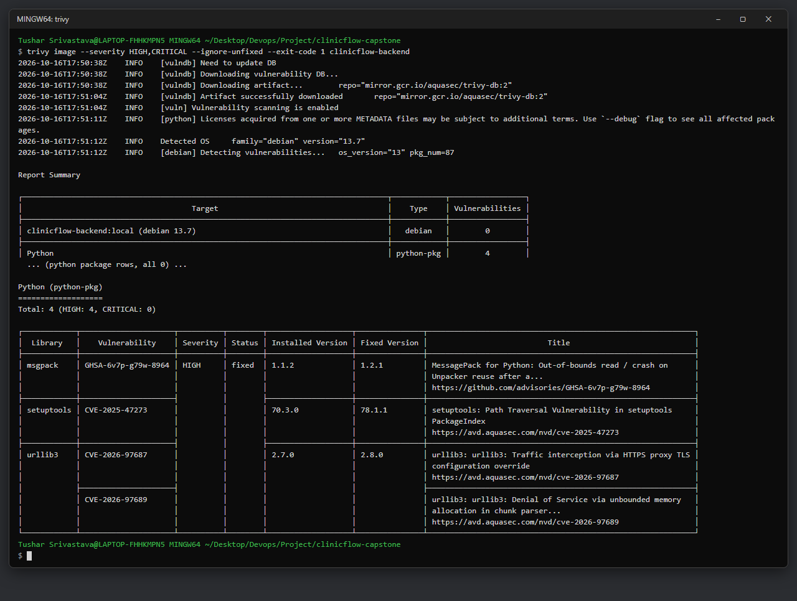
The Trivy gate did its job
M6 DevSecOps · 5 pts
4
0
HIGH CVEs in backend, runs #1–#2 failed
fixable HIGH/CRITICAL in both images, run #3 green
What was found: CVE-2026-97687 in urllib3 2.7.0, where an HTTPS-proxy TLS setting can be overridden, allowing interception (fixed in 2.8.0). Plus a urllib3 DoS, a msgpack out-of-bounds read and a setuptools path traversal.
Root cause: none were our dependencies; all were vendored inside pip itself.
Fix: uninstall pip from the runtime image, since it is never used at runtime.
Also: Trivy action pinned to a commit SHA (tag hijack CVE-2026-33634)
trivy image --severity HIGH,CRITICAL --ignore-unfixed --exit-code 1
Notes:
Trivy scans the OS packages of both base images and every Python and npm package. The pipeline fails on HIGH or CRITICAL findings that have a fix. Explain urllib3 CVE-2026-97687 and why removing pip, rather than bumping a version, was the right fix.

Slide 13
Run
M7 Terraform · M8 Kubernetes and Helm · M9 Observability

Slide 14
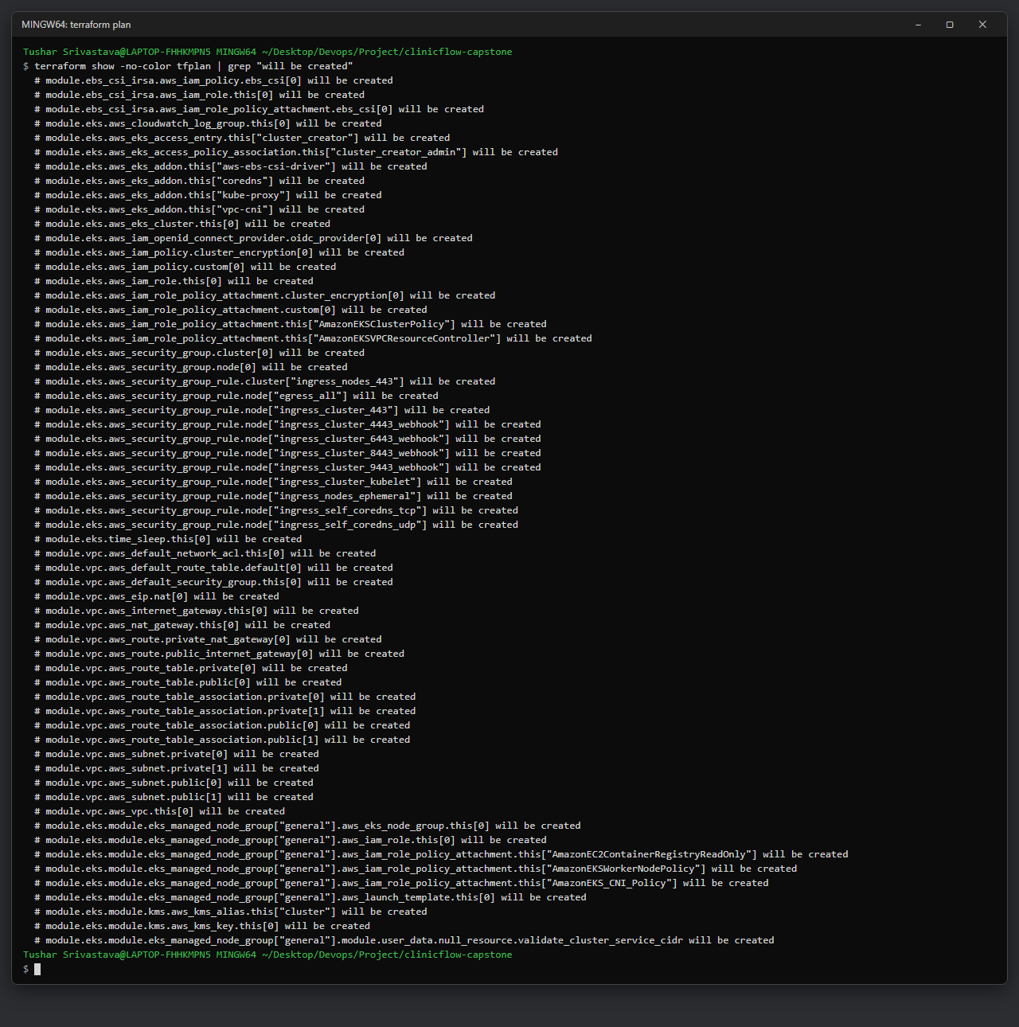

AWS infrastructure as code
M7 Terraform · 15 pts
61
2 + 2
resources in terraform plan
public + private subnets, ap-south-1
VPC
10.30.0.0/16 · 2 public subnets (tagged for load balancers) + 2 private, across 2 AZs · one NAT gateway
EKS clinicflow-dev-eks
AL2023 managed node group, 2× t3.medium · CoreDNS, kube-proxy, VPC CNI
EBS CSI driver + IRSA
Postgres gets a real gp3 disk; only terraform.tfvars.example is committed
terraform init → validate → plan: no errors
Notes:
Everything is variable-driven HCL using the community VPC and EKS modules. The workflow is init, plan, apply, update-kubeconfig, and terraform destroy straight after grading because EKS and NAT bill hourly.

Slide 15
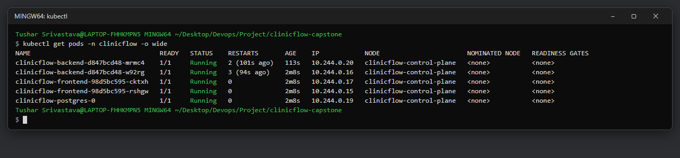
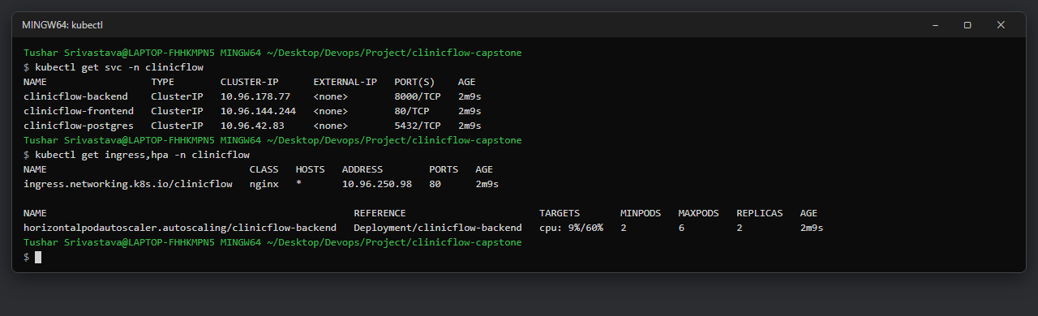
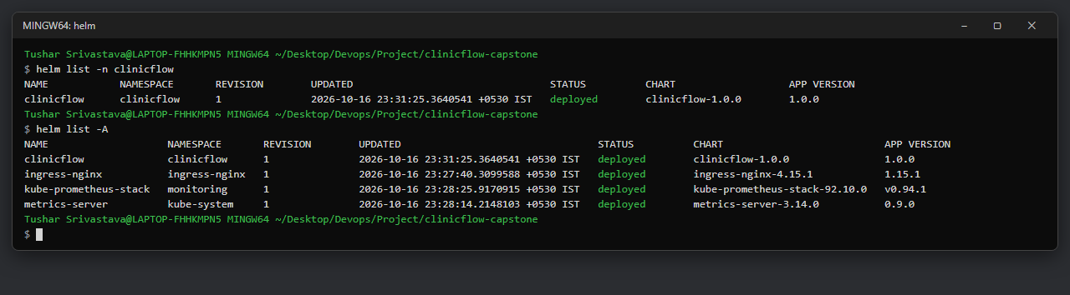
Deployed with one Helm chart
M8 K8s + Helm · 15 pts
Backend Deployment
2+ replicas, HPA 2–6 at 60% CPU, startup / readiness / liveness probes
Frontend Deployment
2 replicas behind a ClusterIP Service
Postgres StatefulSet
5 Gi PVC, credentials from a Secret
Ingress (nginx)
/api → backend :8000, / → frontend :80
Pods run non-root, no privilege escalation, all capabilities dropped
Notes:
helm upgrade --install deploys Deployments, Services, Ingress, HPA, StatefulSet, ServiceMonitor and the Grafana dashboard ConfigMap. kubectl get pods shows two backend and two frontend pods Running plus postgres-0. values-dev.yaml targets a local kind cluster, values-prod.yaml targets EKS.

Slide 16
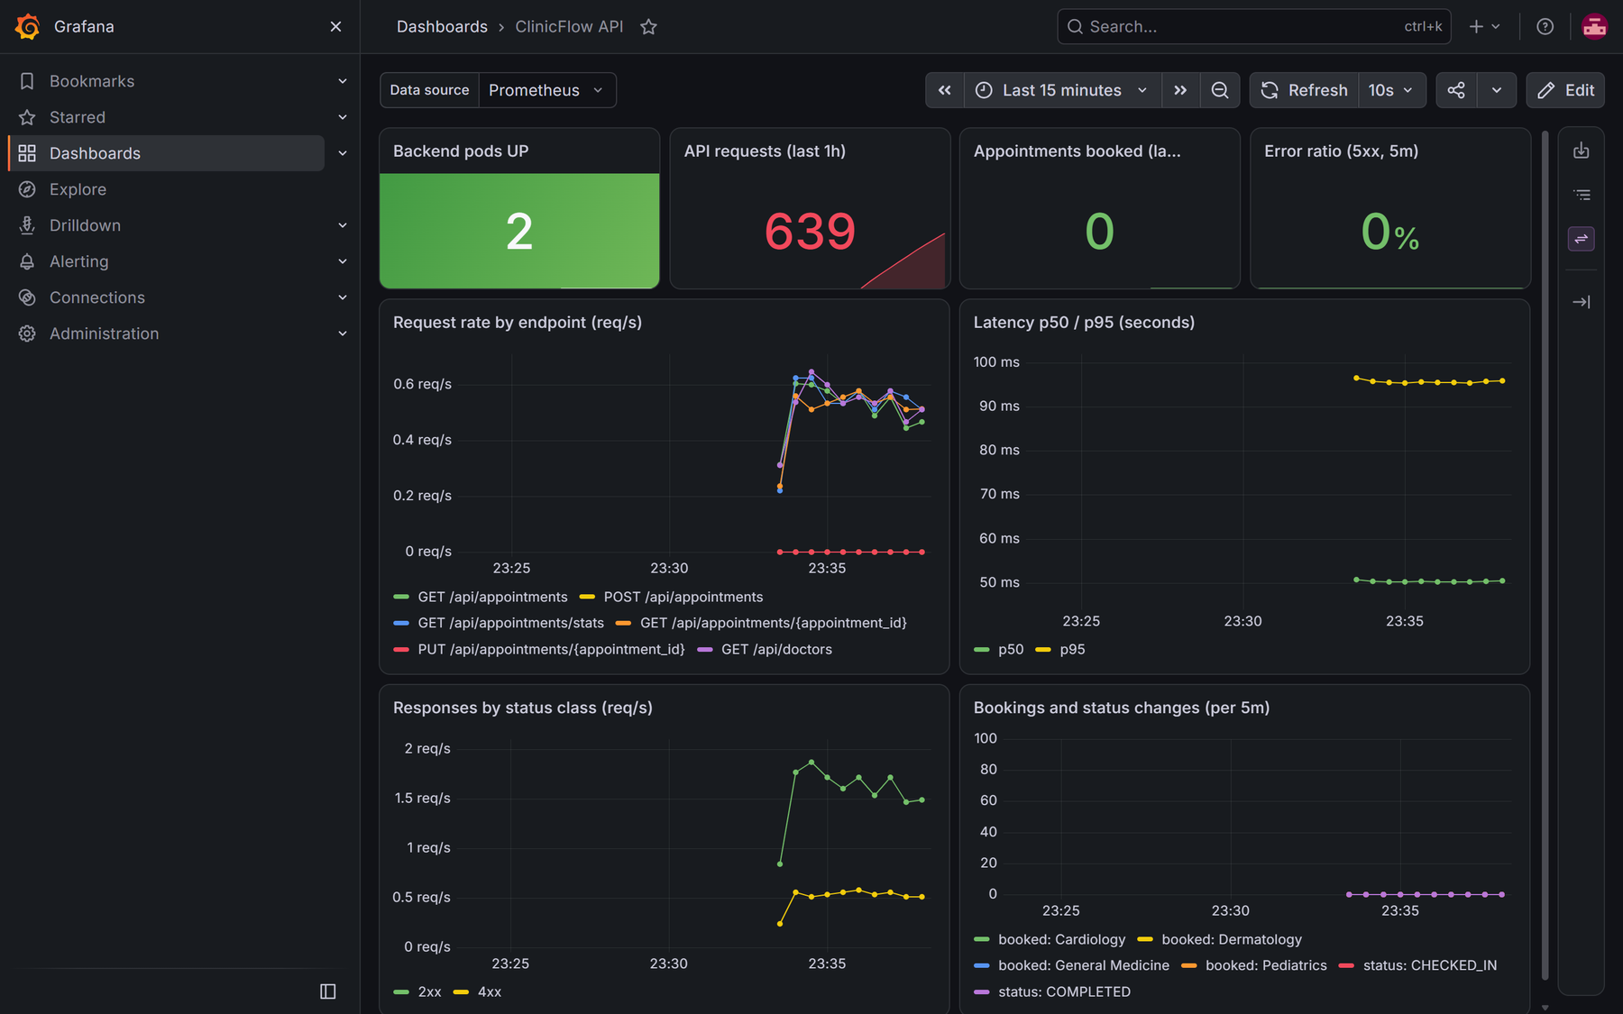
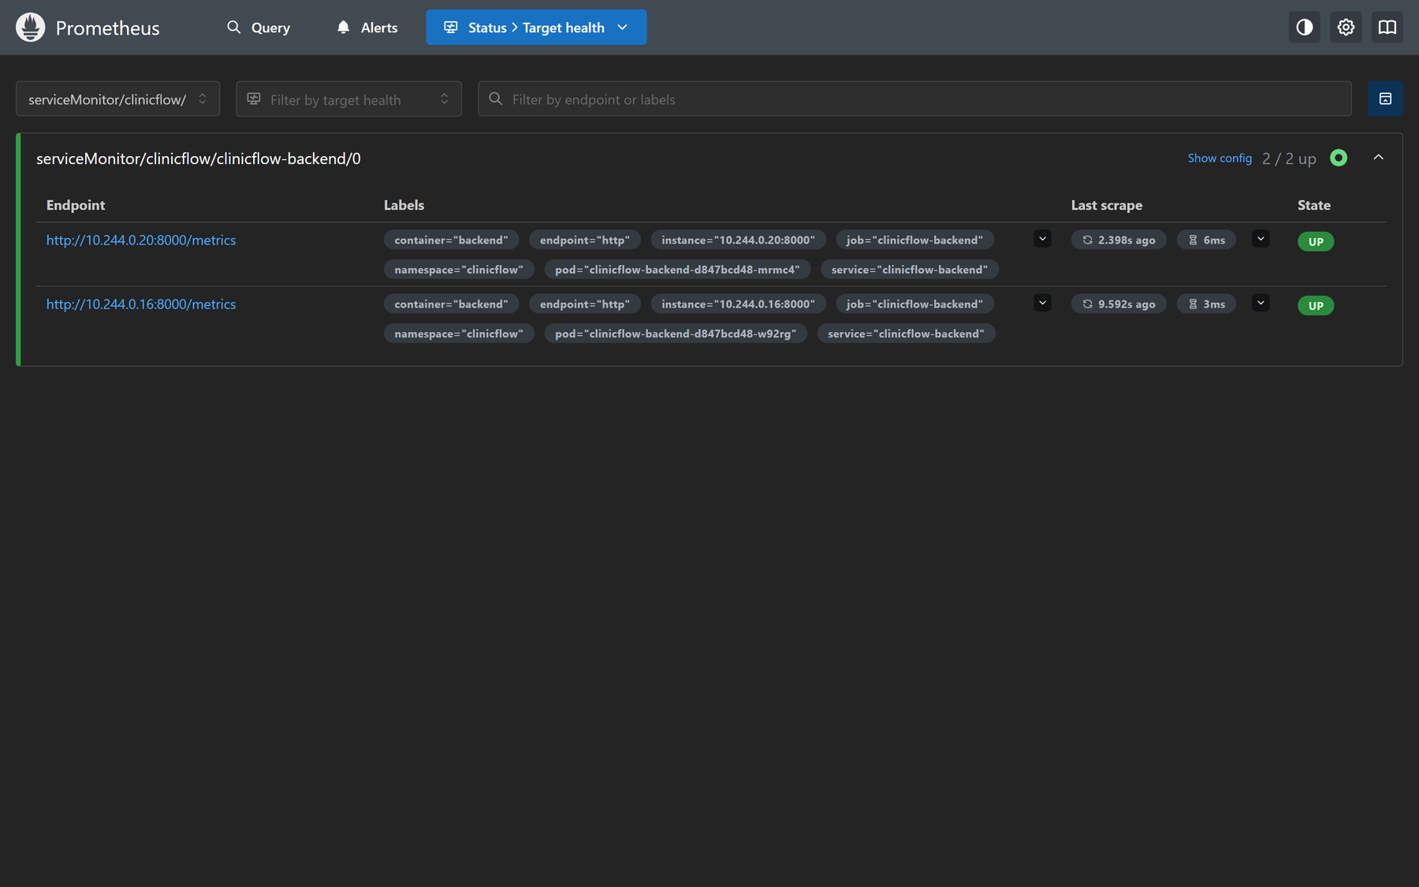
Live metrics, not guesses
M9 Observability · 10 pts
/metrics http_requests_total, http_request_duration_seconds
Business metrics appointments booked by specialty, status changes
kube-prometheus-stack ServiceMonitor scrapes the backend; target is UP
Grafana 8 panels: pods up, requests, bookings, 5xx ratio, rate per endpoint, p50/p95 latency
ClinicFlow API dashboard under load from scripts/load-test.sh
Notes:
Show /metrics output, the Prometheus Targets page with the backend UP, then the Grafana dashboard while the load-test script runs: request rate per endpoint, latency p50 around 50 ms and p95 under 100 ms, 0% errors.

Slide 17
Live demo: commit to running pods
M10 Demo · 5 pts
1
2
3
4
5
6
7
Book
Use the app through the Ingress; a double booking returns 409
Commit
Change the dashboard heading, push to main
Gate
Tests pass, Trivy fails on CVE-2026-77214 (libexpat): nothing ships
Fix
CI now pulls the base image and rebuilds the runtime stage
Green
New run passes; SHA-tagged images land in GHCR
Roll out
helm upgrade to the new SHA: zero-downtime rolling update
Observe
Prometheus targets UP, Grafana dashboard live
Recorded walkthrough: demo/clinicflow-demo.mp4 (4 min 51 s)
The deploy job targets EKS and stays off while DEPLOY_ENABLED is false, so the same Helm upgrade runs against a local kind cluster in the video.
Notes:
This is the M10 live demo script. Commit b539493 changes the heading; its run fails on the Trivy gate. Commit ac0e34f forces a fresh base image pull and rebuild of the runtime stage, the run goes green, and helm upgrade rolls out the new SHA with no downtime.

Slide 18

What I learned building it
Scan what you ship, not what you install
Caches can hide security fixes
The 4 HIGH CVEs lived in pip’s vendored packages. Removing unused tools from the runtime image beats chasing versions.
A cached apk upgrade layer kept an old libexpat. Pull the base image and rebuild the runtime stage every time.
Pin third-party actions by SHA
Plan for many replicas from day one
Tags can be moved or hijacked, as trivy-action’s were in March 2026. A commit SHA cannot.
Two backend pods ran migrations at once. A Postgres advisory lock serialises Alembic safely.
Notes:
The most useful lessons came from the pipeline failing. Each of these is backed by a commit in the history.

Slide 19

Thank you
Repository
github.com/Stonetenth2005/Devops-Capstone
Demo video
demo/clinicflow-demo.mp4 in the repository
Questions welcome
Evidence
30 screenshots in /screenshots, mapped to M1–M9
Notes:
Close with the links and open for questions. Remind the panel that terraform destroy is run after evaluation.

