Slide 1
Astronomy Town Hall Meeting
Nov. 2016

Slide 2
Topics of Discussion
Astronomy courses / degree requirements
Research opportunities
Astronomy club
Graduate School
Whatever is on your mind

Slide 3
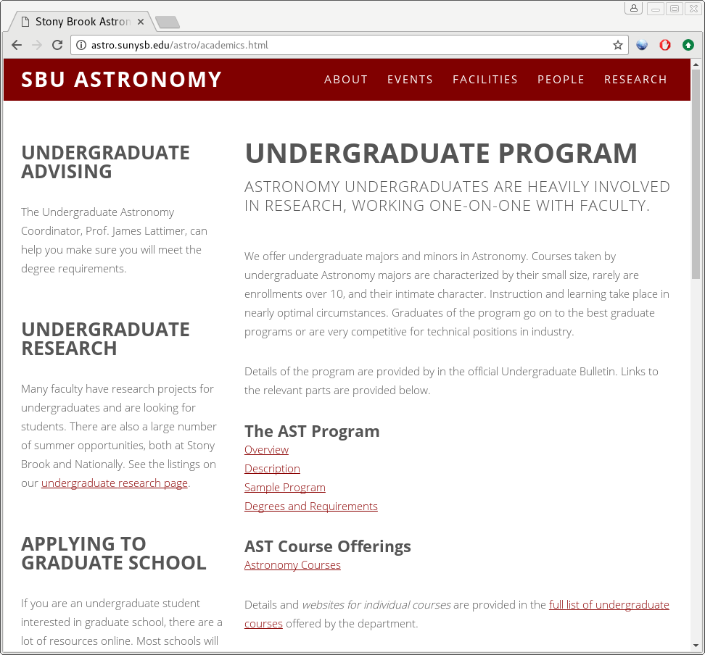
UG Astro Program
http://astro.sunysb.edu/astro/academics.html
Links to the UG bulletin with degree requirements
Links to research opportunities
Information about graduate school

Slide 4
Astronomy Courses
AST 203 offered every Spring; is the prerequisite for most classes
AST 205 offered every Fall (order with 203 doesn’t matter)
AST 34x-level classes offered on a 2-year cycle—plan ahead
Many students take AST 443 (Observational Techniques) to satisfy major requirements
  Can be used in place of the senior Physics lab (PHY 445) if you are a double major (note: if you plan to later do the MAT in Physics, then you will need to take the Physics lab)
Many students also do research or reading classes to satisfy major requirements—plan ahead
  You need to find an advisor who agrees to mentor you for this.
  You may not find someone willing to do 3 credits in one semester.
Physics major and Astronomy major are closely related—many students double major
Talk to Prof. Lattimer for information about the major

Slide 5
Astronomy Degree
Major requirements:
  AST 203
  AST 341 (stars and radiation); AST 346 (galaxies); AST 347 (cosmology)
  6 credits from AST 205 or higher (except: AST 248, PHY 277, AST 301, AST 389, AST 475)
    Popular combinations: AST 443 (observational techniques) + AST 205 (planetary science)
    Either AST 443 or AST 205 + 3 credits/semesters of research
    We will also accept PHY 408 (Modern Relativity) here
  PHY intro sequence
  PHY 251/2 (modern physics)
  PHY 277 (computation)
  PHY 300 (waves)
  PHY 306 (thermal physics)
  8 credits from advanced physics courses
  MAT 131 and 132 or similar sequence
  MAT 203 or 205 or 307 or AMS 261 (calc III)
  MAT 303 or 305 or 308 or AMS 361 (calc IV)
Note: no more than 3 classes with a grade of C– may be applied to the major
Practical note: you need AST 203 by Spring of your sophomore year to finish in 4 years

Slide 6
34x Sequence
AST 341 (Stars & Radiation):
  Fall 2016
  Fall 2018
AST 346 (Galaxies):
  Spring 2017
  Spring 2019
AST 347 (Cosmology):
  Fall 2017
  Fall 2019
AST 349 (special topics):
  Spring 2018
  Spring 2020
proposed

Slide 7
34x Sequence
AST 349: Special Topics
  This course could substitute one of the other AST 34x courses
  Potential topics:
    Black Holes and Neutron Stars
    Computational Astrophysics (follow-on to PHY 277)
    Exoplanets
    Gravitational Wave Astrophysics
    Radio Astronomy
    …
  Thoughts?

Slide 8
PHY 277 as a Prereq?
It has been proposed to make PHY 277 a prereq for the upper level AST classes—thoughts?

Slide 9
Astronomy Degree
In addition to the courses, there is a writing requirement
  Don't wait until the very last semester just before graduation to turn these in...
Students are certified as satisfying the upper-division writing requirement by registering for the 0-credit AST 459 and completing writing projects within their major. All students majoring in Astronomy/ Planetary Sciences must submit two papers (term papers or independent research papers) to the Astronomy coordinator for Department evaluation by the end of the junior year. If this evaluation is satisfactory, the student will have fulfilled the upper- division writing requirement. Papers should be written in the form of a journal article. All papers must consist of an abstract, introduction, main content, and references. References should be cited throughout the text. Any figures should be numbered and have an appropriate caption. If you are using a lab report for the basis of this requirement, you should expand upon the introduction and describe the connection to topical scientific research.
A typical length should be 10 pages (double spaced, 11-point font) plus references, preferably written in LaTeX.
Students should consult with the department advisor to ensure that their plan for completing the Upper Division Writing Requirement is consistent with university graduation requirements for General Education. Students completing the Stony Brook Curriculum (SBC) must complete a course that satisfies the "Write Effectively within One's Discipline" (WRTD) learning objective to graduate. The Upper Division Writing Requirement is consistent in most cases with the SBC learning outcomes for WRTD.

Slide 10
Honors
In your Junior year, you can apply to become a candidate for Departmental honors
  Need to complete a thesis as part of your research coursework
  Need to register for AST 447 or AST 487
    You will want to have an faculty mentor lined up at this point.
  Need a GPA of 3.3 or higher in math/natural sciences
Note: in order for your thesis to count as part of your writing requirement you have to submit it separately as a writing requirement paper. This is not automatic.

Slide 11
Research Opportunities
AST 200 (Current Astronomical Research at Stony Brook) is a good way to see what research is taking place here
PHY 277 (Computation for Physics and Astronomy) provides a good basis for the tools you will need to do research
Local opportunities
  Knock on doors
  Talk to fellow students
  Look at the UG section of the Astro Group webpage
UG student office (back of ESS 437) available to research-active students
Course credit:
  AST 287: Introductory Research
  AST 345: Undergraduate Research
  AST 447: Senior Tutorial
  AST 475: Teaching Practicum (not for major credit though)
  AST 487: Senior Research

Slide 12
Local Research Opportunities
From Prof. Lattimer:
  I have a project to upgrade the database I keep of neutron star masses. I want to include properties of the binaries containing the stars, and make some comparative graphs.
  Another project I envision is to model the high-density equation of state in a variety of simple ways to explore the consequences of large neutron star mass measurements for limits to radii and other neutron star properties. This would require a little computational experience like PHY 277.
From Prof. Zingale:
  I have several software development projects for students who have had courses on ODEs and PDEs, and some programming background.
  I am always looking for students who to take the lead on some new simulation projects using existing codes.
From Prof. Walter:
  I have space for undergrads doing analysis of old nova data. AST 203 / PHY 277 required. Desire to learn to program in IDL a plus.

Slide 13
Local Research Opportunities
From Prof. Simon:
  Mike Simon regularly includes undergraduates in his research on the astrophysics of stars much younger than the sun. My current interests include:
    Mass measurements of stars that still retain their circumstellar disks using ALMA data that will, one happy day, finally be taken and mysteriously arrive here.
    Measurements of the effective temperatures of the ALMA targets using observed and synthetic high resolution spectra.
    Calculation of custom evolutionary tracks of young stars using the Modules in Experimental Stellar Astronomy (MESA).
    Identifying very nearby stars younger than about 50 MY suitable for asteroseismological study using data from the extended Kepler (K2) Mission.
  Suitable preparation includes some of the following, not necessarily all found in one individual:
    Astronomy knowledge at least through the AST 203 and or 205 levels.
    Physics through the PHY 131,2 or 141,2, and Modern Physics levels.
    Math or Applied Math at levels required the above.
    A level of comfort with computers such as provided in the Introduction to Computing Course.

Slide 14
External Research Opportunities
NSF REU program
  Provides stipend and travel expenses for ~10 week research experience at a University in the US.
  Previous SBU students went to Hawaii, Harvard, Texas, SF, ...
  Highly competitive
  applications due in Dec./Jan.
Many other summer opportunities exist—look at the UG webpage
Typically application requires: transcript, 2-3 letters of recommendation, statement of interests

Slide 15
Graduate School
Apply during senior year
Both Physics and Astronomy programs and Astronomy/Astrophysics program
Strong application:
  GPA
  Letters of reference
  Research experience
  Physics GREs + general GREs
PhD graduate students are fully supported
  Teaching/research assistant with annual stipend (~$29,000) + tuition waiver
~4 – 6 years to get degree (sometimes shorter, sometimes longer)
If you think you might be interested in graduate school, talk to some of our grad students—they're friendly!

Slide 16
Timeline
Applications are due in winter of your senior year
  You'll hear in March-ish
  Deadline to make a choice is typically April 15th of your senior year

Slide 17
Physics GREs
Dates (https://www.ets.org/gre/subject/register/centers_dates/)
  09/27/14
  10/25/14
  04/18/15
Content (https://www.ets.org/gre/subject/about/content/physics)
  Classical mechanics: 20%
  E&M: 18%
  Optics and waves: 9%
  Thermo and stat mech: 10%
  Quantum: 12%
  Atomic physics: 10%
  Special relativity: 6%
  Laboratory methods: 6%
  Specialized topics: 9%
You may not have had all the upper level courses on these topics by the time you take the exam. Plan your schedule as best as you can and look over the practice exams.

Slide 18
Careers
Astronomy research provides students with the skills to do data analysis, software/algorithm design, and problem solving
  Not every path requires a graduate degree
Career paths
  Academic (all levels: grade school through high school, college & university)
  Industry
    Astro related
    Software
    Financial
    ...
  National observatories
  National Laboratories
  Museums/Planetariums
  Journalism
  ...

Slide 19
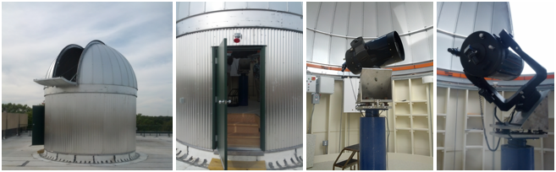
Undergraduate Astronomy Club
Revived ~2010
Run observing sessions
Use rooftop telescope (and know how to use it better than the faculty)
Help with open nights
Annual AstroFest

Slide 20
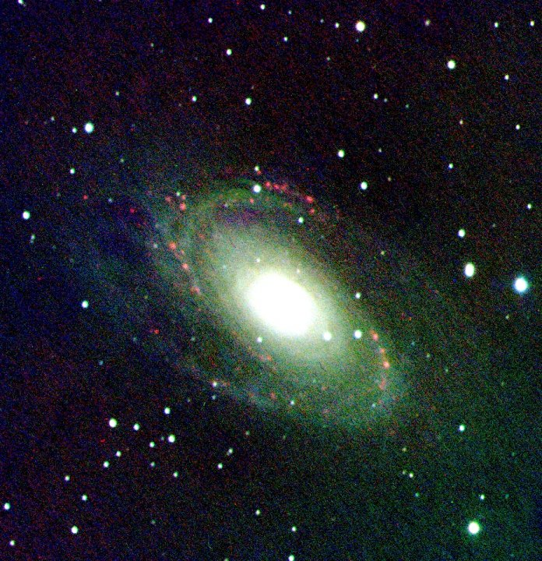
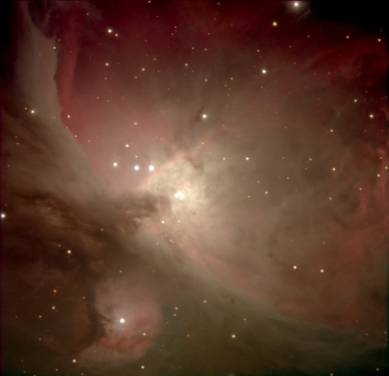
Mt. Stony Brook Observatory
M42: the Orion Nebula (image: Matt Wahl)
Bodes Galaxy (M81), exposed for roughly 40 minutes combined in B, V, and H_alpha filters. (image: Matt Wahl)

Slide 21
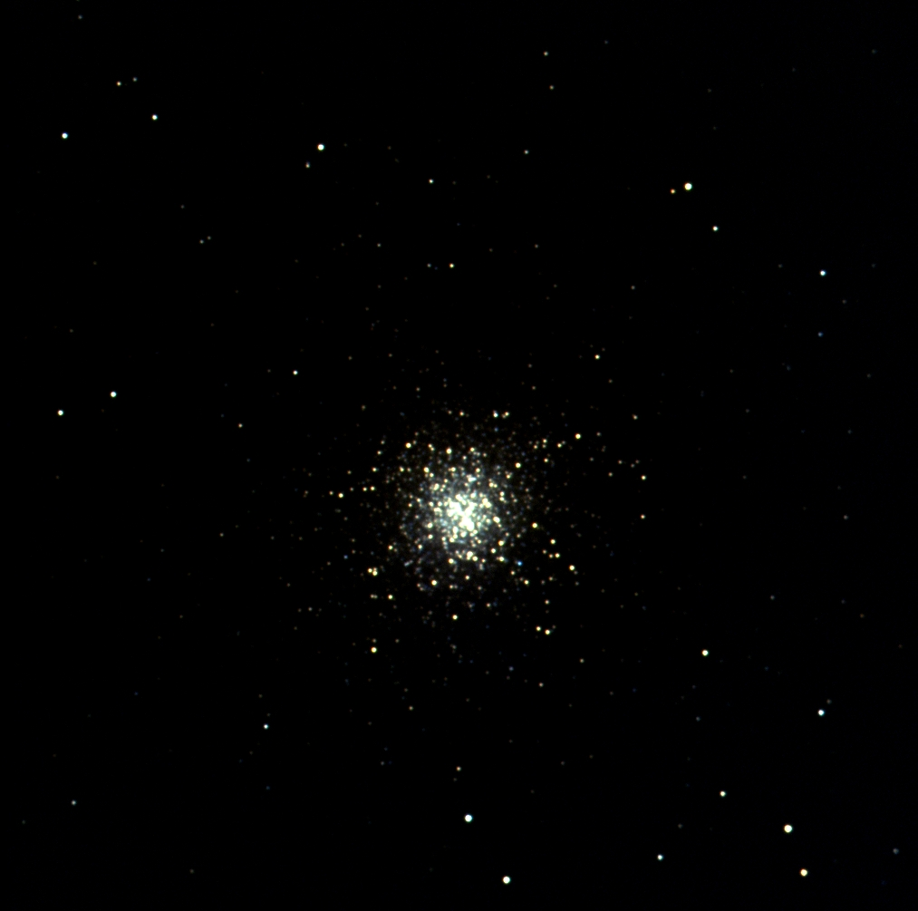
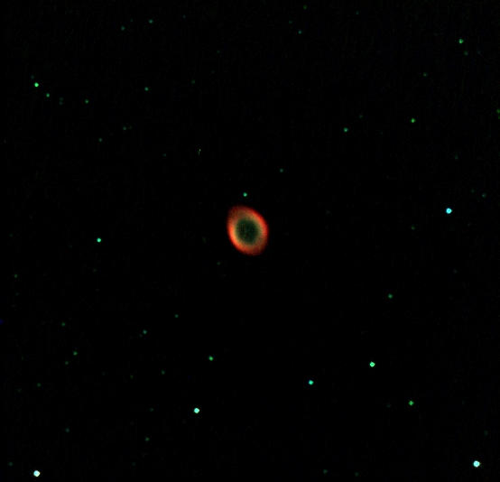
Mt. Stony Brook Observatory
M13: a globular cluster made up of roughly half a million stars, notice the different color stars within the cluster (image: Matt Wahl)
M57: The Ring Nebula—a planetary nebula formed when the exterior layer of a red giant star expands out into space. (20mins each in B V and H_alpha filters; image: Matt Wahl)

