Slide 1
Evaluation of the Impact of IGRT on SSD Measurement
Zhigang (Josh) Xu, Ph.D, DABR (Radiation Oncology Department)
Ruwaifa Anwar, Javad Nejati

Slide 2
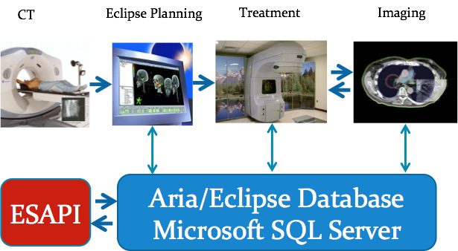
IGRT Procedure
CT (Computed Tomography):
Initial scan of tumor affected body
3D scan captures tumor from different orientations
Size of tumor is measured from center of organ to the boundary of the body
Notes:
Before explaining our work, i’ll describe how Image guided radiotherapy works as it’s important to understand what our project is based. IGRT has four distinct phases
When a person with suspected tumor is brought in hospital. The first thing that phyisicians usually perform is CT imaging.
CT is 3D scan of image from different orientation.
CT Camera is rotated in different anles to measure to capture tumor from different directions
Once a 3D image is generated, the size of tumor is calculated from the center to tumor to the boundary of organ

Slide 3
IGRT Procedure
Planning
From CT scan, Physicians “plan” treatment procedure
Radiotherapy dosage are adjusted accordingly for different points in body
Notes:
Next step is planning phase, The physicians takes feed from CT image and plan how to treat patients accordingly. Different regions can have different growth of tumor and also physicans have to be mindful about depth and surroundings og the tumor. So they carefully plan out the whole treatment plan

Slide 4
IGRT Procedure
Treatment
From planning feeds, radiotherapeutic treatment is exercised for different points of the tumor affected organ
Notes:
Thats; the actually radiontherapy step. The plan provides all the essential details about the treatment process. Dosages are applied accordingly

Slide 5
IGRT Procedure
Imaging
This is done before all treatment phases
3D CBCT images are taken of tumor affected organ
CBCT images are compared with initial CT images
Notes:
This is most important which is done before and after each treatment step.
As already mentioned, a tumor can change its size and shape
How do we compare, go to next slide

Slide 6
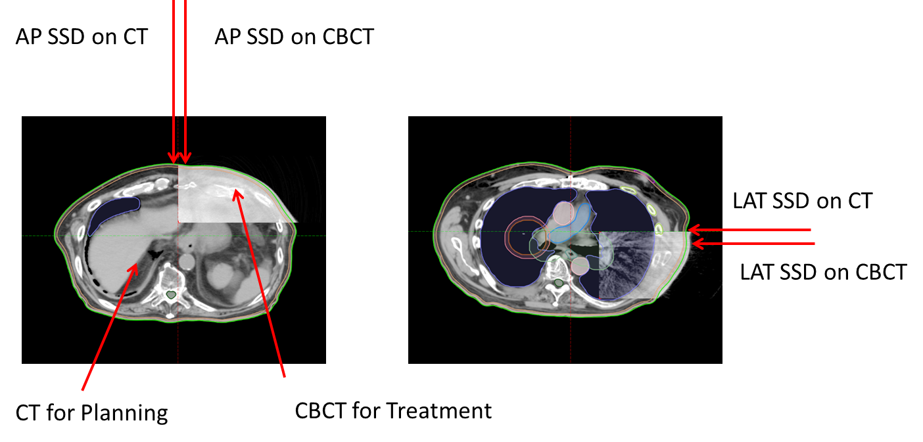
IGRT Procedure
Imaging
CT image is superimposed on CBCT image so that their centers are aligned
Distance from center to organ boundary is calculated for both images
Difference in organ size and shape gives information about change in tumor

Slide 7
Problem
Nowadays, physicians have to calculate this difference manually
CT and CBCT are 3D volume images
Need to find right slice
Position isocenter on both images
Find the difference in lengths
Manually doing all this requires a lot of physicians time
Notes:
Nowadays , alot of steps are done manually, which requires alot of physicians time

Slide 8
Our Approach
ESAPI (Eclipse scripting API) provides limited access to CT and CBCT images and other treatment parameters
Get parameters like isocenter, 2D slice containing isocenter for both CT and CBCT
Superimpose both images using transformation matrix
Find tumor growth/movement automatically without calculating anything manually

Slide 9
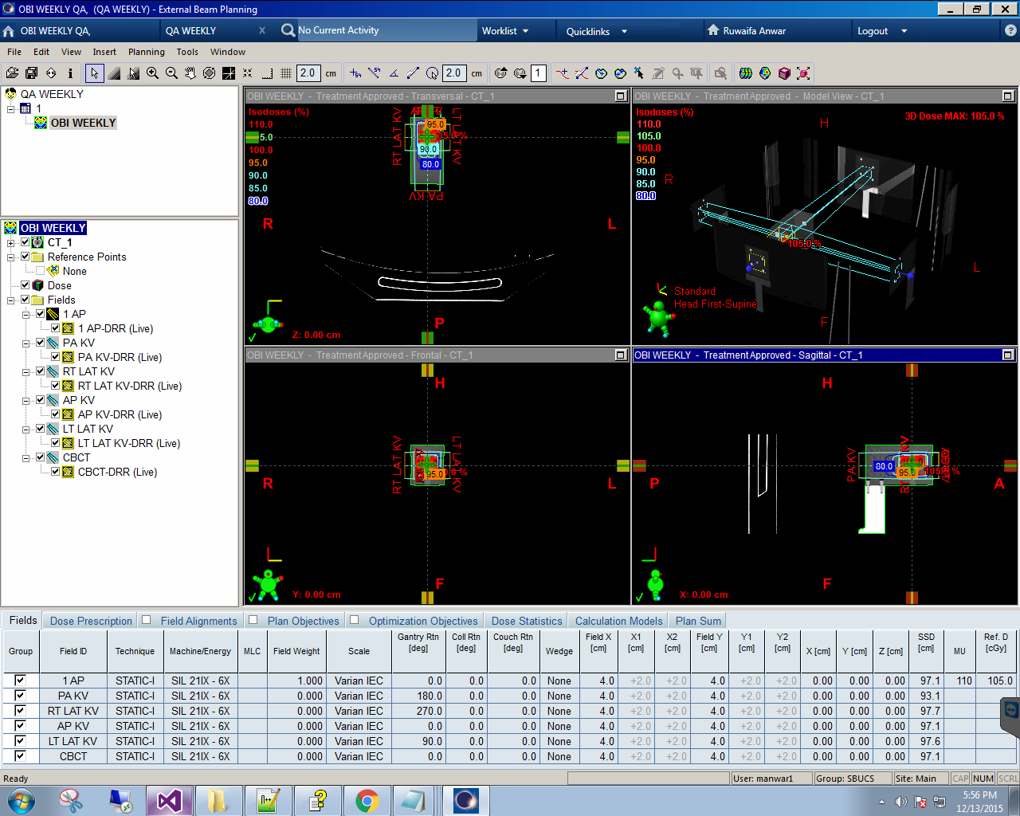
Methodology
Harnessing information through Eclipse Scripting API
Notes:
Not all the info we can see through varian software is accesible directly through API

Slide 10
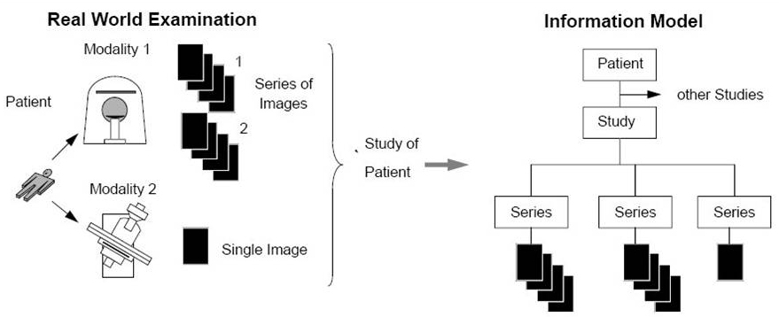
Methodology
Information Model
Patient have multiple studies
Each study has image set or series
Each series has different modality
Modality can be CT, CBCT, Registration etc
A series has collection of images
Images are stored in DICOM format

Slide 11
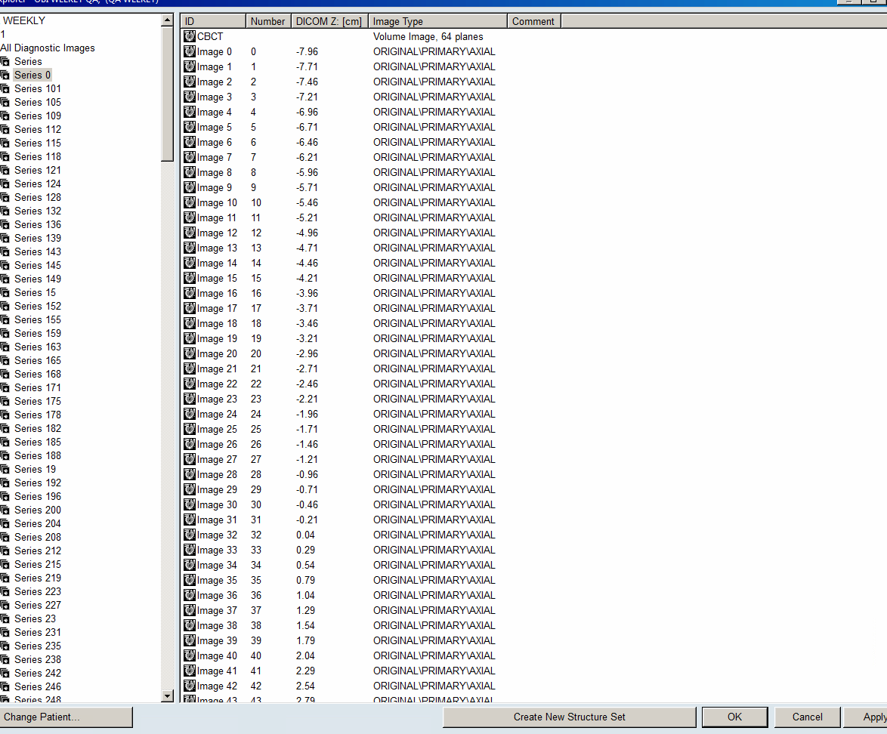
Methodology (Getting right series)
First step is getting to right series
CT and CBCT have same modality number
We needed to isolate CT from CBCT from other parameters like station_name, imaging device, user comments

Slide 12
Methodology (Getting right slice)
Isocenter corresponds to one 2D slice from image volume
We couldn’t directly apply z-coordinate to 3D volume to get right slice across z-axis
From parameters like size of slice, origin across z-axis, we could map user defined isocenter to actual “center” of tumor
Notes:
these paremters were not directly availble in API

Slide 13
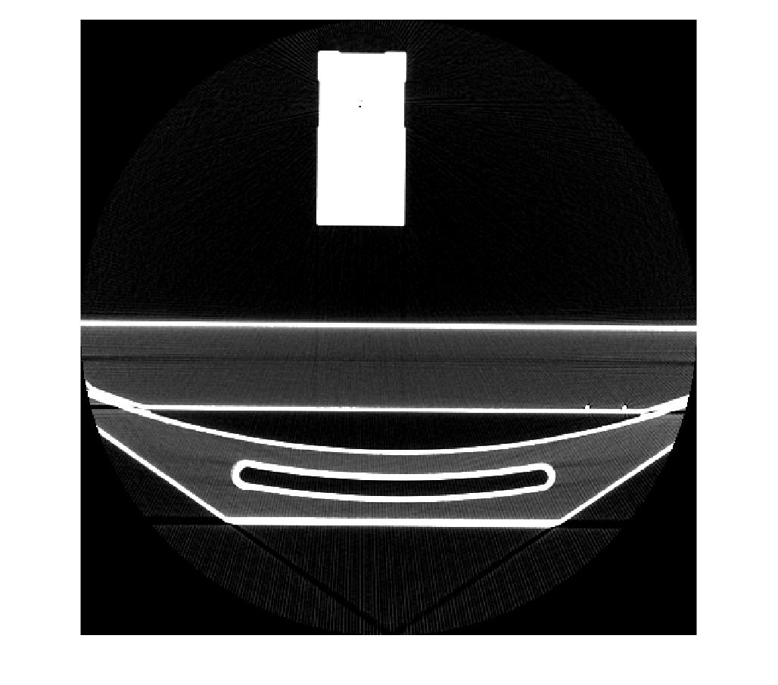
Methodology (Getting image)
We have access to voxels (3D pixels )
We extracted right 2D slice and regenerated only the slice of interest or ROI
Next step is to put isocenter and calculate the distance to the boundary of the organ

Slide 14
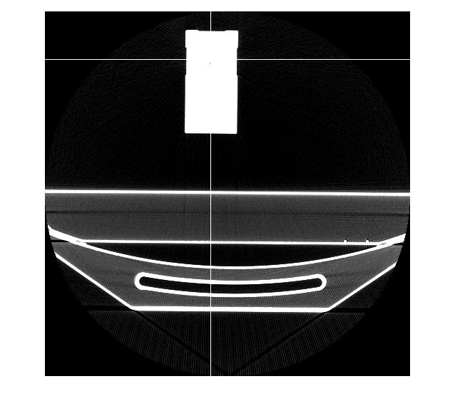
Methodology (Getting the distance)
Converting user coordinates to DICOM coordinates was the next step
Then we needed to find the pixels (then the distance) from isocenter to the boundary of the organ
For that we needed to write some decent edge detection algorithm
Notes:
We confirmed isocenter position with eclipse software

Slide 15
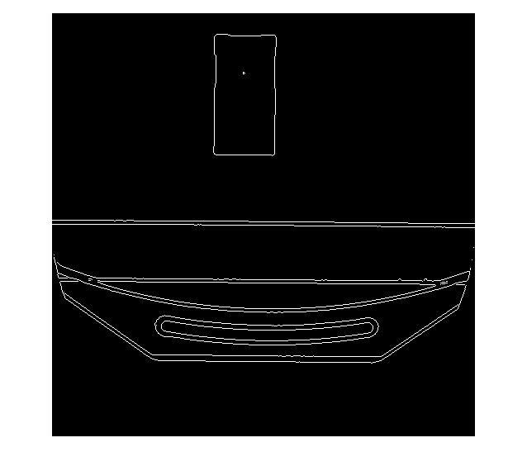
Methodology (Edge detection)
Edge detection was done in three steps
Gaussian Filter (For smoothing and noise removal)
Intensity gradients in both directions
G= sqrt(Gx^2 + Gy^2)
directions = arctan2(Gy,Gx)
-1 | -2 | -1
0 | 0 | 0
+1 | +2 | +1
-1 | 0 | +1
-2 | 0 | +2
-1 | 0 | +1
Notes:
Edge detection might look trivial but it when you have noisy images or images where edges are not well defined due to camera orientations than it can be problem.FIRST step is taking gaussian filter . This is done for smoothing and noise removal
An edge in an image may point in a variety of directions, so we used four filters to detect horizontal, vertical and diagonal edges in the blurred image.
We rounded direction to nearest mutiple of 90 degress

Slide 16
Methodology (Edge detection)
Non Maximum suppression
Edge extracted from gradient values can still be blurred
We suppress all gradient values to 0 except the local maximum
Notes:
After applying gradient calculation, the edge extracted from the gradient value is still quite blurred. but there should be only one response to the edge. Thus we use non-maximum suppression to suppress all the gradient values to 0 except the local maximal, which indicates location with the sharpest change of intensity value. The algorithm for each pixel in the gradient image is:
Compare the edge strength of the current pixel with the edge strength of the pixel in the positive and negative gradient directions.
If the edge strength of the current pixel is the largest compared to the other pixels in the mask with the same direction(i.e., the pixel that is pointing in the y direction, it will be compared to the pixel above and below it in the vertical axis), the value will be preserved. Otherwise, the value will be suppressed.

Slide 17

Methodology (Finding the right distance)
After edge detection, we found shortest distance to the boundaries in both lateral and AP directions
Next step is to repeat this process for CBCT image

Slide 18
Project limitations
It took us around ⅔ of the project’s total time to get the first access to the workstation.
Varian does not support beyond the clinical needs of the users.
There is a small online forum but, usually is limited to basic questions and more specific questions are often left unanswered.
Poor API documentation.
We missed our third team-mate due to first limitation.

Slide 19
Conclusion
We have achieved the main goal of the project which is finding the distance from center of the tumor to patient’s skin (boundary).
We are actively continuing the work to have a good publication.

Slide 20
Q&A

