Slide 1
Free-Space Optics in Data Centers
Acknowledgement for Slides: Navid Hamed Azimi

Slide 2
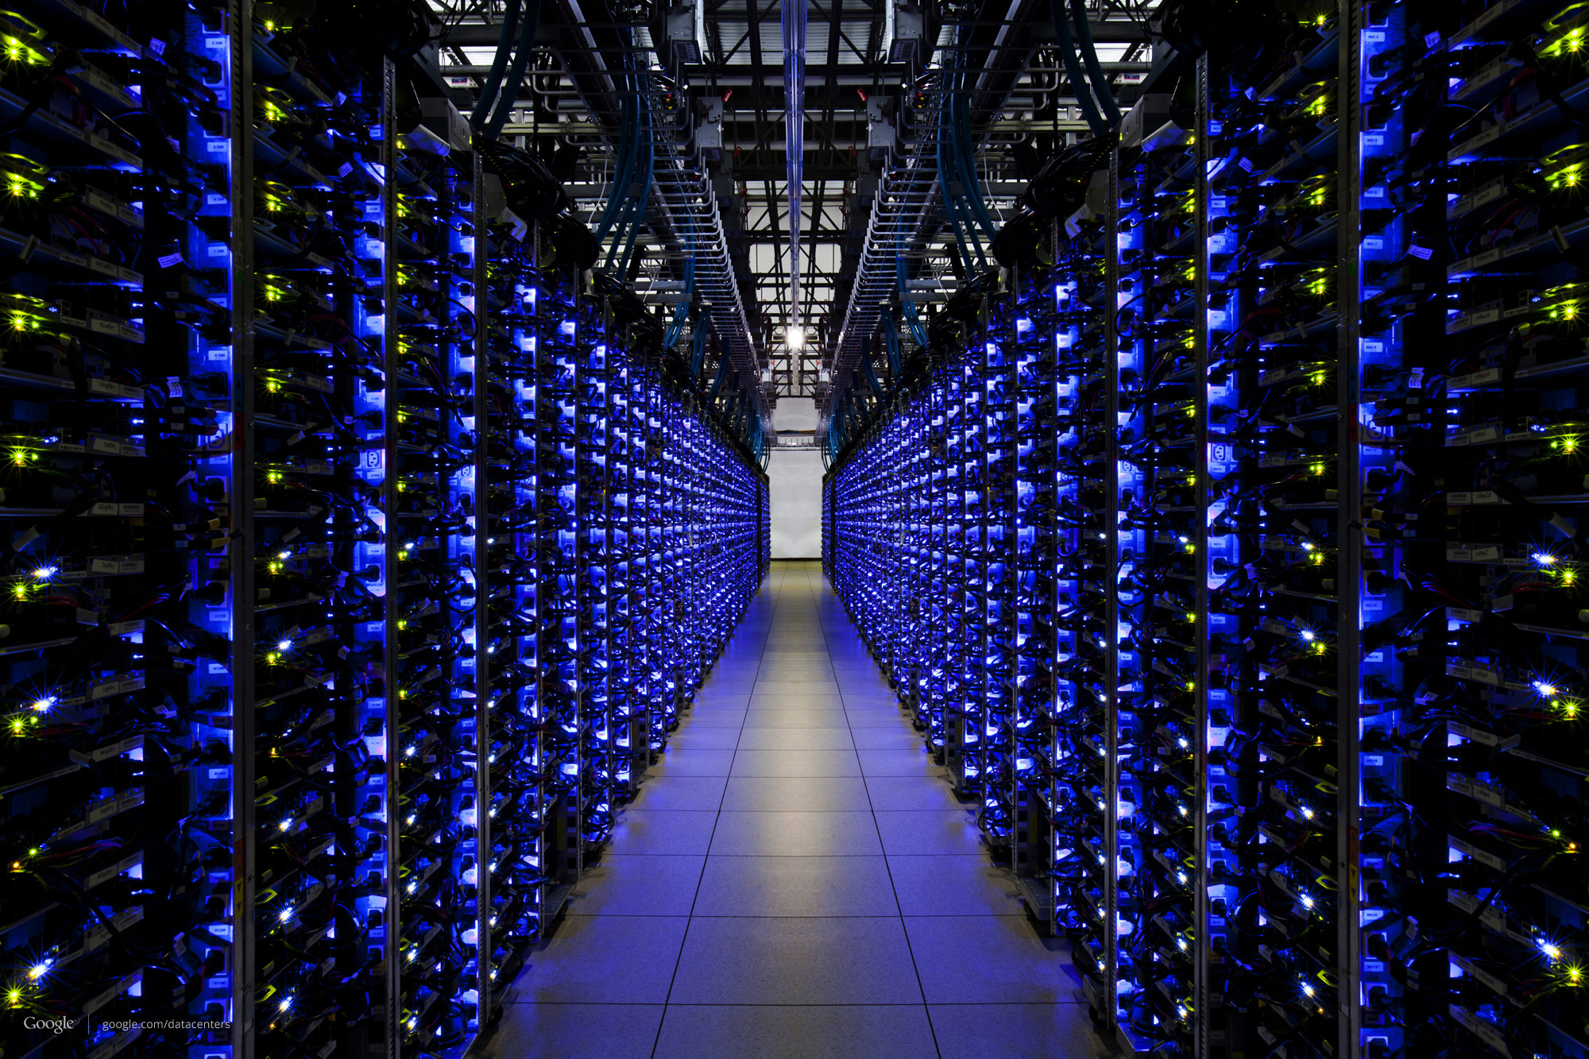
Datacenter network design is hard!
Performance
Cost
Energy
Cabling
Expandability
Cooling
Adaptability
Notes:
Transition to the next

Slide 3

Existing Choices
Cost
Core
Top of Rack (ToR)
Over subscribed
(tree, leaf spine,…)
…
Performance
Notes:
VS: – make cost performance higher size .. Move stuff above .. Avoid stuff close to bottom – change upper layers to “core”. Animate the order of appearance

Slide 4
Existing Choices
Cost
Over provisioned
(Fattree, Jellyfish,…)
Core
Top of Rack (ToR)
Over subscribed
(tree, leaf spine,…)
…
Performance
Notes:
VS: please fix slide 4/5 to be in tune with formatting on slie 3

Slide 5
Existing Choices
Cost
Over provisioned
(Fattree, Jellyfish,…)
Core
Augmented
(c-Through , 3D Beam)
Top of Rack (ToR)
Over subscribed
(tree, leaf spine,…)
…
Performance
Notes:
VS: Increase font of can we get here

Slide 6
Existing Choices
Cost
Over provisioned
(Fattree, Jellyfish,…)
Augmented
(c-Through , 3D Beam)
Can we get here?
Over subscribed
(tree, leaf spine,…)
Performance
Notes:
VS: Increase font of can we get here

Slide 7
Our Vision
Core → Coreless
Wired → Wireless
Static → Flexible
…

Slide 8
Potential Benefits of This Vision
Performance
Cost
Coreless
Cabling
Wireless
Cooling
Flexible
Energy
Expandability
Adaptability
Notes:
Transition to the next

Slide 9
Challenges in Realizing the Vision
Flexible wireless links
Network management

Slide 10
Outline
Flexible wireless links
Network management
Feasibility & cost

Slide 11

Traditional RF is not Sufficient
…
Wide beam
High interference

Slide 12
Traditional RF is not Sufficient
…
Wide beam
Difficult to narrow
High interference

Slide 13
Solution: Free Space Optical Links (FSOs)
…
No interference
High throughput
over long range
Easy to narrow beam

Slide 14
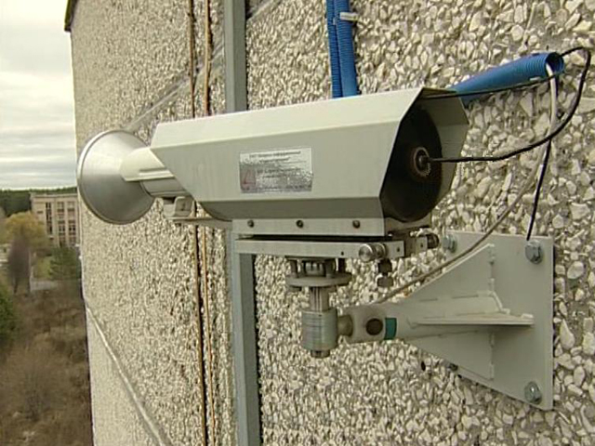
Concerns with FSOs
Cost : $30K
Size : 3 ft³
Power: 60w
Flexibility
Notes:
VS: animate for effect. Show the picture and then emphasize the key things

Slide 15
Why Size, Cost, Power Can be Reduced?
Traditional use : outdoor, long haul
High power
Weatherproof
Data centers: indoor, short haul
Low power
Feasible roadmap via commodity fiber optics
E.g. Small form transceivers (Optical SFP)

Slide 16
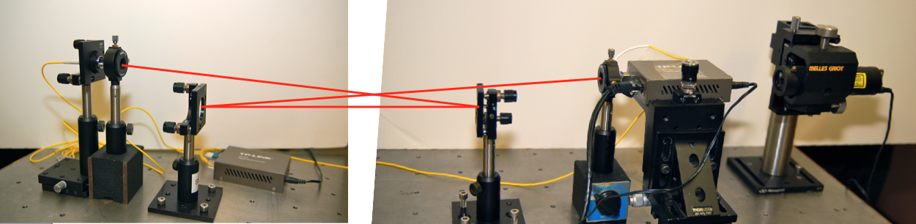
Proof of Concept (1 Gbps) (shown by Navid et.al in Hotnets’13)
Fiber connected
to SFP (TX)
SFP (RX)
Lens
Lens
Mirror
Mirror
SFP : 2x$40
Lens : 2x$30
Notes:
Pause and say the take away (We have build it cheaply with commodity components with small size)

Slide 17
FSO Link Throughput (shown by Navid et.al in Hotnets’13)
PDF
Throughput
FSO link is the same as optical cable

Slide 18
FSO Link Misalignment Tolerance
Effect of vibrations, etc.
Movement tolerance
0.7mm at destination
3mm at source
3 mm
0.7 mm
TX
RX
FSO link is stable

Slide 19
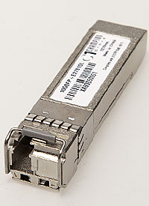
FSOs (1Gbps)
Cost : $30K
Size : 3 ft³
Power: 60w
Flexibility
Cost : $140
Size : 1x4 in
Power: 0.3w
Flexibility
Notes:
Change the architecuter

Slide 20
Flexibility via Switchable Mirror
Switchable Mirror: glass mirror
Electronic control, low latency
Ceiling Mirror
SM in “mirror”
mode
Receiver 1
Reciever2
Sender

Slide 21
Flexibility via Switchable Mirror
Switchable Mirror: glass mirror
Electronic control, low latency
Ceiling Mirror
SM in “mirror”
mode
Receiver 1
Reciever2
Sender
Receiver 1
Reciever2

Slide 22
Outline
Flexible wireless links
Network management
Feasibility & cost

Slide 23
Management: Pre-Configuration
Input: FSO#, SM#,…
Output: Candidate links (Alignment of each SM)
Receiver 1
Reciever2
Sender
23
Notes:
Candidate topology vs Runtime Topology

Slide 24
Management: Reconfiguration
Input: Traffic
Output: Run-time topology
Receiver 1
Reciever2
Sender
24
Notes:
Candidate topology vs Runtime Topology

Slide 25
Current Solutions: Simple Heuristics
Pre-Configuration : Regular Random Graph
Reconfiguration
Only reconfigure for large flows
Only delete a link if network remains connected

Slide 26
Goal
How does FSO-based DC compare in terms of end-end performance with other DC topologies like Fattree, JellyFish, Cthrough, 3-D beamforming etc.?
How do we ensure consistent updates across reconfigurations? Properties we want to satisfy:
No black holes
End-End connectivity
Bounded latency

Slide 27
Evaluation Plan
htsim: packet level simulator
End-End performance comparison with other DC topologies
Consistent updates across reconfigurations
Mininet:
Consistent updates across reconfigurations
fs: flow level simulator
Scalability i.e., end-end performance with >=1000 racks

Slide 28
htsim: End-End Performance

Slide 29
htsim: Dynamics Link and Route Updates

Slide 31
Mininet: End-End Performance

Slide 32
Mininet: Route and Link Dynamics

Slide 33
Mininet: Parameters

Slide 34
FS: Parameters

Slide 35
Fs: End-End Performance

Slide 36
Fs: Scalability

Slide 37
TO DO
Implement consistent update algorithms in htsim and mininet
Properties
No Black Holes
End-End Connectivity
Bounded Latency
End-End Performance with
Packet Scattering
Other Data center topologies
fs: End-End performance tests for 1000 rack topologies

