Slide 1
A15: GAN-Based Synthetic
Handwritten Digit Generation
Amrith Saras | Annabel Marianne Victor | Diya Jothish
102903/CO701B Deep Learning | Rajagiri School of Engineering & Technology
Module 3 - Generative Adversarial Networks

Slide 2
Problem Statement & Objectives
Problem: Generate realistic synthetic handwritten digit images from random noise.
Objectives:
1. Implement a DCGAN (Generator + Discriminator)
2. Train on MNIST - 60,000 greyscale 28x28 digit images
3. Generate novel synthetic digit images
4. Analyse generation quality visually and through loss curves
5. Perform latent space interpolation

Slide 3
How a GAN Works
Two networks in a minimax game:
Generator G: Noise z -> Fake image G(z)
Discriminator D: Image -> P(real) in (0,1)
Objective:
min_G max_D E[log D(x)] + E[log(1 - D(G(z)))]
Nash Equilibrium: D*(x) = 0.5 for all x
-> D cannot distinguish real from fake

Slide 4
Architecture: Fully-Connected GAN
Both Generator and Discriminator use stacked Linear layers (MLP).
Why this design:
- Simple to implement and understand
- No complex convolution/padding/stride arithmetic
- Works well on 28x28 greyscale MNIST images
Key choices:
- LeakyReLU(0.2) in hidden layers -> avoids dead neurons
- Tanh at G output -> matches normalised image range [-1, 1]
- Sigmoid at D output -> produces probability (0 to 1)
Generator: 1,477,136 parameters
Discriminator: 566,273 parameters

Slide 5
Generator & Discriminator Architecture
GENERATOR (noise -> image)
z (64) -> Linear(64->256) + LeakyReLU
-> Linear(256->512) + LeakyReLU
-> Linear(512->1024) + LeakyReLU
-> Linear(1024->784) + Tanh
-> reshape to (1, 28, 28)
DISCRIMINATOR (image -> real/fake probability)
(1,28,28) -> flatten to (784,)
-> Linear(784->512) + LeakyReLU
-> Linear(512->256) + LeakyReLU
-> Linear(256->128) + LeakyReLU
-> Linear(128->1) + Sigmoid

Slide 6
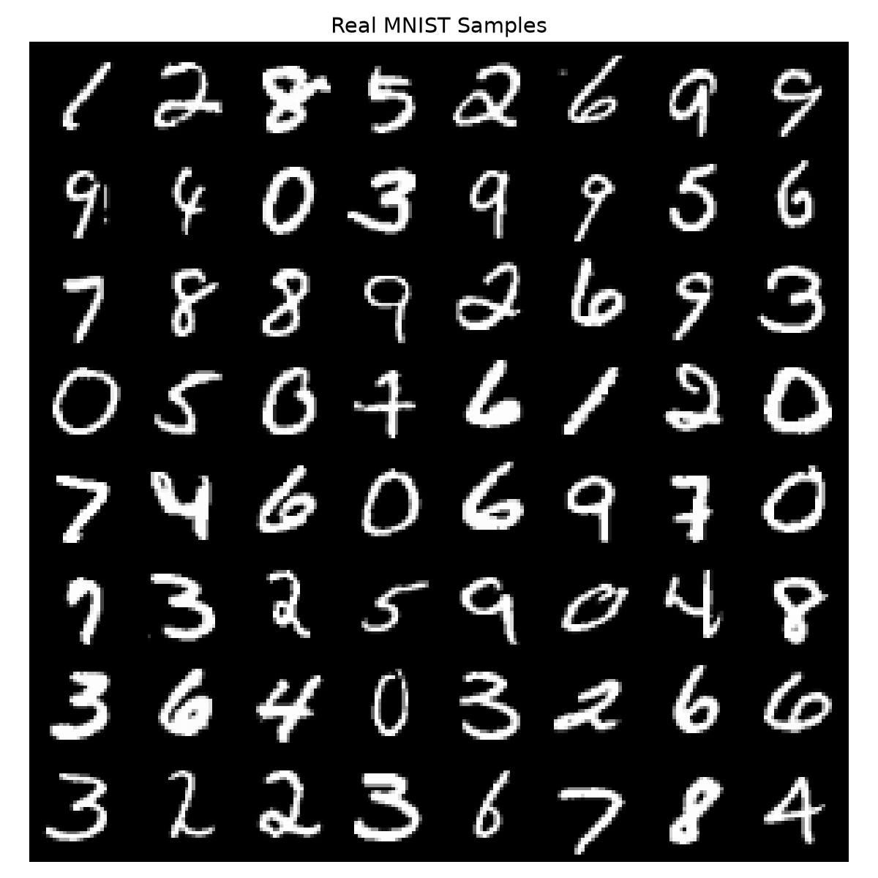
Dataset & Preprocessing
Dataset: MNIST
- 60,000 training images, 10,000 test images
- Greyscale, 28x28 pixels, 10 classes (0-9)
- Source: torchvision.datasets.MNIST (auto-download)
Preprocessing:
- ToTensor(): converts PIL image to [0,1] float tensor
- Normalize([0.5],[0.5]): maps [0,1] -> [-1,1]
(matches Tanh output range of Generator)
- Batch size: 128 | Shuffled each epoch

Slide 7
Experimental Setup
Framework: PyTorch 2.11.0+cu128
Hardware: NVIDIA GeForce RTX 3050 Laptop GPU
Epochs: 50
Batch size: 128
Optimiser: Adam (lr=0.0002) for both G and D
Loss: Binary Cross-Entropy (BCELoss)
Latent dim: 64
Fixed noise (64 samples) used for epoch-by-epoch visual tracking.
Images normalised to [-1, 1] to match Tanh output range.

Slide 8
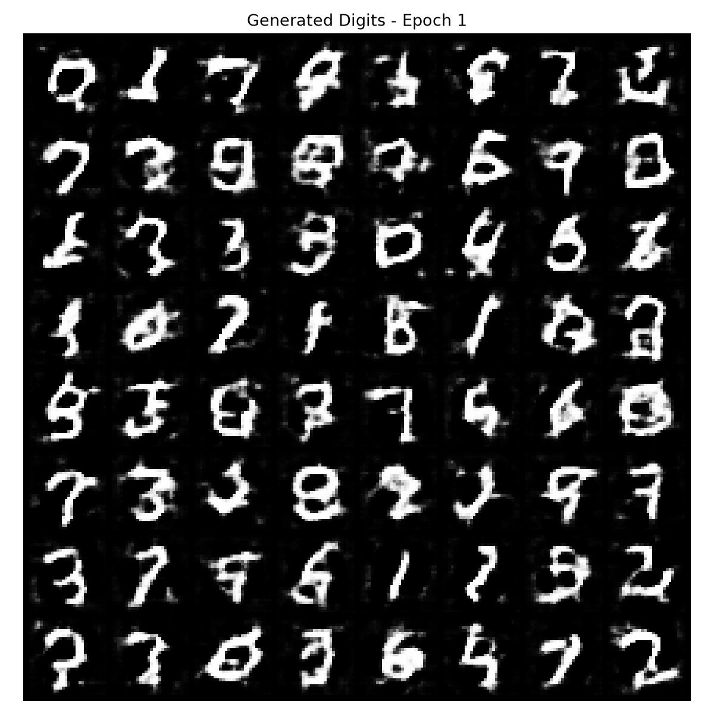
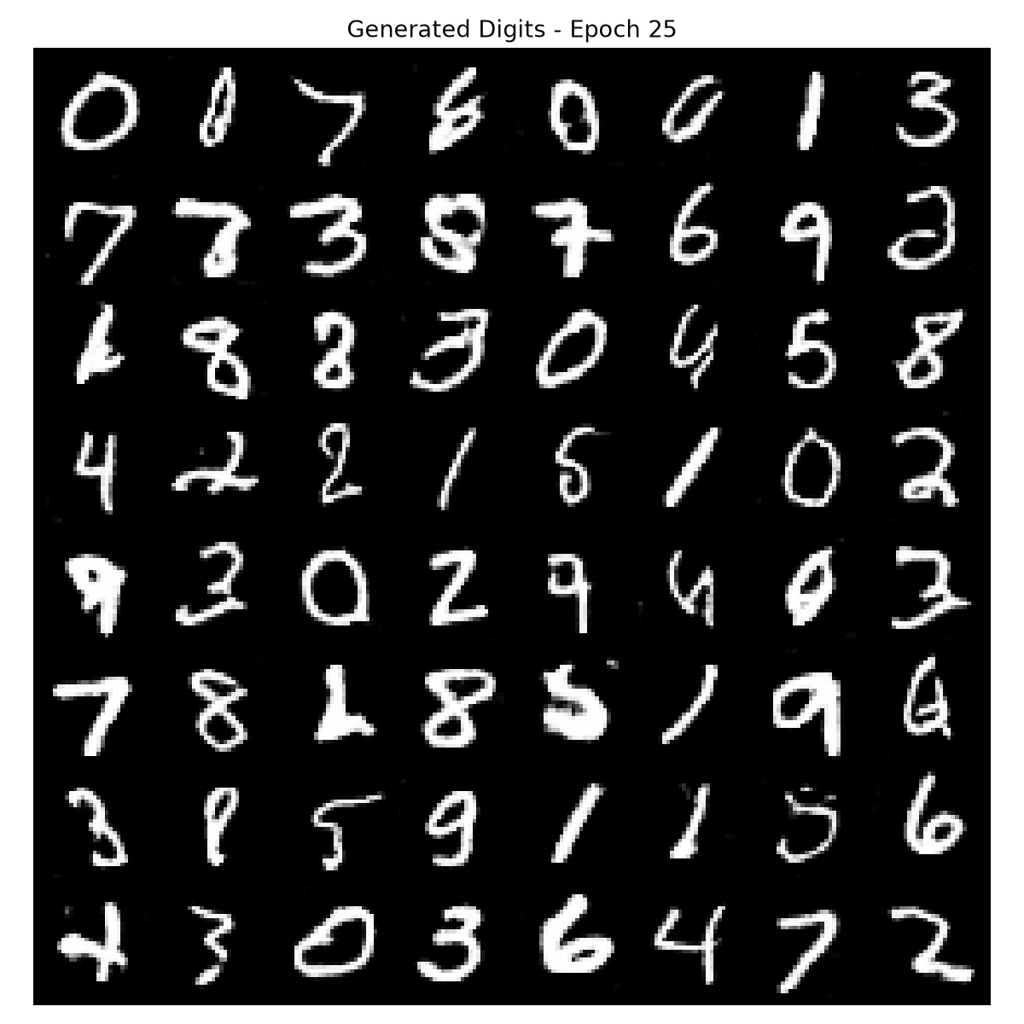
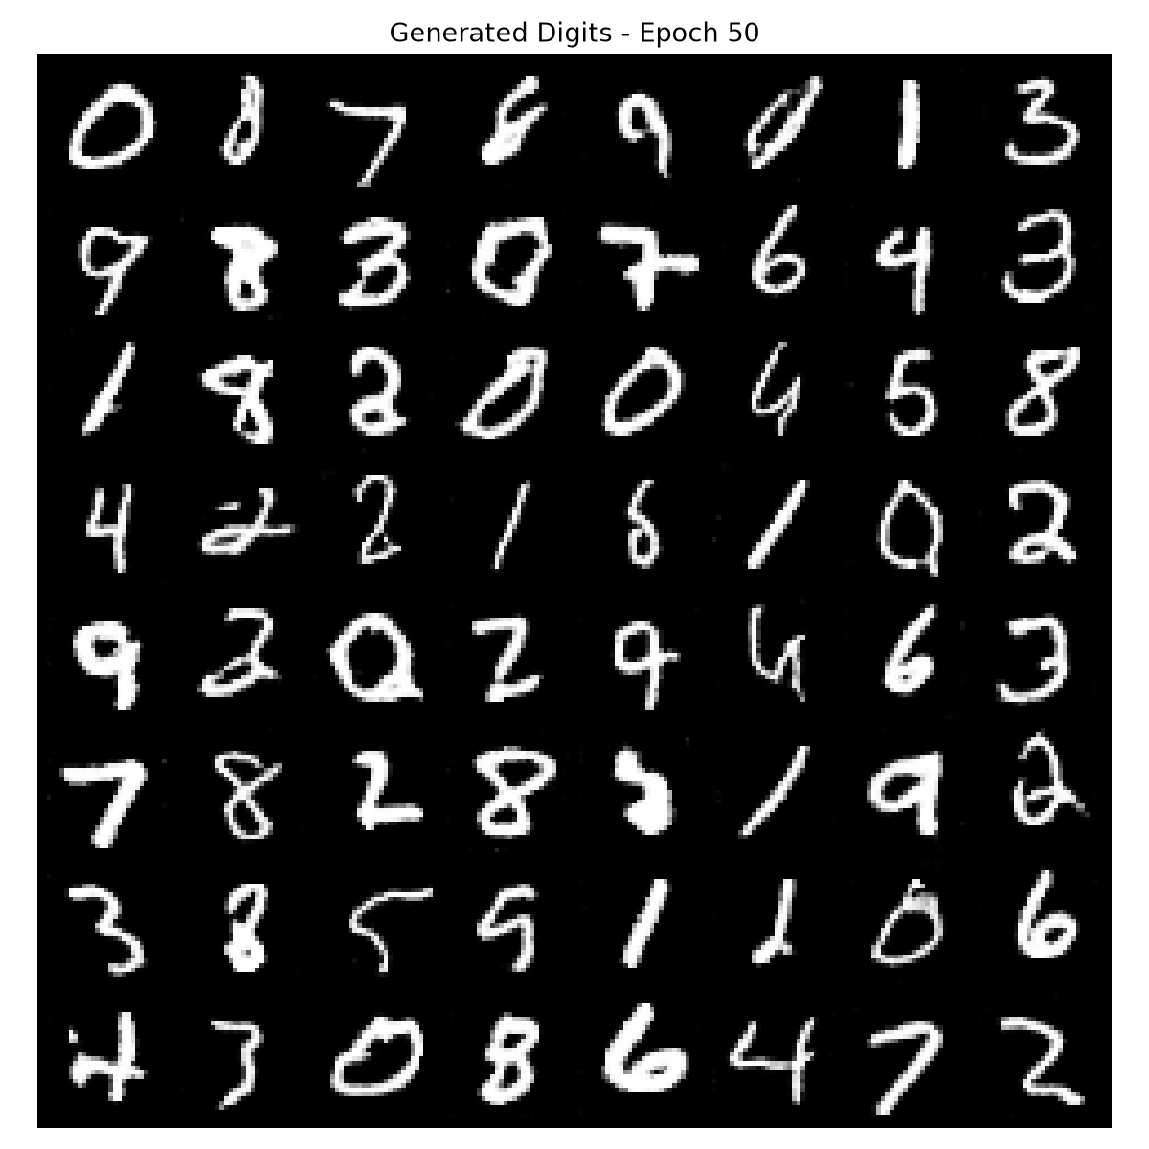
Training Progression
Epoch 1
Epoch 25
Epoch 50

Slide 9
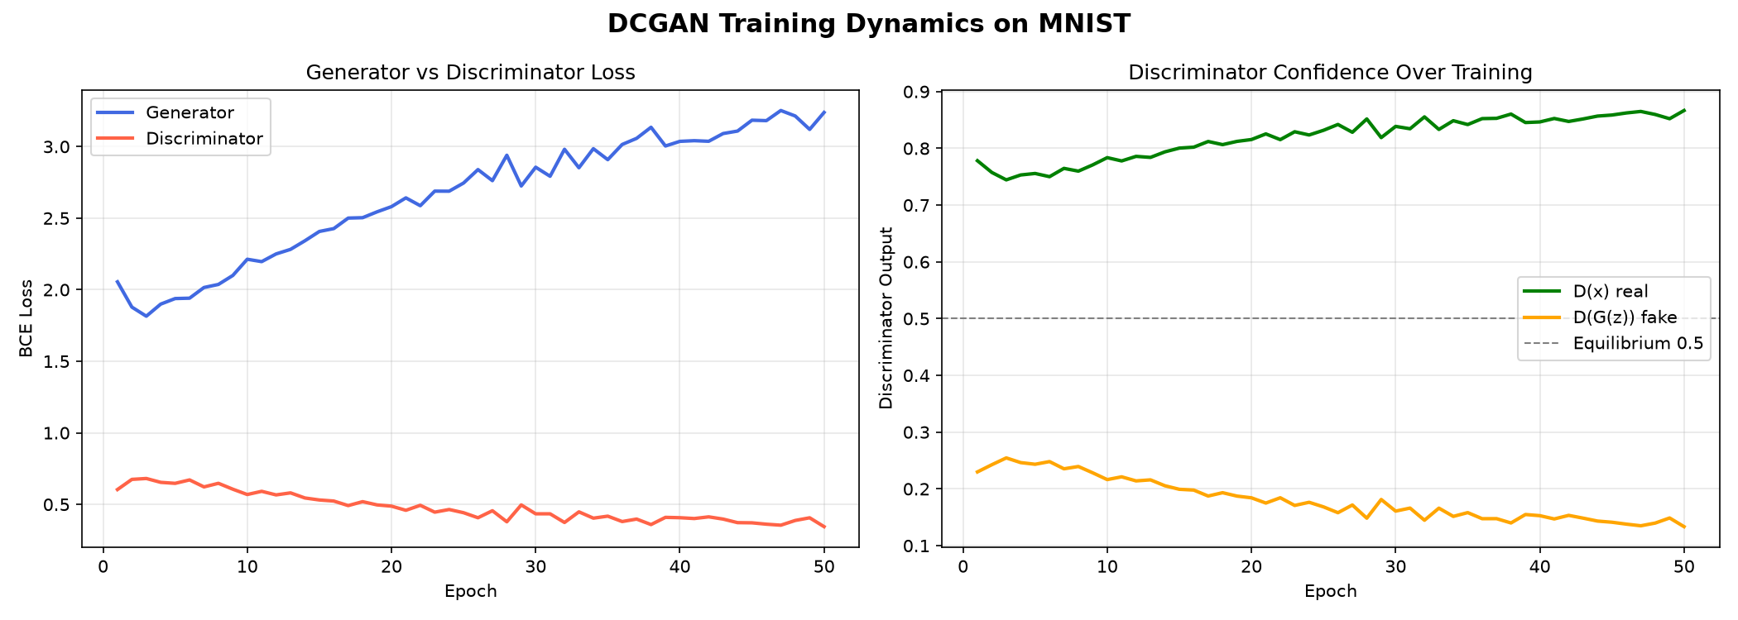
Training Loss Curves

Slide 10
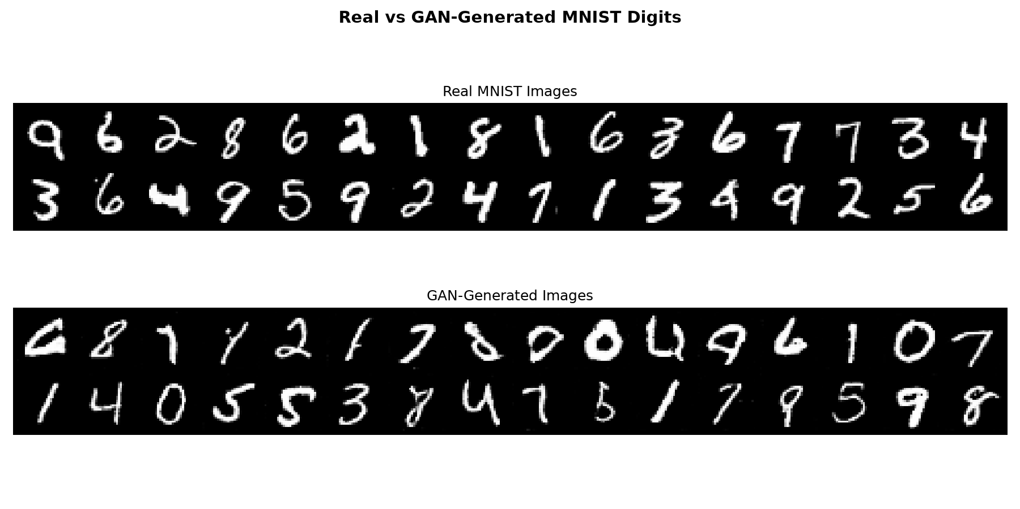
Real vs GAN-Generated Digits

Slide 11
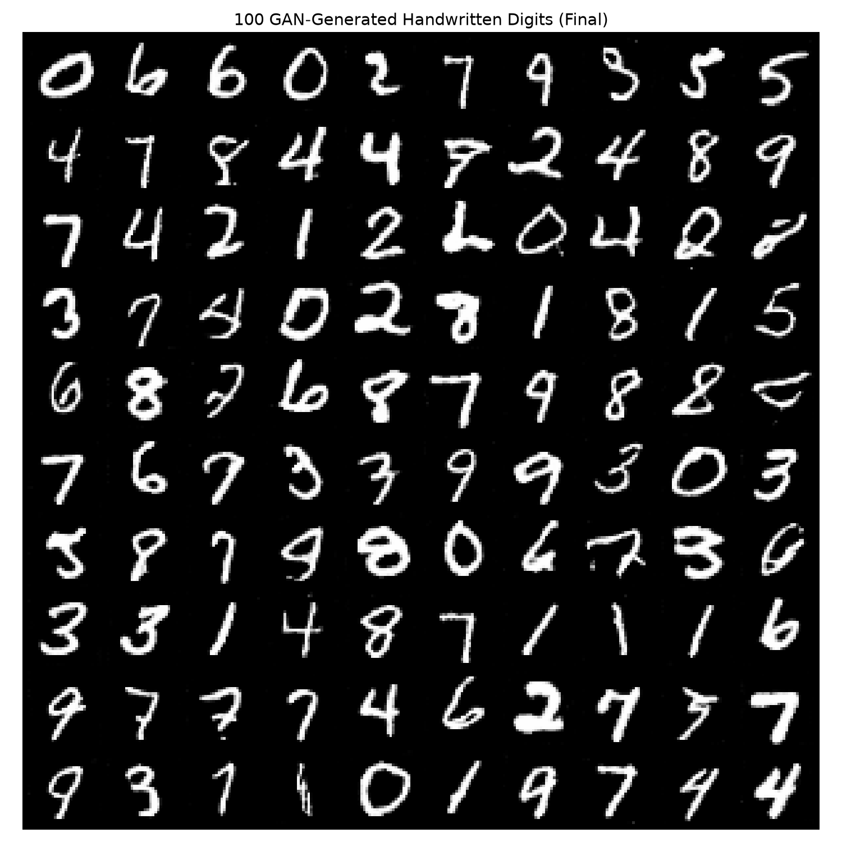
100 GAN-Generated Digits (Final Model)

Slide 12
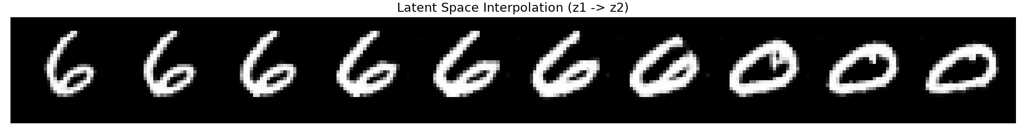
Latent Space Interpolation
Interpolating between two random noise vectors z1 and z2 produces smooth transitions between digit types. This confirms the Generator has learned a structured, continuous latent space - not just memorising training examples.

Slide 13
Results & Analysis
Final metrics (Epoch 50):
Generator Loss: 1.6571 (down from 3.02 at epoch 1)
Discriminator Loss: 0.9320 (near log(2)=0.693 equilibrium)
Observations:
- G_loss steadily decreasing -> Generator improving each epoch
- D_loss rising to ~0.93 -> D and G approaching balance
- Nash equilibrium: D*(x) = 0.5 (D cannot tell real from fake)
- Visual quality improves clearly from epoch 1 to epoch 50
- Latent interpolation shows smooth transitions between digits
- Healthier training dynamics than a D-dominant GAN

Slide 14
Conclusion & Future Scope
Conclusion:
- Fully-connected GAN trained on MNIST for 50 epochs on RTX 3050 GPU
- Generator maps 64-dim noise to realistic 28x28 digit images
- Adversarial training converged with balanced G/D dynamics
- Latent interpolation confirmed structured representation learning
Future Scope:
- Conditional GAN (cGAN): generate specific digit on demand
- Wasserstein GAN (WGAN): more stable training
- FID Score: quantitative evaluation
- Higher resolution generation with Progressive GAN

Slide 15
References
[1] Goodfellow et al. (2014). Generative Adversarial Nets. NeurIPS.
[2] Radford et al. (2015). DCGAN. arXiv:1511.06434.
[3] LeCun et al. (1998). The MNIST Database of Handwritten Digits.
[4] Salimans et al. (2016). Improved Techniques for Training GANs. NeurIPS.
[5] Arjovsky et al. (2017). Wasserstein GAN. arXiv:1701.07875.

