Slide 1
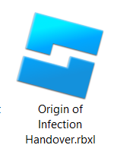
Step 1
Download the project file from the Github link: https://github.com/Stoopid246/Origin-of-Infection
Get the rbxl file (most important)

Slide 2
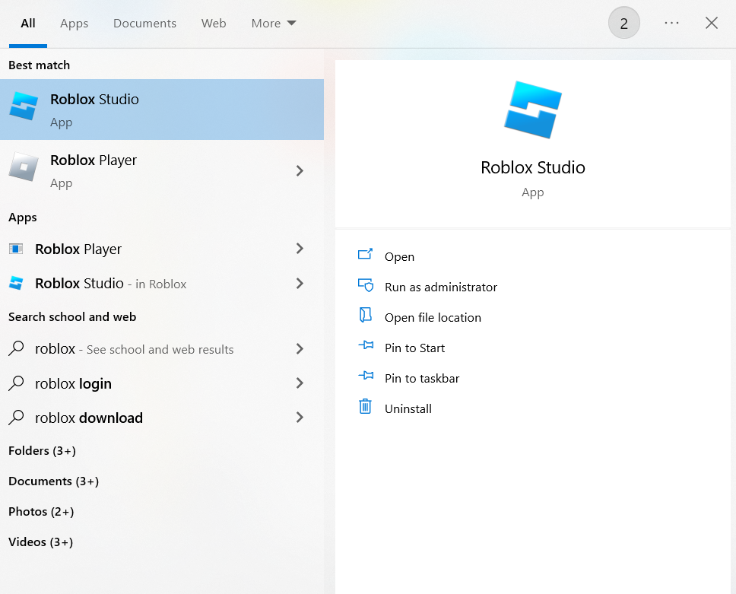
Step 2
Open Roblox Studio

Slide 3
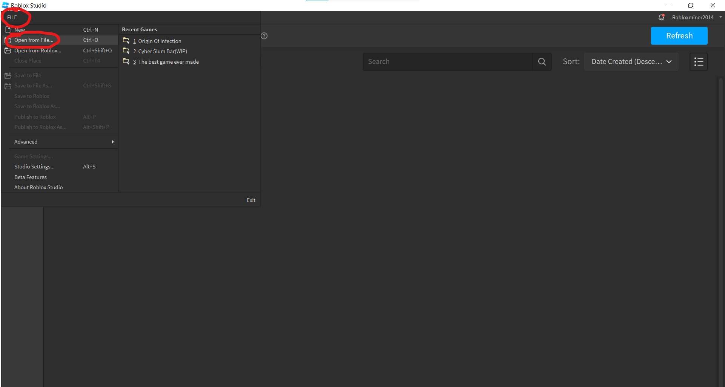
Step 3
Click on File, then click on Open from File

Slide 4
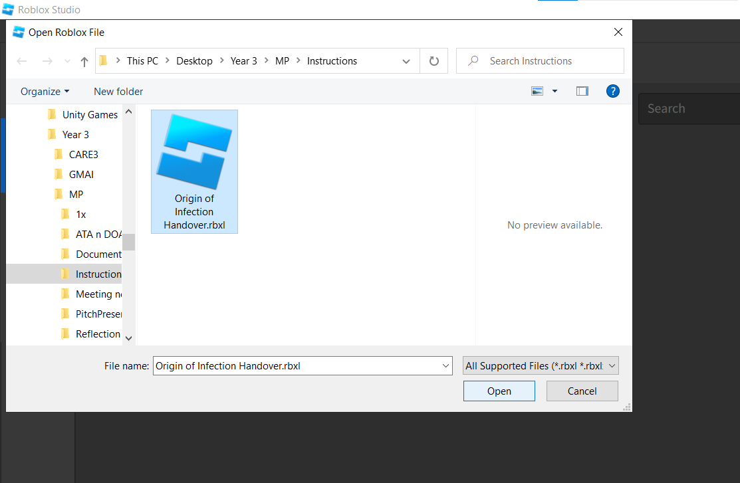
Step 4
Select the project file

Slide 5
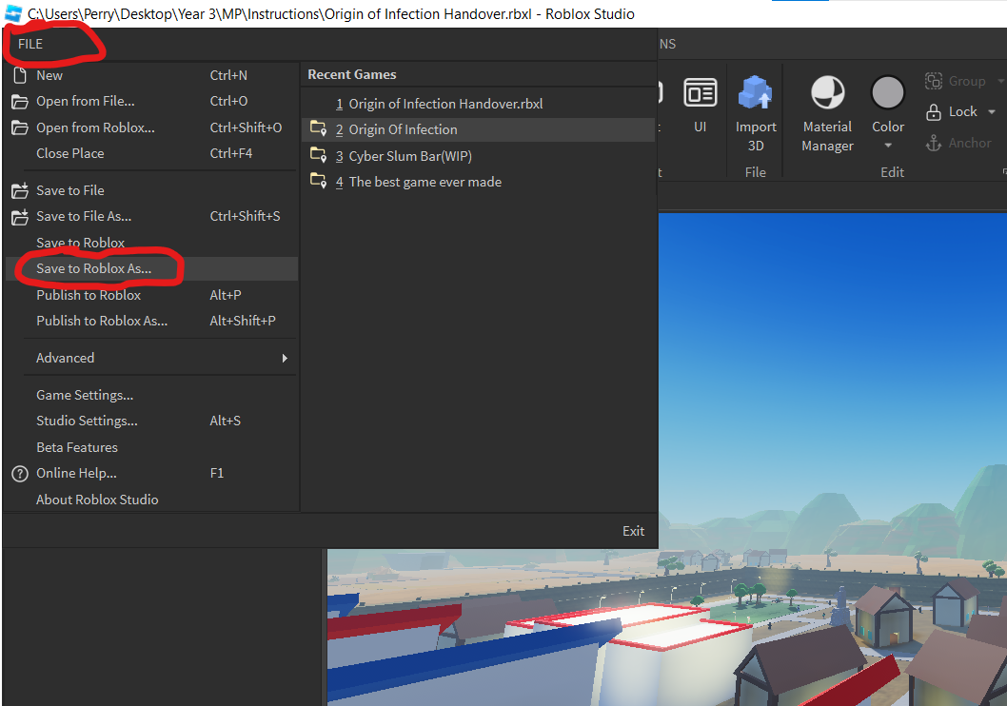
Step 5
Click on File, then click on Save to Roblox As

Slide 6
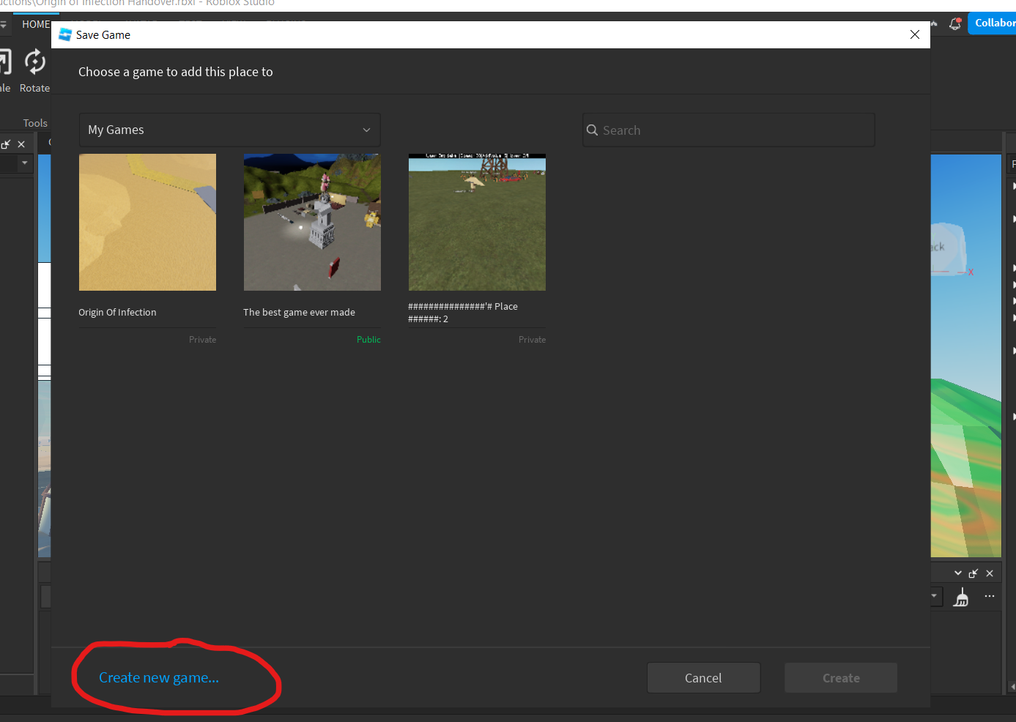
Step 6
Click on Create new game

Slide 7
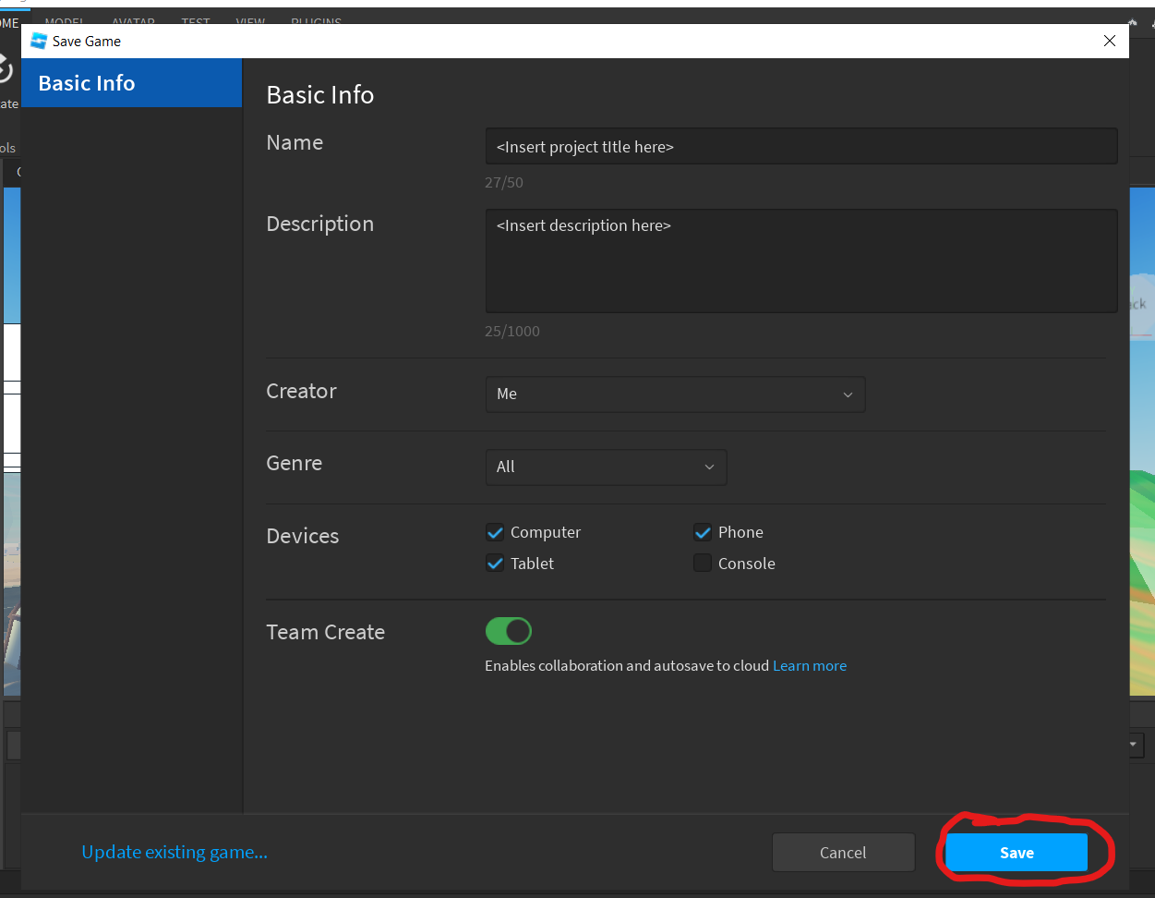
Step 7
Edit the settings then click on save
Remember to keep Team Create enabled

Slide 8
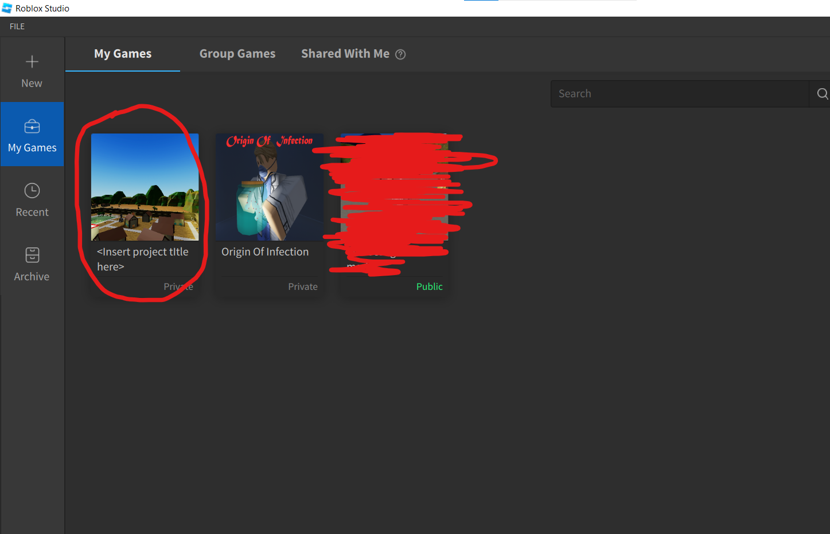
Checkpoint
If you relaunch Roblox Studio now, you should see the project under My Games

Slide 9
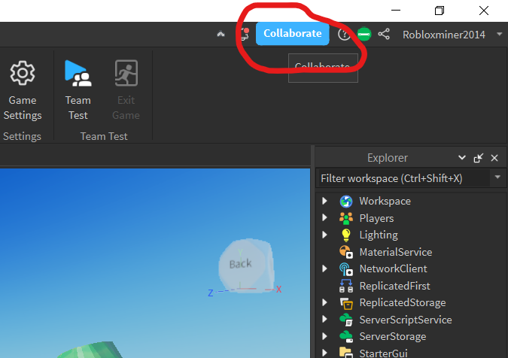
Step 8
To add collaborators to the project, click on Collaborate

Slide 10
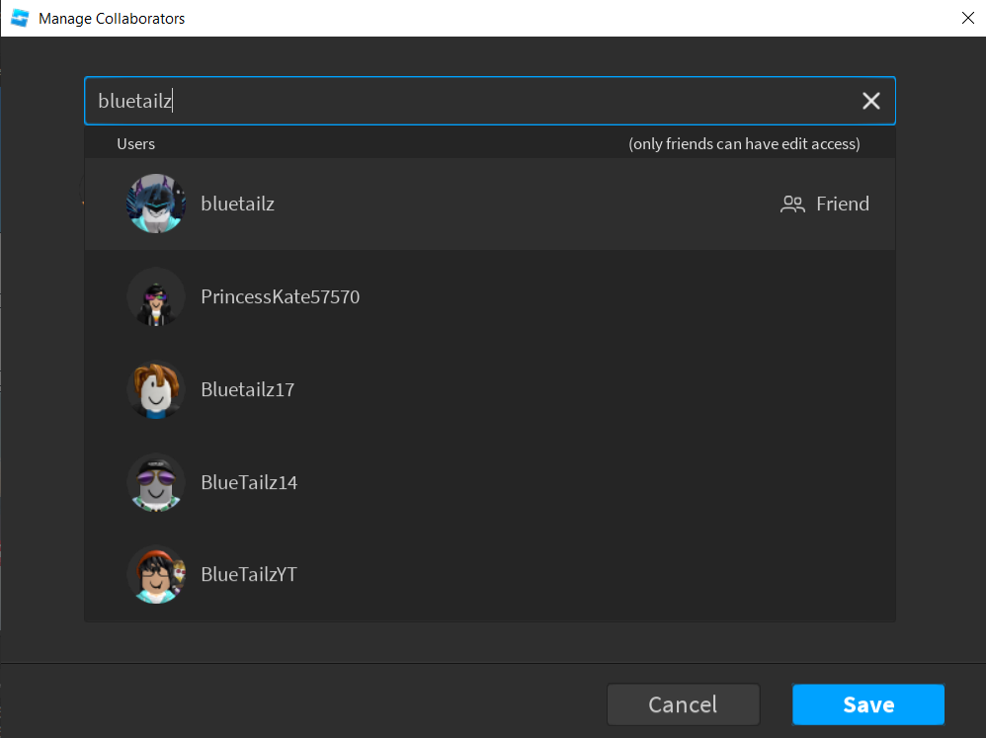
Step 9
Search for the account name of the person you want to add to work on the project, and click on them

Slide 11
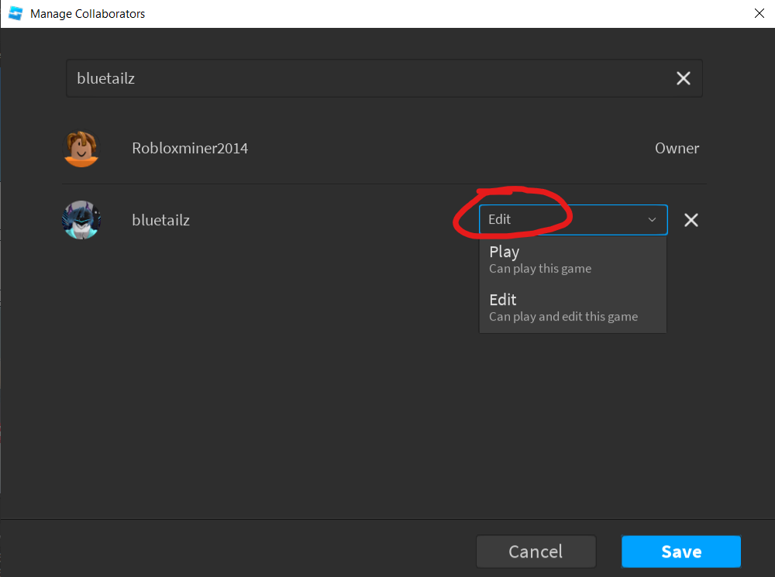
Step 10
After adding someone to the project, you can edit the permissions they have in the project:
Edit – They will be able to edit the project itself
Play – They will only be able to play the game, could be used for play testers.
Remember to click on save after editing the permissions!

Slide 12
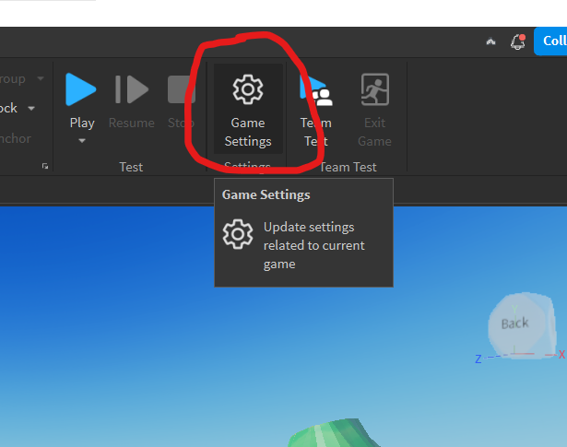
Step 11
To change game settings such as project name, permissions and to add a game icon, we can click on Game Settings

Slide 13
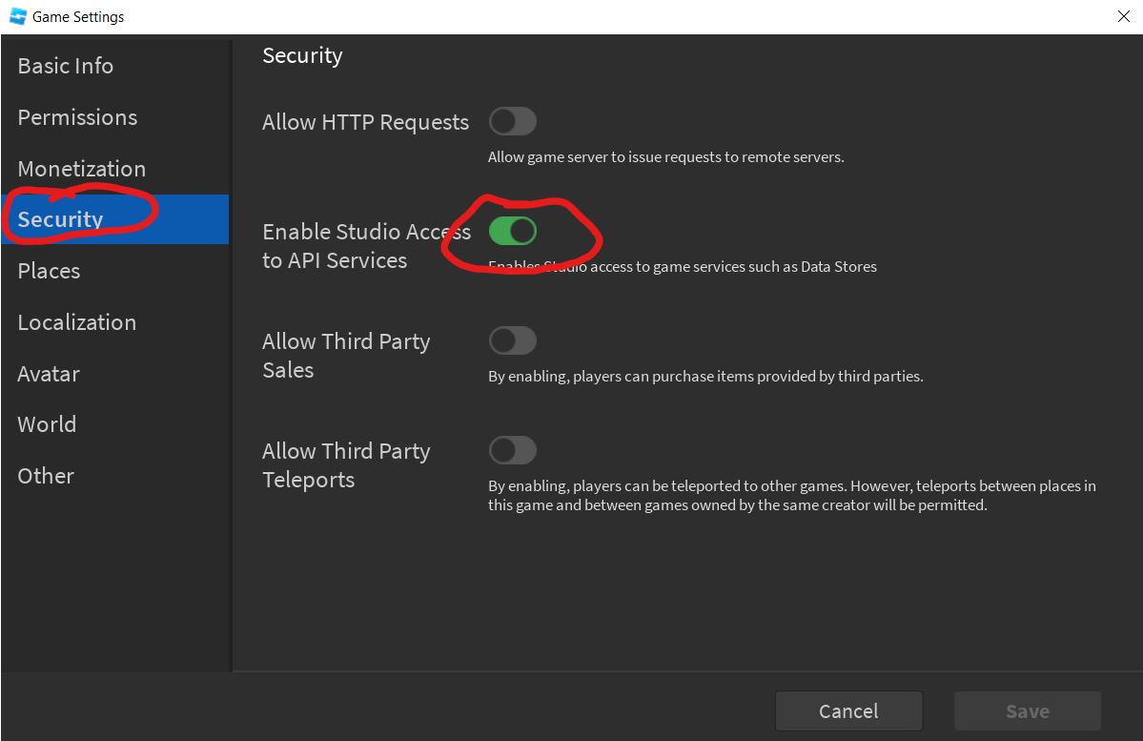
Step 12
An important part of the project is saving, which requires a setting, Enable Studio Access to API Services to be enabled, but Roblox has it disabled by default
After clicking on Game Settings, navigate to Security and enable it
Remember to save the settings

