Slide 1

SOURCE ACADEMY | SWS3012_05
RUN 01
THE PUNISHMENT
OF THE PEANUT BUTTER GOD
Top-down roguelite shooter
Program logic presentation
Team: never fade away
Yuzhen Lin | Pinjia Li | Zecheng Sun | Jiatao He
GITHUB-ASSETED
ARCADE_2D PROJECT
Notes:
[Sources]
- npc_elf.png: https://github.com/StoreManager-Riddle/SourceAcademyProject
- gun assets: https://github.com/StoreManager-Riddle/SourceAcademyProject
- script_3.1.txt: https://github.com/StoreManager-Riddle/SourceAcademyProject

Slide 2
OUTLINE
From Player Experience to Runtime Logic
This presentation follows the data that moves through the game: player input, world offsets, pooled objects, and UI state.
01
Gameplay & Content
The moment-to-moment player loop
11
SLIDES
02
Core Runtime Systems
Camera, player, enemy systems, and tiles
03
Dynamic Game Systems
Spawn logic, lighting, collision, and UI
GAME
SYSTEMS
04
Collaboration & Assets
GitHub repository and asset workflow
SWS3012_05 | NEVER FADE AWAY
02
Notes:
[Sources]
- script_3.1.txt: https://github.com/StoreManager-Riddle/SourceAcademyProject

Slide 3
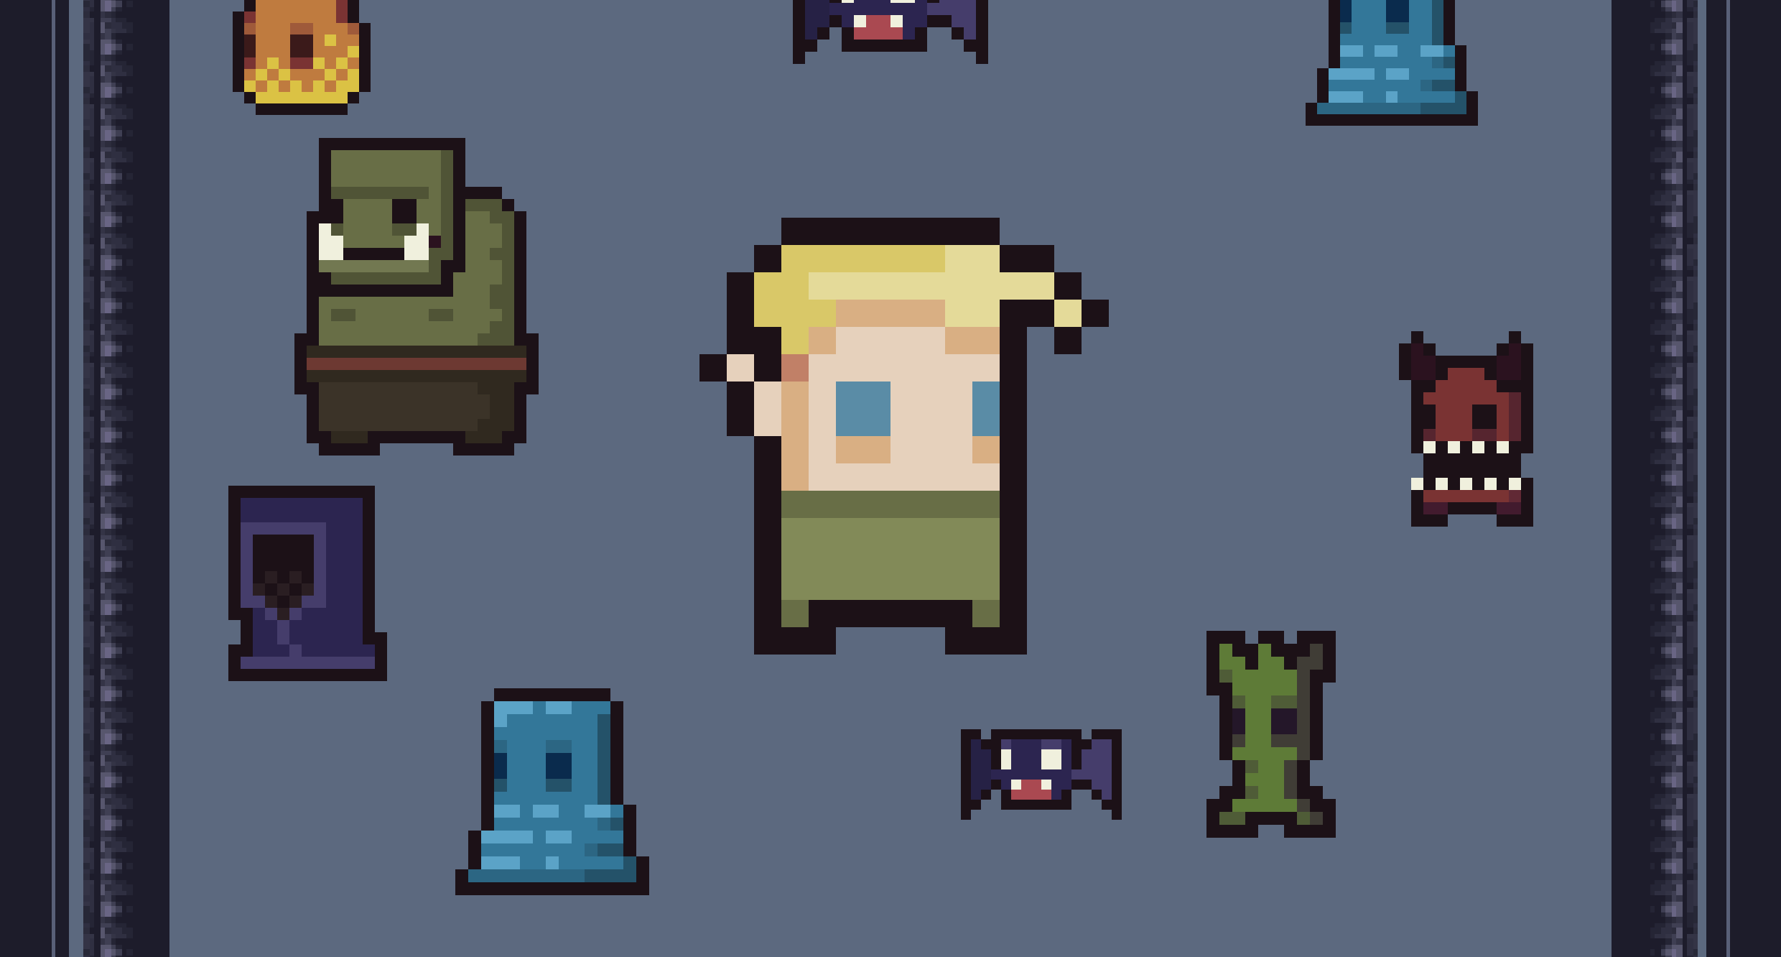
GAMEPLAY & CONTENT
Adapt Under Pressure
The game loop combines a generated dungeon, mouse-aimed combat, and random upgrades into a repeatable survival challenge.
01
02
03
MOVE
FIGHT
BUILD
WASD scrolls world;
player centered
Aim with the mouse
and fire into enemy waves
Kills grant XP;
level-ups offer random cards
Each run changes with the tile map, enemy composition, weapon state, and card choices.
01 | GAMEPLAY & CONTENT
03
Notes:
[Sources]
- script_3.1.txt: generated tile map and gameplay loop: https://github.com/StoreManager-Riddle/SourceAcademyProject
- Source game sprites used in poster map: https://github.com/StoreManager-Riddle/SourceAcademyProject

Slide 4
COLLABORATION: GITHUB FOR CODE AND GAME ASSETS
GitHub Keeps Code and Art in Sync
The repository puts scripts, player art, monsters, weapons, tiles, walls, and audio in one traceable workflow.
StoreManager-Riddle / SourceAcademyProject
script_3.1.txt
monster/
gun assets
tiles & floor
audio
Sprite assets are loaded from raw.githubusercontent.com paths in the code. Team members can update assets, sync scripts, and retain version history.
Repository HEAD verified: 03693e4cde60b4bde2d1613b18a6eac31e2f311b
Result: consistent asset references, traceable changes, and a reproducible exhibition build.
02 | COLLABORATION & ASSET MANAGEMENT
04
Notes:
[Sources]
- Repository root, script_3.1.txt, assets folders: https://github.com/StoreManager-Riddle/SourceAcademyProject

Slide 5
CAMERA: KEEP THE PLAYER CENTERED
Fixed Player, Moving World
The player is a visual anchor at screen center; input updates map coordinates while tiles, enemies, rewards, and projectiles shift in the opposite direction.
WORLD OBJECTS MOVE
IN THE OPPOSITE DIRECTION
INPUT
dx / dy
tile_sprites / enemies
rewards / enemy bullets
PLAYER AT CENTER
Why it works: the player remains readable, while boundaries and collision checks stay in map-space coordinates.
player_map_px = player_map_px + dx
world_object.x = world_object.x - dx
enemy.update_map_offset(dx, 0)
03 | RUNTIME LOGIC - CAMERA
05
Notes:
[Sources]
- script_3.1.txt: input_listener, update_map_offset: https://github.com/StoreManager-Riddle/SourceAcademyProject

Slide 6
PLAYER & WEAPONS: AIM, FIRE, REUSE
Pointer Aim Meets a Bullet Pool
The pointer determines firing direction; a preallocated pool reuses sprites instead of constructing a new object for each shot.
BULLET POOL
if (!b_active[i]) {
b_active[i] = true
b_vx[i], b_vy[i] = velocity
b_life[i] = 0
}
500
pointer - player center
→ atan2 → gun rotation
Preallocated bullet sprites
Pointer sets muzzle angle
and projectile velocity.
State arrays: active / velocity / lifetime / type
Inactive projectiles return to the same pool for the next shot.
03 | RUNTIME LOGIC - PLAYER / GUN / BULLET POOL
06
Notes:
[Sources]
- script_3.1.txt: bullets, bullet_pool_size = 500: https://github.com/StoreManager-Riddle/SourceAcademyProject
- ak47.png: https://github.com/StoreManager-Riddle/SourceAcademyProject
- bullet.png: https://github.com/StoreManager-Riddle/SourceAcademyProject

Slide 7
ENEMIES: POOLS, SPAWNING, AND DIFFERENT BEHAVIORS
Different Enemies, One Reusable Runtime
Each enemy carries HP, speed, texture, and a behavior ID. The spawner activates inactive pool entries only at valid map positions outside walls.
100
Behavior examples
enemy(hp, speed, texture, behavior, reward)
spawn only if !is_alive()
map position must not be a wall
Standard enemy pool
+ 5 boss objects
explode
chase in sine-wave
flee
Movement branches cover direct chase, sine-wave drift, dash bursts, ranged spacing, death explosions, fleeing, and area healing.
Collision: AABB is used as a broad-phase test, followed by a squared-distance check. A hurt cooldown prevents repeated damage each frame.
03 | RUNTIME LOGIC - ENEMY SYSTEM
07
Notes:
[Sources]
- script_3.1.txt: enemy, enemy_spawner, collision loops: https://github.com/StoreManager-Riddle/SourceAcademyProject
- fire_elemental.png: https://github.com/StoreManager-Riddle/SourceAcademyProject
- orc.png: https://github.com/StoreManager-Riddle/SourceAcademyProject
- healer.png: https://github.com/StoreManager-Riddle/SourceAcademyProject
- reward_monster.png: https://github.com/StoreManager-Riddle/SourceAcademyProject

Slide 8
Spawn Only After Space Is Valid
After a cooldown, the spawner reuses an inactive enemy and tests its map tile before activation.
01
02
03
04
05
COUNT DOWN
REUSE
PICK A RING
CHECK TILE
ACTIVATE
spawn_cooldown--
first !is_alive()
r = 600
!is_wall(...)
enemy.spawn
spawn_cooldown = spawn_cooldown - 1
if (spawn_cooldown <= 0 && !enemy('is_alive')()) {
if (!is_wall(tile_map, tx, ty)) enemy('spawn')(sx, sy)
}
spawn_cooldown = spawn_rate
SCALE & BOSS GATE
Base: 4 enemies every 360 frames
Levels 1-6: 1.2x per level; then capped + 1 / level
Every 5th level: one boss from a 5-object pool
Normal spawns retry up to 10 times; boss spawns use r = 500-700 and retry up to 20 times.
03 | RUNTIME LOGIC - MONSTER SPAWNING
08
Notes:
[Sources]
- script_3.1.txt: enemy_spawner: https://github.com/StoreManager-Riddle/SourceAcademyProject
- script_3.1.txt: spawn_boss: https://github.com/StoreManager-Riddle/SourceAcademyProject
- script_3.1.txt: max_pool_size = 100, boss_pool_size = 5: https://github.com/StoreManager-Riddle/SourceAcademyProject

Slide 9
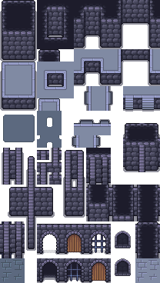
TILE MAP: A 2D STRING ARRAY BECOMES A PLAYABLE ROOM
A 2D Array Drives the Tile Map
Initialization generates a 60 × 55 string array. Each string selects one source tile sprite and positions it on the grid.
generateTileMap(60, 55)
Mapping and rendering
wallTop wallTop wallTop wallTop
tile = choose(name)
store(tile)
place(tile, grid_pos)
LeftWall wallCenter wallCenter RightWall
LeftWall texture1Floor floor RightWall
LeftWall floor texture2Floor RightWall
tile_sprites is also the collection moved by the camera system when the world scrolls.
bottomWall bottomWall bottomWall bottomWall
Border cells become walls; interior cells mix two textured floors at a density of 0.3.
03 | RUNTIME LOGIC - TILE MAP
09
Notes:
[Sources]
- script_3.1.txt: generateTileMap, map.generate_map: https://github.com/StoreManager-Riddle/SourceAcademyProject
- walls_floor.png: https://github.com/StoreManager-Riddle/SourceAcademyProject

Slide 10
LIGHTING & UI: REAL-TIME PLAYER FEEDBACK
Lighting and UI Feed the Same State
A translucent light overlay follows the player's center, while HP, XP, level, and kill count update inside the main loop.
lightCover
HUD STATE
HP
LV: 4
XP
KILLS: 27
hpRatio = player_hp / player_max_hp
xpRatio = player_kills / xpNeed
update_scale(fill, [ratio, 1])
Fixed at width / 2, height / 2
A shot briefly raises the muzzle-light alpha.
表现与逻辑共享同一套状态变量，玩家能立即读懂自身风险与升级进度。
Rendering and logic share state variables, so players can read risk, progression, and reward timing immediately.
03 | RUNTIME LOGIC - LIGHTING & UI
10
Notes:
[Sources]
- script_3.1.txt: lightCover, fireLightCover, HP/XP UI: https://github.com/StoreManager-Riddle/SourceAcademyProject

Slide 11

SURVIVE.
LEVEL UP.
CLAIM THE REWARD.
The Punishment of the Peanut Butter God
THANK YOU
Team: never fade away
Yuzhen Lin | Pinjia Li | Zecheng Sun | Jiatao He
SWS3012_05 | NEVER FADE AWAY
11
Notes:
[Sources]
- wall_center.png: https://github.com/StoreManager-Riddle/SourceAcademyProject
- reward_drop.png: https://github.com/StoreManager-Riddle/SourceAcademyProject

