Slide 1
Stork and Babies
Team:
Danyu Yang, Chen Xu, Jiajun Shen, Zhuofu Chen, Jiayuan Shi, Tong Zhang

Slide 2
C
ONTENTS
Introduction
Mechanism
0
1
0
3
Screens
Art
0
2
0
4
Interaction
0
5

Slide 3
Part One
Introduction
We will use Unity 3D for development and finally run the game on Android and IOS systems.

Slide 4
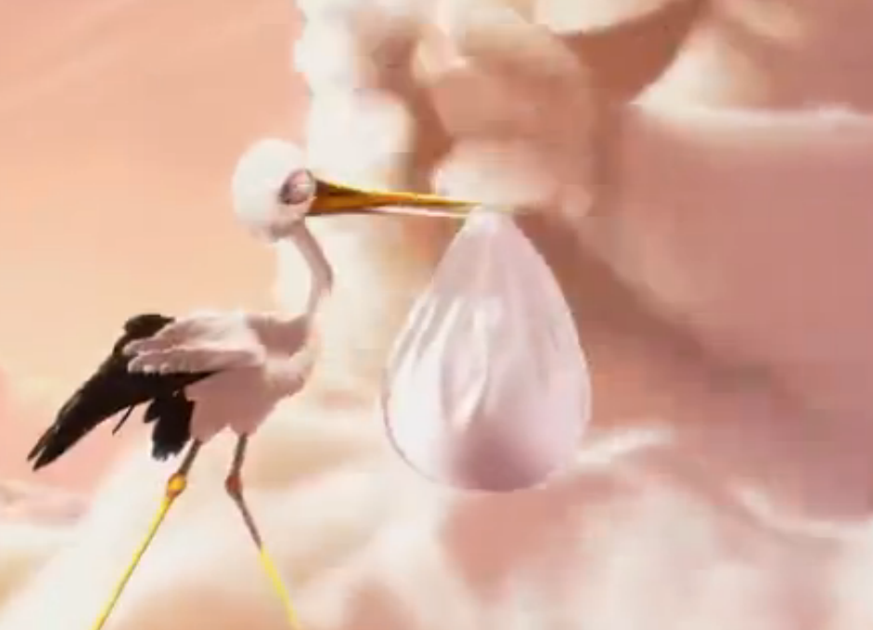
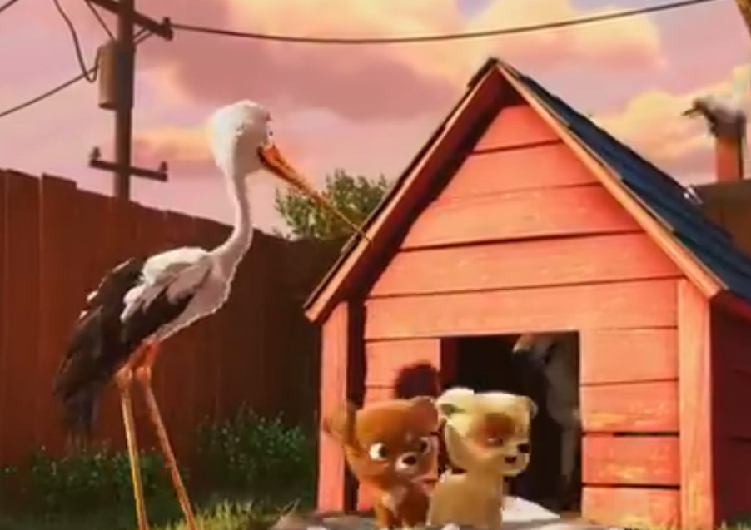
Overview
The background story is based on a very famous European folklore in which a stork is responsible for delivering new babies to new parents. In the game, the player will control a stork to get babies’ spirits from holy clouds and deliver him to the destination.
There are naturally created talents hidden somewhere waiting for the stork to pick them up along the road. Moreover, there are evil demons living in the shadows that eat new babies spirits.
The main goal of the player is to let stork pick up all the required talents and finally reach the new parents’ house in limited time.

Slide 5
Game Play
As an action and adventure game, player will control the stork by control panels both on the lower-left corner and lower-right corner. There are two status of the stork: moving or fighting. When moving, player use lower-left control panel to control flying height and turning. At the same time, lower-right panel has buttons for moving forward and acceleration.
We use third-person perspective. Player will see the back of the stork.

Slide 6
Part Two
Screen
Introducing what is displayed before and during the game

Slide 7
Entry Screen
Title
Title is the name of the game
Tapping entry allow player to enter the game
Quit exit the game
Entry
Quit
Main Menu
Resume
Resume continue the game
Select Stage allow player to select different stages
Setting set volume, etc.
Leave back to upper layer
Select Stage
Setting
Leave

Slide 8
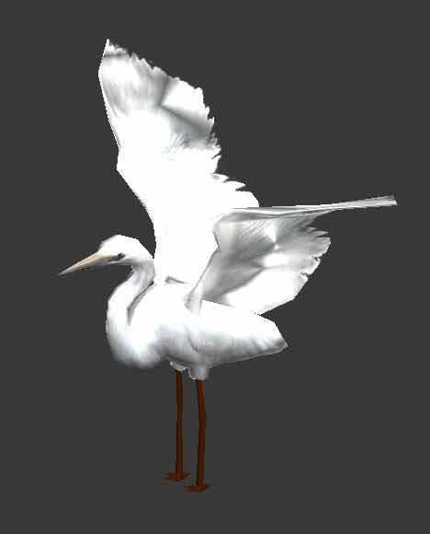
More Detail
1
Select Stage
In Select Stage screen, we can choose stories as well as the stages in each story.
However, we can only choose those unlocked stages.
2
Setting
In Setting screen, we can choose proper volume of music, adjust control flexibility, and do account setting.

Slide 9
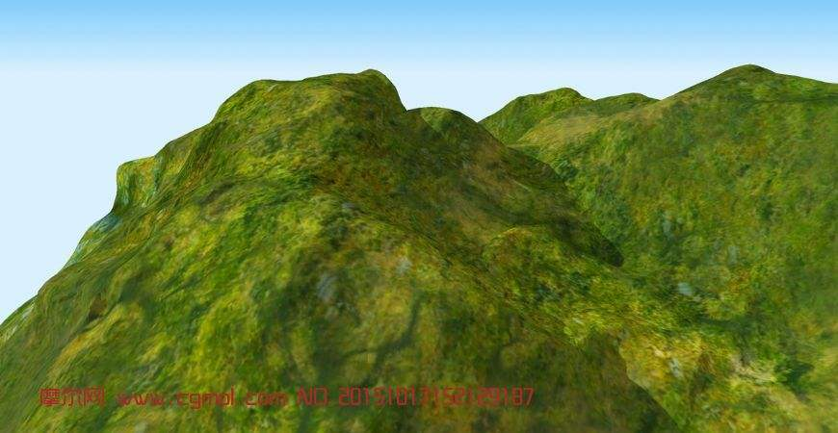
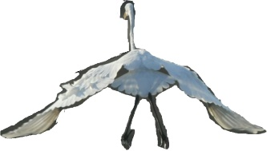
In the game!
Blood
Energy
Time
Forward
Speed
A
B

Slide 10
Part three
Mechanism
Introducing main elements and mehcanism in our game.

Slide 11
01
02
Agents
Environment
Forests
Mountains
Caves
……
Stork
Demons

Slide 12
Stock
Move forward
Forward
Speed
01
A
B
02
Move backward
03
Increase height
Movement
04
Decrease height
05
Turn left
06
Turn right
07
Combined movement

Slide 13
Stock
100%
Energy Status
Can accelerate and use fighting skill 2

Slide 14
Stock
80%
Energy Status
Can accelerate and use fighting skill 1

Slide 15
Stock
50%
Energy Status
Can use fighting skill 1

Slide 16
Stock
30%
Energy Status
Can only move with normal speed

Slide 17
Stock
0%
Energy Status
Drop the baby and fail

Slide 18
Demons
Movement
Move in a limited area
Normal
Status
Fighting
Dead

Slide 19
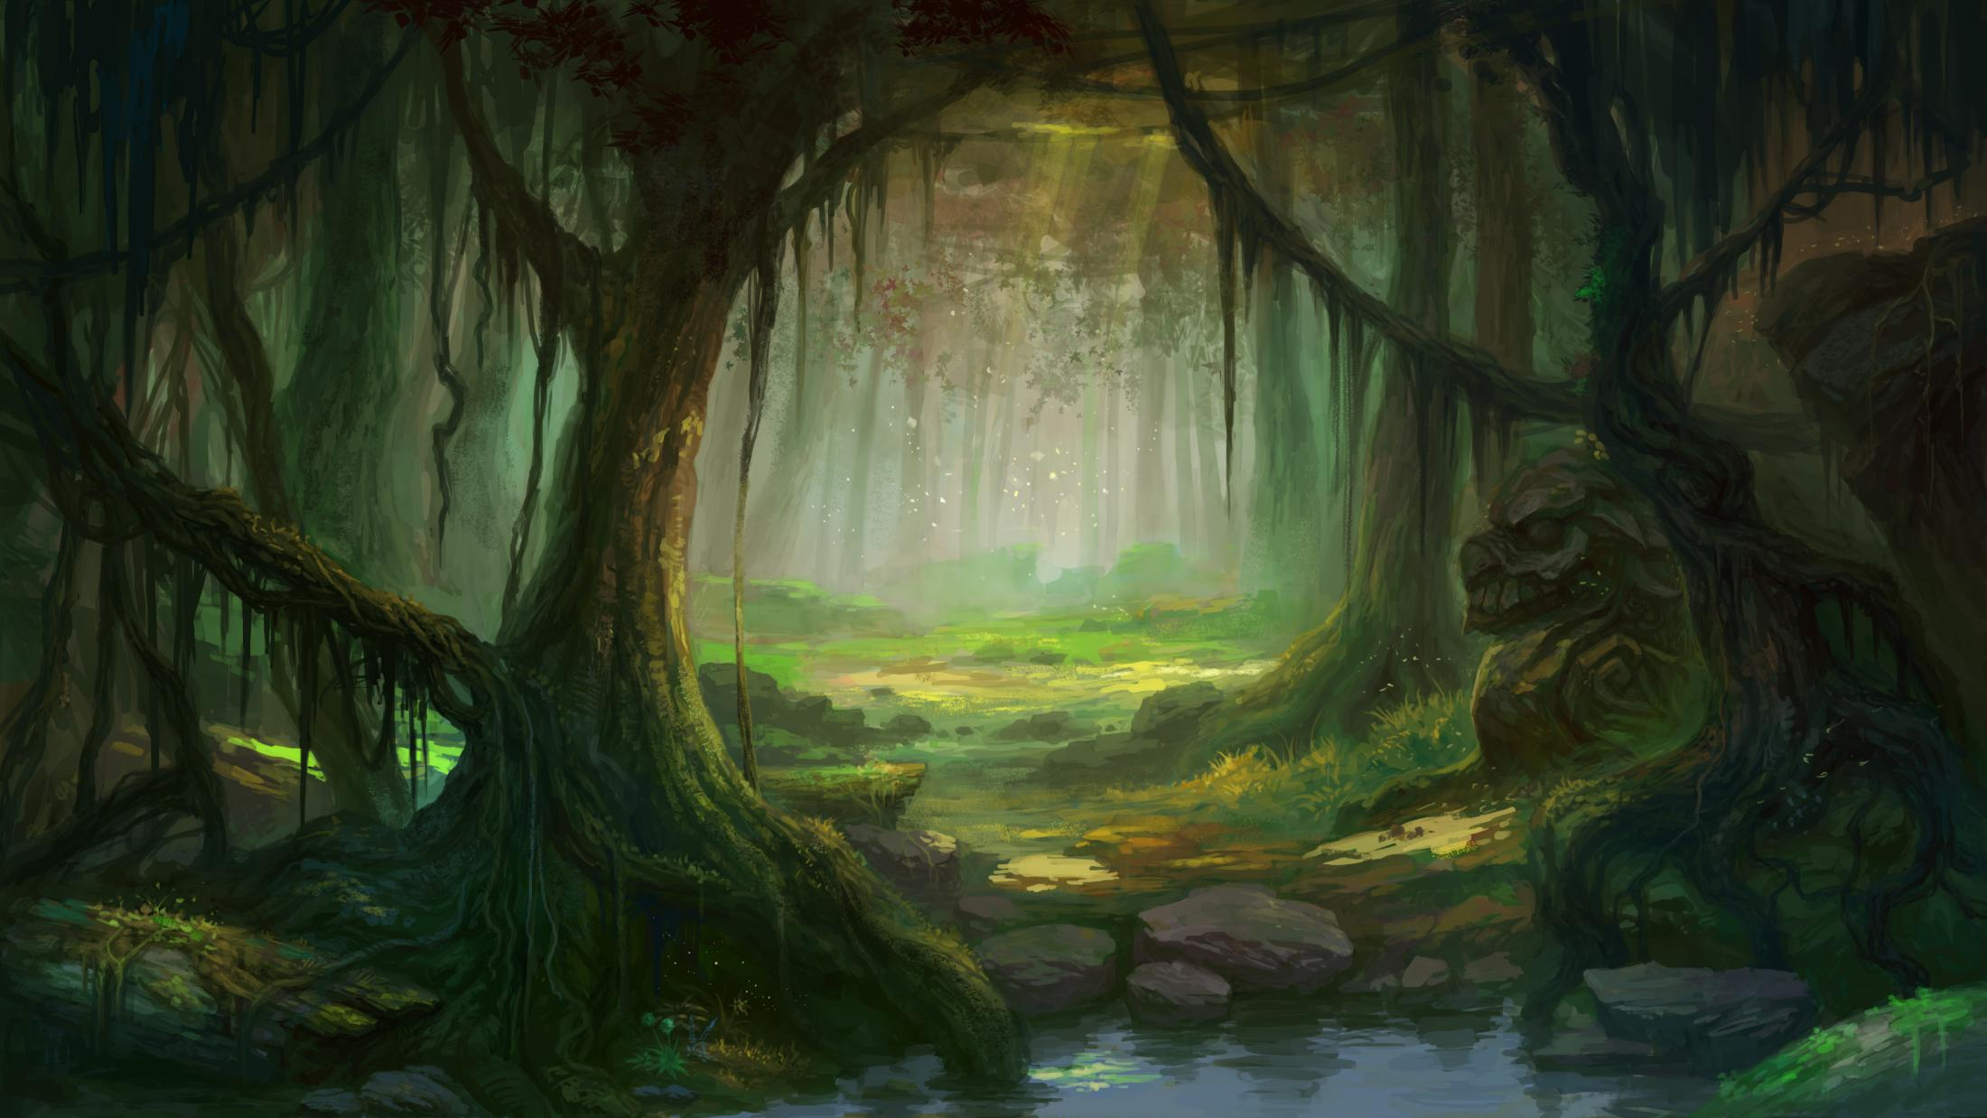
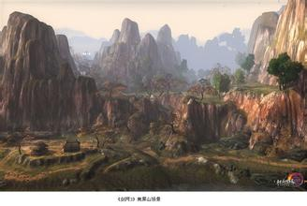
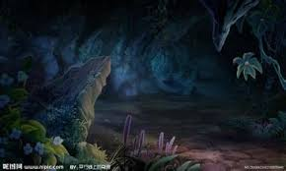
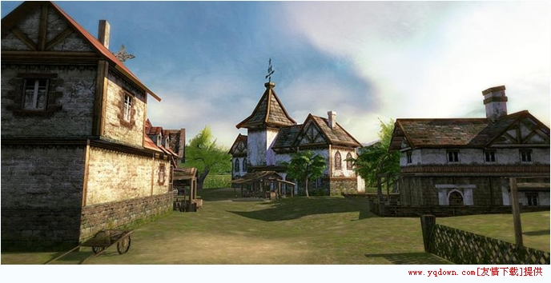
Environment
In different stories we have different environments
……

Slide 20
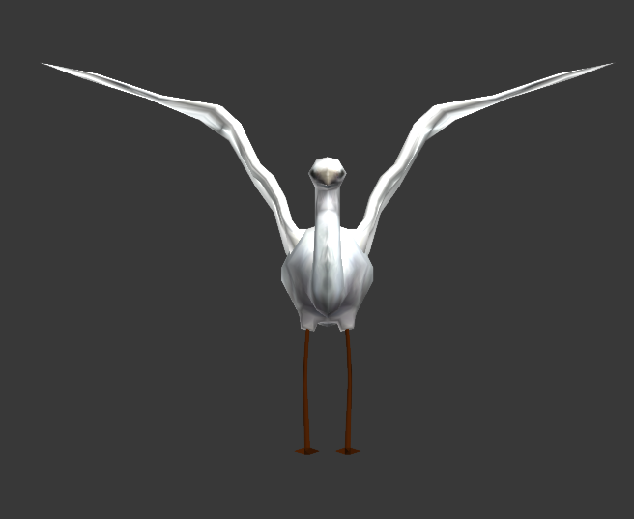
Part four
Art Direction

Slide 21
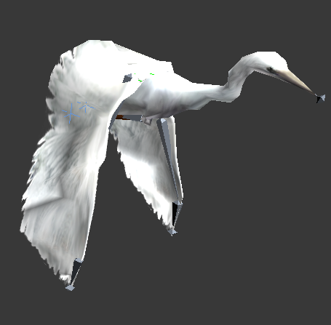
Art Direction about our game
Since our development is mainly focus on program design and implementation, we will not take too much time on art. We will use basic models of both agents and environment elements and structure them appropriately. After we have complete game program, we will refine the art design.
。

Slide 22
Part five
Interaction

Slide 23

Basic Version
*In basic version, we set up the standard game world and put basic models in it.
*We will finish basic functions of the stork and demons.
*The most important task is to design a good software structure which is easy to modify and extend.
。

