Slide 1
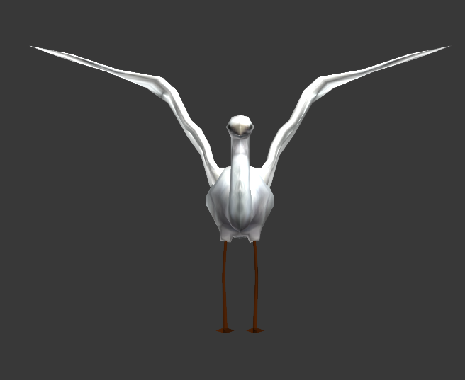
Part four
Art Direction

Slide 2
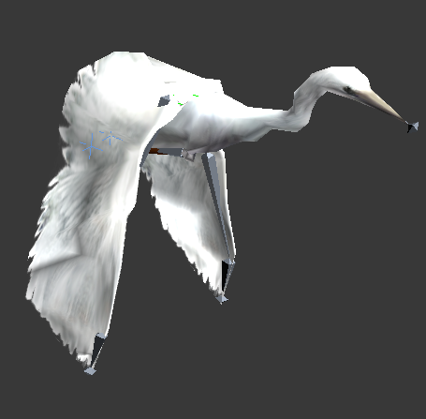
Art Direction about our game
Since our development is mainly focus on program design and implementation, we will not take too much time on art. We will use basic models of both agents and environment elements and structure them appropriately. After we have complete game program, we will refine the art design.
。

Slide 3
Part five
Interation

Slide 4
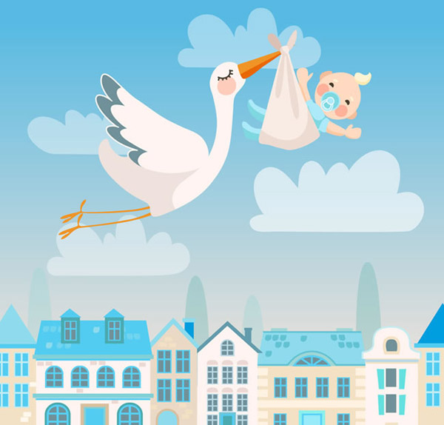
Basic Version
*In basic version, we set up the standard game world and put basic models in it.
*We will finish basic functions of the stork and demons.
*The most important task is to design a good software structure which is easy to modify and extend.
。

