Slide 1


Magento Mobile Shop Application
IGATE is now a part of Capgemini

Slide 2
TEAM MEMBERS
Pujarani Parida
Sreya Jaiswal
Shweta Pawar
Saran Madhu
Ragini Ahire.

Slide 3
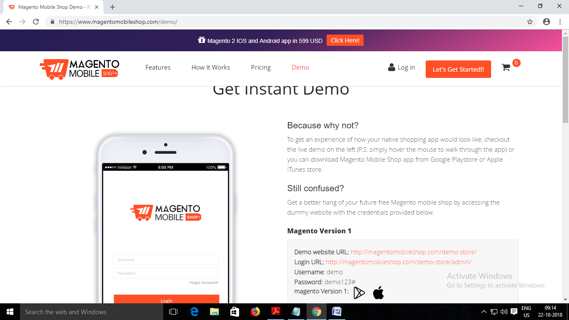
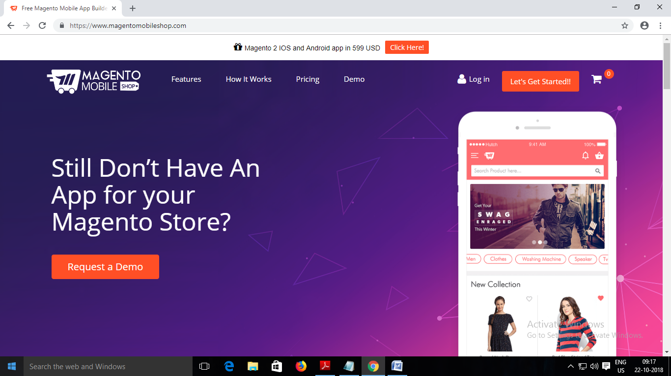
OVERVIEW OF THE PROJECT
In Magento Mobile Application is used for building websites. User buys the domain and then builds his website. User can also add features to his website.
User also have different types of subscription . User also can try this application for free.

Slide 4
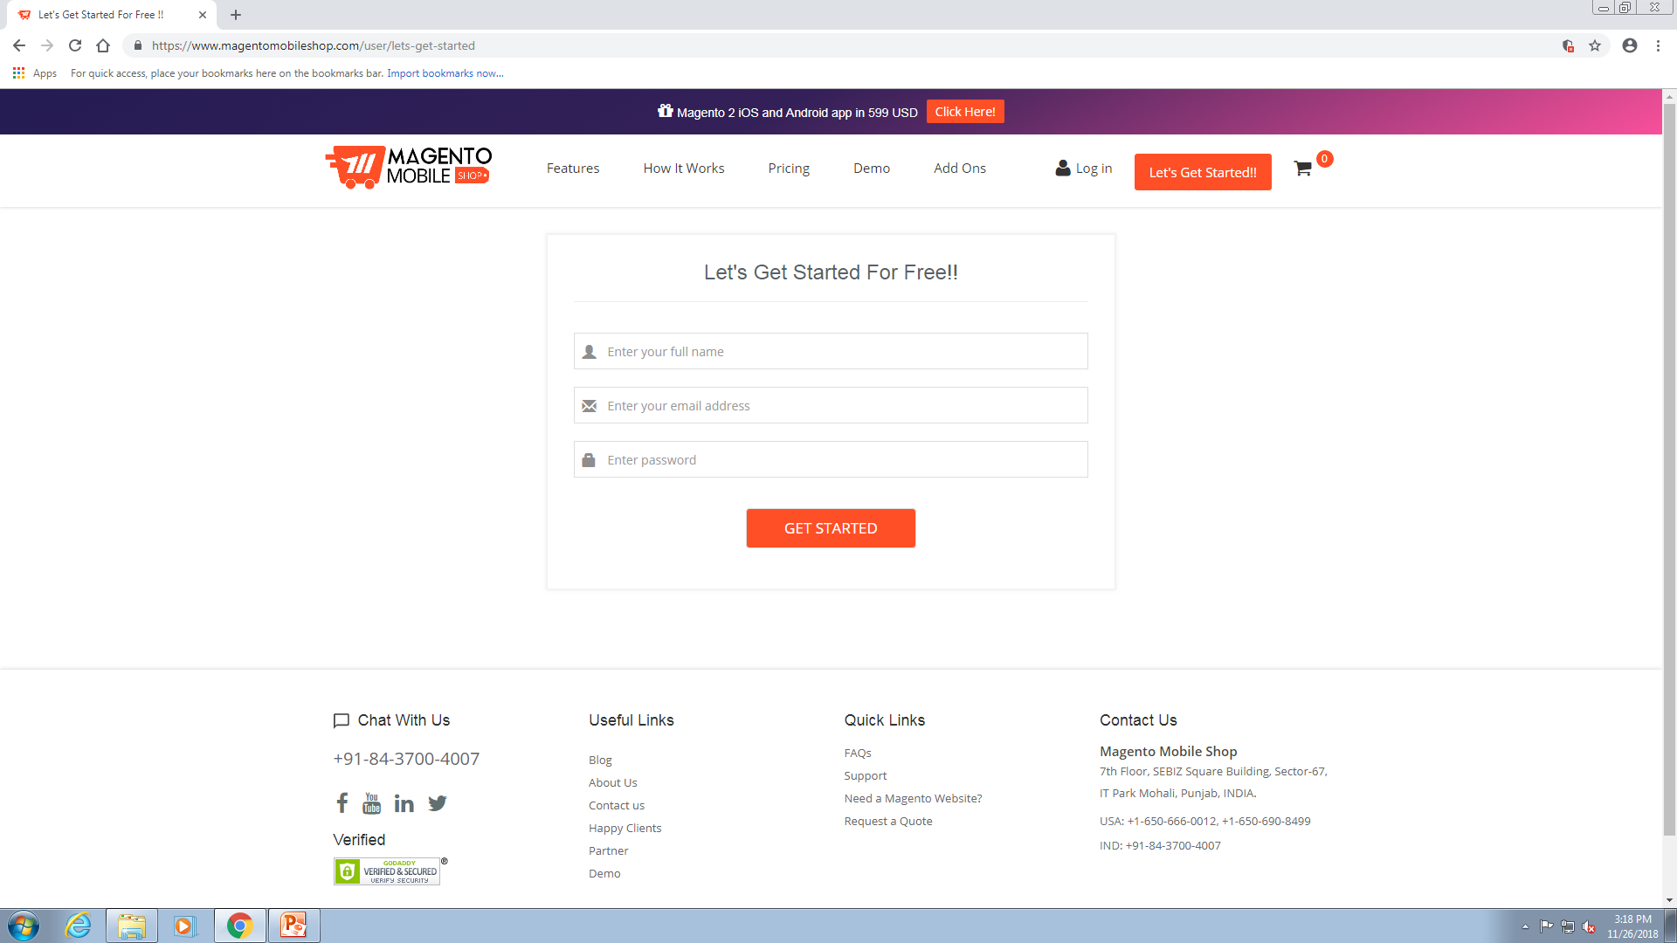
This application includes some modules:
1.Registration Page:
1.On registration page user have to register first.
2.User have to create user name and password for logging into application.

Slide 5
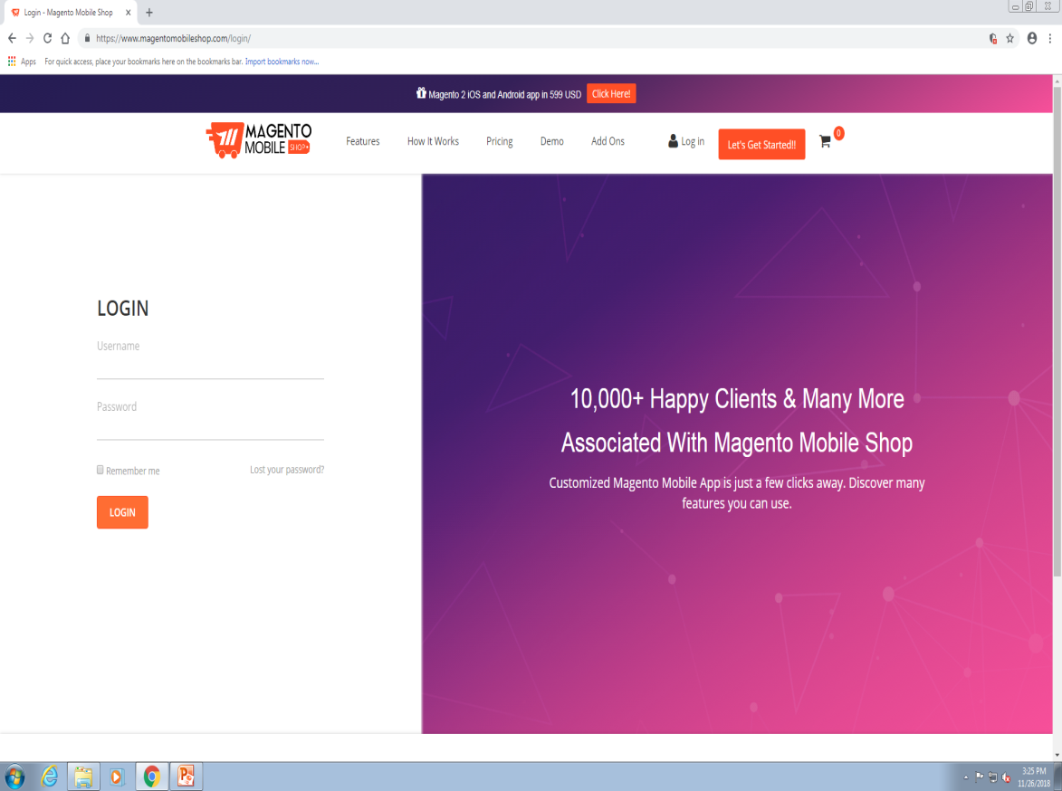
2.LOGIN:
1. On LOGIN page ,user has to enter valid credentials.
2. There is link provided in the login module “Lost your password?” which redirects the user to the page where user can recover their password using email-id.

Slide 6
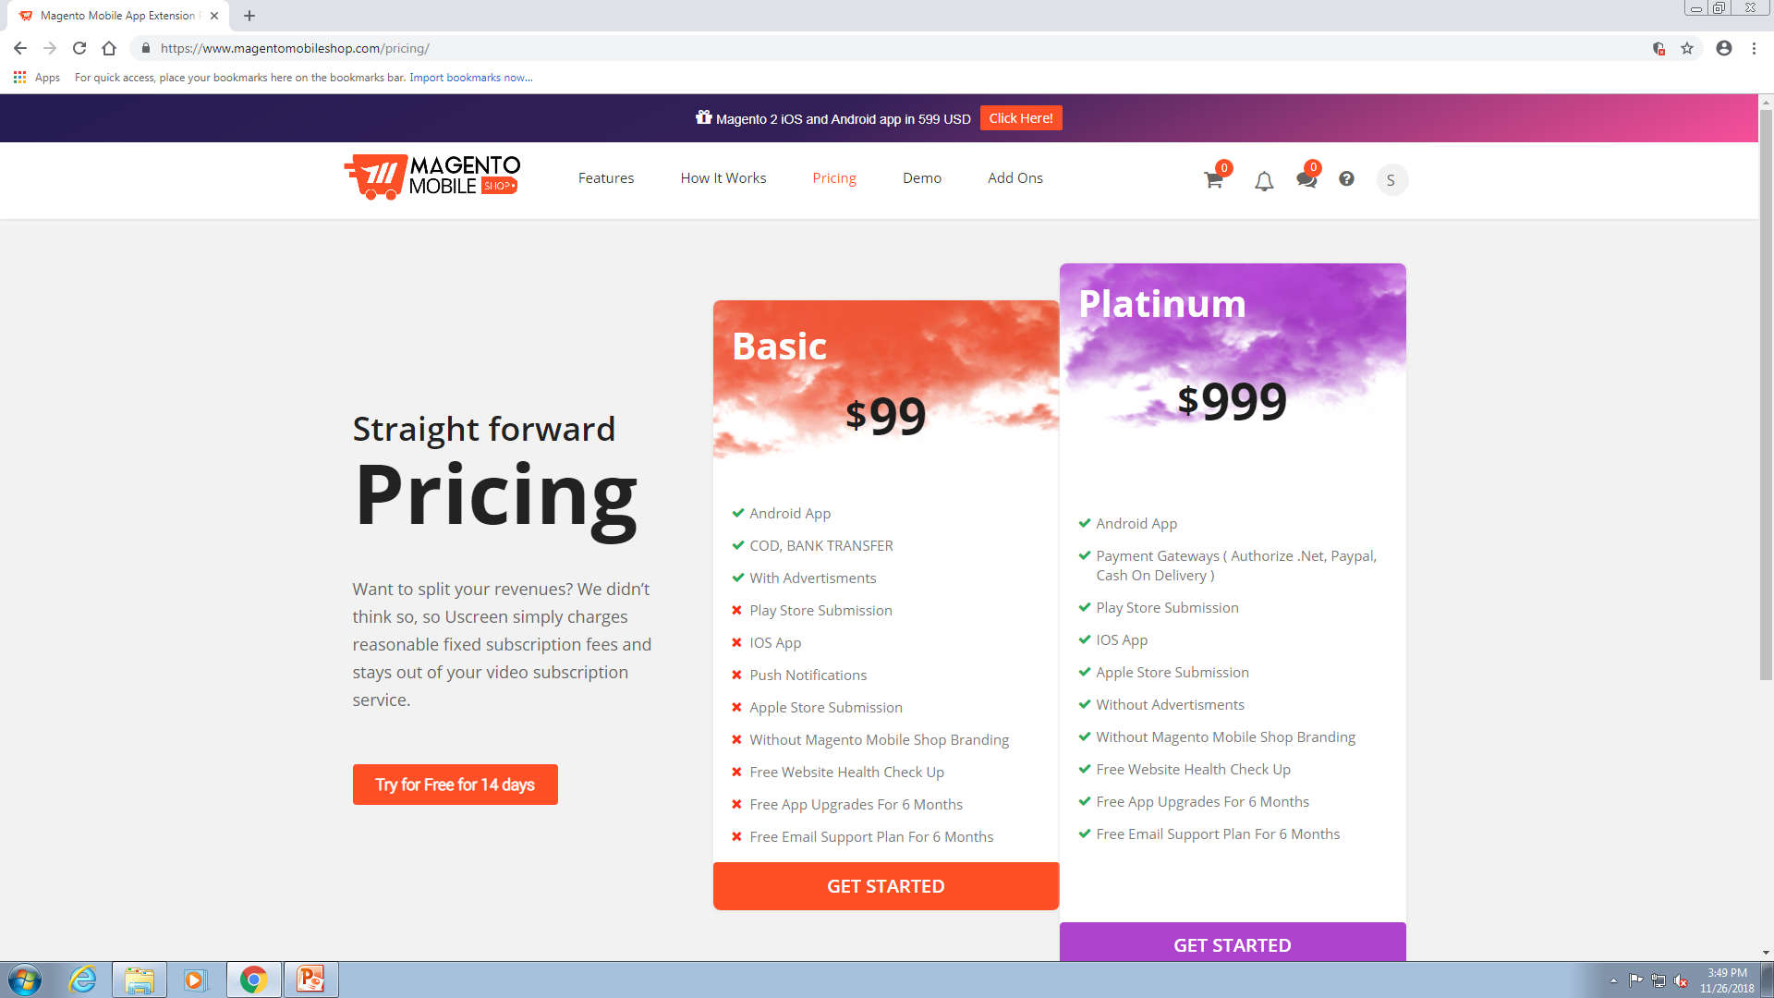
3. Pricing:
1.In this menu user can try this application free for 14 days.
2.There are also two other plans first is Basic plan, where application is only providing the facilities of Android App, COD, Bank Transfer, With Advertisements, by $ 99 and 3.The another plan is Platinum plan where user can subscribe by $999, which is providing so many facilities than Basic plan.
4.After choosing any one of the plan application will ask user for register to proceed further.

Slide 7
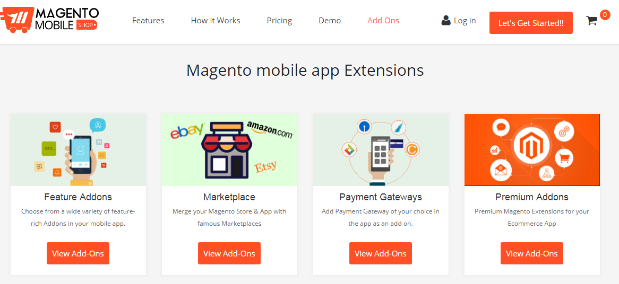
4. ADD-ONS:
1.In this menu different-different features are available to Add in websites which is being build by user.
2. User can select any feature and add it to the cart.
3.After adding in cart further payment process will ne done.

Slide 8
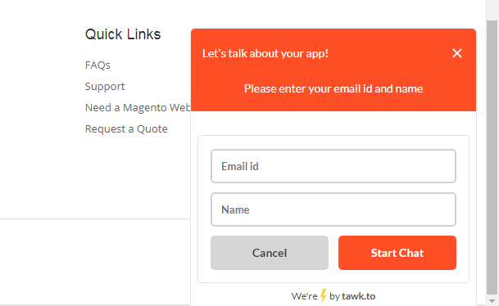
5. Chat Box:
There is a tab provided to chat i.e. “Let’s talk about your app!” which provides the functionality to talk about your application or any issue with the admins of the Magento Mobile Application.

Slide 9
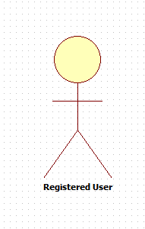
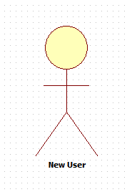
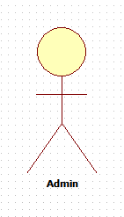
Actors

Slide 10
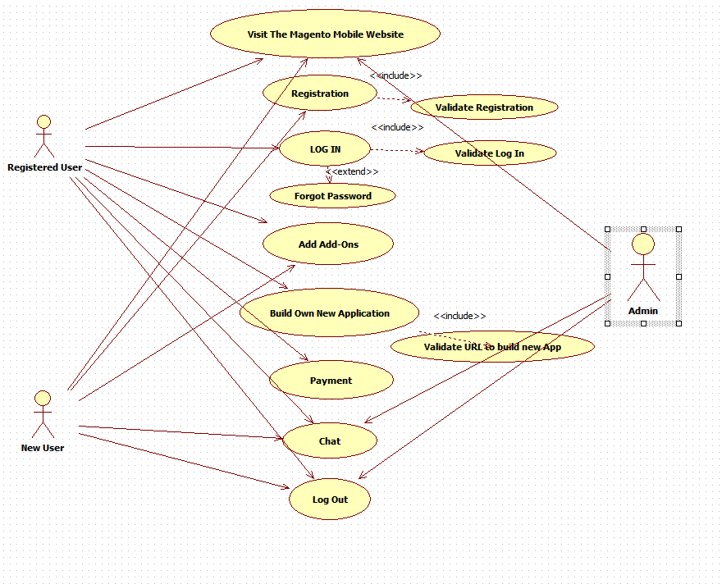
USE CASE :-

Slide 11
TEST CASES
This is the link to go through the 5 types of Test Cases of Magento Mobile Website
Use Case Based Test case
Cause and Effect Test Case
State transition Test Case
Inter System Test Case
Security Test Case
Link to Test Cases

Slide 12
Defects Found…
By testing the Magento Mobile shop website we have found some defects and try to make the website as quality application.
Here are the defect reports :--
Log In Page Defect Report
Registration Defect Report
Add Features Defect Report
Chat Box Defect Report
Building new Website Defect Report
Pricing Defect Report

Slide 13
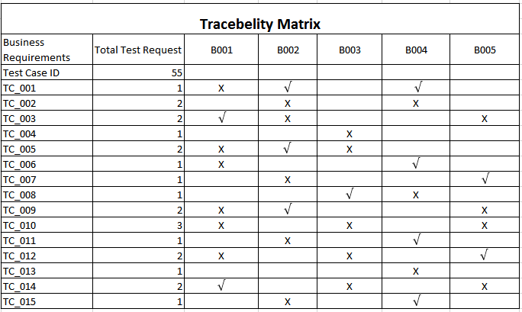
Tracebility Matrix
B001 | B002 | B003 | B004 | B005
Log In link should present in every pages of the website | Only registered user should have the access to build new website | Log Out button should present in every page of the website | Registered user should access to make payment using every payment methods | Entered URL for making new website should be new one

Slide 14
Project Summary :-
After testing the Magento Mobile Shop Website we have found total 55 test cases.
Among them 39 test cases are failed and 16 test cases are passed.
And we have tried to recover the failures and to make the website quality one.

Slide 15
Thank You

