Slide 1
Antarctic Microbial Sensor
Autonomous Marine Environmental Monitoring System
EEE4113F · Group 14 · University of Cape Town
Devon Clark · Joshua Naidoo · Kiyuran Naidoo · Saeed Solomon
Supervised by Dr Emma Rocke · MARiS, UCT
May 2026

Slide 2
Background & Motivation
Why does Antarctic marine monitoring matter?
THE OCEAN'S EARLY-WARNING SYSTEM
THE 'WINTER DATA GAP'
• Marine microbes are the 'invisible engines' of the ocean ecosystem
• They are the first biological indicators of climate change and pollution
• Dr Emma Rocke (MARiS, UCT) studies microbial dynamics across Antarctic & Southern Oceans
• Early detection of harmful algal blooms requires continuous, high-resolution data
• Current practice relies on expensive, infrequent research cruises
• Austral winter (-30 °C, expanding sea ice) makes the region inaccessible for months
• This creates a critical 'winter data gap' — the time most valuable for early warnings
• Human presence in the Antarctic is hazardous, costly, and logistically prohibitive

Slide 3
Project Objectives
Design a low-cost, autonomous bipartite marine monitoring system
① Continuous Sensing
② Reliable Storage
Acquire chlorophyll-a fluorescence, temperature, and depth as microbial community proxies
Store sensor data in non-volatile memory under extreme sub-zero conditions during a dive
③ Wireless Offload
④ Offline Intelligence
Transfer stored data wirelessly to a researcher's laptop upon probe retrieval — no physical port
Process data locally using ML anomaly detection to identify ecological events — fully offline
⑤ Annual Autonomy
⑥ Low Cost & Safe
Sustain operation for up to 12 months on a single primary battery without human maintenance
Total component cost ≤ R2 000; hand-deployable by one non-specialist from a vessel of opportunity

Slide 4
System Architecture Overview
A bipartite store-and-forward system deployed from vessels of opportunity
The system comprises two hardware nodes and one software platform. The submersible probe collects data autonomously underwater, then offloads wirelessly to a USB dongle connected to the researcher's laptop.
SUBMERSIBLE PROBE
ESP-NOW WIRELESS LINK
MISSION CONTROL (LAPTOP)
• ESP32-C6 (FireBeetle 2)
• FRAM non-volatile storage
• AS7341 spectral sensor
• DS18B20 temperature
• Pressure/depth sensor
• Li-SOCl₂ primary battery
• Thermal insulation shell
• Connectionless data-link protocol
• 100 m range; ultra-low power
• CRC-16 packet integrity check
• Reed switch wakeup from deep sleep
• ACK/NACK retry mechanism
• < 60 s full data offload
• Receiver dongle (ESP32-C6 via USB)
• Python GUI (CustomTkinter)
• Raw data table + interactive graphs
• Isolation Forest + XAI anomaly detection
• Save / load session files
• 100 % offline — no internet required
⇌ ESP-NOW

Slide 5
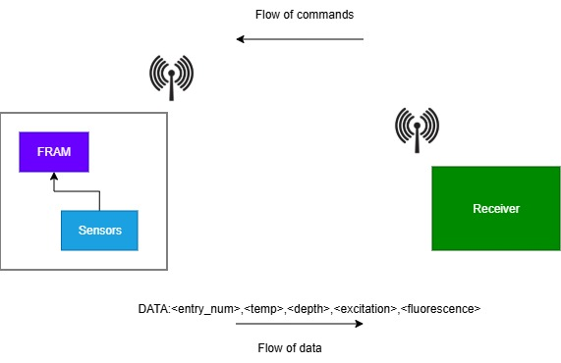
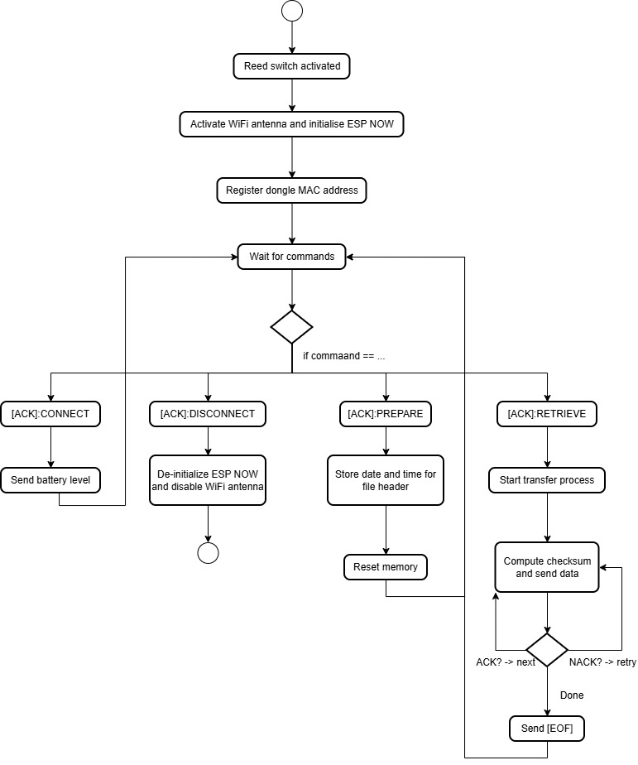
Subsystem 1 — Data Transfer & Visualisation
Saeed Solomon · ESP-NOW wireless protocol + Mission Control GUI
PROTOCOL SELECTION
• NFC — ruled out: strict proximity & orientation requirements
• BLE — implemented but abandoned: ESP32-C6 stack immaturity
• ESP-NOW — selected: proven reliability, 100 m range, ultra-low power
PROBE COMMAND FLOW
• [CMD]:CONNECT — verify link, update battery level on GUI
• [CMD]:PREPARE — reset FRAM, store session timestamp
• [CMD]:RETRIEVE — stream all records with CRC-16 check
• [CMD]:DISCONNECT — power down radio to conserve battery
RESULTS
• 1.2 % avg data error (spec: < 5 %)
• 8 s wake-to-advertising (spec: < 10 s)
• All 7 ATPs passed

Slide 6
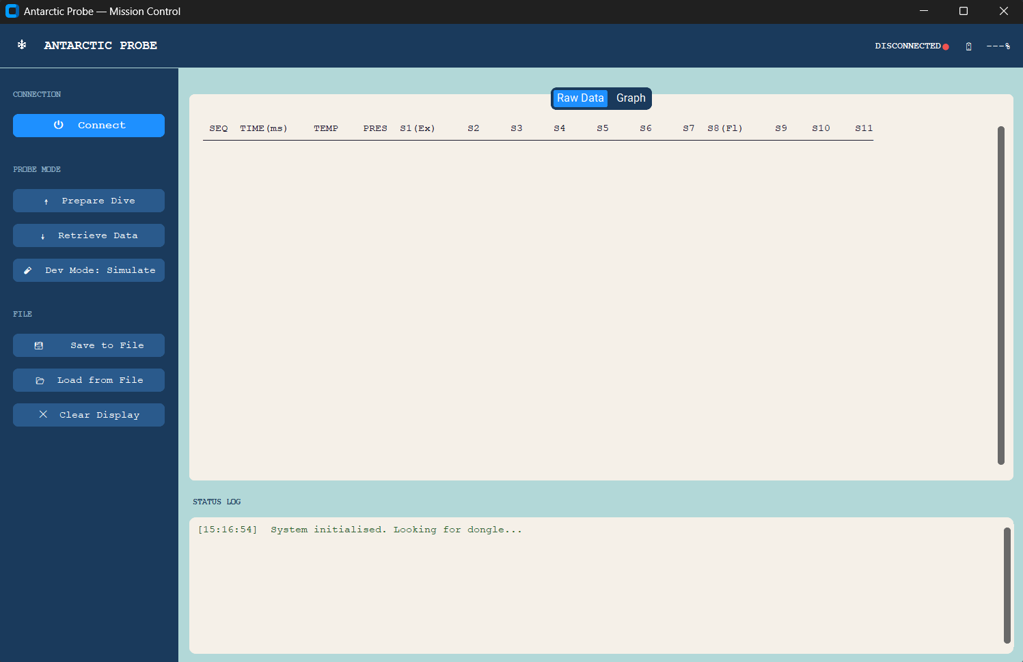
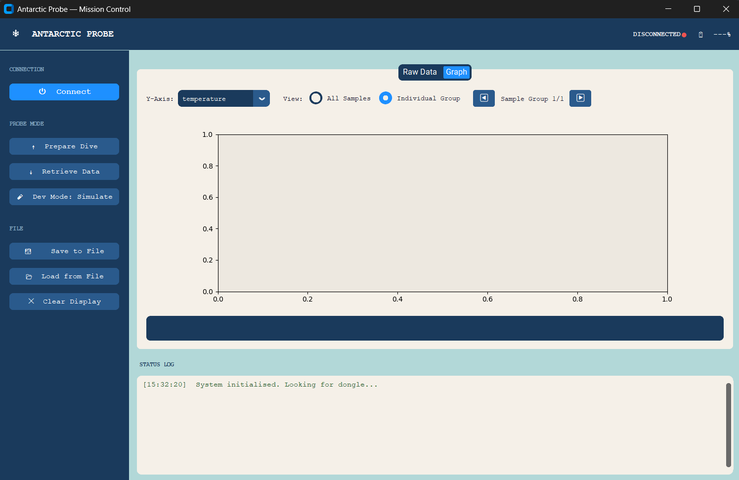
Mission Control GUI
Fully offline Python desktop application — CustomTkinter + Matplotlib
KEY FEATURES
• Top toolbar shows connection status and battery percentage
• Sidebar: Connect / Prepare Dive / Retrieve Data / Dev Mode / Save & Load
• Raw Data tab — scrollable table of all 14 sensor channels per record
• Graph tab — interactive time-series with All Samples or per-Group view
• Status log at the bottom prints timestamped system events
• Anomaly markers (red dots) overlaid on graphs by the ML backend
Raw Data tab
Graph tab

Slide 7
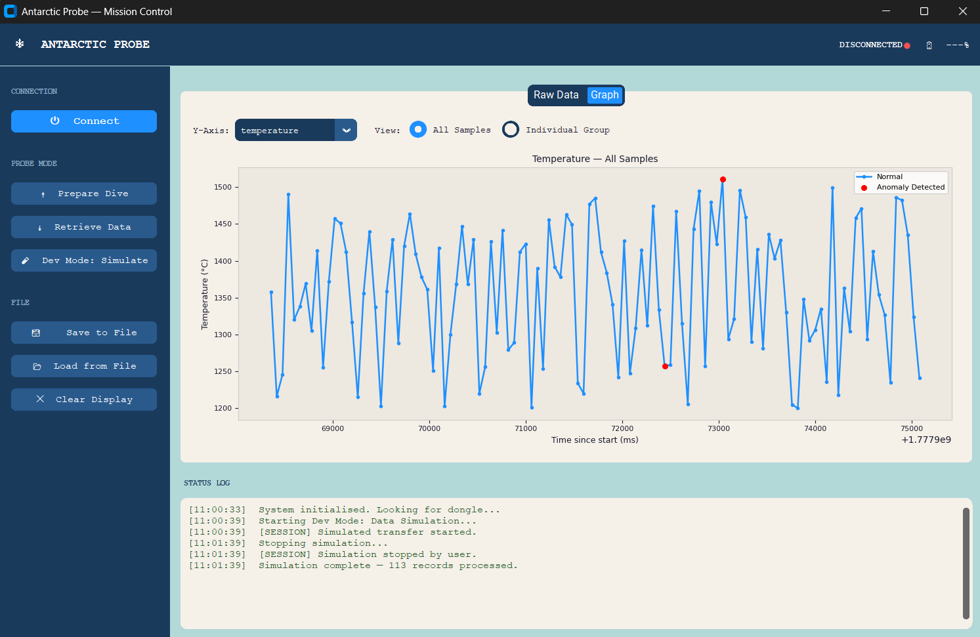
Subsystem 2 — Edge Architecture & Explainable AI
Kiyuran Naidoo · On-probe firmware lifecycle + offline ML anomaly detection
4-STATE FIRMWARE LIFECYCLE
• STATE_IDLE — deep sleep on LP-IO, woken by magnetic reed switch
• STATE_ARMED — sinking delay (15 min) before data acquisition begins
• STATE_LOGGING — periodic measurement cycles; records written to FRAM
• STATE_OFFLOAD — activates ESP-NOW; awaits [CMD]:RETRIEVE from GUI
MEMORY — FERROELECTRIC RAM (FRAM)
• 10 mA write current vs 100 mA for SD card
• Operating range: -55 °C to +85 °C
• Data preserved across deep sleep resets (RTC SRAM)
• 58-byte fixed MTU per record, 14 sensor values
Mission Control graph: 113 records with anomalies flagged in red by the MarineAnomalyDetector
EXPLAINABLE AI (XAI) ENGINE
• Isolation Forest: anomaly isolation via random decision trees — O(n log n)
• Post-hoc deterministic ruleset: classifies Phytoplankton / Cyanobacteria / CDOM
• 92 % accuracy, 0 false positives, ~0.008 s inference (spec: < 2 s)

Slide 8
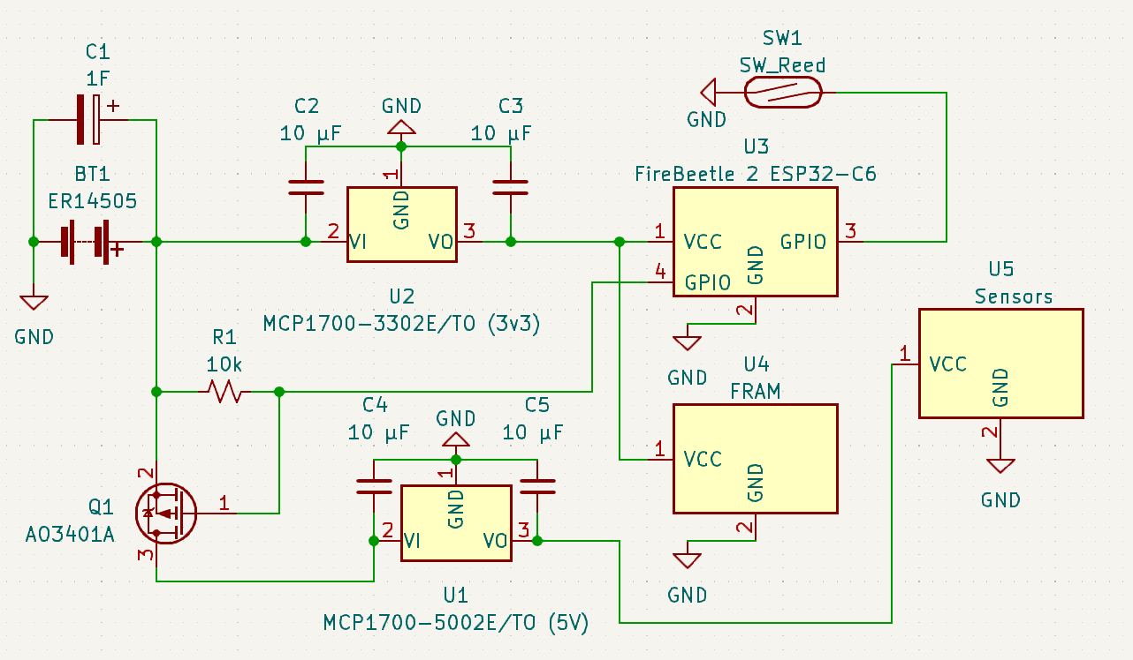
Subsystem 3 — Power & Thermal Management
Joshua Naidoo · 365-day autonomy in Antarctic cryogenic conditions
ENERGY ARCHITECTURE
• ER14505 Li-SOCl₂ battery — operational down to -55 °C
• Nominal 2 400 mAh; 50 % capacity derated for -50 °C
• MCP1700 LDO: 1.6 µA quiescent vs 5 mA for LM7805
• FireBeetle 2 ESP32-C6: 10 µA deep sleep vs 10 mA (DevKit)
• Split-rail: 3.3 V always-on rail + 5 V switched sensor rail
• P-MOSFET (AO3401A) power gate — GPIO-controlled sensor isolation
• ~22 measurement cycles/day over 365-day mission verified
THERMAL 'HUDDLE' STRATEGY
• Layer 1 — Aluminium foil tape: reflects infrared radiation
• Layer 2 — EWELDH010 foam: stagnant air pockets, high thermal resistance
• RF window: 20 mm foil gap allows 2.4 GHz ESP-NOW signal to escape
• MCP1700 regulators thermally bonded to battery stack (self-heating)
• Result: internal core held at -12 °C after 6 h cold-soak at -30 °C
• 16.8 µA measured standby current — within 20 µA specification
Split-rail power schematic: ER14505 battery → MCP1700 LDOs → ESP32-C6 + FRAM + Sensors

Slide 9
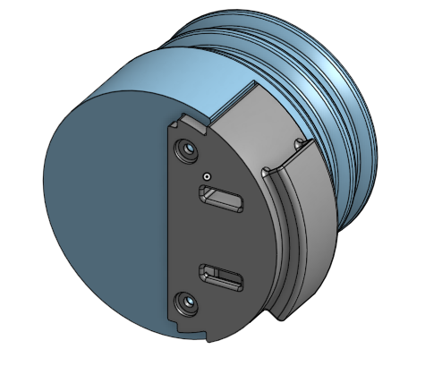
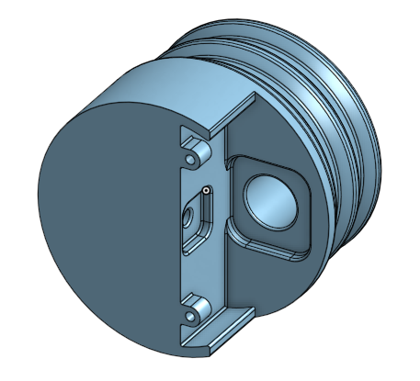
Subsystem 4 — Sensors & Housing
Devon Clark · Chlorophyll fluorometer, temperature, depth, waterproof PVC enclosure
SENSOR SUITE
• AS7341 — 11-channel spectral sensor; 445 nm excitation, 680 nm fluorescence channels
• CZ104BC — 460 nm blue LED excitation (5 500–6 000 mcd); matches chlorophyll-a peak
• DS18B20 — waterproof 1-Wire digital; factory-calibrated; ±0.4 °C achieved
• Analog pressure sensor — 0–120 m range; R² > 0.99 depth linearity
• 11-step PWM ramp algorithm to optimise fluorometer sensitivity
WATERPROOF HOUSING
• 50 mm OD PVC pipe main body (46.8 mm ID, 250 mm length)
• FDM 3D-printed PLA end caps with 4 perimeters (SLA recommended for production)
• Friction-fit double O-ring seal — field serviceable, no tools required
• Negatively buoyant — self-sinking with ballast weights
• Waterproof to 1 m for 30 min (prototype validation)
• Total system cost: < R2 000 · Mass: < 1 kg
Rear end cap (sealed side)
Front end cap (sensor window side)

Slide 10
System Results & Validation
All subsystem acceptance test procedures passed
Data Transfer & Visualisation
Edge Architecture & Explainable AI
Power & Thermal Management
Sensors & Housing
• 1.2 % avg data error (spec: < 5 %)
• 8 s wake-to-advertising (spec: < 10 s)
• 100 m operational range (spec: > 10 m)
• All 7 ATPs passed
• Fully offline GUI operation confirmed
• FRAM data intact across all deep sleep cycles
• 4-state lifecycle validated via HITL serial telemetry
• 92 % XAI classification accuracy, 0 false positives
• 0.008 s inference per record (spec: < 2 s)
• All 4 ATPs passed
• 16.8 µA measured standby (spec: ≤ 20 µA)
• -12 °C core after 6 h cold-soak at -30 °C
• 3.3 V & 5.0 V rails stable across full discharge
• P-MOSFET gate: sensor current drops to 0 µA on GPIO
• All 5 ATPs passed
• Fluorescence ratio monotonically increases down to 1/32 dilution
• Temperature accuracy ±0.4 °C (spec: ±0.5 °C)
• Depth linearity R² > 0.99 (spec: R² > 0.99)
• Waterproof at 1 m for 30 min — no ingress
• All 8 ATPs passed · Total cost < R2 000

Slide 11
Conclusions & Future Work
A functional, integrated Antarctic monitoring system demonstrated across all four subsystems
CONCLUSIONS
FUTURE WORK
• A fully integrated bipartite probe system was designed and demonstrated
• Sensor data is acquired, stored in FRAM, and wirelessly offloaded to a laptop GUI
• ML-based anomaly detection operates entirely offline on standard hardware
• System is hand-deployable by one non-specialist from a vessel of opportunity
• Annual autonomy validated through energy modelling and cold-soak testing
• Total cost within R2 000 budget; fits within 50 mm OD PVC housing
• All 24 acceptance test procedures across four subsystems passed
• Migrate to BLE once ESP32-C6 NimBLE stack matures (remove dongle requirement)
• SLA resin end caps for long-term immersion (replace FDM PLA)
• Absolute chlorophyll calibration using field samples
• Extend depth rating beyond 2 m prototype limit
• Add dissolved oxygen & nutrient sensors within revised budget
• LoRaWAN / NVIS relay from docking station to mainland research facility
• Satellite uplink for real-time data access during deployment

