Slide 1
Can You Predict the Likelihood of Receiving Conflicted by Form ADV Data?

Slide 2

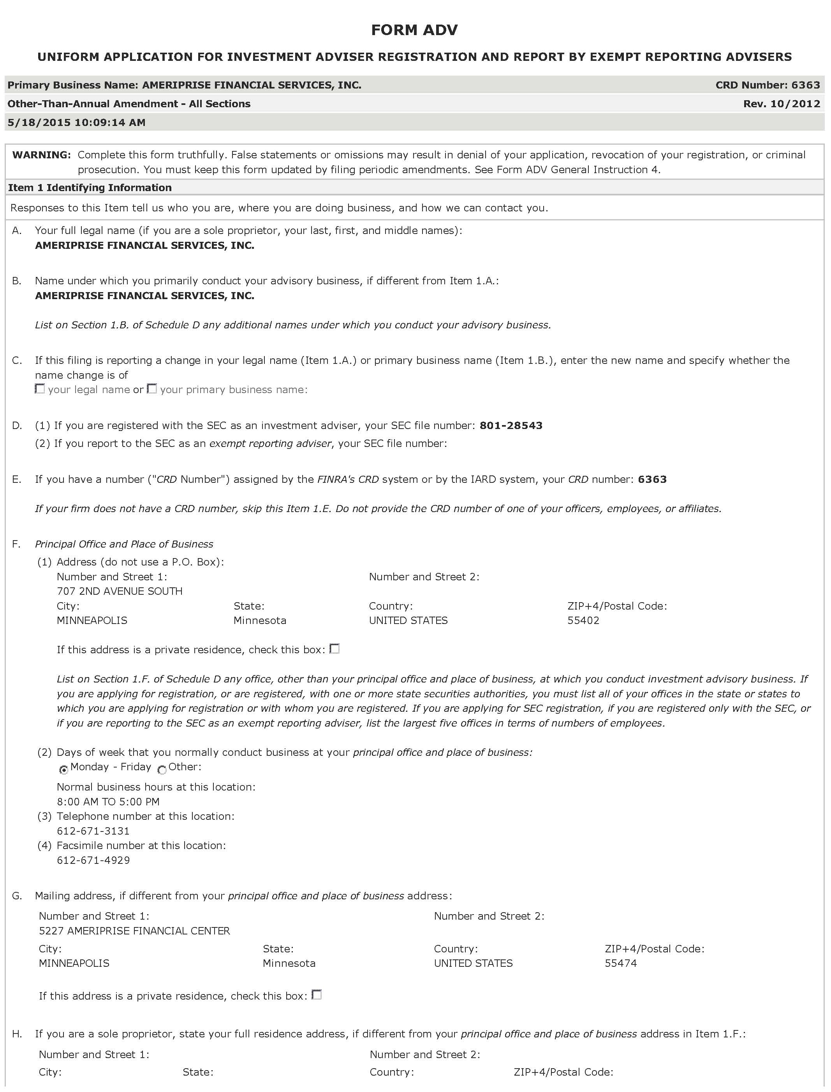
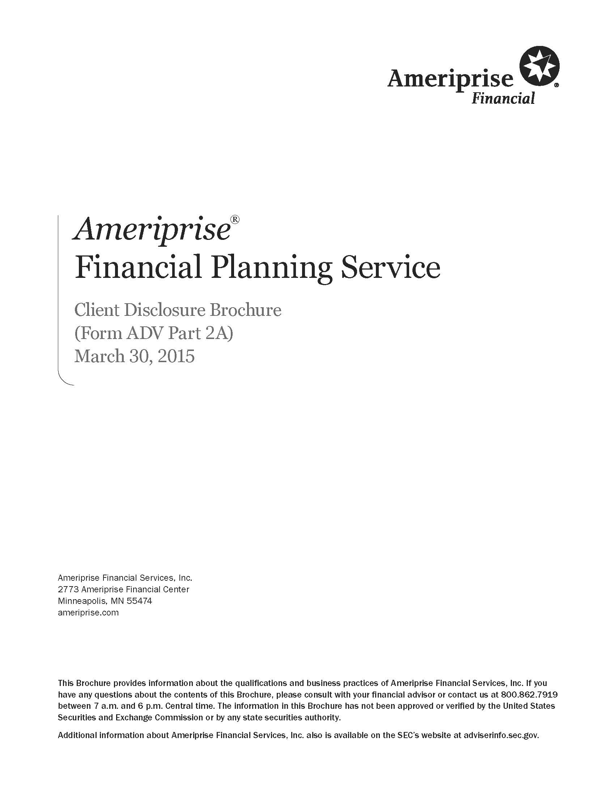
What is Form ADV?
Form ADV is the uniform form used by investment advisers to register with both the Securities and Exchange Commission (SEC) and state securities authorities. The form consists of two parts.
Part 1 requires information about the investment adviser’s business, ownership, clients, employees, business practices, affiliations, and any disciplinary events of the adviser or its employees. Part 1 is organized in a check-the-box, fill-in-the-blank format.
Part 2 requires investment advisers to prepare narrative brochures written in plain English that contain information such as the types of advisory services offered, the adviser’s fee schedule, disciplinary information, conflicts of interest, and the educational and business background of management and key advisory personnel of the adviser.

Slide 3
What is Conflicted Advise?
RIAs are generally under a legal obligation to act under a fiduciary standard of care, or in the best interest of a client.
However, there are instances where an RIA can act under a lower standard called the suitability standard but must disclose these events.
There may also be instances where an RIA may say one thing, but carefully examining disclosures in the form ADV may reveal inconsistencies.
Due to disclosure requirements, language and information in the form ADV can reveal instances where there is a "conflict of interest" regarding the financial advice being given or financial product being sold.
A conflict in the type of advise one receives means that a consumer is not receiving advice in their best interest.

Slide 4
Project Design
Part 1 data available in csv format
Examine Form ADV Part 1 for Predictive Features
Tag categorical features/ set baselines
Identify best model
Fit a categorical model on training data
Make predictions based on ADV Part 1 and ADV Part 2
Looking at ADV Part 1 and Part 2 will reveal inaccuracies and misleading statements
Determine if advice from a firm is likely to result in conflicted advice.
ADV Part 1
Mass download of form ADV part 2
Examine Form ADV Part 2 using natural language processing methods
ADV Part 2

Slide 5
Questions?

