Slide 1

WELCOME
MORE ON
ACOUNTS RECEIVABLE &
ACCOOUNTS PAYABLE (FI)
Compiled By S.N.HEGDE

Slide 2
Topics
Dunning
Automatic Payment Program
Down payment
Credit Management

Slide 3
DUNNING

Slide 4
Dunning –
Dunning stands for sending reminders for recovery. The dunning procedure you need to maintain allows you to set various parameters such as –
How many times?
When i.e. with what interval?
Any dunning charges applicable?
Interest to be charged?
Legal notice is to be sent?

Slide 5
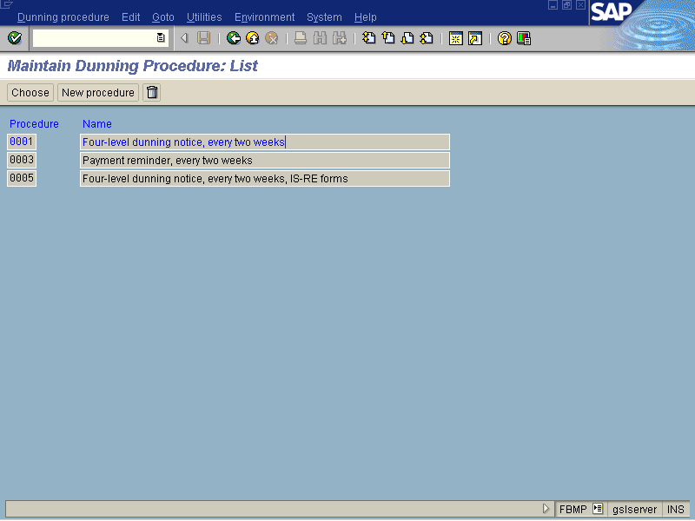

Slide 6
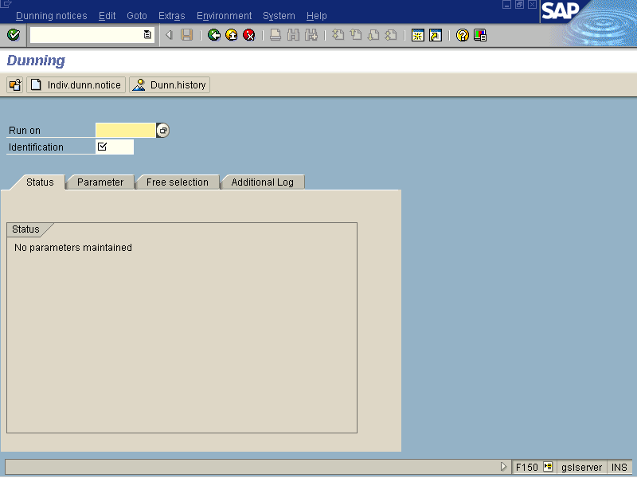

Slide 8
B) AUTOMATIC
PAYENT PROGRAM

Slide 9
Automatic payment program
Instead of using manual payment method to pay for more than one invoice in single activity, you can use ‘Automatic payment program’ after configuration.
You need to configure –
- Your company details
- Minimum amount to be paid/received
- Foreign currency dealings allowed or not?
- Payment methods (printing program)
- GL accounts, ranking order and so on…

Slide 10
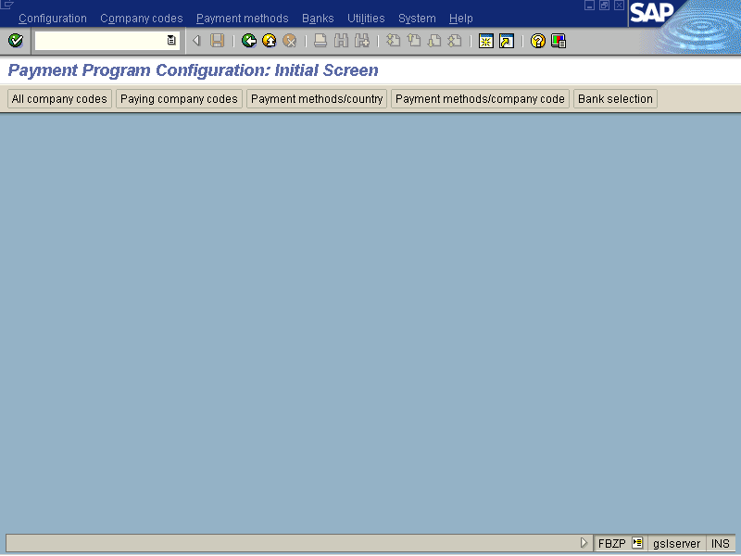

Slide 11
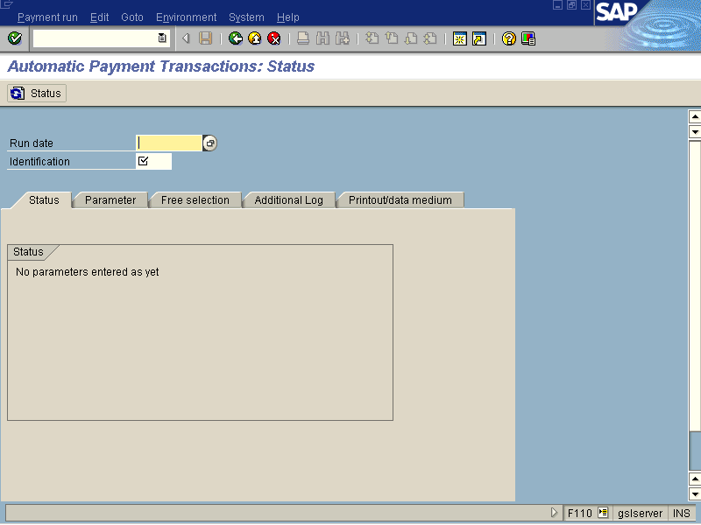

Slide 13
C) DOWN PAYMENT

Slide 14
DOWN PAYMENT

Slide 15
Refer separate note

Slide 16
D) CREDIT MANAGEMENT

Slide 17
CREDIT MANAGEMENT
Credit management is a matter of concern in both FI and SD. There are vital pieces of credit management configuration in both modules.
In FI modules, the activities involved are:
Defining Credit Control Area
Defining Credit Risk Categories.
Creating Credit Representative Groups
Assigning Employees to Credit Rep. Group
Define Days in Arrears Calculation

Slide 18
CREDIT MANAGEMENT
To get to the configuration screen for Creating Credit Control Area, use following menu : Enterprise Structure -> Maintain Structure -> Definition -> Financial Accounting-> Maintain Credit Control
Transaction code : OB45

Slide 19
CREDIT MANAGEMENT
To get to the configuration screen for Defining Credit Risk Categories , use following menu : Financial Accounting ->Accounts Receivable and Accounts Payable -> Credit Management -> Credit Control Account -> Define Risk Categories.
Transaction code : OB01

Slide 20
CREDIT MANAGEMENT
To get to the configuration screen for Creating Representative Group, use following menu : Financial Accounting ->Accounts Receivable and Accounts Payable -> Credit Management -> Credit Control Account ->Define Accounting Clerk Group
Transaction code : OB02

Slide 21
CREDIT MANAGEMENT
You can assign employees to credit representative groups by using following menu:Financial Accounting ->Accounts Receivable and Accounts Payable -> Credit Management -> Credit Control Account ->Define Credit Representative
Transaction code : OB51

Slide 22
CREDIT MANAGEMENT
To get to the configuration screen for Maintaining the Days in Arrears Calculation, use following menu :Financial Accounting ->Accounts Receivable and Accounts Payable -> Credit Management -> Business Transaction: Credit Monitoring -> Define Intervals for Days in Arrears for Credit Management
Transaction code :OB39

