Slide 1

WELCOME
CONFIGURATION
TO
ASSET ACCOUNTING (FI)
Compiled By S.N.HEGDE

Slide 2
Topics
Asset Accounting
Chart of Depreciation,
Account Determination
Screen Layout & Number Ranges
Asset Class & Master Records
Acquisition of Assets
Retirement of Assets
Depreciation Run

Slide 3
ASSET ACCOUNTING

Slide 4
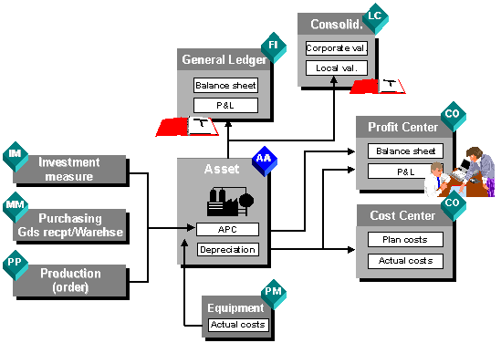
Asset Accounting

Slide 5
Asset Accounting
This sub-ledger allows you to maintain all fixed assets.
The asset values including cost of asset, depreciation value and retirement (sale value) of asset are maintained in detail in the Asset chart (Register).
The asset’s life, depreciation rates, depreciation methods are handled very neatly in the system.

Slide 6
Asset Accounting
Various reports are available to view asset values –
- Asset explorer
- Asset account balances
- Asset history sheet
- Depreciation reports (According to
Company Act and Income Tax Act)

Slide 7
Asset Accounting customization
The customization includes –
- Chart of depreciation
- Asset account determination
- Screen layout rules
- Number ranges
- Asset class
- For Depreciation –
- Depreciation key which includes
- Calculation methods
- Rate and style (Straight line/ Diminishing
balance)
These depreciation keys are attached to each depreciation area in the asset master record.

Slide 8
B) CHART OF
DEPRICIATION

Slide 9
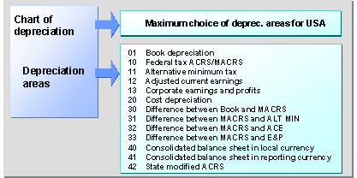
Chart of Depreciation
Charts of depreciation are used in order to manage various legal requirements for the depreciation and valuation of assets. These charts of depreciation are usually country-specific and are defined independently of the other organizational units. A chart of depreciation, for example, can be used for all the company codes in a given country.

Slide 10
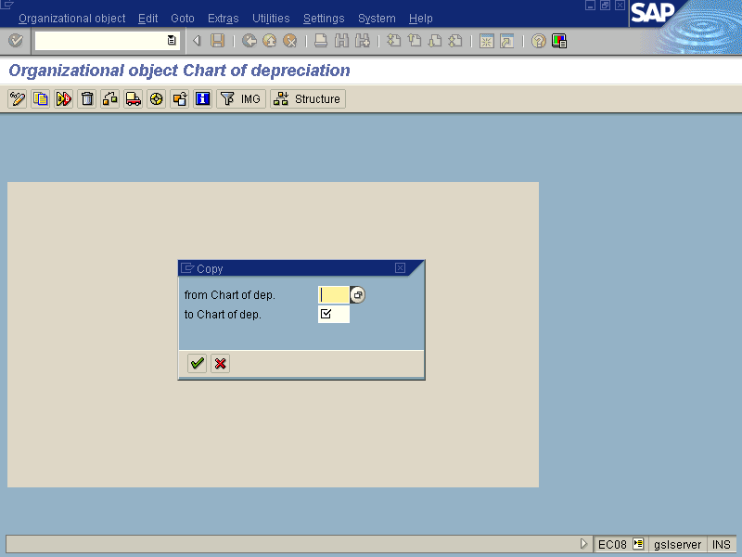

Slide 11
C) ACCOUNT
DETERMINATION

Slide 12
Asset account determination
You can automatically update all relevant transactions to the general ledger. These include all accounting transactions that are posted to assets, and all changes to asset values that are automatically calculated by the system (particularly depreciation). This update takes place immediately online for one depreciation area, or as part of periodic processing for all depreciation areas.
- In short, this is link between your asset and
general ledger.

Slide 13
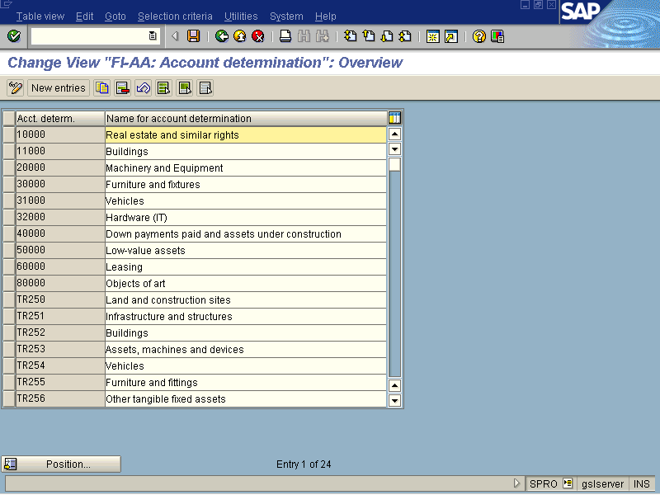

Slide 14
D) SCREEN LAYOUT
& NUMBER RANGE

Slide 15
Screen Layout rule
- For maintaining master record you must configure screen layout (field status). You can specify which fields are required, optional and suppressed and at what level they will be used either asset class (broader level) or individual asset level (micro level).
Number Range interval
To identify the asset with particular number or id this number ranges are required to maintain.
Asset class
This is nothing but classification of asset according to the type of asset, for e.g. building, vehicles, furniture & fixture and so on…
Here you need to link Account determination, screen layout rule and number range interval.

Slide 16
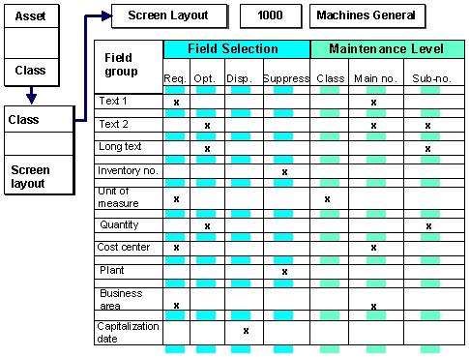
Asset Screen Layout Rule

Slide 17
D)ASSET CLASS
& MASTER RECORD

Slide 19
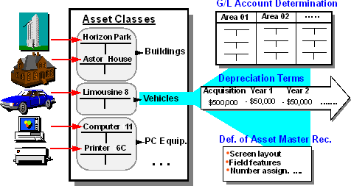
Asset Class

Slide 20
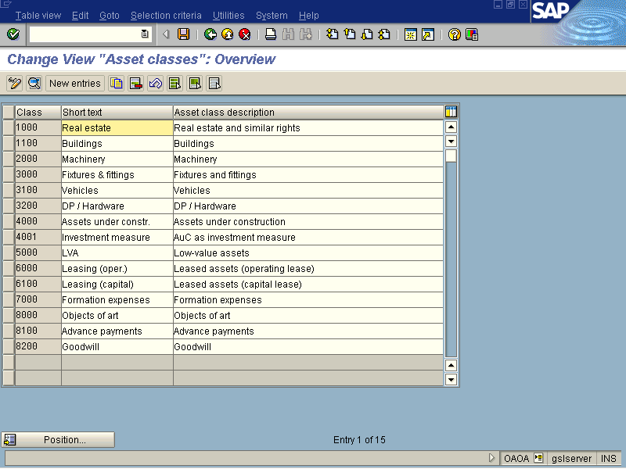

Slide 21
Asset master record
Details of individual asset are recorded in this master data. Each master record includes –
- description
- quantity & unit of measure (if required)
- needs asset history?
- allocation to business area, cost center,
plant and others if any
- value of asset, date of capitalization
- depreciation key per depreciation area
- life of asset, start date of deprecation
Some details are updated in this after acquisition.

Slide 22
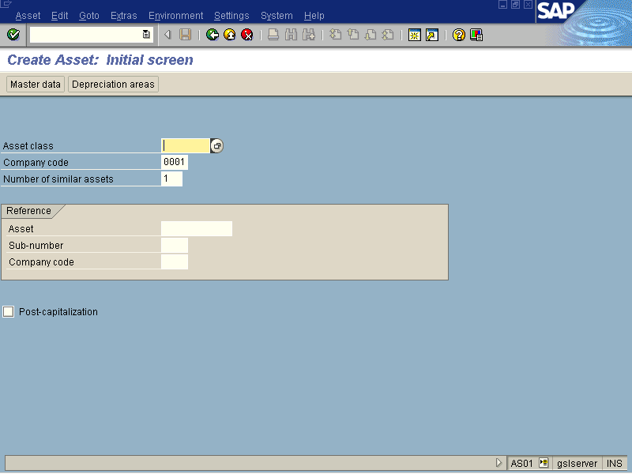

Slide 24
F) ASSET ACQUISITION

Slide 25
Asset acquisition
Asset can be acquisited (purchased) and recorded in the asset accounting via MM or directly. This means you can go through complete cycle of MM for purchase of an asset. You can even create asset at entry level (purchase requisition or purchase order).
After invoice (from MM or asset accounting ) only the asset will be recorded in the books of accounts.
The posting date and amount will be considered as acquisition / capitalization date and acquisition value on and from which depreciation will be charged up to and according to useful life and depreciation key mentioned in the asset master record.

Slide 26
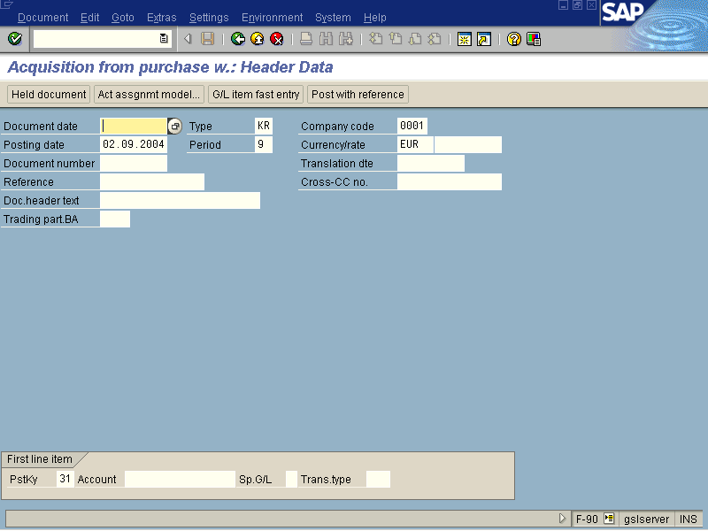

Slide 27
Asset Explorer (report)
This report shows complete details of asset valuation. It shows –
- Acquisition value and date
- Depreciation amount on periodical basis
- Value comparison up to and throughout
useful life
- Depreciation key and depreciation start
date
- Allocation or assignment (PO number,
vendor, cost center, GL account)

Slide 29
G)RETIREMENT OF ASSET

Slide 30
Retirement (Sale) of Asset
- The sale of asset is disposal (removal) from your books of accounts.
- System allows you to sale the asset on part or fully (complete) basis.
- Considering the date of sale and value of asset, system calculates and updates gain or loss from sale of asset and depreciation for the said period.
The asset gets deactivated (if it is sold fully) and stops to use the same for any further transactions.

Slide 31


Slide 32
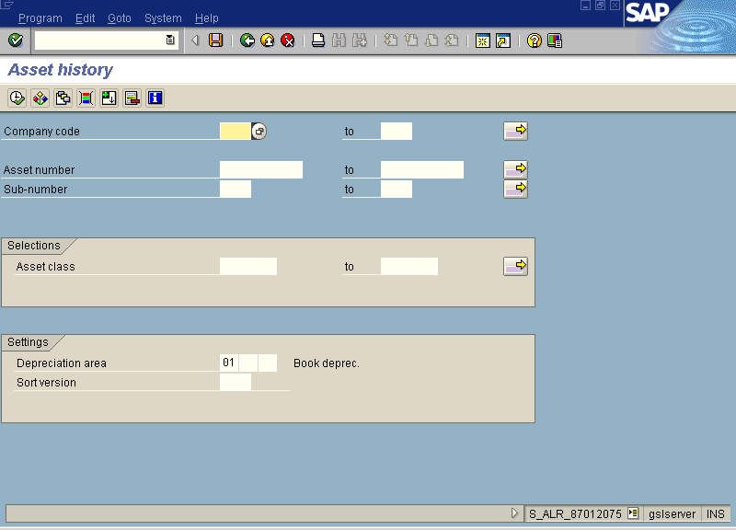

Slide 33
H)DEPRECIATION RUN

Slide 34
Depreciation
The depreciation is charged on all assets in your company code for the given period of a fiscal year. The document entry for depreciation gets posted in the background as soon as you execute ‘Depreciation Run’.
- While posting these entries system checks for the parameters like rate and date and method (SLM/WDV).
- The values are updated in ‘Asset Accounting’ and in the ‘GL’. Separate documents gets posted in both modules.

Slide 35
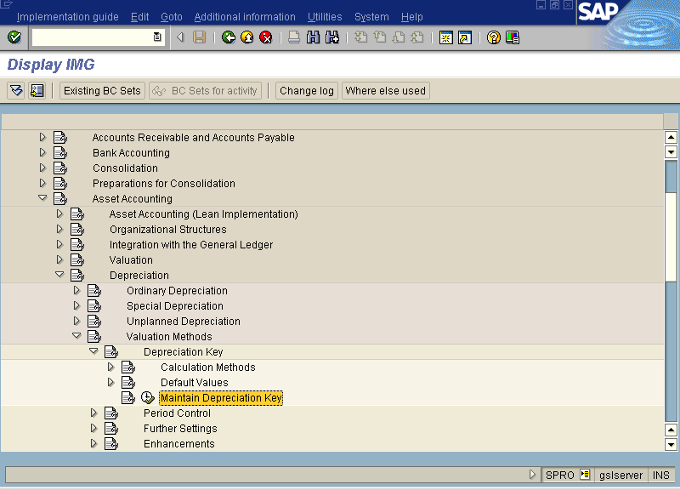

Slide 36
