Slide 1
Mobile Motion Tracking Robot Arm
Jeffery Ruocco (Computer Engineer)
Jeffrey Falberg (Computer Engineer)
Getro Jean-Bapiste (Electrical Engineer)

Slide 2
Goals
Create a robot arm that is controlled by motion tracking
Arm and platform can be controlled from a distance
Prototype for possible use in situations unsafe for humans

Slide 3
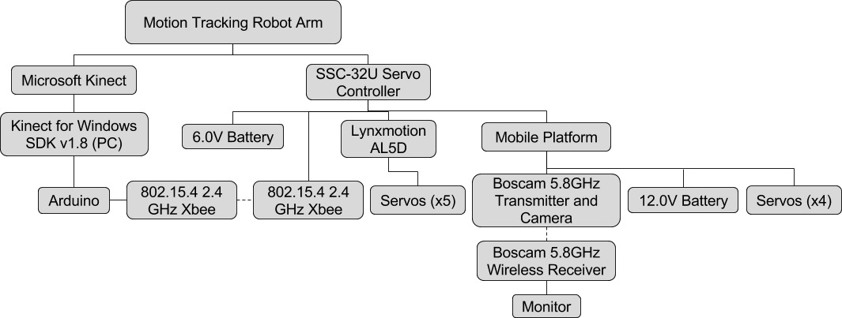
System Hierarchy

Slide 4
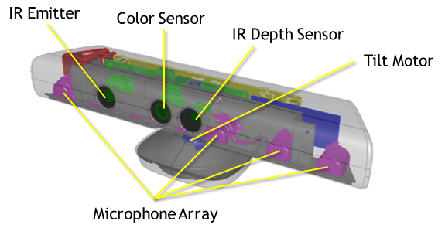
Microsoft Kinect
Three Sensors: IR Emitter, IR Depth Sensor, RGB Camera
Kinect uses a technique known as structured light to create a depth map
Body position is inferred using machine learning
Kinect for Windows SDK v1.8
Notes:
Structured light: IR emitter emits pattern of infrared light, pattern gets distorted by objects in room. IR Depth Sensor detects distortions and uses it to create depth map.
Depth map passed through machine learning algorithm to determine body positions in the room.

Slide 5
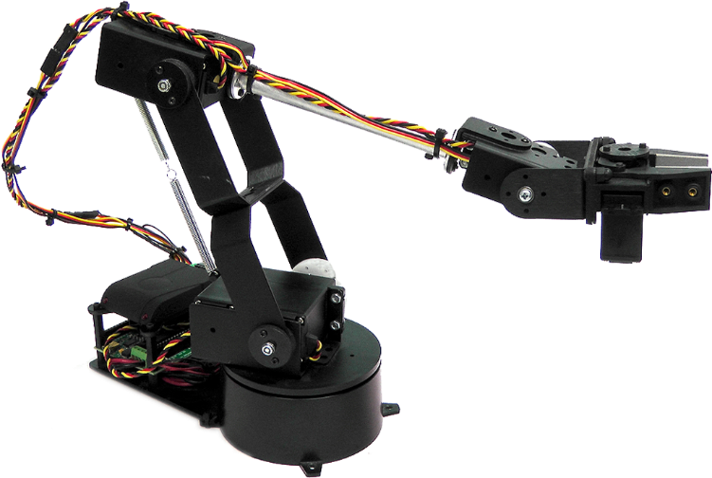
Lynxmotion AL5D
Five servos: base, shoulder, elbow, wrist, gripper
Maximum reach of 16.5 inches
Can lift up to 10oz at full reach

Slide 6
SSC-32U Servo Controller
Accepts string commands
3-pin servo connector
Power requirements
9600 Baud rate

Slide 7
Mobile Platform
Four FeeTech continuous servos, one for each wheel (4WD)
One aluminum panel and two aluminum channels

Slide 8
Arduino Uno
ATmega328 processor
I/O pins

Slide 9
802.14.5 2.4GHz Xbee Module
Created custom Arduino shield for Xbee
Configured to transmitter and receiver
Ranges

Slide 10
Boscam 5.8GHz Transmitter and Camera
Power
Range
Resolution + fps
130 degree field of view

Slide 11
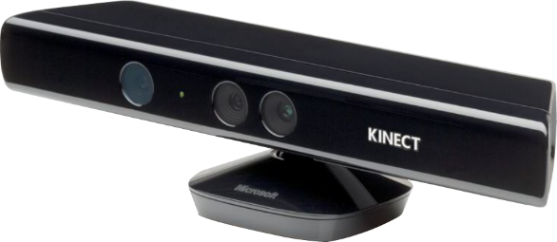
Motion Tracking
Skeletal tracking using SDK
Extracting hand joint and coordinates
Sending coordinates to Arduino
Sending platform signals to Arduino

Slide 12
Arduino Programming
IK calculations – what is IK?
Linear regression calculations
Xbee communication
Sending commands to SSC-32U
Platform control

Slide 13
SSC-32U Commands
Receive commands from Arduino through Xbee

Slide 14
Cost
Kinect – free
Arduino Uno + Shield
Xbee modules
Platform
Lynxmotion AL5D
Camera
5.8 GHz receiver + adapter
Batteries + charger

Slide 15
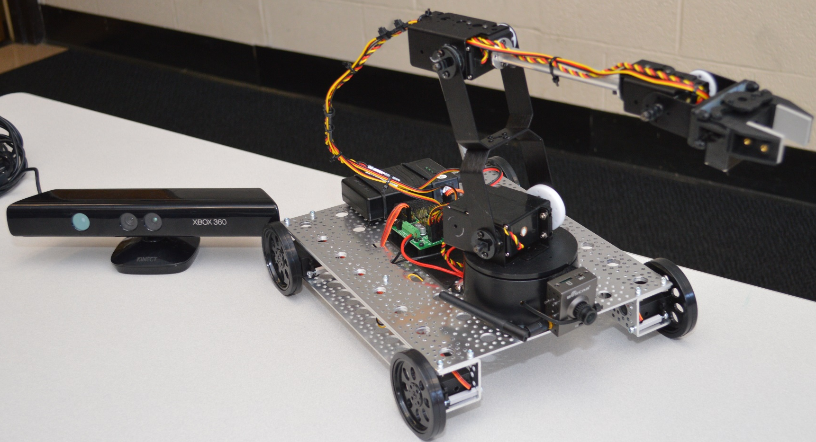
Results
Picture/video of project

Slide 16
References

