Slide 1
Mobile Motion Tracking Robot Arm
Jeffery Ruocco (Computer Engineer)
Jeffrey Falberg (Computer Engineer)
Getro Jean-Bapiste (Electrical Engineer)

Slide 2
Goals
Create a robot arm that is controlled by motion tracking
Arm and platform can be controlled from a distance
Prototype for possible use in situations unsafe for humans
Notes:
Be able to control from a distance. Final test for us was to drive to a distance object, pick it up, and bring it back – project is success
Prototype for future device that could be used in situations that are not safe for humans

Slide 3
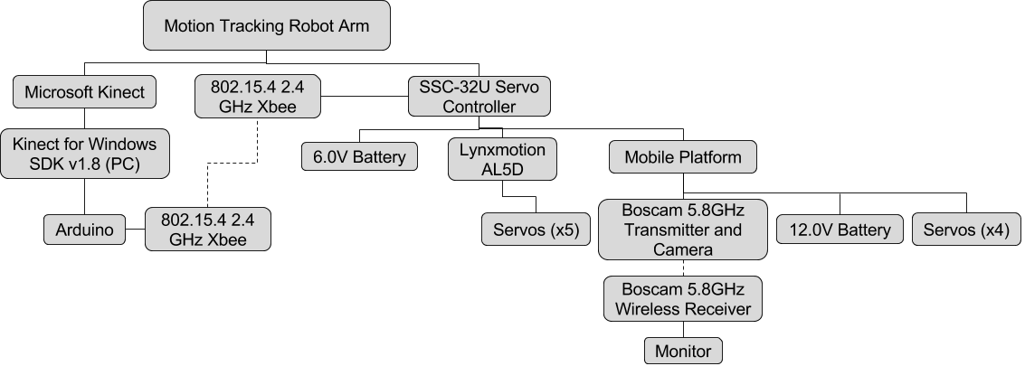
System Hierarchy
Notes:
Starts at Kinect – does motion tracking
Communicates with SDK
SDK sends coordinates for user’s hand to Arduino
Arduino translates coordinates into servo positions
Arduino sends commands to SSC-32U through wireless Xbees

Slide 4
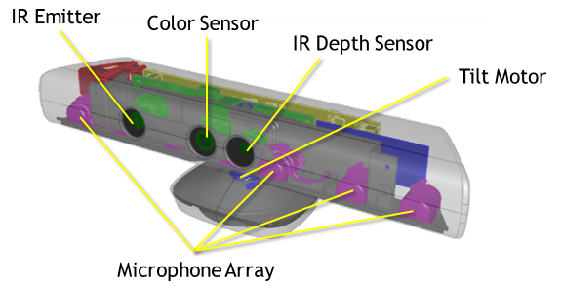
Microsoft Kinect
Three Sensors: IR Emitter, IR Depth Sensor, RGB Camera
Kinect uses a technique known as structured light to create a depth map
Body position is inferred using machine learning
Kinect for Windows SDK v1.8
Notes:
- Jeff R.
Structured light: IR emitter emits pattern of infrared light, pattern gets distorted by objects in room. IR Depth Sensor detects distortions and uses it to create depth map.
Depth map passed through machine learning algorithm to determine body positions in the room.
Use SDK to extract coordinates from joints

Slide 5
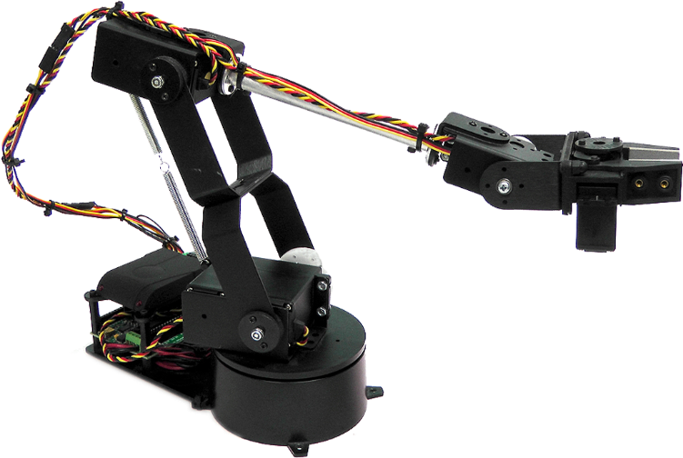
Lynxmotion AL5D
Five servos: base, shoulder, elbow, wrist, gripper
Maximum reach of 16.5 inches
Can lift up to 10oz at full reach
Notes:
Wrist tracking with Kinect not reliable enough to allow wrist movement on arm

Slide 6
SSC-32U Servo Controller
3-pin servo connector
Requires 6Vdc
We use 9600 Baud rate
Connector for Xbee modules
Accepts string commands
#0 P1500 S500 T1000
Notes:
# - servo number, P – servo position, S – maximum servo speed (microseconds per second), T – time to complete motion

Slide 7
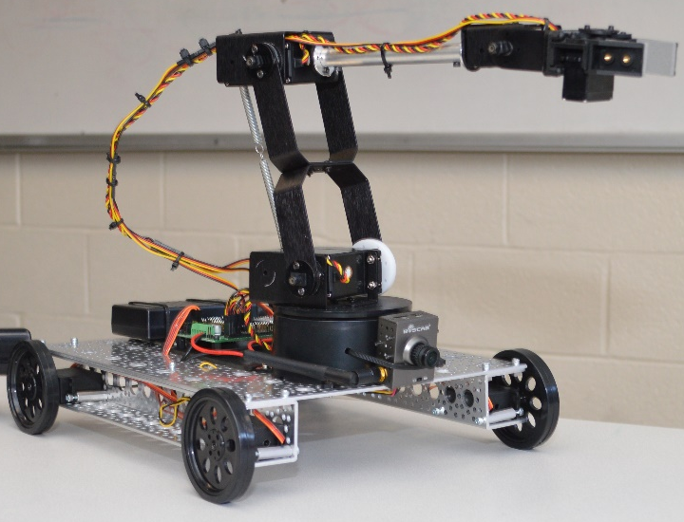
Mobile Platform
One aluminum panel and two aluminum channels make up the frame
Four FeeTech continuous servos, one for each wheel (4WD)
Controlled by SSC-32U
Boscam 5.8 GHz transmitter and receiver
Notes:
Under 6V – servos have 2.8lbs of torque, more than enough for arm
Servo over motor so we could control with SSC-32U

Slide 8
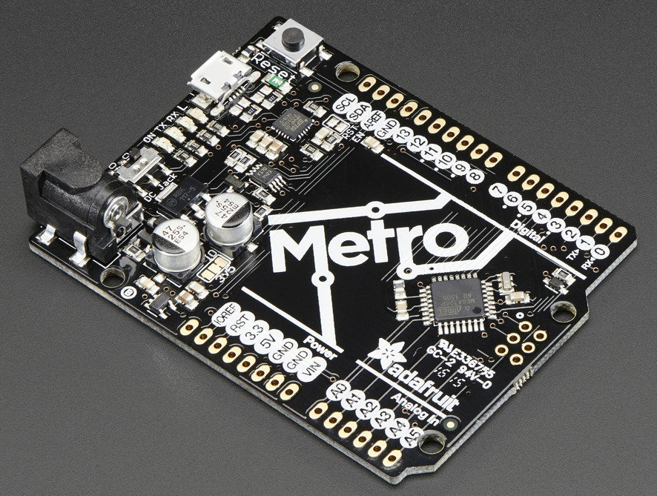
Arduino Uno
Uses an ATmega328 processor
Pins 0 and 1 used as Rx and Tx for serial communication with PC
Pins 2 and 3 used as Rx and Tx for serial communication with Xbee (SoftwareSerial)
Notes:
Our version of the Arduino – Adafruit Metro328
Use it calculate servo positions from the Kinect’s coordinates

Slide 9
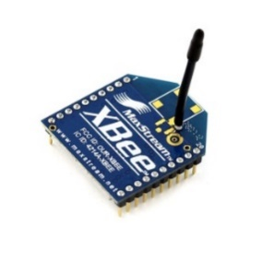
802.14.5 2.4GHz Xbee Module
Operates on 2.4GHz
Range from 40 to 100 meters
Created custom Arduino shield for Xbee
Used X-CTU to configure transmitter and receiver
Notes:
Used to communicate wirelessly between Arduino and robot arm
Range – inside or outside with line of sight
Custom shield to wire SoftwareSerial pins 2 and 3 to Rx and Tx of Xbee
X-CTU – set destination address to ID of opposite Xbee

Slide 10
Boscam 5.8GHz Transmitter and Camera
1440x1080 30fps video
130 degree field of view
5.8GHz transmitter and receiver, 200mW transmitting power
Requires 12Vdc
Notes:
Used to give a clear view of the arm wherever it is
5.8GHz - With wall in between, range can go maybe one room over, but outside you can get a range of 100+ meters

Slide 11
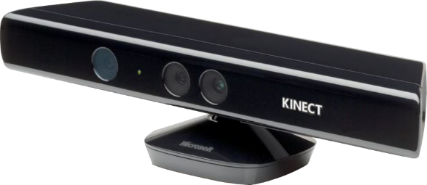
Motion Tracking
Skeletal tracking done using Kinect for Windows SDK v1.8
Joint information copied from SkeletonStream.
HandRight.X, HandRight.Y, HandRight.Z
Use serial communication to send coordinates to Arduino
arduinoPort.WriteLine(“HandRight,xPos,yPos,zPos”)
Platform and gripper input done in Kinect SDK
“forward”, “backward”, “HandOpened”, “HandClosed”
Notes:
Use skeletal tracking to achieve motion tracking
Kinect SDK has skeleton stream – stores information about each joint (coordinates)
Each joint is an enumeration – HandRight.X gives x coordinate
Filter out right hand joint
Write to Arduino port – comma delimiter
Use gestures for hand opened/closed – Interaction stream: Grip/GripReleased events

Slide 12
Arduino Programming
Handles calculations to convert hand coordinates into servo positions
Two types of calculations: inverse kinematics (IK) and linear regression (y=mx + b)
Three steps to IK calculations:
Convert Kinect coordinates to robot arm coordinates (linear regression)
Calculate servo angles from desired robot arm coordinates (IK)
Calculate servo positions from servo angles (linear regression)
Servo commands sent through Xbee modules to SSC-32U using Software Serial
Notes:
Inverse kinematics is a series of equations used in robotics to find the joint angles required to put the end of an arm at a specific location
Linear regression: set max and min values for Kinect and arm and use them to find slope and intercept for our equations
Kinect coordinate measured as distance from Kinect – won’t work for arm. Scale down to inches

Slide 13
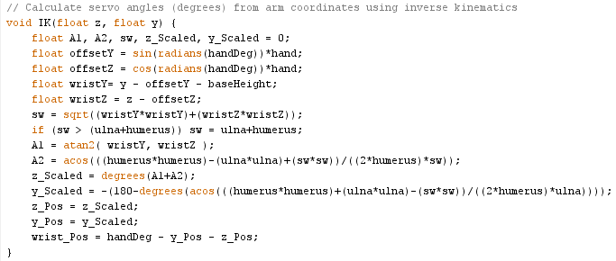
Inverse Kinematic Calculations
Notes:
Geometry
Hand – length of hand, ulna – length of ulna, etc.
Tell it where hand should be
Finds where wrist should be based on length of robot’s hand
sw - Finds distance between shoulder and wrist, think of it as a line
A1 - Finds angle b/w that line and ground
A2 - Finds angle b/w that line and humerus
Shoulder angle – A1 + A2
Elbow angle
Wrist maintains same angle to ground no matter what position the arm is in

Slide 14
Cost
Part | Cost | Part | Cost
6V Battery + Charger | $24.00 | 2.4GHz Xbee Modules (x2) | $50.00
12V Battery + Charger | $24.00 | Xbee Adapter | $10.00
Lynxmotion AL5D | $310.00 | Microsoft Kinect | $110.00*
Platform Components | $48.00 | Boscam 5.8GHz Transmitter + Camera | $59.99
FeeTech Continuous Rotation Servos (x4) | $47.80 | Boscam 5.8GHz Receiver | $17.98
Adafruit Servo Wheels (x4) | $11.80 | AV to VGA Converter | $18.00
Arduino Uno | $25.00 | Total | $647.17
* Kinect was already owned by a group member – not included in total price

Slide 15
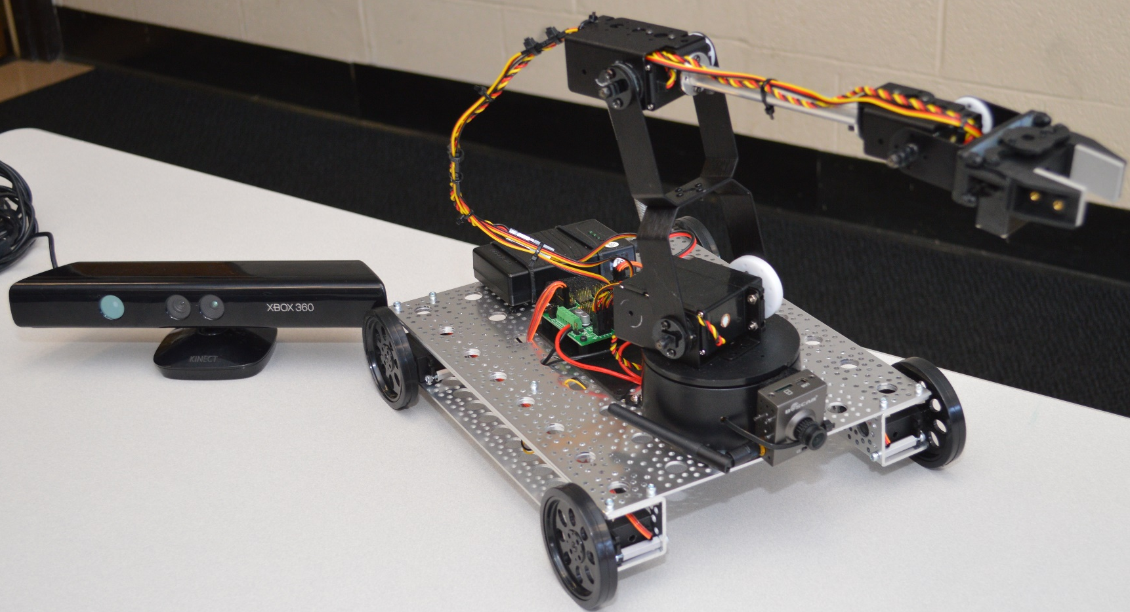
Results
Picture/video of project

Slide 16
GitHub
https://github.com/StormWulf/Mobile-Motion-Tracking-Robot-Arm

Slide 17
References
Lynxmotion. "Lynxmotion - SSC-32U USB Servo Controller." Lynxmotion. N.p., n.d. Web. <http://www.lynxmotion.com/p-1032-ssc-32u-usb-servo-controller.aspx>.
"METRO Development Boards with ATmega328." Digikey. N.p., n.d. Web. <https://www.digikey.com/en/product-highlight/a/adafruit/metro-development-boards-with-atmega328>.
MacCormick, John, Dr. "How Does the Kinect Work?" (n.d.): n. pag. 6 Sept. 2011. Web. <http://users.dickinson.edu/~jmac/selected-talks/kinect.pdf>.
Pterneas, Vangos. "Vangos/kinect-coordinate-mapping." GitHub. N.p., 4 May 2014. Web. <https://github.com/Vangos/kinect-coordinate-mapping>.
Smith, Tammy R. "Kinect for Windows Programming Guide." Microsoft Developer Network. Microsoft, 15 Jan. 2015. Web. <https://msdn.microsoft.com/en-us/library/hh855348.aspx>.
Velvárt, András. "Kinect Interactions With(out) WPF – Part III: Demystifying the Interaction Stream." Dotneteers. N.p., 3 May 2013. Web. <http://dotneteers.net/blogs/vbandi/archive/2013/05/03/kinect-interactions-with-wpf-part-iii-demystifying-the-interaction-stream.aspx>.
Keesling, Mike. "Lynxmotion Arms and Inverse Kinematics." Lynxmotion. N.p., n.d. Web. <http://www.lynxmotion.com/images/html/proj057.htm>.
Micromega Corporation. "Application Note 44: Controlling a Lynx6 Robotic Arm." (n.d.): n. pag. 9 Feb. 2009. Web. <http://www.micromegacorp.com/downloads/documentation/AN044-Robotic%20Arm.pdf>.
Kawal. "How to Use Xbees with Arduino." Community of Robots. N.p., 4 Dec. 2011. Web. <http://communityofrobots.com/tutorial/kawal/xbee-and-arduino>.

Slide 18
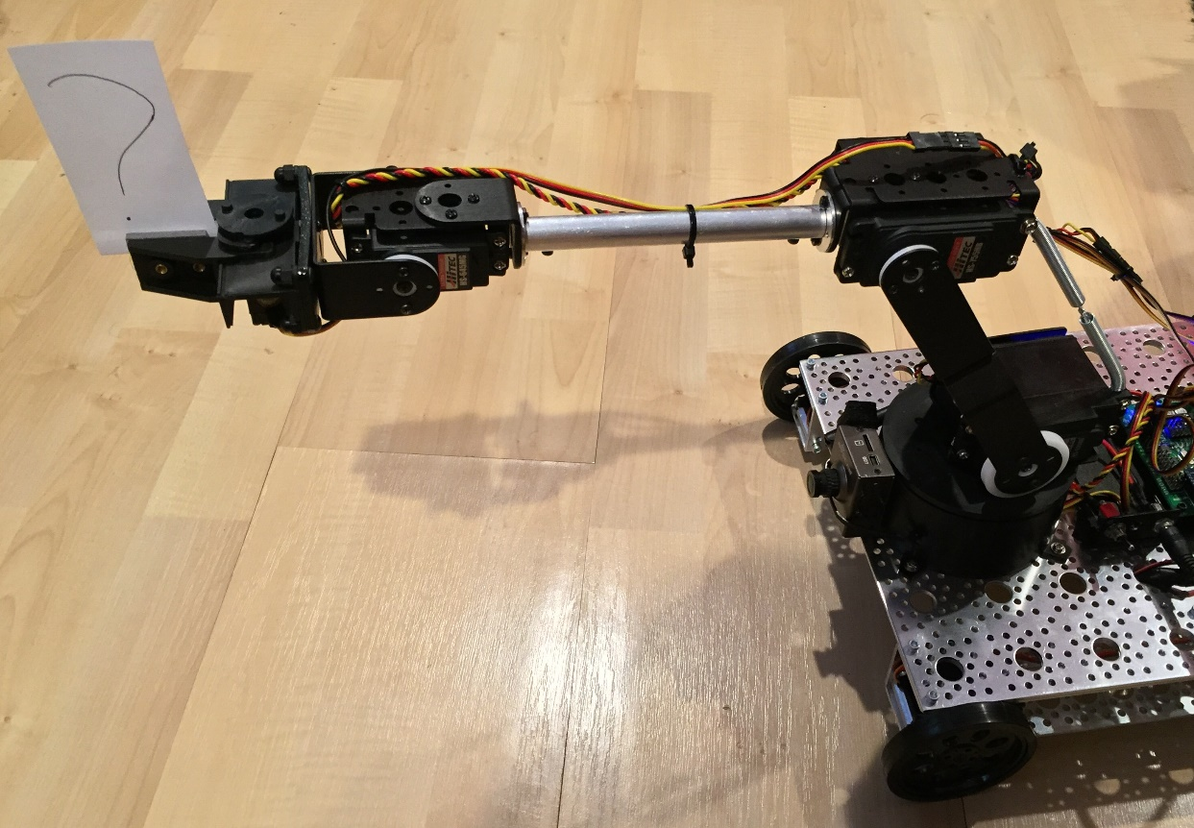
Questions?

