Slide 1
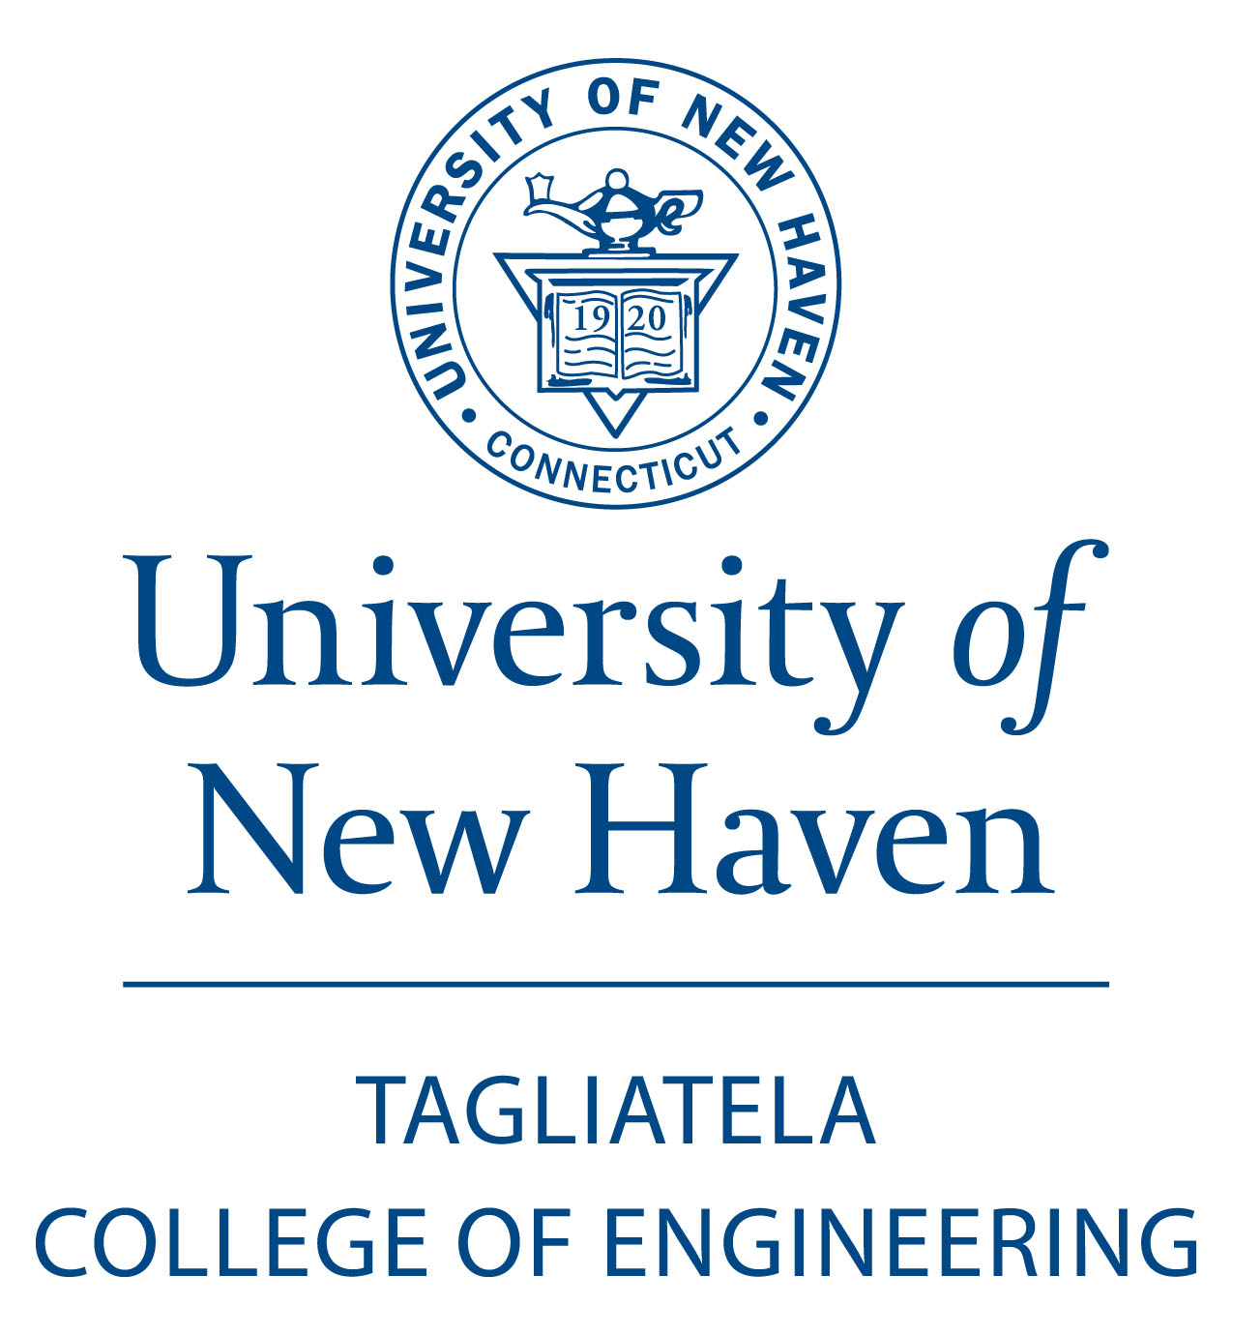
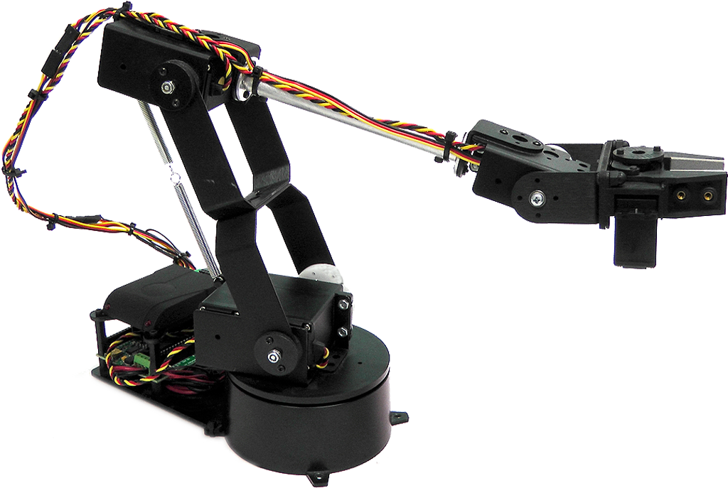
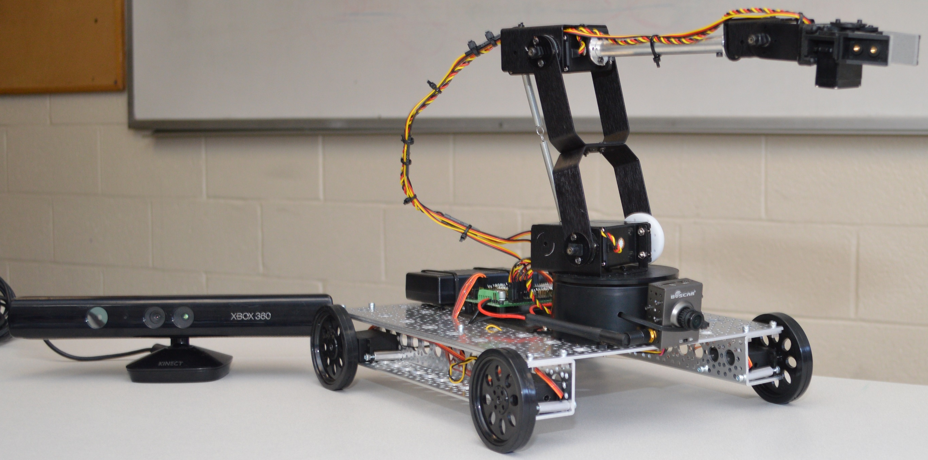
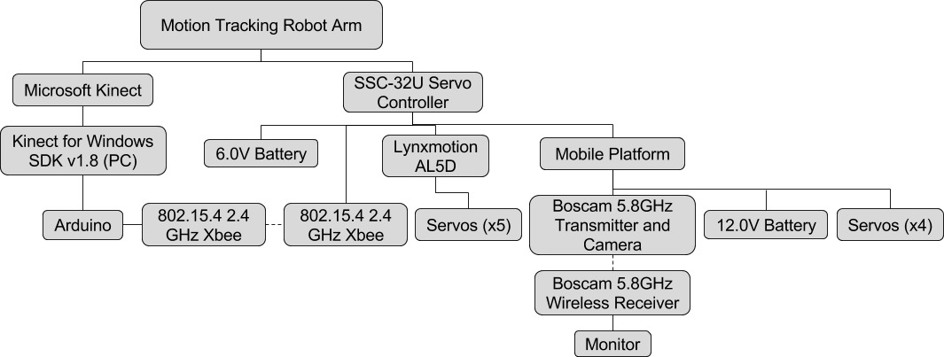
Mobile Motion Tracking Robot Arm
Jeffery Ruocco, Jeffrey Falberg, and Getro Jean-Baptiste
Introduction
Objectives
Results
We’ve created a robot arm that is controlled simply by moving your hand. The Microsoft Kinect tracks the position of the user’s hand and the Arduino Uno handles inverse kinematic and linear regression calculations to determine the required servo positions to mimic the user’s movement.
Create a mobile robot arm that is controlled by motion tracking
Allow the user to control the arm and drive the platform from a distance
Prototype a device for possible use in situations unsafe for humans
System Hierarchy
Acknowledgements
Professor Bijan Karimi
for guiding us through the design and implementation
phases of the project
Mark Morton
for helping us obtain the required equipment and hardware
needed to complete our project

