Slide 1

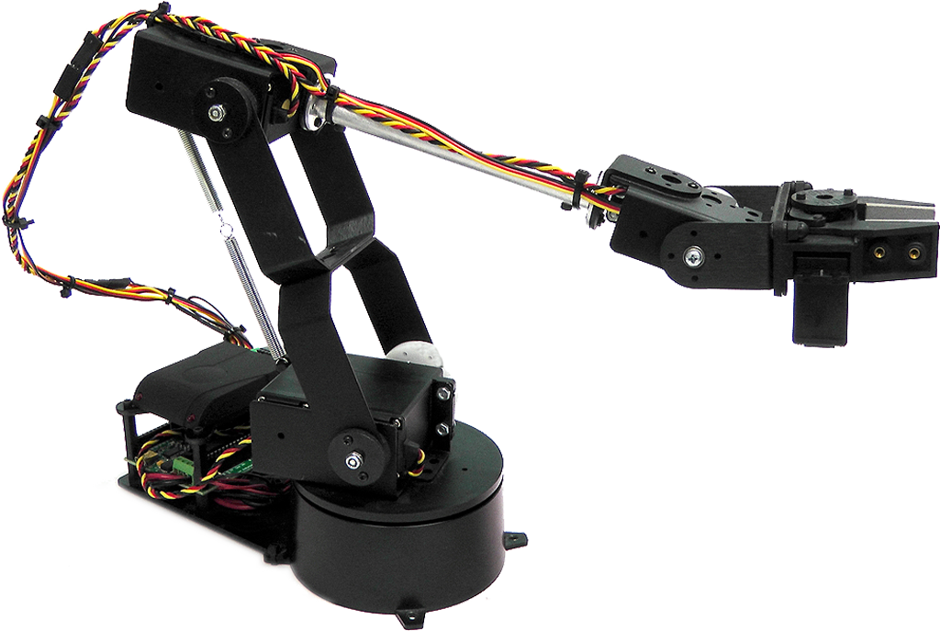
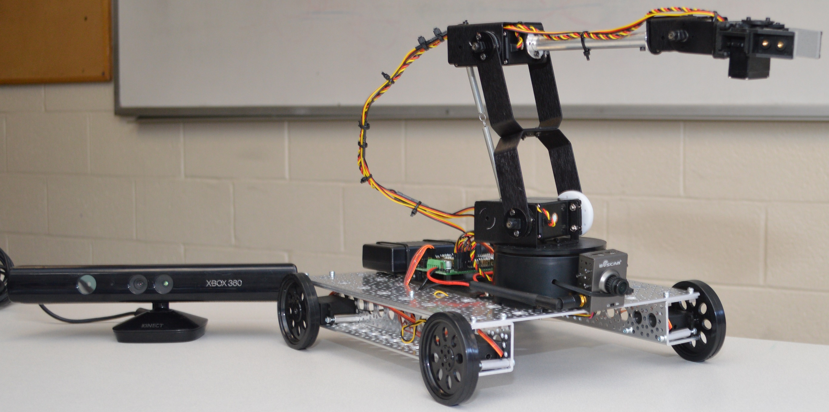
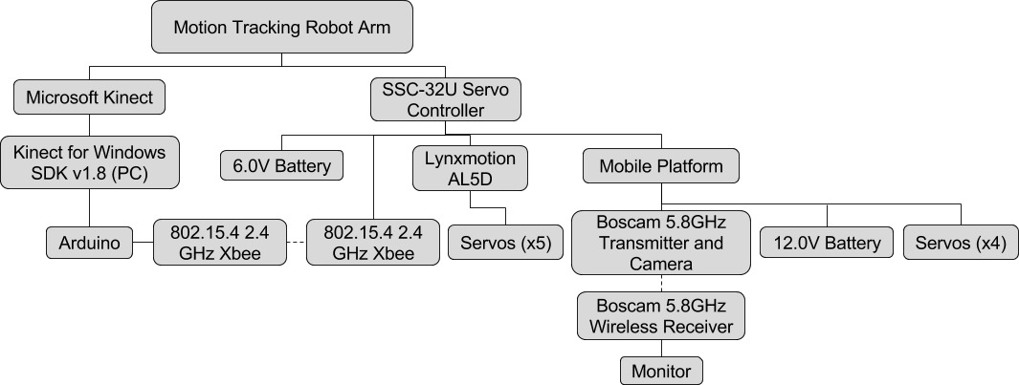
Mobile Motion Tracking Robot Arm
17
Jeffery Ruocco, Jeffrey Falberg, and Getro Jean-Baptiste
Advisor: Dr. Bijan Karimi
Introduction
Objectives
Results
We’ve created a robot arm that is controlled simply by moving your hand. The Microsoft Kinect tracks the position of the user’s hand and the Arduino Uno performs calculations to convert the hand’s coordinates to servo positions.
Create a mobile robot arm that is controlled by motion tracking
Allow the user to control the arm and drive the platform from a distance
Prototype a device for possible use in situations unsafe for humans
Methods
Acknowledgements
Microsoft Kinect
Structured light and machine learning algorithms used to detect body positions
Arduino Uno
Performs inverse kinematic and linear regression calculations to convert 3D coordinates into servo positions
System Hierarchy
Professor Bijan Karimi
for guiding us through the design and implementation
phases of the project
Mark Morton
for helping us obtain the required equipment and hardware
to complete our project

