Slide 1

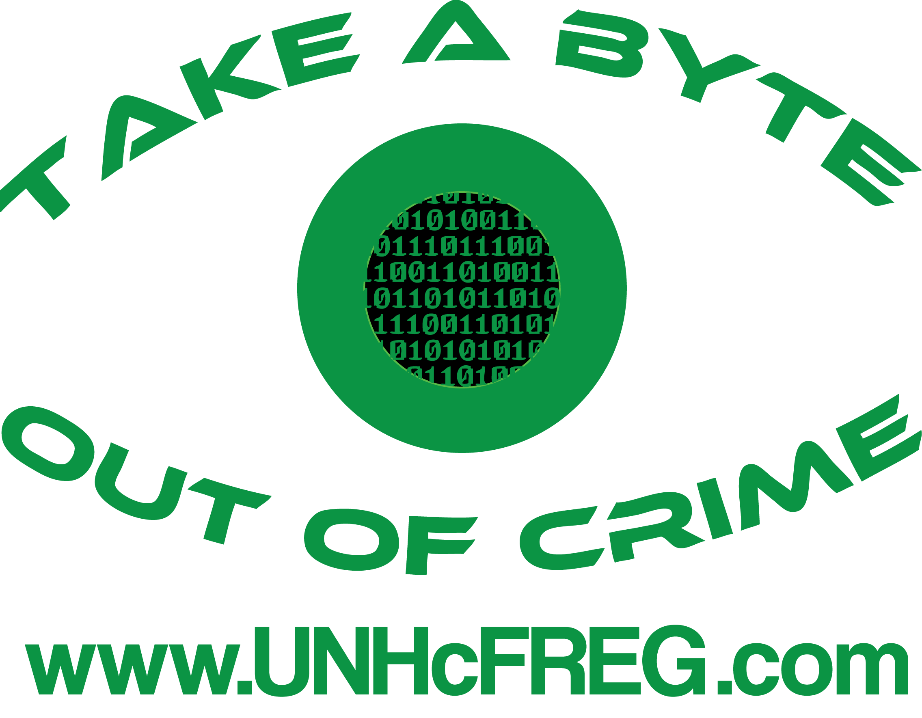
Symmetrics: An Educational Security Game
Brandon Knieriem and Dr. Ibrahim ‘Abe’ Baggili
Introduction
Objectives
Conclusions
Symmetrics is a game that puts you in the shoes of a Penetration Tester; an Ethical Hacker.
The player must infiltrate a vulnerable business in order to assess the strength of their physical and digital security.
Production Window
May – June 2015
Story
Original
Dynamic
Higher than average replay value.
Multiple endings.
Knowledge of Pen. Testing Steps
Reconnaissance
Vulnerability Assessment
Exploitation
Covering Tracks
Analysis and Reporting
Basic Security Concepts
Piggybacking
Phishing
Dumpster Diving
Shoulder Surfing
Social Engineering
Education
Interactive
Engaging
Security Awareness
Other ways we can engage non-professionals in security best practices.
Untapped Mediums
Live training scenarios.
Materials and Methods
References
RPG Maker VX Ace (Ruby)
Open Source Sprites/Assets
Original Soundtrack
Acoustic
Digital
Game Development
Events
If/Then
Triggers
Enterbrain Inc.: RPG Maker. Internet: http://www.rpgmakerweb.com/ Oct. 25, 2015 [Oct. 25, 2015]
Kim, Peter. The Hacker Playbook: Practical Guide to Penetration Testing. CreateSpace Independent Publishing Platform, 2014.
Acknowledgements
Notes:
Don’t forget to personalize this to fit your discipline as well as your color and design preferences.

