Slide 1
Lab 1: NES Controller

Slide 2
Types of video game systems
Video game systems can be very complex and use a large number of different processors
Modern video game systems
Have multi-core CPU
Have dedicated 3d graphic processor
Network connectivity, Wired and Wireless
Optical Drive
Hard disk

Slide 3
Our Video Game System
We will focus on something more simple
Look at the technology available in the 1980s
Our system will have limits
Games will have be small in scope
2d graphics
Only have 16 colors (limit of FPGA board)

Slide 4
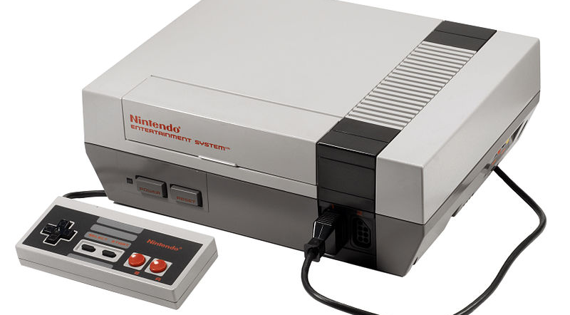
Block Diagram – NES System

Slide 5
Block Diagram – NES system
Game cartridge
CPU
8-bit microcontroller
1.79 MHz
Sound Processor
Copy protection
Controllers
Graphic CPU
PPU 5.37MHz
256x240

Slide 6
Our System
SRAM
GAME
Microblaze CPU
50MHz
Graphic Output/
(Processor ?)
Sound ?
Controller
Hardware
50MHz CLK
FPGA SoC

Slide 7
Start with the controller
We are going to start with the controller
Create VHDL code to generate the signals and read the buttons press
Could be done by bit-banging on the CPU but we have the resources for all the timing to be done outside of the CPU
Later we will connect our hardware to the CPU

Slide 8
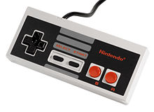
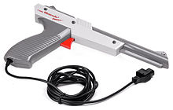
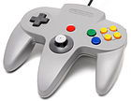
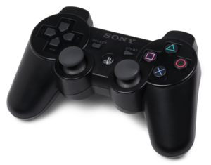
Types of Controllers
Digital only
8 buttons
Digital used a Timer
Digital buttons
Analog direction
Digital buttons
Analog direction/buttons
Analog tilt direction

Slide 9
NES Controller
1
Ground - 1
7
Pulse (in) - 2
Power - 7
Latch (in) - 3
Data (out) - 4
4
5
NES Pin out

Slide 10
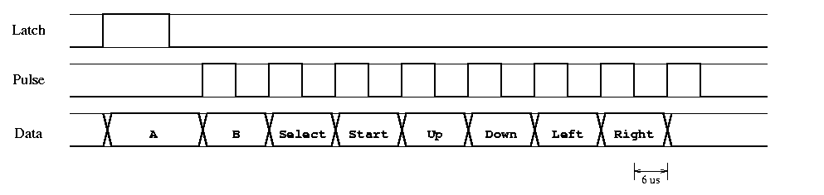
Interface
The latch tells the controller to capture the button state
The pulse moves each button through the data output
Latch is a 12us high signal
Pulse is 12us per cycle

Slide 11
Xilinx Software
VHDL software is written in the ISE program
Start a new project and select the chip we are using
To connect the VHDL to pins we need to edit the UCF file

Slide 12
VHDL Code
VHD File
entity top_level_test is
Port ( reset : in STD_LOGIC;
clk_50mhz : in STD_LOGIC;
buttonled : out STD_LOGIC_VECTOR (7 downto 0);
nes_latch : out STD_LOGIC;
nes_clk : out STD_LOGIC;
nes_data_in : in STD_LOGIC);
end top_level_test;

Slide 13
Example
UCF File
NET "buttonled[0]" LOC = D4;
NET "buttonled[1]" LOC = C3;
NET "buttonled[2]" LOC = E6;
NET "buttonled[3]" LOC = D6;
NET "buttonled[4]" LOC = D13;
NET "buttonled[5]" LOC = A7;
NET "buttonled[6]" LOC = G9;
NET "buttonled[7]" LOC = A8;
NET "clk_50mhz" LOC = C9;
NET "nes_clk" LOC = N14;
NET "nes_data_in" LOC = E15;
NET "nes_latch" LOC = N15;
NET "reset" LOC = N17;

