Slide 1
Lab 2: Graphics Part 1

Slide 2
Background on VGA
In the 1980s display standards started to be developed
CGA (Color Graphics Adapter) was created in 1981
320x200 pixel mode
640x200 pixel mode
Each pixel is addressed able but only 4 colors available
To have different sets of colors there were two palette modes (black, cyan, magenta, white) and (black, green, red, brown)

Slide 3
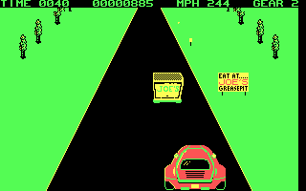
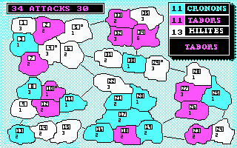
CGA
Palette Mode 0
Palette Mode 1

Slide 4
EGA
EGA (Enhanced Graphics Adapter) was created in 1984
Resolution increased to 640x350
Can display 16 colors
Still used a palette scheme. Could display 16 colors from a set of 64 total colors

Slide 5
VGA
VGA (Video graphics Array) created in 1987
640x480
Each color is 6-bits giving a 262,144 color palette

Slide 6

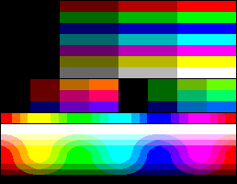

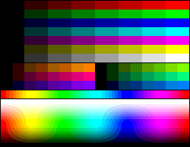
Compare color palette
9-bit RGB
Sega Genesis
6-bit RGB
EGA
Sega Master System

Slide 7

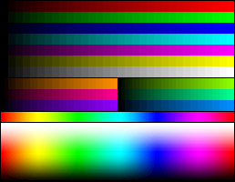


Compare color
18-bit RGB
VGA
Nintendo DS
15-bit RGB
SNES
SVGA
Gameboy advance

Slide 8

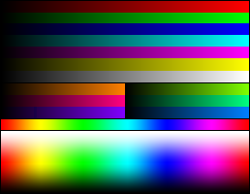
Color compare
24-bit RGB “True color”
SVGA
Nintendo 3DS

Slide 9
NES Graphic
48 color palette
Resolution of 256x240 (only used 256x224)

Slide 10
VGA
We are going to use the VGA standard for our SoC
Use the resolution of 640x480
Use same timing information
But use only 8 colors

Slide 11
VGA

Slide 12
VGA
We will have all the items done in pixel time
The pixel clock is the time to generate 1-pixel on the screen 25MHz
So for a horizontal row
Tdisp = time to display the row
640 pixel clocks
Ts = sync time
800 pixels
Tbp=back porch
48 pixels
Tfp=front porch
16 pixels
Tpw=pulse time
96 pixels

Slide 13
VGA
A vertical refresh requires that all the rows are display
We can use the horizontal sync to count
Tdisp = time to display the screen
480 horizontal syncs
Ts = sync time
521horiz syncs
Tbp=back porch
29 horiz syncs
Tfp=front porch
10 horiz syncs
Tpw=pulse time
2 horiz syncs

Slide 14
VGA UCF file

Slide 15
Display File
You need to create a VHDL file that does all the timing to display the screen
This will be its own file do not mix it with the second part
It must output the x and y pixel coordinates, hsync, vsync, rgb

Slide 16
VGA Test File
Using the display file you need to create a test file
Use the switches to determine a color to output

Slide 17
Graphics in the video system
Screen resolution is 640x480
This gives us a total of 307,200
Each pixel will need 4-bits (R, G, B, transparent bit)
We add transparent bit because we will have a foreground and background
This will mean that we need to set aside video memory of 1,228,800 = 1.2Mbit [307,200bits for 320x240]
So to have a foreground and background we would need 2*1,228,800bits = 2,457,600bits
All the memory has to fit on our FPGA chip
The FPGA has 648Kbits of RAM

Slide 18
Graphics on FPGA
We cannot store the complete video frame on our board
This is going to require that we rethink how to manage the graphics in our chips
We can reduce the resolution
To keep same screen ratio
640x480
320x240
160x120

Slide 19
Scaling
Monitor
640x480
FPGA memory
160x120
Upconvert on FPGA

Slide 20
Up convert
Each pixel is not a block of pixels
Smaller screen resolution
Larger screen resolution

Slide 21
Up convert
If we still use a lower screen resolution we still have a memory problem
It cost to much memory to store each pixel
We need a different way to store the screen to generate

Slide 22
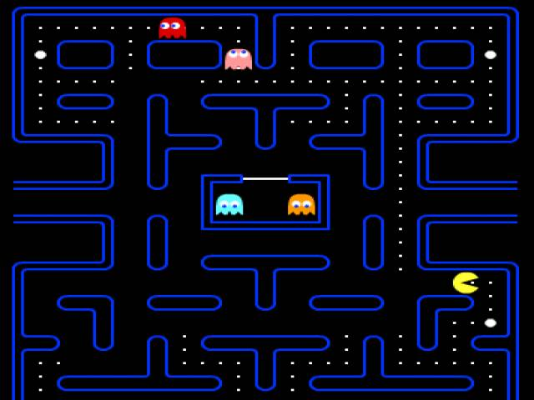
Sprites and Tiles
What we can do is on the graphic card store sprites
A sprite is a pre-created image we want to display
In memory we store the sprites
For animation we have multiple sprites.
Pacman open mouth
Pacman closed mouth

Slide 23
Sprites and Tiles
This means we will need to place a limit on the number of sprites our game can support
We can always have the game software load in different sprites
Ex. We make pacman two players
Player one we can load in the sprite for pacman
Player two we con load in the sprite for ms. Pacman
We need a way to know where to place the sprites

Slide 24
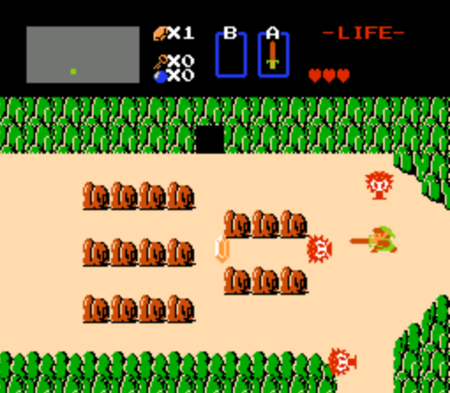
Sprites and Tiles
The screen is made up of a tile-map
The tile-map is a grid or 2D-array that tells which sprite to use

Slide 25

Tile Map
=sprite 0
=sprite 1
=sprite 2
=sprite 3
The portion of
The tile map is
2 | 3 | 2
0 | 0 | 0
1 | 0 | 0

Slide 26
Size of sprites and Tile-map
By using sprites and tile-map the memory requires are smaller
A tile map of 40x30 [screen resolution of 320x240]
Requires 120 tiles
Each tile requires n-bits where we have 2^n=sprites
So say we have 32 sprites then we need 5-bits
Size of memory 600 bits

Slide 27
Sprites
Sprites will need to be a group of pixels
We will create sprites of 8x8
Size will be 64 pixels at 4-bits = 256bits
We have 32 sprites so 256*32 = 8,192bits
In total 600 bits for Tile-map + 8,192bits for sprites for a total of 8,792bits required ~8.8Kbits (to store each pixel need 307kbit so we reduce by 97%)
The FPGA has 648Kbits of RAM

Slide 28
Sprite

Slide 29
Lab
In this lab you will need to create two different screen resolutions with different grid sizes
This will be the start of your tile-map. Next lab we add the memory and sprites
320x240
Create grid of 40x30
160x120
Create grid of 20x15
Make each grid tile a different color

Slide 30
Lab
You want each tile to have a way to index
Using the pixel_x and pixel_y you need to be able to index which tile in the tile-map
0 | 1 | 2 | 3
4 | 5 | 6 | 7
8 | 9 | 10 | 11
12 | 13 | 14 | 15

Slide 31
To use memory
Architecture
Constant cblue : std_logic_vector(2 downto 0) := “100”;
Constant cgreen : std_logic_vector(2 downto 0) := “010”;
Type tile_map is array(0 to 119) of std_logic_vector(2 downto 0);
Signal grid_map : tile_map := (cblue, cred, cgreen, … );
Signal mapindex : std_logic_vector(7 downto 0);
begin

Slide 32
Mapindex <= ( place in here an express with type std_logic_vector);
Rgb <= grid_map(conv_integer(mapindex));
For conv_integer make sure you add
use IEEE.NUMERIC_STD.ALL;
use ieee.std_logic_arith.all;
use ieee.std_logic_unsigned.all;

