Slide 1
BCSE307P • COMPILER DESIGN LABORATORY
Review 3 — Final Project Review
Lumen
A diagnostics-first compiler: report one mistake once, in the right place, and keep going
Srijan Sengupta • Reg. No. 24BCE2218 • VIT Vellore
github.com/Stormii2/Lumen-CD
BCSE307P • Compiler Design Lab • Review 3 — Final Project Review
1

Slide 2
REVIEW 3 RUBRIC
Ten criteria, one section each
# | Criterion | What the examiner looks for | Our evidence
1 | Project completion | Objectives completed | All planned objectives built (slide 3)
2 | Functional correctness | Correctness of outputs | 459 tests, 98.9% / 100% on held-out data (slides 4, 8)
3 | Technical complexity | Depth of implementation | SSA optimiser, 8 recovery layers, repair engine (slides 5, 7, 8)
4 | Compiler integration | Use of compiler concepts | Full pipeline, concept-to-module map (slide 6)
5 | Innovation | Originality | SSA optimiser, switchable layers, applicability classes (slide 9)
6 | Code quality | Structure and documentation | Module map, one entry point (slide 10)
7 | Testing | Comprehensive validation | 125 cases + 334 machinery tests + evaluation (slide 11)
8 | Demonstration | Working project demonstration | Live script (slides 12-13)
9 | Documentation | Quality of project report | Report, guide, catalogue (slide 14)
10 | Viva | Individual technical understanding | Prepared answers (slides 15-16)
BCSE307P • Compiler Design Lab • Review 3 — Final Project Review
2

Slide 3
CRITERION 1 OF 10 — PROJECT COMPLETION
Every planned objective is built
Objective | Status | Where
Lexer, parser, scoped symbol table, type checker | done | lexer.py, parser.py, checker.py
Three-address code and executing interpreter | done | tac.py, interpreter.py
Repair engine with applicability classes | done | suggest.py, repair.py
--fix to a fixpoint, --diff, --unsafe-fixes | done | fixer.py
--explain and 52-code error catalogue | done | explain.py, docs/ERROR_CODES.md
FIRST/FOLLOW computed from the grammar, used for recovery | done | grammar.py, parser.py
Span-containment suppression of cascades | done | diagnostics.py
Seeded-defect evaluation with baselines | done | eval/
Run-time safety (R0001-R0007) | done | interpreter.py
SSA construction and optimiser (-O) | done | cfg.py, ssa.py, optimizer.py
Native code generation | not built: programs run as TAC in an interpreter | -
BCSE307P • Compiler Design Lab • Review 3 — Final Project Review
3

Slide 4
CRITERION 2 OF 10 — FUNCTIONAL CORRECTNESS
Outputs are correct: tested, and measured against known defects
459
98.9%
100%
23
automated tests, all passing
one error at the defect, held-out (377 programs)
of 3 simultaneous defects found
precision 100%
bugs found by adversarial testing and fixed
3 were hangs
Valid programs print the right answer: truncating division, modulo sign, int to float widening, short-circuit logic, shadowing, globals, recursion.
Invalid programs get the right code at the right line: every one of the 52 catalogued error examples is compiled in a test and must raise exactly its code.
Run-time faults are reported, not hidden: divide by zero, array bounds, overflow, stack depth, runaway loops each give a located R-code.
Correctness of the repairs: safe --fix restored the original program in every one of its attempts (no wrong fix); guesses are opt-in.
BCSE307P • Compiler Design Lab • Review 3 — Final Project Review
4

Slide 5
CRITERION 3 OF 10 — TECHNICAL COMPLEXITY
Recovery layers, grammar tables, repair engine, SSA optimiser
Component | Depth of implementation | Lines
Parser | Recursive descent + Pratt expressions; phrase-level repair, panic mode with sync set from FIRST/FOLLOW, error-gap rule, progress guarantee in every loop | 987
Type checker | Scoped symbol table, error type as lattice bottom, annotations for codegen, lost-declaration inference, return-path analysis | 575
Interpreter | Functions pre-decoded to tuples, resolved jumps, 64-bit overflow, call depth and step limits, located R-codes | 363
TAC generator | Short-circuit lowering, explicit itof widening, unique storage names | 309
Grammar | LL(1) grammar as data; nullable, FIRST, FOLLOW fixpoints; conflict check | 234
Repair and fixer | Damerau-Lowrance-Wagner distance, length-scaled threshold, applicability classes, back-to-front fixpoint application | 280
CFG, SSA, optimiser | Basic blocks, critical-edge splitting, dominators and frontiers, pruned SSA, constant/copy propagation, GVN, DCE, phi elimination | 1,282
Core compiler: about 5,100 lines in 22 files, plus tests and evaluation tooling.
BCSE307P • Compiler Design Lab • Review 3 — Final Project Review
5

Slide 6
CRITERION 4 OF 10 — COMPILER INTEGRATION
One pipeline; each classic compiler concept has a home
Lexer
Parser
Checker
Diagnostics
TAC
SSA + opt
Interpreter
regular expressions /
finite automaton
LL(1), recursive descent,
panic mode, FIRST/FOLLOW
symbol tables, scopes,
type rules, coercion
error recovery,
cascade suppression
intermediate code,
short-circuit
CFG, dominators,
phi, folding, GVN
execution of IR,
run-time checks
driver.compile_source is the single entry point: the command line, the test suite and the benchmarks all call it, so they exercise identical code.
The checker annotates the AST (types, unique names); code generation reads the annotations instead of repeating inference.
Recovery is a cross-cutting concern: lexer marks damaged tokens, parser repairs and resynchronises, checker poisons types, diagnostics pass de-duplicates. Each layer is a switch in RecoveryConfig.
Clean programs genuinely run: errors stop the pipeline after diagnostics, so no code is generated from a broken tree.
Optional -O converts TAC to SSA and back; the interpreter runs optimised and plain code alike.
BCSE307P • Compiler Design Lab • Review 3 — Final Project Review
6

Slide 7
CRITERION 3 OF 10 — TECHNICAL COMPLEXITY: SSA AND THE OPTIMISER
SSA form and an optimiser that must not change behaviour
What SSA is
Passes (run to a fixpoint)
Every variable is assigned exactly once (x$1, x$2, ...). Where paths join, a phi function picks the value by incoming edge, so every use has one definition.
Constant folding and propagation, branch folding
Copy propagation, trivial-phi removal
Global value numbering (CSE over the dominator tree)
Dead-code elimination; jump threading, block merging
L1: i$2 = phi(B1: i$1, B3: i$3)
t$1 = i$2 < 5
Basic blocks, critical-edge splitting, dominators (Cooper-Harvey-Kennedy), dominance frontiers
Pruned phi placement on iterated frontiers; renaming by dominator-tree walk
Phi elimination with parallel-copy sequencing (swap cycles broken by a temporary)
verify_ssa checks single definition and dominance
Safety rule
Anything that can fail at run time (overflow, divide by zero, array bounds) is never folded or deleted, so int unused = 1 / z; still stops with R0001. Calls, print and stores to globals are kept.
BCSE307P • Compiler Design Lab • Review 3 — Final Project Review
7

Slide 8
CRITERION 2 OF 10 — CORRECTNESS AND EFFECT OF THE OPTIMISER
5,000 random programs behave identically; 27% fewer steps
0
27%
48%
1
mismatches in 5,000 random programs
(1,472 end in a run-time error)
fewer TAC steps on 17 real programs
fewer on the demo (47 to 15 instructions)
real bug found by the campaign and fixed:
string + was treated as commutative
Run it: python3 lumenc.py examples/optimize_demo.lum -O --opt-stats --emit-ssa
Ablation: dead-code elimination and constant propagation matter most; CSE is small on these programs.
SSA round trip with every pass off adds about 15% steps (extra copies); the passes more than pay for it.
Optimiser cost grows slightly faster than linear (slope 1.27): 1.4 s at 6,400 lines. Opt-in with -O.
BCSE307P • Compiler Design Lab • Review 3 — Final Project Review
8

Slide 9
CRITERION 5 OF 10 — INNOVATION
What is original: a compiler that is measured, not just built
Every recovery technique is a switch
Applicability classes
Eight layers can be turned off one at a time, so the effect of each is measured by ablation rather than assumed. Two choices were changed because the data said so.
Each suggested fix is machine-applicable or maybe-incorrect (as in rustc). --fix applies only the first kind. Measured wrong-fix rate: 0 safe, 18.8% for guesses.
Known-ground-truth evaluation
SSA optimiser checked by differential testing
377 single-defect, 120 three-defect and 300 random-token mutants, with fail-fast and no-recovery baselines, Wilson intervals, and a held-out corpus.
Constant, copy, CSE and dead-code passes on pruned SSA; 5,000 random programs behave identically optimised and not, including run-time errors. Dead code that can fail is never removed.
Honest scope: the optimiser is per-function with no inlining or loop hoisting. The techniques (panic mode, phrase-level repair, edit-distance suggestions) are standard; the contribution is combining them and evaluating each one.
BCSE307P • Compiler Design Lab • Review 3 — Final Project Review
9

Slide 10
CRITERION 6 OF 10 — CODE QUALITY
Structure: small modules, one job each, one entry point
Folder | Contents | Purpose
lumen/ | 22 files, 5,100 lines | lexer, parser, checker, repair, TAC, SSA, optimiser, interpreter
lumenc.py | 172 lines | command-line interface and exit codes
tests/ | 14 files, 459 tests | table-driven cases plus machinery tests
eval/ | corpus, harness, perf, baselines | evaluation corpora, harness and benchmarks
tools/ | 3 generators | TEST_CASES.md, ERROR_CODES.md, evidence images
docs/ | language, architecture, results, evidence | everything reproducible from the repo
Quality practices
Most modules open with a docstring saying what they do and why.
Diagnostics are data (code, span, help, edits), not formatted strings.
Grammar and error catalogue are data, checked by tests.
No hidden state: results are deterministic from the seed.
Benchmarks found and fixed a quadratic cost; tests pin every bug fixed.
BCSE307P • Compiler Design Lab • Review 3 — Final Project Review
10

Slide 11
CRITERION 7 OF 10 — TESTING
Comprehensive validation: every input class the brief names
Input class | Cases | Examples
Valid | 24 | precedence, truncating division, widening, short-circuit, shadowing, recursion, arrays
Invalid | 34 | one case per diagnostic family: lexical, syntax, scope, type, call, return path
Boundary | 32 | empty file, INT_MAX/INT_MIN, array index = length, depth 3000, 5000-term expression, 2000 statements
Error and recovery | 23 | single defect gives one error; three defects give each once; cascade cases
Complex | 12 | primes, bubble sort, gcd, Collatz, statistics, Fibonacci, sieve
459
125
tests, all pass
named cases
Beyond the cases
grammar tables and LL(1) check
fixer idempotence and fixpoint
52-entry error catalogue
19 regression tests for bugs found
command-line exit codes
Plus a statistical evaluation: 377 + 120 + 300 seeded-defect programs against fail-fast and no-recovery baselines (results on the next slide).
BCSE307P • Compiler Design Lab • Review 3 — Final Project Review
11

Slide 12
CRITERION 7 OF 10 — TESTING: EVALUATION RESULTS
Recovery makes the difference, and each layer was measured
Config | One-error-at-defect (single) | Recall (3 defects) | Precision (3 defects) | Hangs
Fail-fast (stop at first error) | 100.0% | 33.3% | 100% | 0
No recovery layers | 56.0% | 100% | 70.5% | 0
Lumen (all layers on) | 98.9% | 100% | 100% | 0
Held-out corpus (seed 9001), never examined while tuning; the development corpus gives 99.5%.
Fail-fast looks perfect on one defect, but finds only a third of three defects.
On harder random token damage Lumen is 72% clean (no recovery 25%): cascades remain there.
Ablation: phrase-level repair, error poisoning, token poisoning, the 3-token error gap and statement muting matter; containment suppression and variable poisoning showed no measurable effect.
BCSE307P • Compiler Design Lab • Review 3 — Final Project Review
12

Slide 13
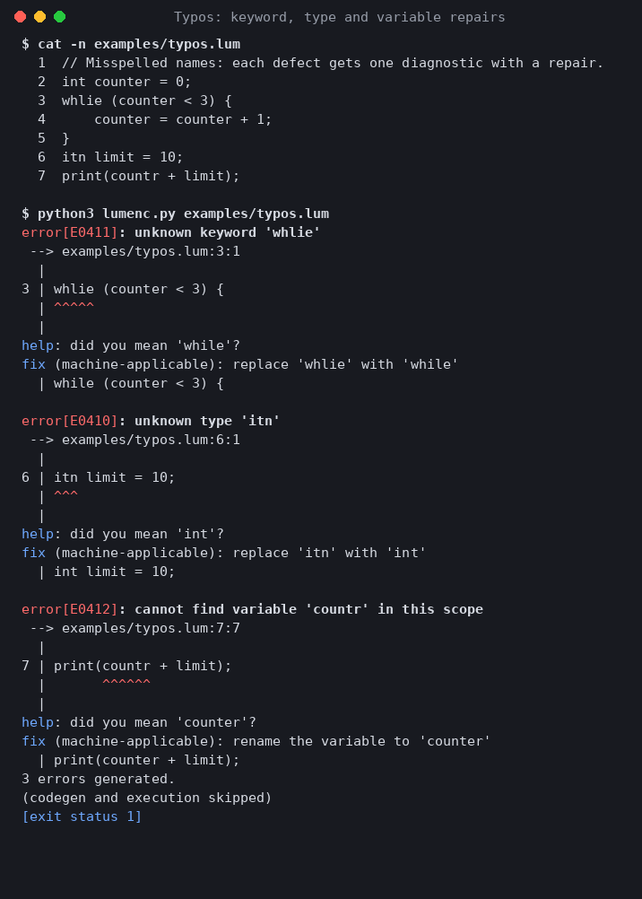
CRITERION 8 OF 10 — DEMONSTRATION
Live demo script: four commands, about three minutes
1
python3 lumenc.py examples/valid.lum
A valid program compiles and runs.
2
python3 lumenc.py examples/demo.lum
Seven defects in one file: each gets one diagnostic with a caret and a repair; no cascade.
3
python3 lumenc.py examples/typos.lum --fix --diff
Preview the safe repairs as a unified diff; nothing is written until --fix runs without --diff.
4
python3 lumenc.py examples/runtime_error.lum
A run-time fault is reported with a caret and an R-code, not a silent 0.
Extras if asked: -O --opt-stats, --emit-ssa, --explain E0412, --emit-tac, --grammar, --no-phrase-level (watch the cascade return).
Backup: recorded output is in docs/evidence if the live run fails.
BCSE307P • Compiler Design Lab • Review 3 — Final Project Review
13

Slide 14
CRITERION 9 OF 10 — DOCUMENTATION
Quality of the project report: written for a reader, reproducible
Document | Contents
Final project report | Introduction, architecture, language, features, recovery design, testing, evaluation, performance, limitations, appendix
USER_GUIDE.md and README.md | Install, every command-line option, exit codes, worked examples
docs/LANGUAGE.md | Full language reference and grammar
docs/ARCHITECTURE.md | Pipeline, data structures, recovery layers
docs/ERROR_CODES.md | All 52 error codes, each with a failing and a corrected example
docs/TEST_CASES.md and test_results.txt | Every case with input and actual diagnostics; the full test run
Bug log (docs/) | The 23 defects found by adversarial testing, with before and after
docs/results/ | Evaluation and performance results with charts, regenerated by one command each
docs/evidence/ | Captured compiler output for 14 scenarios (rendered from real runs)
BCSE307P • Compiler Design Lab • Review 3 — Final Project Review
14

Slide 15
CRITERION 10 OF 10 — VIVA: QUESTIONS I SHOULD BE ABLE TO ANSWER
Individual technical understanding
Why is the grammar LL(1), and how do you know?
Predict sets for each production are disjoint; grammar.py computes nullable, FIRST and FOLLOW and a test checks for conflicts (there are none).
What is panic mode and how does Lumen resynchronise?
After an error, skip tokens until one in the sync set: FIRST(statement) minus IDENT and {, plus ; and }. The set is derived from the grammar.
What is error-type poisoning?
A failed expression gets type ERROR; any operation on ERROR yields ERROR silently, so one bad name is reported once, not at every use.
What is SSA, and how do you know the optimiser is safe?
Each variable is assigned once and phi functions merge values at joins, so constants and common expressions are easy to track. Anything that can trap is never folded or deleted, and 5,000 random programs run identically optimised and not.
Why is --fix conservative?
Only unique, distance-1, at-least-4-letter repairs are machine-applicable. Guesses were wrong 18.8% of the time when applied.
BCSE307P • Compiler Design Lab • Review 3 — Final Project Review
15

Slide 16
CRITERION 10 OF 10 — VIVA: HARD QUESTIONS AND HONEST ANSWERS
What the numbers do not show
Are the 98.9% numbers realistic?
They are on synthetic mutants of 12 programs. Held-out data guards against overfitting the tuning corpus but shares the base programs. Random token damage is harder: 72% clean.
Which layers did not help?
Containment suppression and the variable-poisoning policy showed no measurable effect; FIRST/FOLLOW sync and lost-declaration inference were within one mutant. They are kept because they are cheap and unit tested.
How fast is it?
Compile time grows linearly with program size (slope 1.07): about 0.55 s for 6,400 lines, and recovery adds little (programs full of errors compile in about 1.2 times the clean time). The interpreter runs 2.7 to 7.0 million TAC steps per second.
What is the weakest case?
A missing ] (75% clean, 8 cases) and a missing } (91%): where the bracket belongs is a guess, so those fixes are maybe-incorrect and never auto-applied.
What is not implemented?
Native code generation: programs run as three-address code in an interpreter. The optimiser is per function; no inlining, loop-invariant motion or strength reduction.
BCSE307P • Compiler Design Lab • Review 3 — Final Project Review
16

