Slide 1
Solving SAT with DNA Tiling and Self-Assembly
SAT – NP-complete
Several Methods to solve in polynomial time with DNA
    1. Stickers Method – Not tile based.
        Solved Largest SAT problem with DNA(20-Variable, 24-Clause)
    2. String Tile Method – Uses hairpin tiles.
        If hairpin makes a circle, then clause is satisfied.
    3. 2D tiling - Lagoudakis and LaBean
        Attempt to create an instance-independent algorithm for solving SAT.

Slide 2
Case Study – Lagoudakis and LaBean
2 Designs
  Design A encodes clauses
  Design B encodes literals
Both use a tile library
A tile is represented a square with 1 to 4 ‘sticky’ corners. Only corners that match can bind together.
      A tile is added to the assembly when it has 2 corners that can bind with existing tiles.
      Corners are used to store the data on the tile. Different corner types and values for different tiles.
      Implementation is not the focus. The focus is the algorithm.
      Assume that this process works and is error free.
        This is difficult to achieve due to many potential problems.

Slide 3
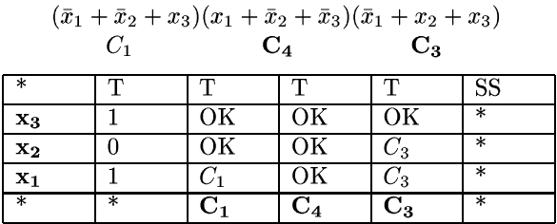
Design A - Example
Basic idea
  1. Encode inputs on left, clauses on bottom. Work bottom-up
  2. Second column is assignment values
  3. Work across the row, checking to see if assigning the value to the variable satisfies a clause. If so, place an OK in the cell, otherwise propagate the clause upwards.
  4. If Ok reaches top row and the cell directly to the left on the top row is a T, then place a T in the cell. If Clause reaches top, then place an F.
  5. If a T reaches, the SS, then the assignment satisfies the expression.

Slide 4
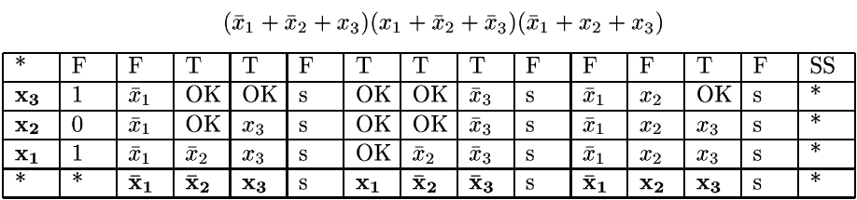
Design B - Example
Basic idea – Similar to Design A
  1. Encode inputs on left, literals on bottom. Work bottom-up
  2. Second column is assignment values
  3. Work across the row, checking to see if assigning the value to the variable satisfies the literal. If so, place an OK in the cell, otherwise propagate the literal upwards.
  4. If Ok reaches top row then place a T in the top cell. If literal reaches top, then place an F.
  5. When working across top row, when a separator column is reached (denoted by a columns of ‘s’ with an F on top row) if cell directly to left is an F, then the assignment values do not satisfy.

Slide 5
Case Study – Lagoudakis and LaBean
Tile library is built based in a general way. Library components correspond to table cells.
Tiles self-assemble to form a 2D plane using tiles from the library.
  It is this massive parallelism that makes it possible to solve SAT in polynomial time.
Deliverable is a program that demonstrates these Designs

Slide 6
Case Study Complexity
m = number of variables
n = # of clauses = (4/3)m(m-1)(m-2)= O(m³)
--- | Design A | Design B
Time | O(m+n+2) =O(m³) | O(m+mn+n+2)=O(m³)
Space | O((m+2)*(n+3))=O(m⁴) | O((m+2)*(mn+n+3))=O(m⁴)
Library Size | O(m⁴) | O(m²)

Slide 7
References
[1] Michail G. Lagoudakis and Thomas H. LaBean. “2D DNA Self-Assembly for Satisfiability.”
[2] Seeman, Nadrian C., Winfree, Erik, and Yang, Xiaoping. “Universal Computation via Self-assembly of DNA: Some Theory and Experiments.” 7 Aug. 1996.<http://www.dna.caltech.edu/Papers/self-assem.pdf>
[3] Adleman, Leonard M., Winfree, Erik, Roweis, Sam, et. al. “A Sticker based Model for DNA Computation.” May 1996. <http://citeseer.ist.psu.edu/cache/papers/cs/1062/ftp:zSzzSzhope.caltech.eduzSzpubzSzroweiszSzDIMACSzSzstickers.pdf/roweis96sticker.pdf>
[4] Adleman, Leonard M., Braich, Ravinderjit S., Chelyapov, Nickolas, et.al. “Solution of a 20-Variable 3-SAT Problem on a DNA Computer.” Sciencexpress 14 March 2002 <http://www.dna.caltech.edu/courses/cs191/paperscs191/Braichetal_Science2002.pdf>
[5] Eng, Tony, Rozenberg, Grzegorz, and Winfree, Erik. “String Tile Models for DNA Computing by Self-Assembly.” <http://www.dna.caltech.edu/Papers/stringtiles.pdf>
[6] Papadakis, Nick, Rothemund, Paul, and Winfree, Erik. “Algorithmic Self-Assembly of DNA Sierpinski Triangles.” PLoS Biology 2.12 December 2004: <http://www.dna.caltech.edu/Papers/SierpinskiDNA_PLoS2004.pdf>

