Slide 1
RetainIQ — Who to call, and what it costs
Hansraj Tiwari & swayangjeet nayak
ChurnZero 26 · IIT Kharagpur

Slide 2
The 80:1 problem
Missed churner (FN): ₹40,000
Unnecessary call (FP): ₹500
Cost ratio 80:1 — threshold 0.5 is wrong for this problem

Slide 3
Dataset snapshot
8,101 train · 97 features · 16.1% churn
2,026 test customers · submission 16.6% positive
Inactivity and balance stress separate churners

Slide 4
Where churn concentrates
Higher churn: low tenure, low digital engagement, complaints
Lower churn: stable tenure + active digital footprint
Segments guide playbook priority

Slide 5
RetainIQ pipeline
LGB + CatBoost OOF → meta on OOF → Platt calibration
Rank → churn_probability; calibrated + cost → churn_prediction
IPTW uplift · fairness (gender, region)

Slide 6
Model scores plateau — cutoff still matters
Logistic → LGB → stack → calibrated: PR-AUC ≈ 0.9999
AUC gains are flat on this dataset
Where we win: cost-optimal cutoff + uplift + playbook

Slide 7
Out-of-fold results
 | t = 0.002 | t = 0.5
PR-AUC | 0.9999 | 0.9999
Business cost (INR) | 65,000 | 202,500
Recall | 99.9% | 99.6%
5-fold OOF · seed 42 · primary metric: PR-AUC

Slide 8
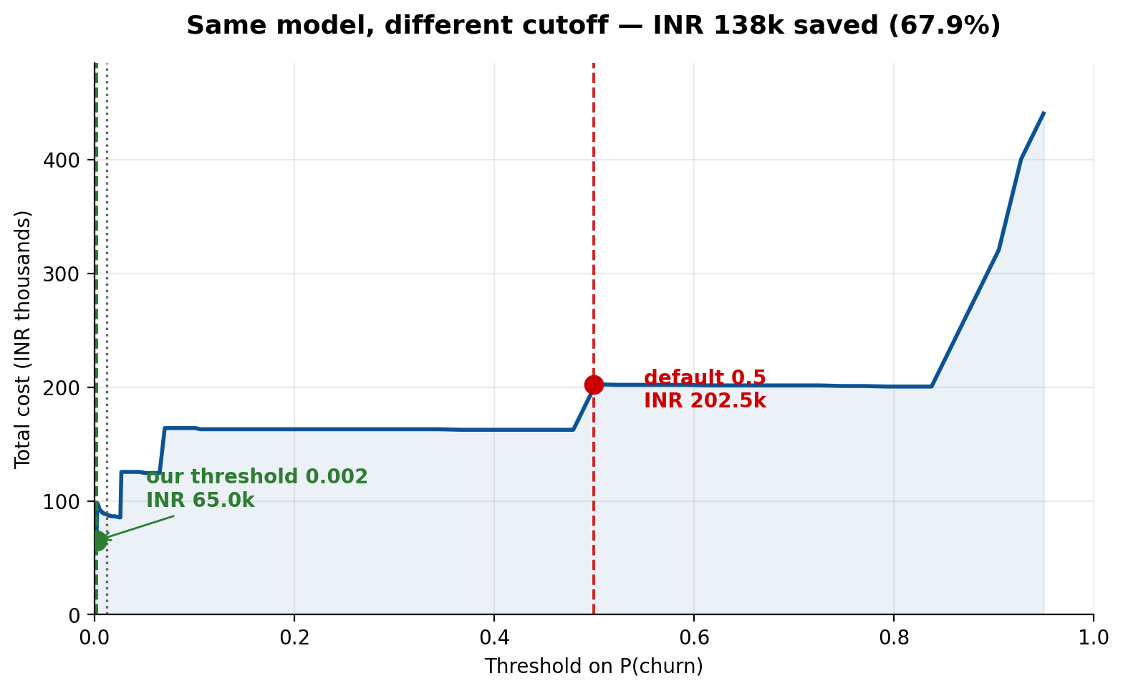
Same model, different cutoff
Cost-optimal threshold 0.002 vs naive 0.5
₹137,500 saved on 8,101 customers (~68%)

Slide 9
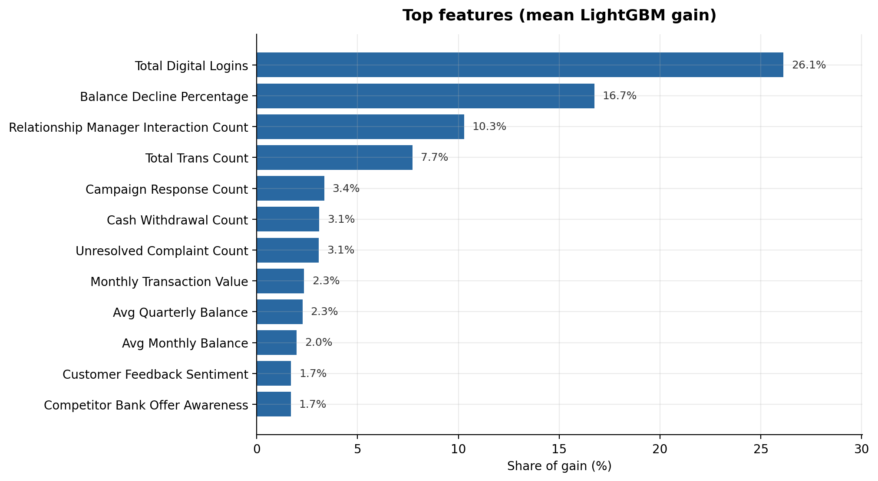
What drives churn
Actionable: logins, complaints, campaigns, RM touches
Structural: tenure (monitor only)
Top: total_digital_logins (~30% LGB gain)

Slide 10
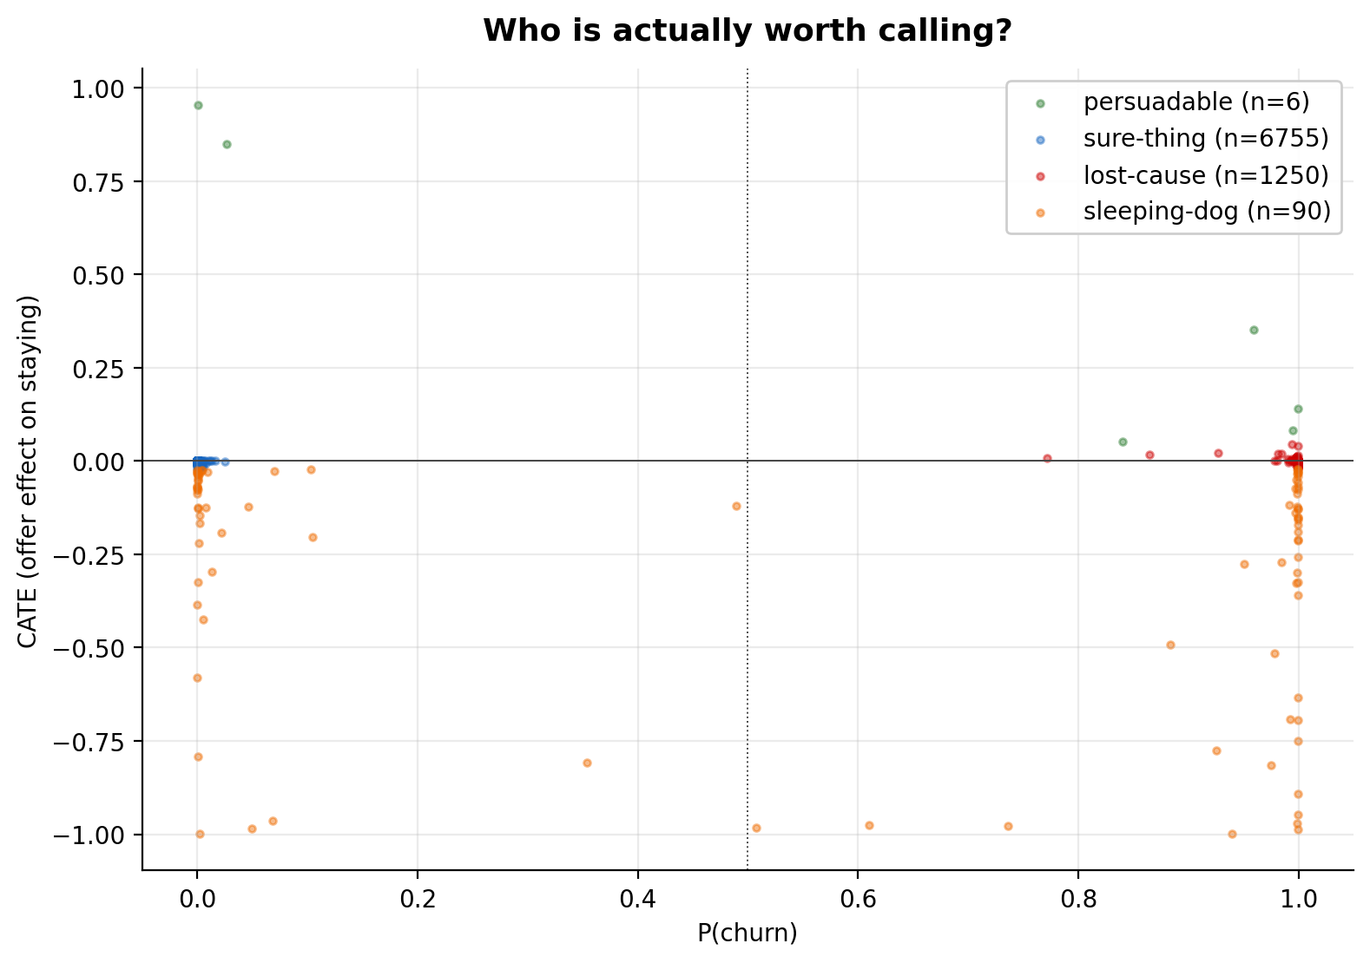
Who is worth calling?
6 persuadables — offer helps (CATE +0.40 avg)
90 sleeping-dogs — offer may hurt (CATE -0.30 avg)
Offers not randomized — IPTW; directional only

Slide 11
Case study — persuadable segment
Customer 140348 · segment: persuadable
P(churn) = 0.959 · CATE = +0.351
High uplift in persuadable band (CATE + risk), not mass blast
Uplift CATE = +0.351: offer strongly associated with staying for this profile.
Actions: targeted RM call, resolve complaints, timed waiver—not mass campaigns.

Slide 12
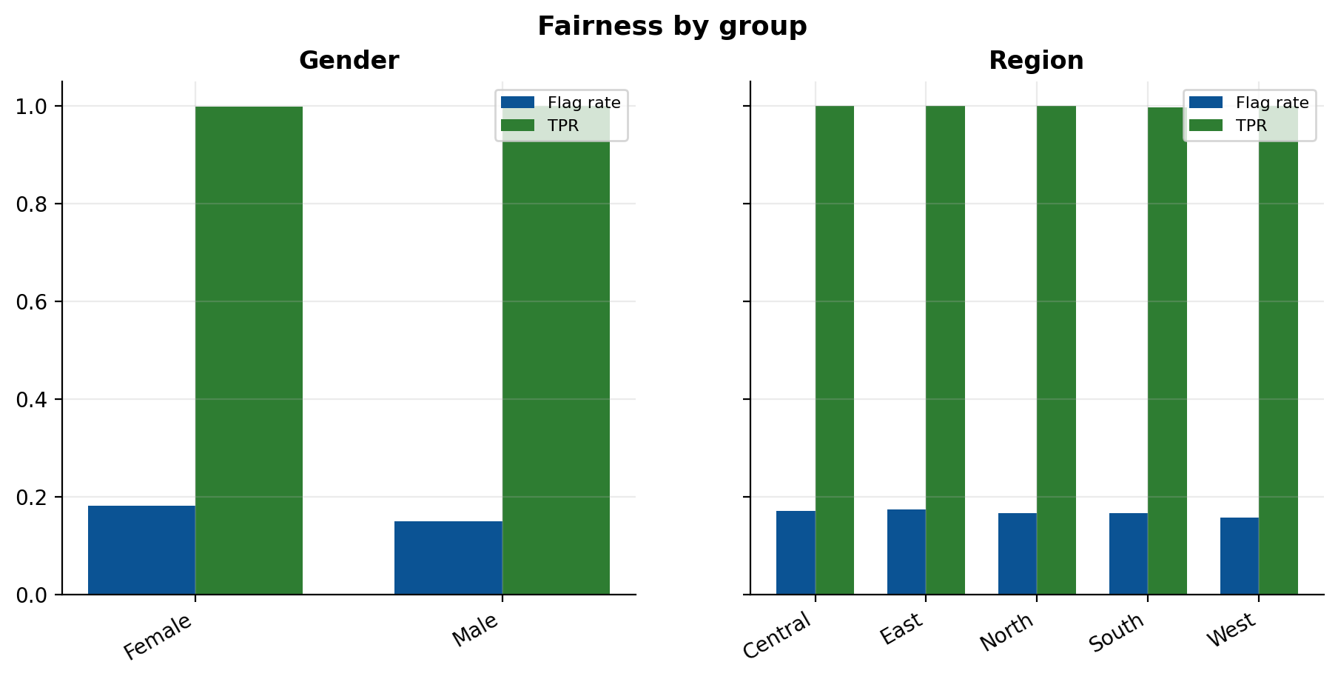
Fairness at operating threshold
Gender DP gap: 3.1% · Region: 1.7% (limit 10%)
Equal opportunity gaps ≈ 0

Slide 13
Monday-morning playbook
Persuadable → RM call + waiver
Sleeping-dog → no promotional contact
Lost-cause / sure-thing → low-touch or cross-sell
ROI: ₹137.5k saved (~₹17/customer)

Slide 14
Production path
Weekly CRM scores · quarterly retrain · PSI on drivers
python -m scripts.train · 58 pytest tests + CI
Limits: observational uplift, PR-AUC ~1.0 on this dataset

Slide 15
RetainIQ — Thank you
Questions?
github.com/Stormynubee/retainiq-churnzero-26

