Slide 1
Agile Vs Waterfall
Dan Story
CS-250

Slide 2
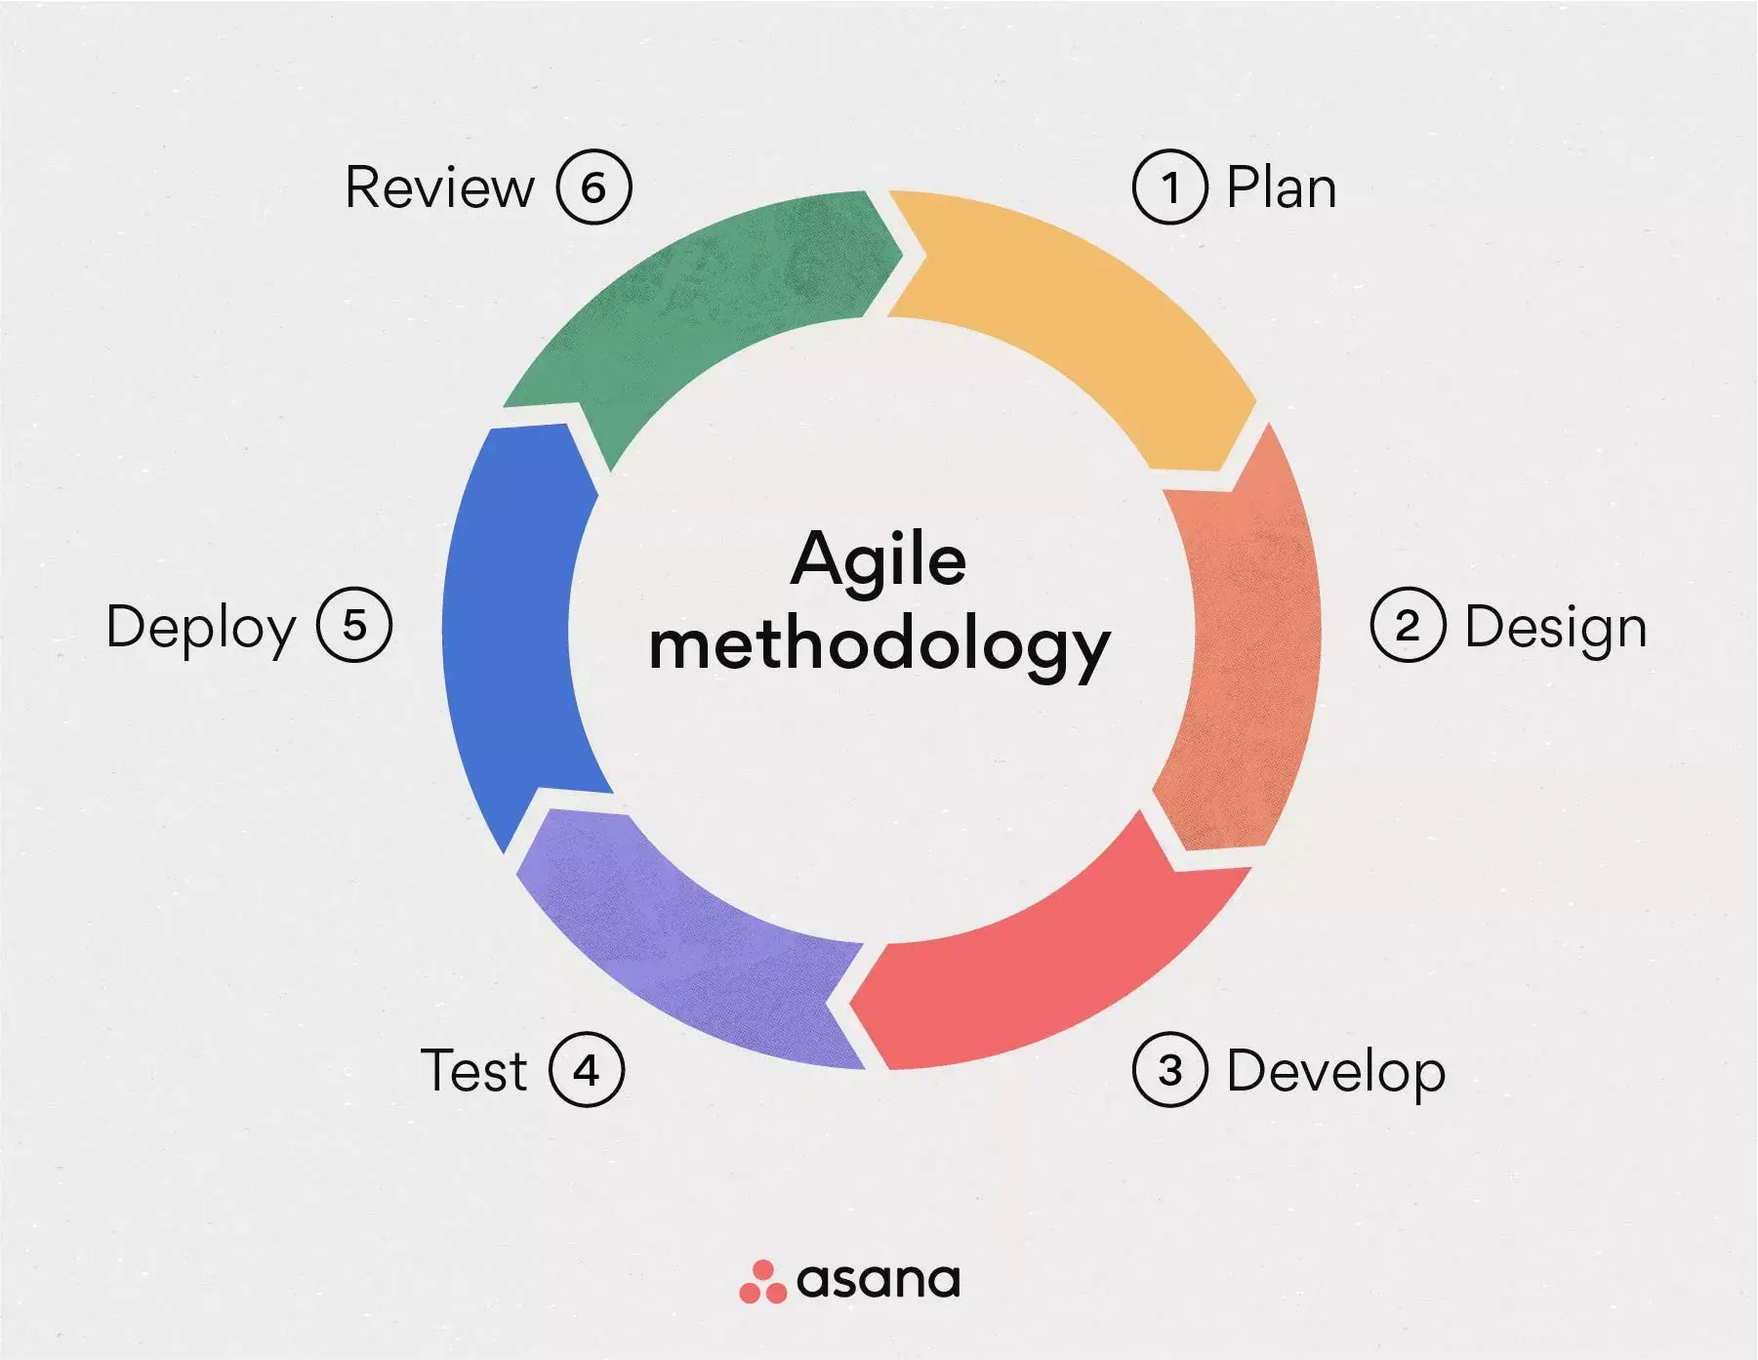
What is the Agile Methodology?
The Agile Methodology breaks down projects into phases, known as sprints.
This is an iterative methodology. Teams reflect to see if there’s something to be improved next Sprint
1. Phases of Agile (Asana.com 2025)

Slide 3
Phases of the Agile Methodology
1.Plan-This stage requires 3 things, a vision statement, a rough timeline, and a backlog of items.
2.Design-The initial design phase. This is also where the majority of the initial team building done.
3.Develop-Where the “meat” of the work is done. Regular communication should be provided with clients.
4.Test-When clients get their first deliverables. Making sure the team is on the right track, and meets the client’s needs. If they aren’t, the team repeats steps 3 and 4.
5.Deploy-Delivering the software to your client.
6.Review-Debriefing and improving to become more efficient.

Slide 4
What is the Scrum Team?
A Scrum Team is a framework, not a job title
Scrum has three main roles. Product Owner, Scrum Master, and Development Team members.
The Product Owner’s manage backlogs and understand the customer’s needs.
The Scrum Master is the bridge between the Product Owner and the Development Team. They focus on outcomes and manage roadblocks.
The Development Team are the people that are doing the meat of the work. They’re the team member with the right skills as part of the team to do the work.

Slide 5
The Waterfall Methodology
The Waterfall Method is a five stage process, Requirements, Design, Implementation, Verification, and Maintenance.
The Waterfall Method is very safe. It has a clear structure, set costs, and fewer delays.
Because it is not an iterative process, the only interaction the team gets with the customer is in the requirements stage. This can mean a bloated initial project, longer development times, and limited client feedback.
If we used the Waterfall Methodology for the Travel Project, the client would have missed out on numerous feature requests, and likely not have the product they wanted.

Slide 6
Waterfall Vs Agile, Which should I pick?
Waterfall
If you want a specific finalized budget.
If you want superior risk management, Waterfall has you stick to one plan and has no need to iterate.
If you value risk management. The deliverable will be done in the specific way you described to the customer.
Agile
If you value feedback or customer input.
If the industry you’re developing for is fast paced. Agile lets you make changes to your plan on the fly.
If you value growth in the company over singular releases. Agile encourages changes over each iteration and establishing processes.

Slide 7
References
1.What is Agile Methodology?(A beginner’s guide) (Laoyan, Sarah Feb 20, 2025) https://asana.com/resources/agile-methodology
2.A guide to the Agile Development Lifecycle (Kitch,Bryan May 16 2024) https://www.mural.co/blog/agile-development-lifecycle#the-six-phases-of-agile-project-management
3.Agile Scrum Roles and Responsibilities (West, Dave, Aug 14, 2020)https://www.atlassian.com/agile/scrum/roles
4.Waterfal Methodology: A Comprehensive Guide (West, Dave September 21, 2023)https://web.archive.org/web/20230921094009/https://www.atlassian.com/agile/project-management/waterfall-methodology

