Slide 1
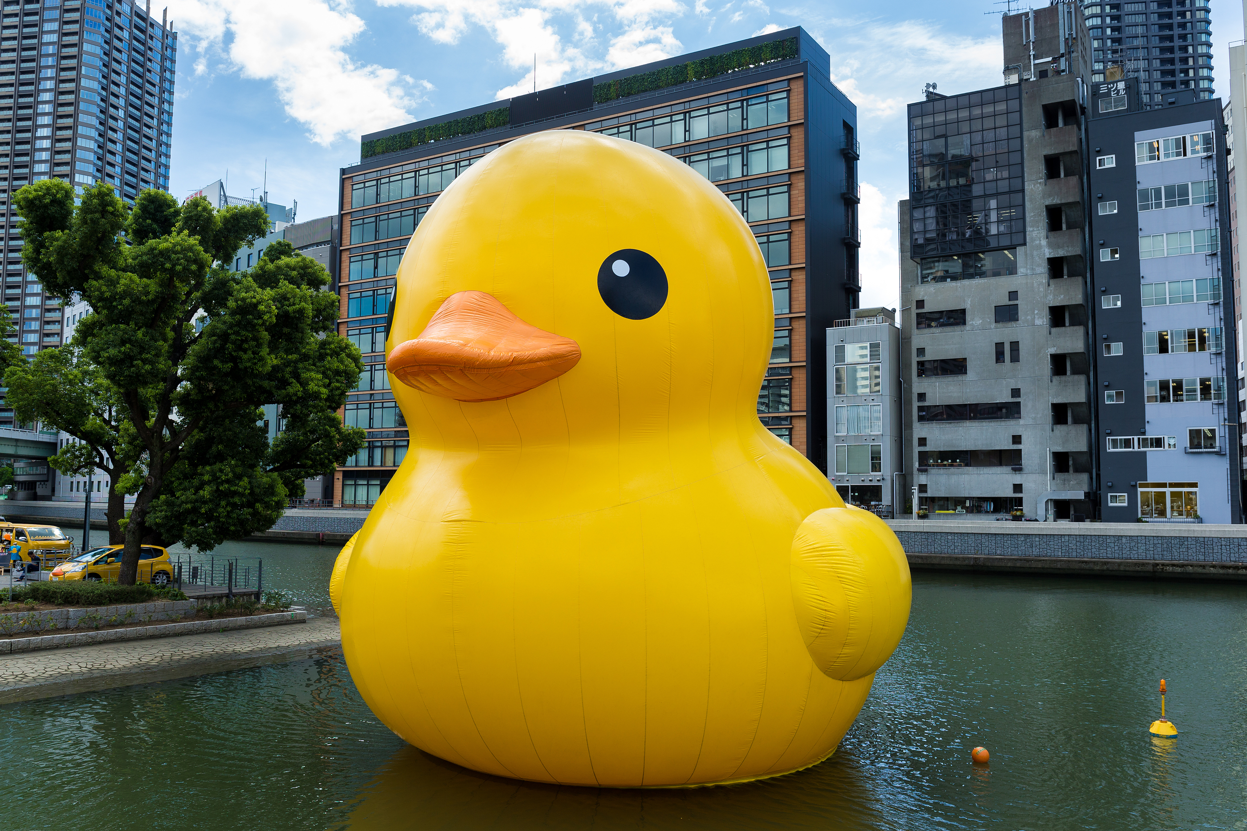
Duck Workshop

