Slide 1

Poodle E - Learning
Presented by:
Momtchil Botev
Teodora Stoykova
Stoyan Gyulemerov

Slide 2
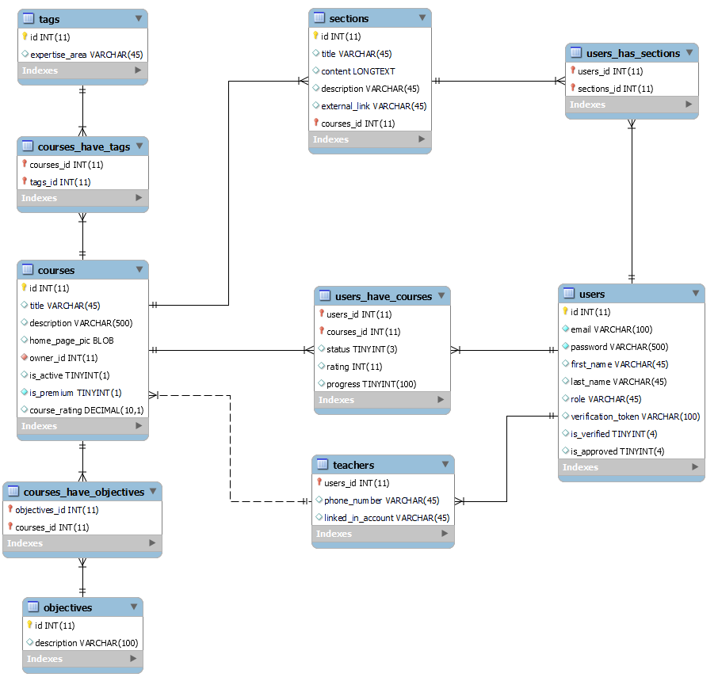
DB schema

Slide 3
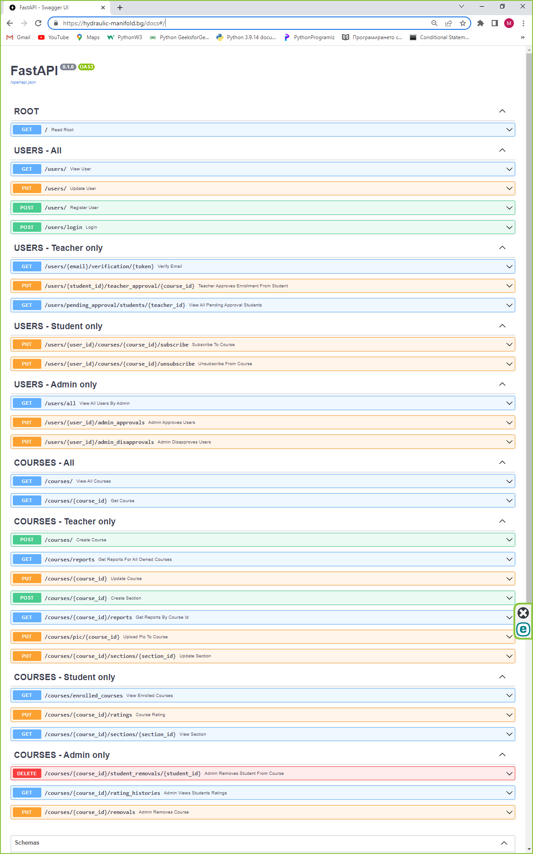
Swagger documentation

Slide 4
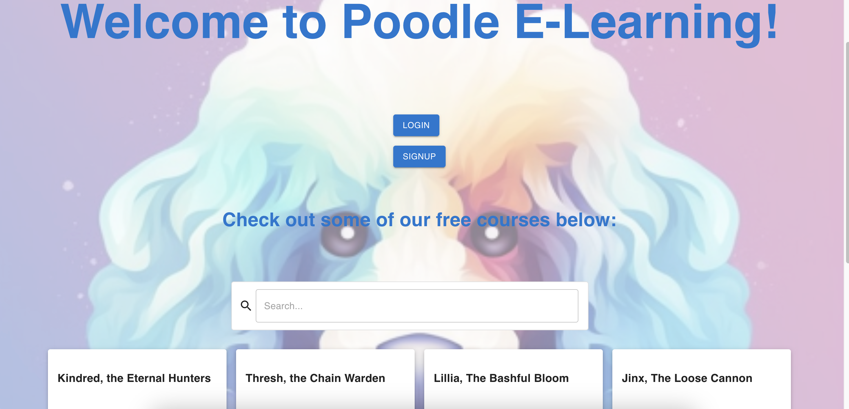
Front end demonstration

Slide 5
Summary
Previous knowledge of: Functions, FastAPI, REST principles, HTTP protocol, UnitTests, SQL, Relational DB, Postman
Knowledge acquired during the project: JWT, Password hashing, Email Verification and Notification, React, Node.js, Deployment in WSGI server

Slide 6
Conclusion

