Slide 1
Software Project - Midterm presentation
Angel Karchev Ivan Nestorov
Ivan Todorov
Liselotte Jongejans
Stoyan Dimitrov

Slide 2
Overview
Overview of the requirements
Live demo of the product
Future improvements
Conclusion
Q&A session

Slide 3
Project Plan: Project Goals
Build a suitable tool
Build a user-friendly tool
Build a scalable tool

Slide 4
Project Plan: Requirements
Use-Case Analysis
Non-Functional Requirements
Open-Source
Python, Django, JavaScript

Slide 5
Project Plan: Requirements (2)
Functional Requirements
Must
Public space classifier for multiple years
Easy and intuitive user interface
Should
User login
Manual classification

Slide 6
Project Plan: Requirements (3)
Functional Requirements
Could
Filter on time period
Won’t
Diverse urban objects
Different countries

Slide 7
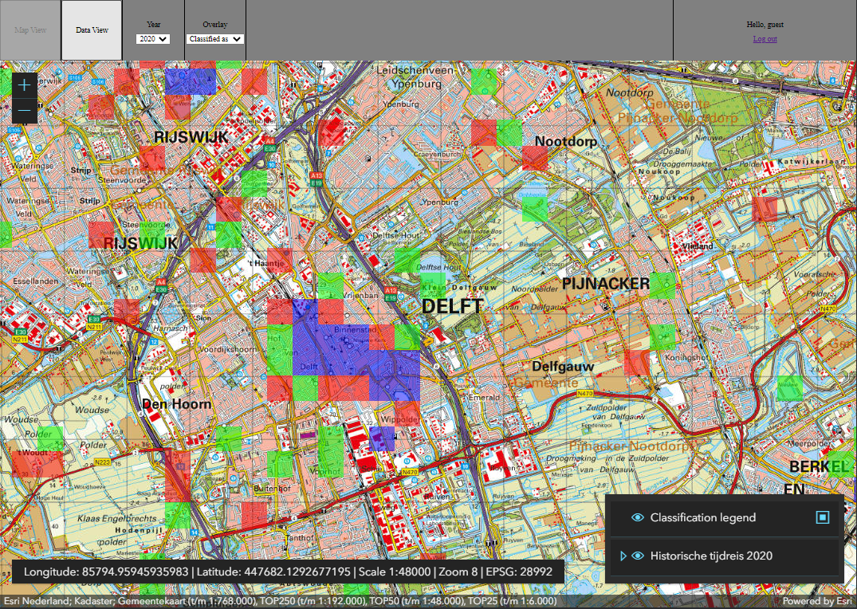
Demo

Slide 8
Future Improvements
High Priority
Improve the speed of the classifier
Add manual classification
Implement test suites
Low priority
Classify tiles on demand
Add more heuristics for training data extraction

Slide 9
Conclusions
Requirements translated into prototype
Prioritized improvements for upcoming weeks

Slide 10
Questions / Feedback

