Slide 1
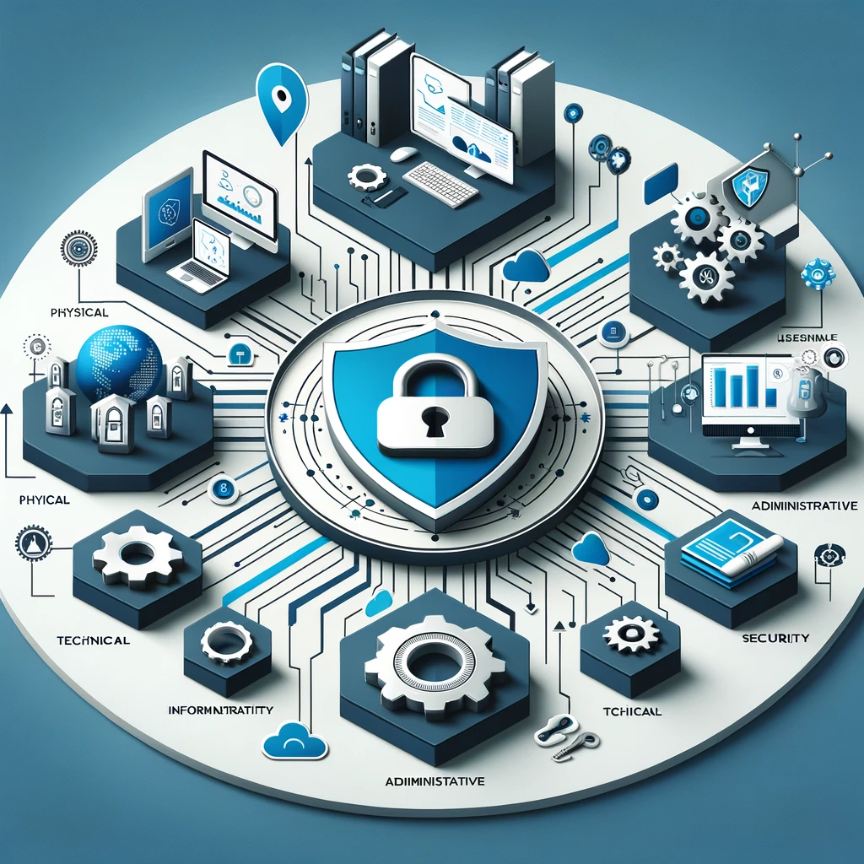
Understanding Information Security
• Overview of information security
• Key challenges in information security management
• Components of information security: physical, technical, administrative
Notes:
In today's digital age, information security is not just a buzzword; it's an essential shield protecting the lifeblood of any organization - its data. Picture this: your organization is a fortress, and information security is its defense against digital invaders. This defense isn't just about erecting walls; it's about creating a comprehensive strategy that includes physical security, like secured facilities; technical measures, such as encryption and firewalls; and administrative controls, including policies and training. The landscape of threats is constantly evolving – from phishing scams to sophisticated cyber-attacks. Each day brings new challenges, making information security a dynamic and ever-important field. In our journey, we'll understand its multifaceted nature and why a single breach can be catastrophic, leading to financial loss and damaged reputations. It's not just about protecting data; it's about safeguarding trust and continuity in an increasingly connected world. So let’s gear up to explore the importance of each component in creating a robust information security framework that stands resilient in the face of evolving digital threats

Slide 2
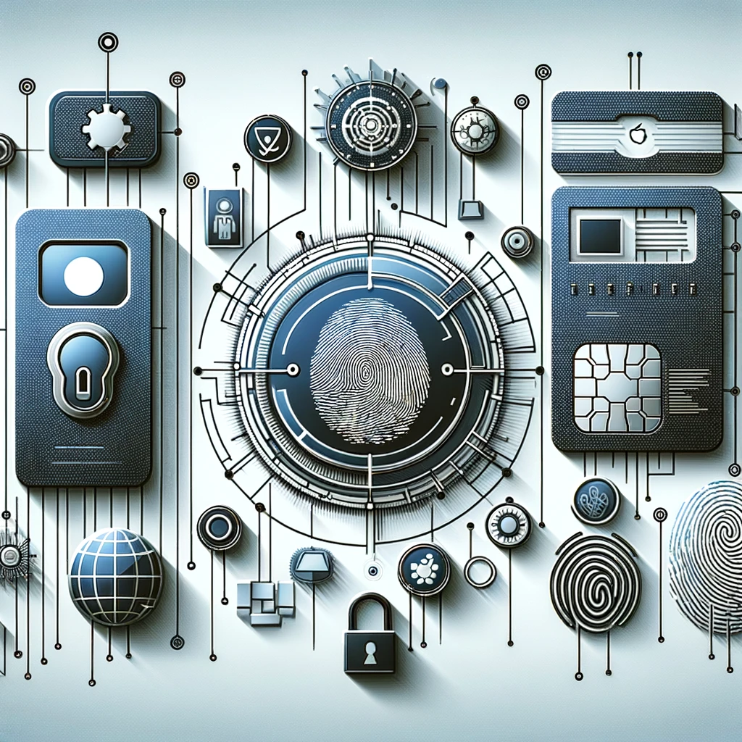
Advanced Authentication Technologies
• Details on tokens, smart cards, biometric authentication
• Comparative analysis of these technologies
• Visual comparison of different authentication methods
Notes:
Welcome to the futuristic world of authentication technologies – a crucial frontline in the battle for data security. Here we delve into the fascinating array of tools that verify who you are in the digital realm. Imagine a world where your identity can be confirmed with a token, a smart card, or even your fingerprint. Tokens, like those key fobs that generate codes, offer portability and enhanced security. Smart cards, akin to your credit card but smarter, carry your data and credentials securely. And then, there’s biometrics – using your unique physical traits like fingerprints or iris patterns for identification. But it's not all sci-fi and smooth sailing. Each method has its strengths and weaknesses. Tokens can be lost, smart cards can be tampered with, and biometrics can raise privacy concerns. We'll explore how these technologies are employed in various sectors, from banking to government, and compare their effectiveness. By examining real-world applications and cases, we'll understand how these methods shape our digital identities and security landscape, striking a balance between convenience and security.

Slide 3

Securing Networks: Firewalls and Beyond
• Role of firewalls in network security
• Intrusion Detection Systems and Antivirus Software
• Network diagram showing firewall placement
Notes:
Let's navigate the critical realm of network protection, where firewalls stand as the first line of defense in securing an organization's network. Firewalls are like digital gatekeepers, scrutinizing incoming and outgoing traffic based on predefined rules to block unauthorized access. But in our complex digital ecosystem, relying solely on firewalls is like having a fortress with only an outer wall. Enter Intrusion Detection Systems (IDS) and Antivirus Software – the additional layers of security. IDS serves as a vigilant lookout, detecting unusual activities and potential threats in real time. Antivirus software acts like a digital immune system, identifying and neutralizing malicious software. Together, these tools form a robust security infrastructure. We'll delve into how firewalls, IDS, and antivirus software complement each other, creating a layered defense strategy. It's not just about blocking threats; it's about creating a resilient, adaptive security system that can predict, prevent, and respond to cyber threats. As we explore their functions, roles, and integration, we'll see
how they collectively safeguard data integrity, confidentiality, and availability in an organization's network. This integrated approach is crucial in today's landscape, where threats can come from any direction and in many forms - from simple malware to complex, targeted cyber-attacks. We'll discuss real-world scenarios, illustrating the importance of each component in a comprehensive network security strategy. By the end of this session, you'll appreciate the complexity and significance of network protection strategies, understanding how they are critical in maintaining the security and functionality of modern digital infrastructures.

Slide 4
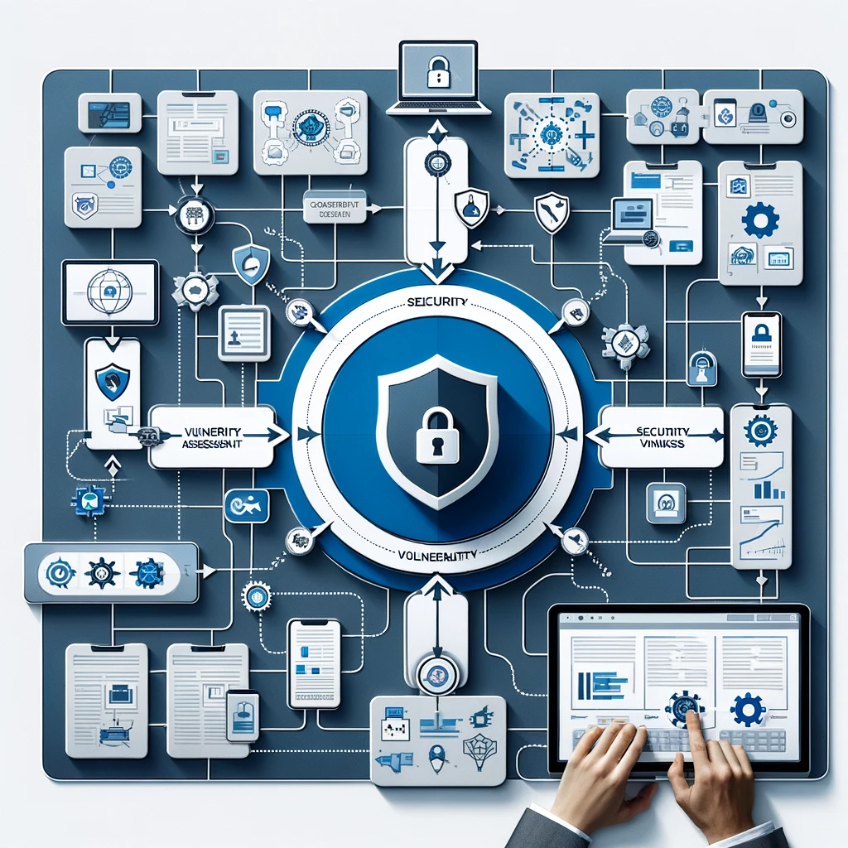
Exploring Security Vulnerabilities
• Overview of security vulnerability analysis
• Steps in conducting a vulnerability assessment
• Flowchart of the vulnerability assessment process
Notes:
In this segment, we dive into the intriguing world of security vulnerabilities – the chinks in the armor of IT systems. Security vulnerabilities are weaknesses or flaws in a system that can be exploited by cybercriminals to gain unauthorized access or cause harm. Identifying these vulnerabilities is like a strategic game of hide and seek, where the stakes are high. We'll discuss the steps involved in conducting a thorough vulnerability assessment: from preparing and defining the scope, to scanning and identifying vulnerabilities, analyzing the findings, and finally, mitigating the risks. This process is crucial in preempting cyber attacks by patching the gaps before they can be exploited. We'll explore real-life examples where vulnerability assessments have played a pivotal role in averting data breaches and maintaining the security posture of organizations. This exploration will not just highlight the technical aspects but also emphasize the strategic importance of understanding and managing these vulnerabilities. It's about being proactive rather than reactive in the cybersecurity landscape, and by mastering this process, organizations can significantly reduce their risk profile and strengthen their defense against cyber threats.

Slide 5

Risk Analysis Using Spreadsheets
• Use of spreadsheet software in risk analysis
• Breakdown of common risks and their impact
• Spreadsheet model for risk analysis
Notes:
Here, we'll see how spreadsheets, a tool so often associated with financial planning and data analysis, can be a powerful ally in risk analysis. Risk analysis in IT is about identifying potential threats to digital assets and assessing the likelihood and impact of these risks. By using spreadsheets, we can organize, quantify, and analyze these risks effectively. We will explore how to set up a risk analysis model in a spreadsheet, breaking down common risks like data breaches, system failures, or cyber-attacks, and evaluating their potential impact on the organization. This process involves not just the identification of risks, but also the estimation of their severity and the planning of mitigation strategies. We’ll discuss real-world scenarios where risk analysis has been pivotal in decision-making, helping organizations prepare for and mitigate potential threats. This hands-on approach to risk analysis using spreadsheets will demonstrate its practicality and effectiveness, providing you with the skills to conduct your own risk assessments and make informed decisions to protect your digital assets.

Slide 6
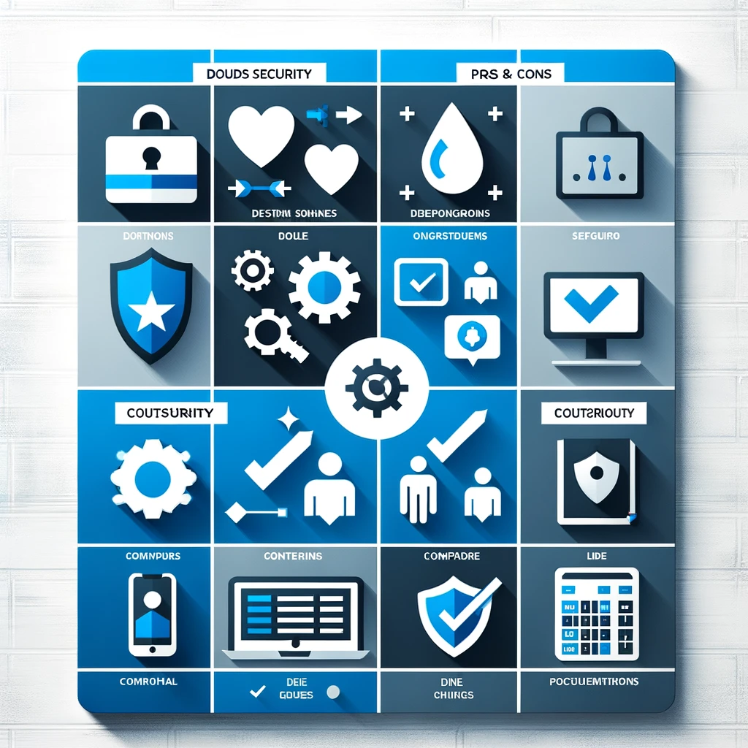
Outsourcing Security: Pros and Cons
• Benefits and drawbacks of outsourcing security functions
• Criteria for selecting a security outsourcing service
• Pros and cons list or a decision-making matrix
Notes:
Our final topic covers the increasingly common practice of outsourcing security functions. In the face of growing cyber threats and complex IT environments, many organizations are turning to external experts for their security needs. But is this the right move for everyone? We'll explore the advantages, like access to specialized expertise and cost savings, as well as the potential downsides, such as loss of control over security processes and data privacy concerns. We'll discuss key criteria for selecting a security outsourcing service, including their expertise, reputation, and alignment with your organization's security needs. This session will also delve into different scenarios where outsourcing can be beneficial or risky, providing insights into how to make this critical decision. By understanding both sides of the coin, you'll be equipped to evaluate whether outsourcing security aligns with your organization's strategy and how to approach it effectively.

