Slide 1

Unsupevised relation extraction with Row-less Universal Schema
Stoyan Dimitrov, SAP

Slide 2
Goal: Knowledge extraction from regulatory texts
Vast amount of regulatory texts contain important knowledge for the banking data model
´Knowledge´ means triples of <subject, predicate, object> relations between relevant concepts
We have a lot of triples in FSDM (and will get a lot more through matching with other knowledge bases)
We want to capture new concepts and their relations from text
Evaluation: compare the performance with manual annotation

Slide 3
Universal Schema for Entity type classification
avoids the need to manually design an ontology
avoids the need for labeled data
avoids the boundary difficulties that arise from forcing our semantics into finite, pre-defined, somewhat arbitrary “boxes”
Universal schema does not force the natural diversity and ambiguity of the original input types into a smaller set of types
The key characteristic of universal schema is that it enables us to model directed implicature among the many candidate types of an entity

Slide 4
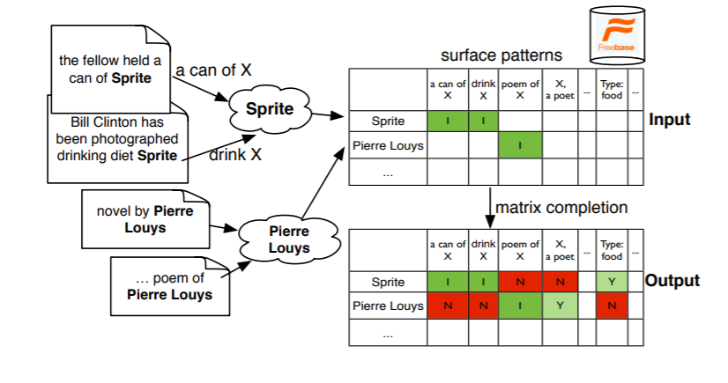
Matrix completion for enitity types
Each row in the matrix corresponds to an entity, and each column an entity type
Some cells of the matrix are observed and marked true, and many are unobserved
It is the job of matrix completion to “fill in” the matrix, marking the unobserved cells as either true or false

Slide 5
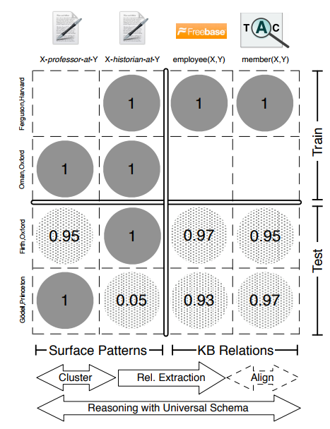
Relation extraction
Learn BEHAVIOUR on giving high scores on right relations
Use the input data itself as training criterion
The rows come from running cross-document entity resolution across pre-existing knowledge bases and textual corpora
The columns come from the union of surface forms and knowledge base relations

Slide 6
Matrix factorization model
estimating vector embeddings for both entities and types by online stochastic gradient descent optimization
The probability of assigning a type to an entity is determined by the dot-product of the corresponding embeddings, mapped through a logistic function.
identify entity mentions and extract the dependency path as the surface patterns for them
To fill the matrix, perform string match coreference to cluster mentions into entities

Slide 7
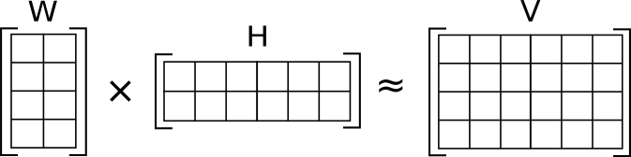
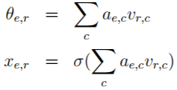

Matrix factorization (latent feature) model
V=WH
Rows of W and columns of H are embeddings – the original matrix V is factorized by two matrices that contain the embeddings of the rows and columns in the original matrix.
Embedding for enitity pairs and relation, different pairs sharing the same entity would not share parameters

Slide 8
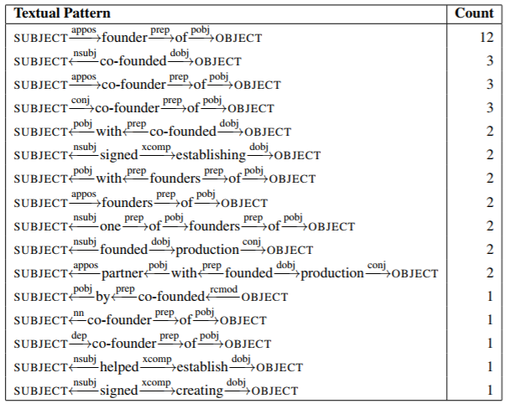
Representing Text for Joint Embedding of Text and Knowledge Bases (Toutonova et al.)
Extract new KB relations, using also text for learning better embeddings
largely synonymous textual relations often share common sub-structure, and are composed of similar words and dependency arcs
using a convolutional neural network to derive continuous representations for textual relations boosts the overall performance on link prediction, with larger improvement on entity pairs that have textual mentions

Slide 9
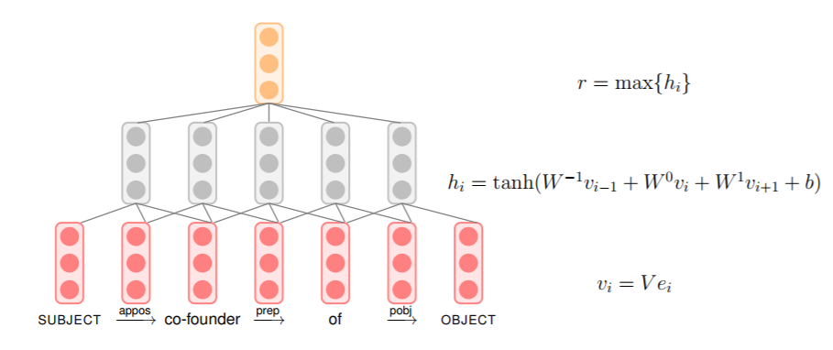
Compositional Representations of Textual Relations
The statistical strength of the model could be improved if similar dependency paths have a shared parameterization

Slide 10
Compositional Representations of Textual Relations
The difference between a basic model and its CONV-augmented variant is in the parameterization of textual mentions
The basic models learn distinct latent feature vectors of dimensionality K for all textual relation types, whereas the CONV models derive the K-dimensional latent feature vectors for textual relation types as the activation at the top layer of the convolutional network

Slide 11

Training loss function
the task is to predict the subject or object entity for given held-out triples, e.g. to rank all entities with respect to their likelihood of filling the respective position in the triple
approximation to the negative loglikelihood of the correct entity filler
The negative examples are sampled from the set of triples that do not appear in the training set

Slide 12
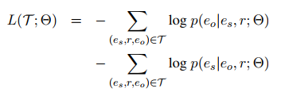


Training loss function
For both KB and textual relations with scaling factor $τ$ for the textual relations:

Slide 13
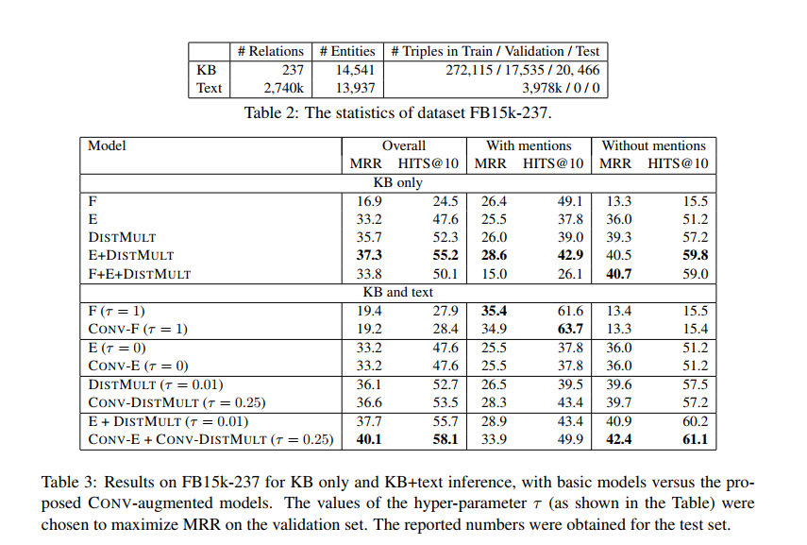
Experimental results

Slide 14
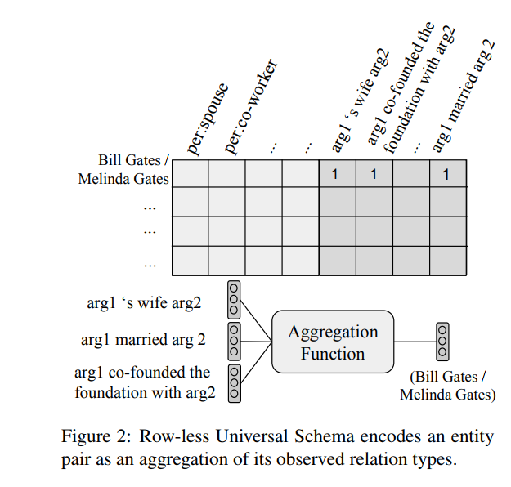
Row-less universal schema (Verga et al.)
Rather than representing each entity pair with an explicit dense vector, encode entity pairs as aggregate functions over their relation types
The column-less universal schema model generalizes to all possible input textual relations and the row-less model generalizes to all entities and entity pairs, whether seen at train time or not
The parse path between the two entities in the sentence is encoded with an LSTM model (avoiding errors from dependency parsing)

Slide 15
Aggregation function
Centroid representations:
Mean Pool creates a single centroid for the entity pair by averaging all of its relation vectors
Max Pool also creates a single centroid for the entity pair by taking a dimensionwise max over the observed relation type vectors
Query-specific representations (produce separate representations for an entity pair dependent on the query):
Max Relation represents the entity pair as its most similar relation to the query vector of interest
Attention gives weighted sum over a set of output representations for each relation type resulting in a query-specific vector representation of the entity pair

Slide 16
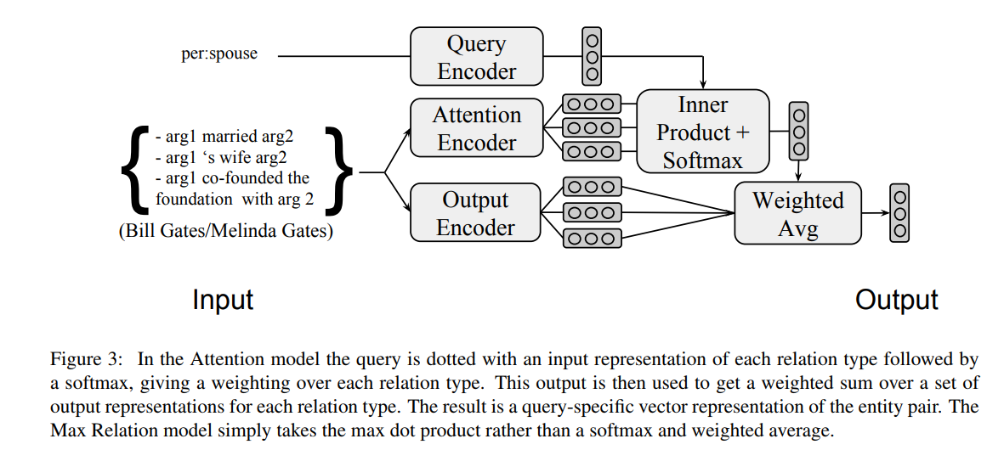
Aggregation function: Attention
Makes sence for entity pair with more than one relation

Slide 17
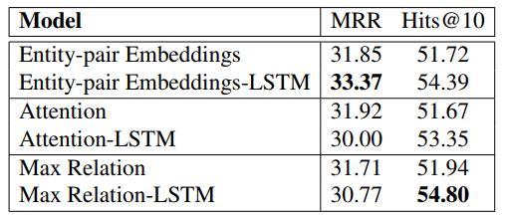
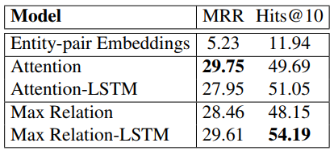
Paper Results
On enitity pairs from the KB used during training:
Models with the suffix “-LSTM” are column-less
On unseen entity pairs during training:

Slide 18
… for now…
A detailed research about a end-to-end system, given the requirements is done
The end-to-end system is defined
The ability to annotate the text between two entities as a relation was tested, given a predifined set of entites and relations from FIBO
Required is a set of triples extracted from a specific text for evaluation on the performance on this text

Slide 19
Results with sentence scoring
currency rel:hasCurrency country doc 29 30 12 13 0.0113497842 currency rel:hasStatus country doc 29 30 12 13 1 currency rel:payer country doc 29 30 12 13 1 currency rel:isOwedTo country doc 29 30 12 13 0.0001240382 currency rel:hasInvestor country doc 29 30 12 13 0 currency rel:isBasedOn country doc 29 30 12 13 0.025119424 country rel:has currency doc 12 13 29 30 0.0225324613
In particular, in Table 3, series which have the new euro area country as a geographical counterparty become mandatory, while, in Table 4, series originally denominated in the national currency of the new euro area country cease to be reported.
currency rel:hasCurrency country doc 29 30 12 13 0.0113497842
currency rel:hasStatus country doc 29 30 12 13 1
currency rel:payer country doc 29 30 12 13 1
currency rel:isOwedTo country doc 29 30 12 13 0.0001240382
currency rel:hasInvestor country doc 29 30 12 13 0
currency rel:isBasedOn country doc 29 30 12 13 0.025119424
country rel:has currency doc 12 13 29 30 0.0225324613
Trying out different settings (lookup table, LSTM Encoder, CNN Encoder, …) as well as exploiting entity definitions might improve the results. Also, more textual data to feed the encoder with.

Slide 20
Resources:
Row-less Universal Schema, Verga et al. 2016, https://arxiv.org/pdf/1604.06361v1.pdf
Representing Text for Joint Embedding of Text and Knowledge Bases, Toutanova et al. 2015, https://cs.stanford.edu/people/danqi/papers/emnlp2015.pdf
Relation Extraction with Matrix Factorization and Universal Schemas, Riedel et al. 2013, http://aclweb.org/anthology/N13-1008

Slide 21
Thank you.
Contact information:
Stoyan Dimitrov
s.dimitrov@sap.com

