Slide 1

Django Introduction
SoftUni Team
Technical Trainers
Software University
https://softuni.bg

Slide 2
Table of Contents
What is Django?
Creating a Django Project
Creating a Django Application
Setting up a Database
Writing a Simple Task App
Django Admin
Creating a Simple Design
2

Slide 3
Have a Question?
sli.do
#python-web

Slide 4

Django
Full-Stack Framework for Perfectionists with Deadlines

Slide 5
What is Framework?
Platform for developing software applications
Provides a foundation on which software developers can build programs for a specific platform
A framework includes an API
May include code libraries, a compiler, and other programs used in the software development process

Slide 6
What is Django?
High-level python web framework
Ridiculously fast
Reassuringly secure
Exceedingly scalable
Free and Open Source
6

Slide 7
What is MTV?
Django follows the MTV architecture pattern to develop web applications
MTV stands for Model-Template-View
Model - manages the data and is represented by a database
Template - the presentation (front-end) layer
Provides a convenient way to generate dynamic HTML pages by using special template syntax
View - receives HTTP requests and sends HTTP responses
Interacts with the model and the template to complete a response

Slide 8

Creating a Django Project
Where the magic happens

Slide 9
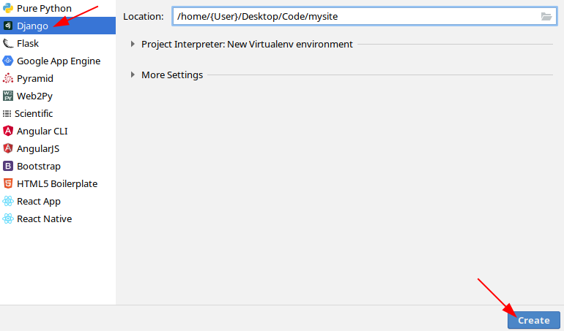
Creating a Django Project
Open PyCharm Professional -> File -> New Project

Slide 10
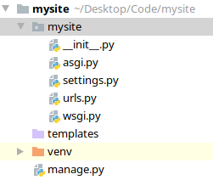
Project Structure
__init__.py
The directory is a Python package
settings.py
The configuration file for the Django Project
urls.py
Table of Content
manage.py
Tool for executing commands

Slide 11
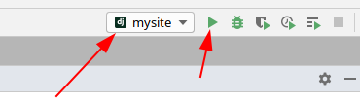
Running a Django Project (1)
Using Terminal command
Using Keyboard Shortcut in PyCharm
Using PyCharm Run button
python manage.py runserver
Shift + F10

Slide 12
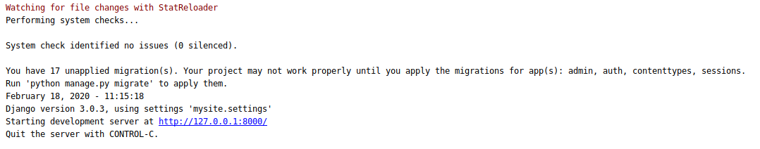
Running a Django Project (2)
You'll see the following output on the command line:
The runserver command starts the development server on the internal IP at port 8000 by default
Note: this server is intended only for use while developing

Slide 13
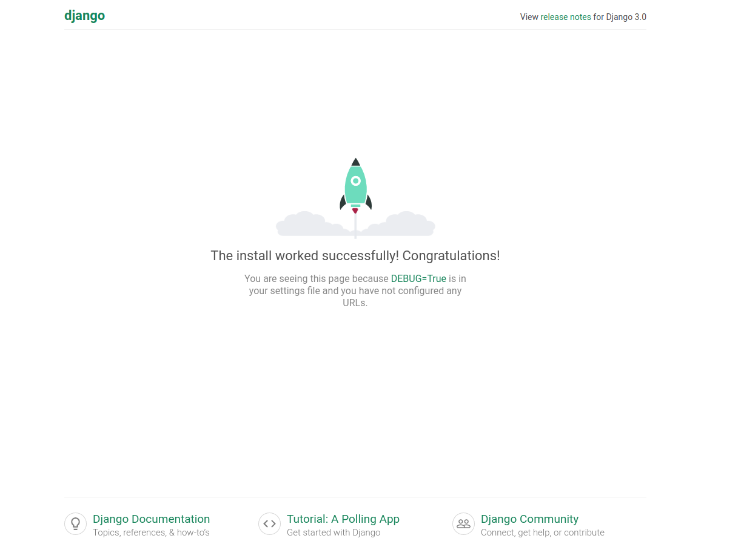
Running a Django Project (3)

Slide 14

Django Application
The Bread and Butter of a Django Project
14

Slide 15
App vs Project
Django App:
A Web application that does something - e.g., a wide web blog system or a small task app
An app can be in multiple projects
Django Project:
A collection of configuration and apps for a particular website
A project can contain multiple apps

Slide 16
Creating a Django App
The app is created in the same directory as the manage.py file
Use the terminal command
Move it inside the project for a better-structured project management
Django automatically generates the basic directory structure of an app
python manage.py startapp tasks
16

Slide 17
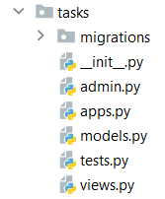
Directory Structure
admin.py
The admin page
models.py
The models of the app
views.py
The views of the app
migrations
Command-line Utility for propagating changes in models
17

Slide 18
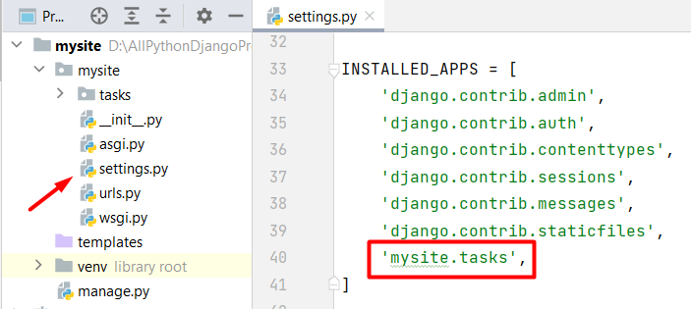
Including an App
To include an app in a project, add a reference to the app in the INSTALLED_APPS setting
18

Slide 19

Setting up a Database

Slide 20
Psycopg2
PostgreSQL database adapter for the Python programming language
Use the Psycopg2 module to:
Connect to PostgreSQL
Perform SQL queries and database operations
It is an external module
20

Slide 21
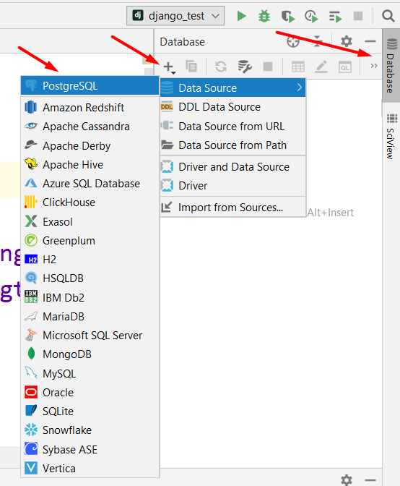
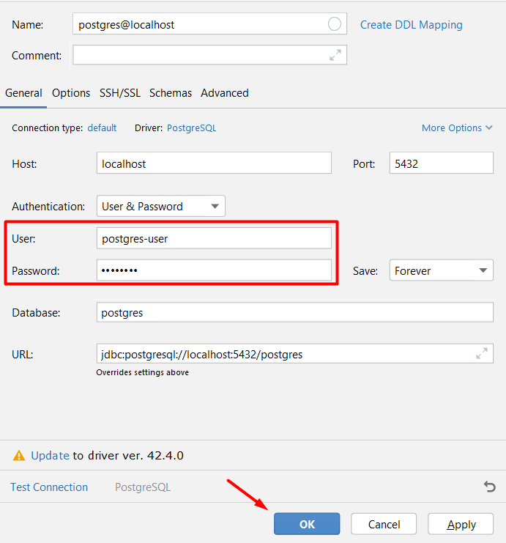
Connect to PostgreSQL

Slide 22
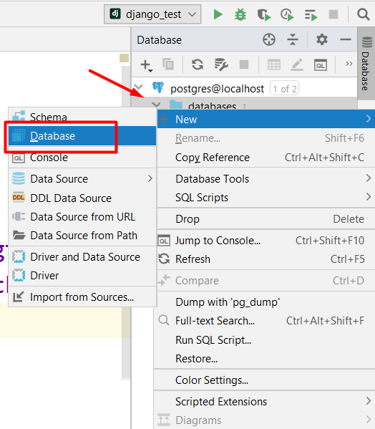
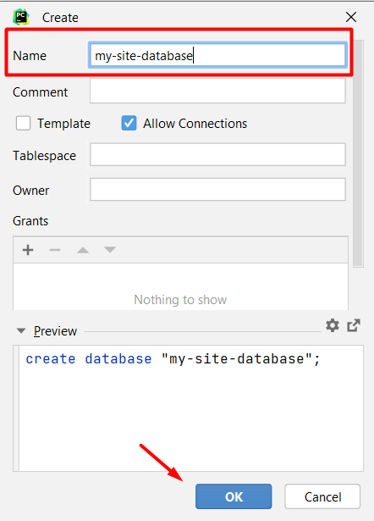
Create a Database

Slide 23
Set up PostgreSQL
To configure our project to work with PostgreSQL, we need to set it up in the settings.py file
Use PostgreSQL
DATABASES = {
'default': {
'ENGINE': 'django.db.backends.postgresql',
'NAME': 'my-site-database',
'USER': 'postgres',
'PASSWORD': 'postgres',
'HOST': '127.0.0.1',
'PORT': '5432'
}
}
Name of the database
Database user credentials
23

Slide 24

Writing a Simple Task App

Slide 25
Django Model
Models store your application's data
The essential fields and behaviors of the stored data
Generally, each model maps to a single database table
Each model is a Python class that subclasses django.db.models.Model
Each attribute of the model represents a database field

Slide 26
Adding a Model
Еach application have a models.py file
In there all models that will be used in the application should be created
tasks/models.py
from django.db import models
class Task(models.Model):
task_title = models.CharField(max_length=50)
task_text = models.TextField()
Model Name
Field Types
Fields
26

Slide 27
Activating Models
Use models to create a database schema for the app
Use migrations to upgrade your database live
First, create migrations for the added model
Next, apply those changes to the database
python manage.py makemigrations
python manage.py migrate

Slide 28
Django View
The views.py file contains view functions/ classes
Each view takes a Web request and returns a Web response
Implements the main logic that needs to happen when a given URL is reached
The names of the functions are usually related to the URL that is being reached

Slide 29
Simple View Example
tasks/views.py
from django.http import HttpResponse
from tasks.models import Task
def index(request):
tasks_list = Task.objects.all()
output = "; ".join(f"{t.task_title}: {t.task_text}"
for t in tasks_list)
if not output:
output = "There are no created tasks!"
return HttpResponse(output)
Get all Task objects
Return the desired output

Slide 30
Django app/urls.py
In the urls.py file you configure what function or logic should be executed when accessing a given URL
Usually, every app should have its own urls.py file
tasks/url.py
from django.urls import path
from {app_name} import views
urlpatterns = [
path('', views.index)
]
URL
Action

Slide 31
Django project/urls.py
The created url.py file should be pointed in the project's urls.py
Import the include() function and insert it in the urlpatterns list
mysite/url.py
from django.contrib import admin
from django.urls import path, include
urlpatterns = [
path('admin/', admin.site.urls),
path('', include('mysite.task.urls'))
]

Slide 32
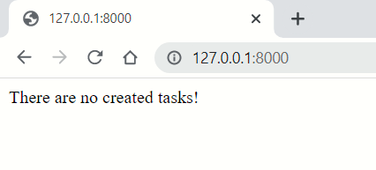
Simple URL Example
Verify it is working by starting the development server

Slide 33
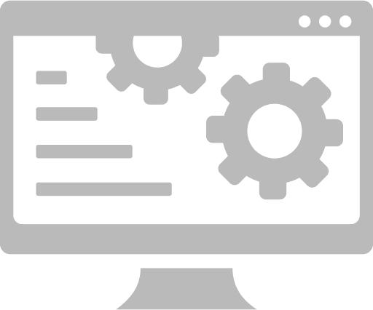
Django Admin Site

Slide 34
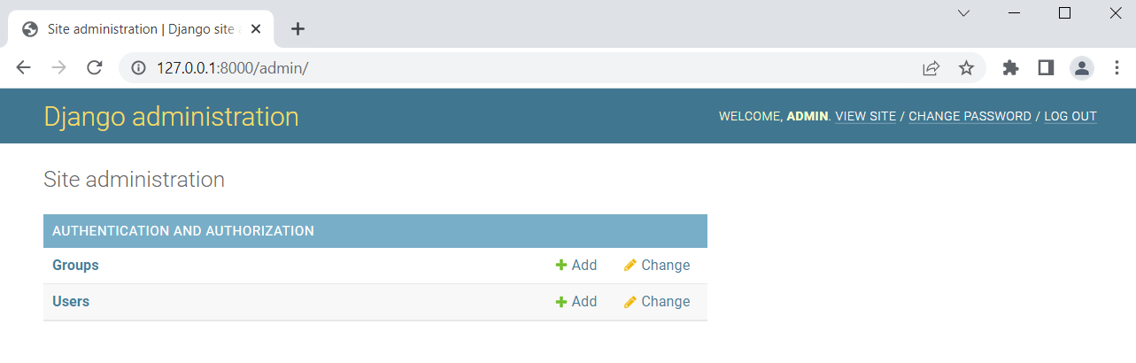
Django Admin Site
It is an automatic admin interface
There trusted users can manage content on the site
One of the most powerful parts of Django

Slide 35
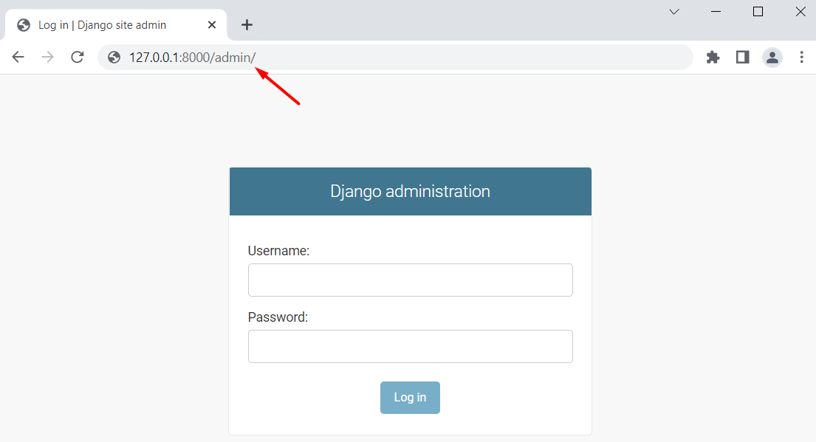
Access Django Admin Site
First, create a user to login with
Then, start the server and navigate to the admin site
python manage.py createsuperuser

Slide 36
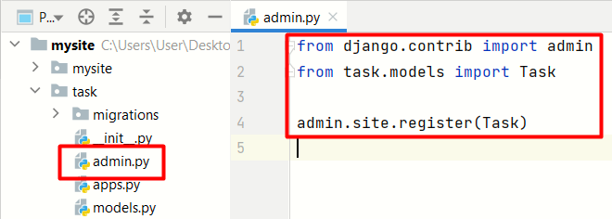
Make the App Modifiable in the Admin
Register all models in a special file in the app called admin.py

Slide 37
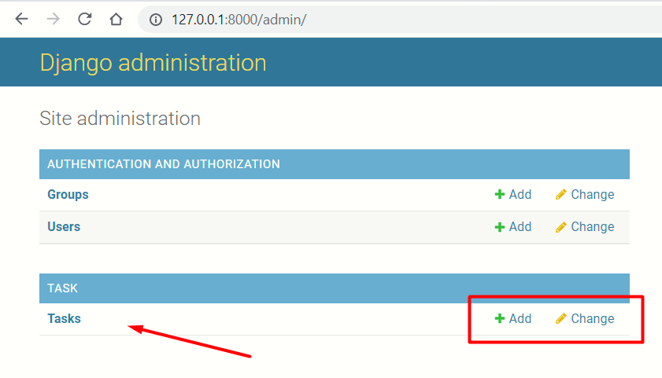
Django Admin Benefits (1)
Easily manage (create, update, delete) the data stored in the database

Slide 38
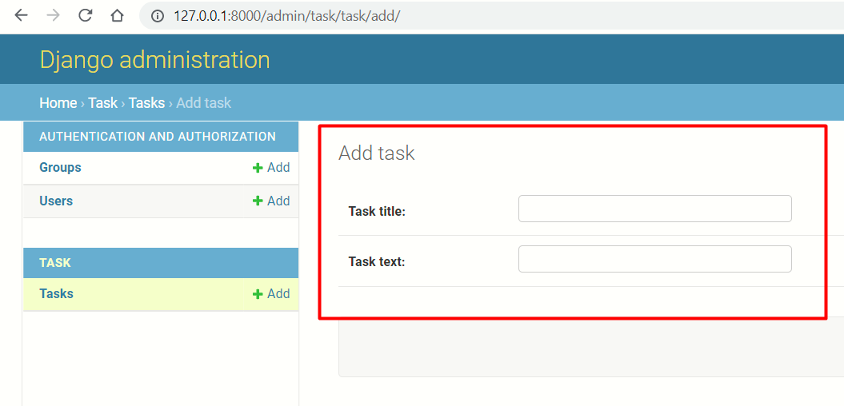
Django Admin Benefits (2)
The form is automatically generated from the models

Slide 39
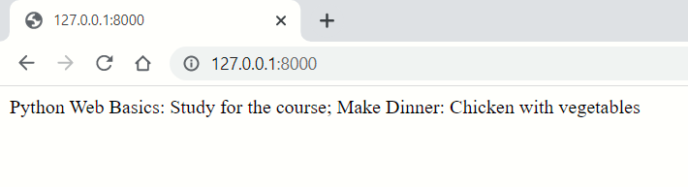
Data Visualization
When adding tasks, they are returned as response in the desired Web page (using the created view in the app)
Note: The page's design is hard-coded in the view

Slide 40

Creating a Simple Design

Slide 41
What is a Template
Being a web framework, Django needs a convenient way to generate HTML dynamically
The most common approach relies on templates
A template contains:
The static parts of the desired HTML output
A special syntax describing how dynamic content will be inserted

Slide 42
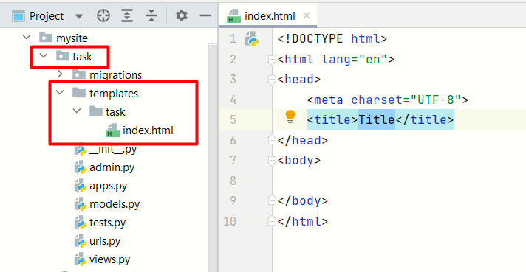
Creating a Template Folder
In order to use templates, we need a special folder where they should be created
Automatically generated code

Slide 43
Rendering a Template
Now that the template is created, we should refactor the views.py file in the app
Instead of using HttpResponse, we can now use the render function that will show the created templatе
task/views.py
from django.shortcuts import render
from task.models import Task
def index(request):
return render(request, 'task/index.html')

Slide 44
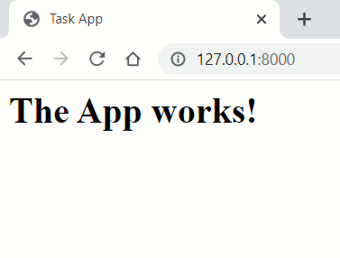
Creating a Template
Creating an .html file that will be the template
index.html
<html lang="en">
<head>
<meta charset="UTF-8">
<title>Task App</title>
</head>
<body>
<h1>The App works!</h1>
</body>
</html>

Slide 45
Adding Context
The render function can receive a context
It is a dictionary passed to the template and used to display data dynamically
task/views.py
from django.shortcuts import render
from task.models import Task
def index(request):
tasks_list = Task.objects.all()
context = {'tasks_list': tasks_list}
return render(request, 'task/index.html', context)

Slide 46
Basic Template Logic
In the templates we can also have programming logic using built-in template tags
index.html
{% if tasks_list %}
{% for task in tasks_list %}
<h1>{{ task.task_title }}</h1>
<p>{{ task.task_text }}</p>
{% endfor %}
{% else %}
<p>There are no created tasks!</p>
{% endif %}
If "tasks_list" is passed as context, for each task return its title and text

Slide 47
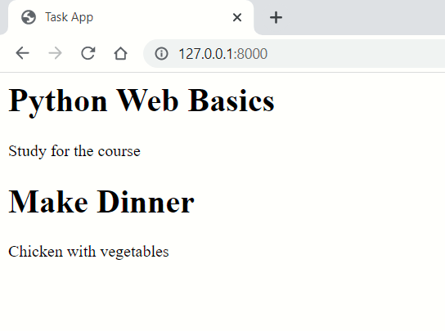
Simple Task App

Slide 48

Demo
Live Exercise in Class

Slide 49
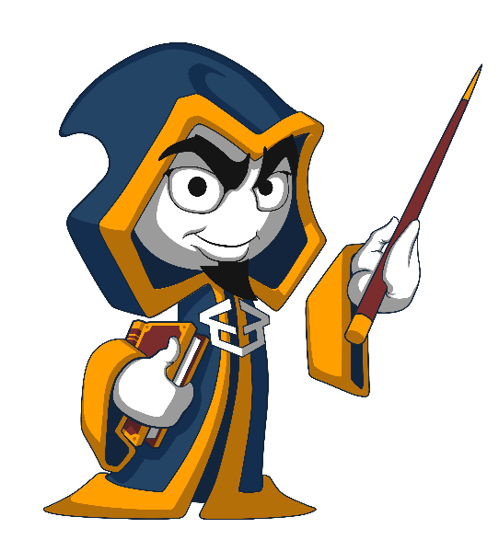
Summary
Django is a high-level Web Framework
Django applications are set of features for a Django Project
We can use terminal commands to manage our projects and apps
We can manage the content of the application using Django Admin

Slide 50
Questions?
Notes:
50

Slide 51
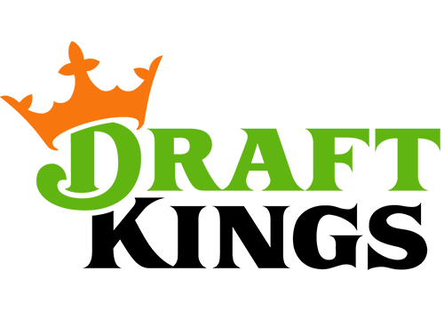

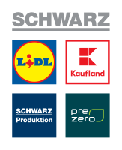



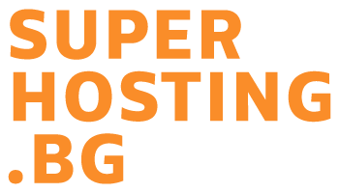
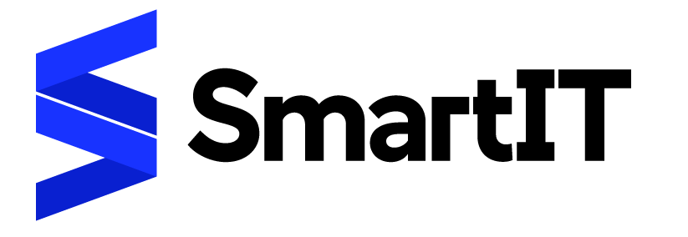



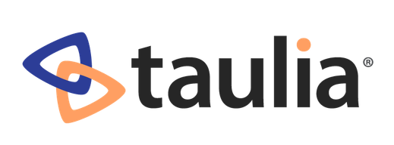

SoftUni Diamond Partners

Slide 52

Educational Partners

Slide 53
Trainings @ Software University (SoftUni)
Software University – High-Quality Education, Profession and Job for Software Developers
softuni.bg, softuni.org
Software University Foundation
softuni.foundation
Software University @ Facebook
facebook.com/SoftwareUniversity
Software University Forums
forum.softuni.bg
53
Notes:
53

Slide 54

License
This course (slides, examples, demos, exercises, homework, documents, videos, and other assets) is copyrighted content
Unauthorized copy, reproduction, or use is illegal
© SoftUni – https://softuni.org
© Software University – https://softuni.bg
Notes:
54

